Slide 1



Alternative Methods for Generating Semantically Annotated Grid Services

Slide 2

What are we trying to solve?
  Give groups other choices for managing semantic metadata and still give them the ability to create caGrid semantically annotated grid services.
    Currently caGrid tools can only use the caDSR, caCore, and SIW etc in order to create semantically annotated grid services.
    User groups that don’t want for whatever reason to use the NCI caDSR or want to create a non authoritative or group authoritative metadata resource during development have no options.
    Support for CTSA’s, Cooperative Groups, Regional Health Groups, Other domain.

Slide 3

openMDR
What are we trying to solve?
  Give groups other choices for managing semantic metadata and still give them the ability to create caGrid semantically annotated grid services.
    Currently caGrid tools can only use the caDSR, caCore, and SIW etc in order to create semantically annotated grid services.
    User groups that don’t want for whatever reason to use the NCI caDSR or want to create a non authoritative or group authoritative metadata resource during development have no options.
    Support for CTSA’s, Cooperative Groups, Regional Health Groups, Other domain.

Slide 4
openMDR
What are we trying to solve?
  Give groups other choices for managing semantic metadata and still give them the ability to create caGrid semantically annotated grid services.
    Currently caGrid tools can only use the caDSR, caCore, and SIW etc in order to create semantically annotated grid services.
    User groups that don’t want for whatever reason to use the NCI caDSR or want to create a non authoritative or group authoritative metadata resource during development have no options.
    Support for CTSA’s, Cooperative Groups, Regional Health Groups, Other domain.

Slide 5
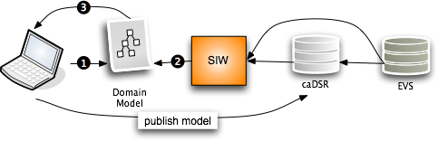

openMDR
Current caBIG Issues:
No support for “local” metadata or terminologies/ontologies.
Can’t or not intended to stand up a “local” caDSR .
The annotation tools and caDSR cant annotate or store a model that is annotated by more that one metadata registry.
Hard to or can’t copy content from NCI caDSR to your own caDSR.
caGrid tools currently can only create grid data services that use models which have gone through the SIW so currently need to use the above NCI source of metadata approach.

Slide 6
openMDR
Where are we going?
  Enable another path for creating semantically annotated grid services.

Slide 7
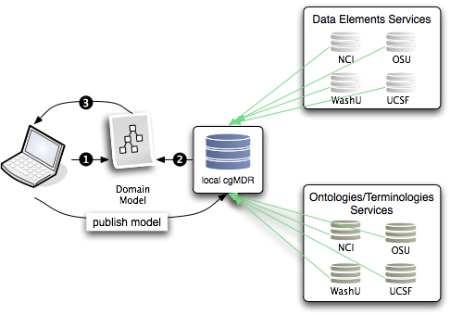
openMDR
Federated semantic metadata management utilizing and enhancing UK CancerGrid cgMDR and adding components to fill the gaps to provide another possible workflow for creating cagrid services that can leverage this alternative process.

Slide 8
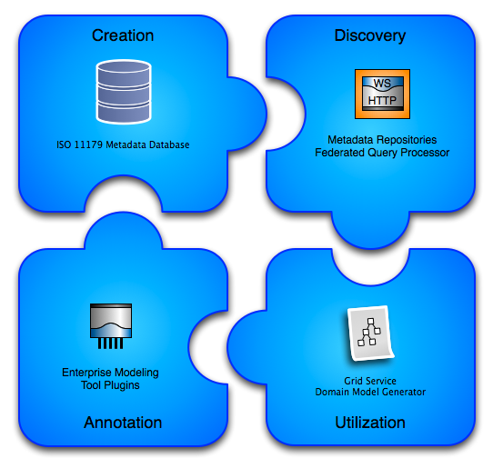
openMDR

Slide 9
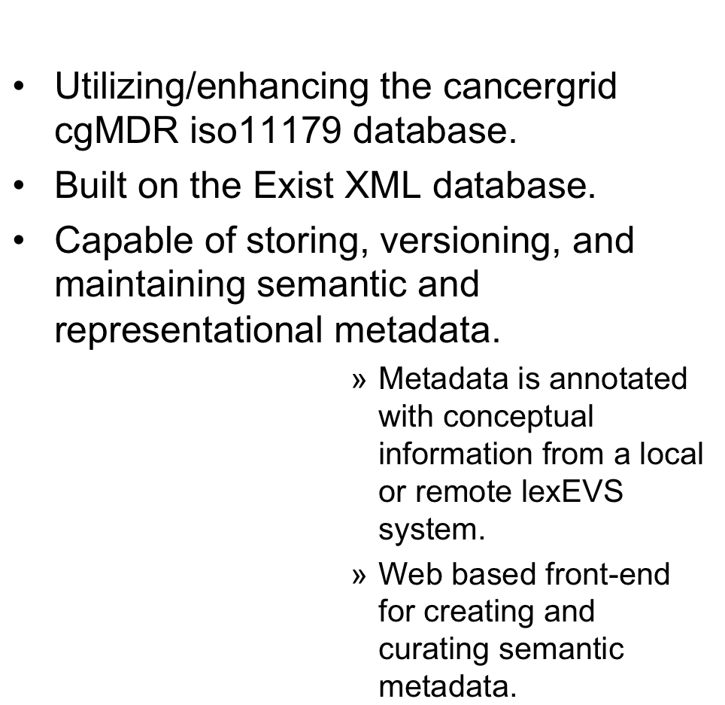
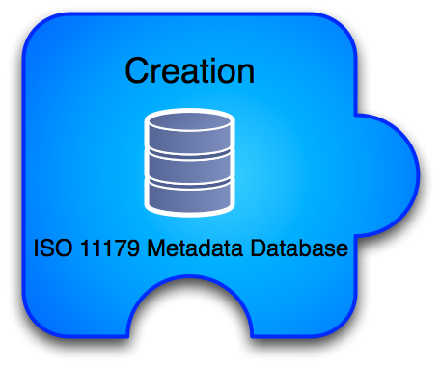
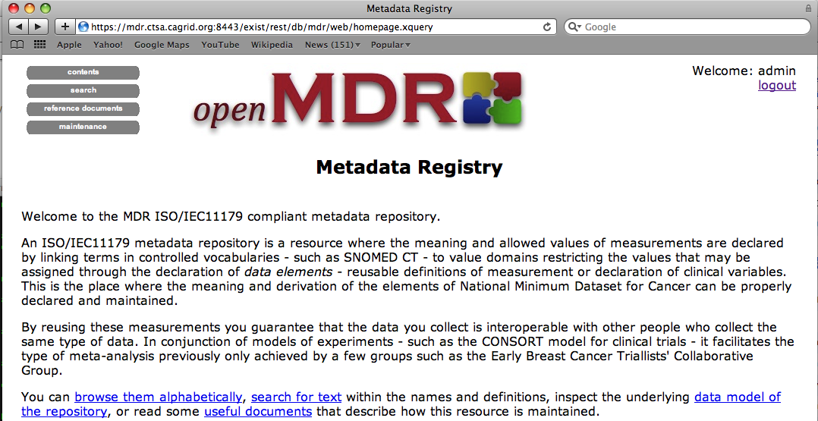
openMDR

Slide 10
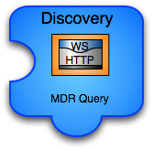
openMDR
caGrid grid service capable of talking to caDSR, many lexEVS and many openMDR systems enabling federated query of common data elements or concepts.
Enhances and wraps the cgMDR mdrConnector in order to parse the received information into a common format.
caGrid service enables it to be deployed in any local or production grid environment and configured and modified to talk to many semantic metadata systems.

Slide 11

openMDR
Enables utilizing the MDRQuery service for locating and utilizing common data elements from many semantic metadata sources for annotation of classes and attributes of the logical domain model.
Tags are created that identify the remote service and locally unique id of the CDE. (Good use case for leveraging identifiers.
The model is annotated just as it could be with the SIW except there is no need to leave the EA environment.

Slide 12
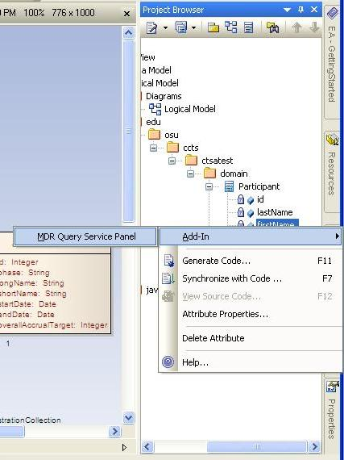
openMDR

Slide 13
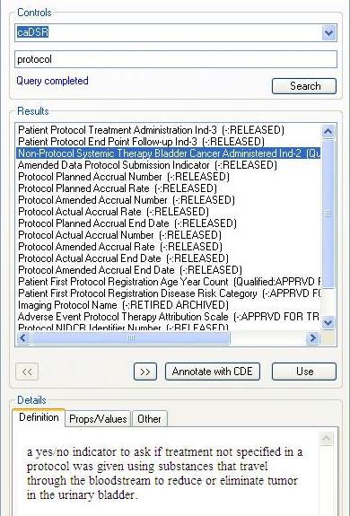
openMDR

Slide 14
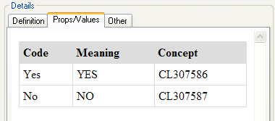
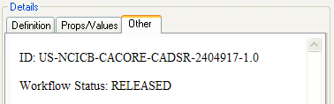
openMDR

Slide 15
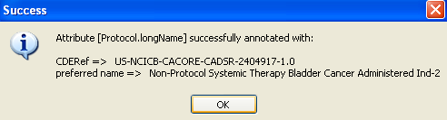

openMDR

Slide 16
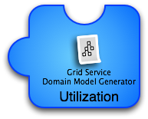
openMDR
Grid services in caBIG require semantic metadata and currently the only way to generate this service metadata is to utilize caGrid tools which can only use the caDSR which only uses the EVS.
This tool can take models annotated with the openMDR annotation plug-in for EA and generate the required semantic service metadata. This metadata can then be used to generate a data service using the Introduce Data Service Wizard which prior to this tool would only be able to utilize the caDSR can now generate data services annotated with data models from almost anywhere.

Slide 17
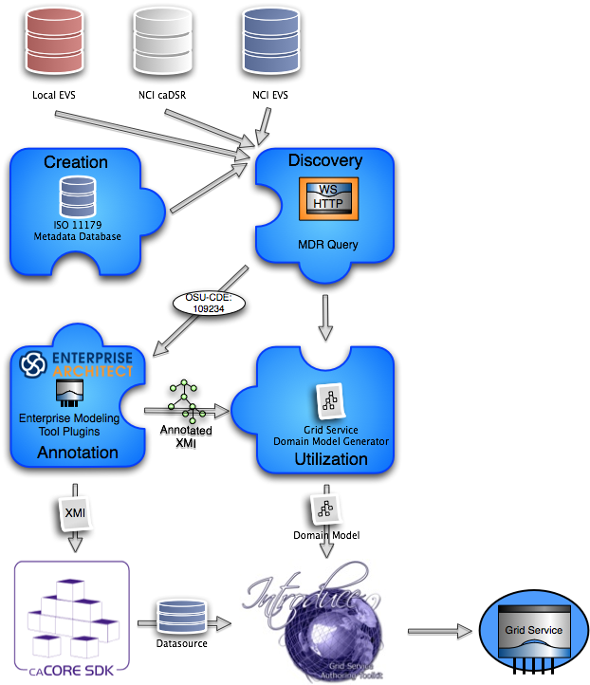
The new service creation workflow:
Draw logical model in EA.
Annotate logical model in EA utilizing openMDR EA plug-in.
Export annotated XMI and
  Run through caCore SDK if you want to build a data service or have schema generated.
  Run through Domain Model Generator to generated grid service metadata for exposing the semantic annotations for the logical model being used.
Generate service with Introduce.

Slide 18
What have we done so far?
  Refactor of cgMDR source to enable the following capabilities.
    Pulled code out of exist source tree so that openMDR is not tied specifically to any version of exist.
    Broke project up into 3 sub projects and added a 4th.
      mdrCore (iso 11179 database and web frontend for curation and browse)
      mdrQuery (refactored mdrConnector in cgMDR with a caGrid grid service which provides this query functionality
      mdrTools (currently an EA plugin which uses mdrQuery to provide model annotation.
      mdrDomainModelGenerator (consumes XMI generated by cgMDR EA and generates a Domain Model file required for caGrid to create the grid data service.
    Create a ivy based project build system which is consistent with the caGrid project build and development processes.
    All code is in the caGrid incubator project in the ESN.

Slide 19
This is a work in progress but we have a real community that is looking for a solution.
Software for download will be coming in the next few months.
The evolving wiki site can be found here:
  https://cagrid.org/display/MDR/Overview

Slide 20

Questions?
shannon.hastings@osumc.edu

