Slide 1
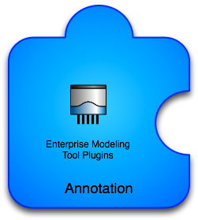
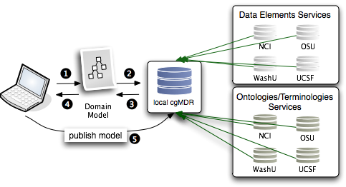
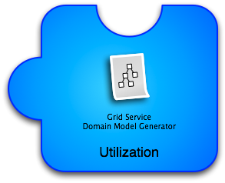
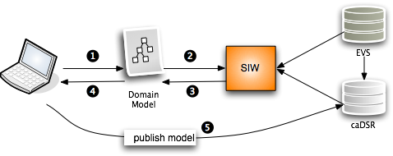
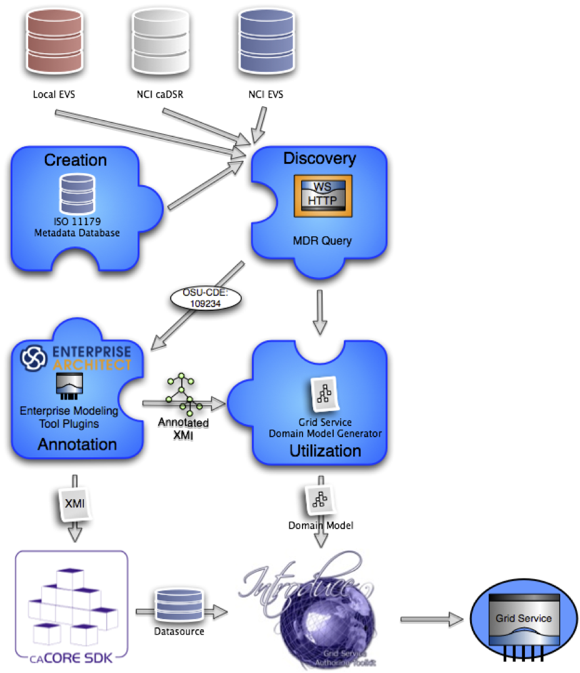
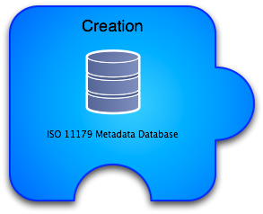
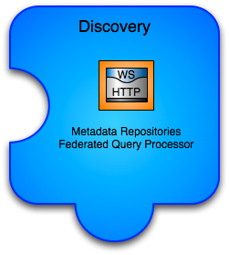
OpenMDR:
Alternative Methods for Generating Semantically Annotated Grid Services
Shannon Hastings, MS¹; Calixto Melean, MS¹; Rakesh Dhaval, MS¹; Scott Oster, MS¹; Stephen LangellaMS¹
Abstract
Proposed Design
MDR Plugins - A series of tools that can be used in different commercial modeling tools, such as Enterprise Architect, to enable the semantic annotation of federated semantics.
Enables utilizing the MDRQuery service for locating and utilizing common data elements from many semantic metadata sources for annotation of classes and attributes of the logical model.
Tags are created that identify the service and CDE locally unique id to enable more information to be retrieved by a consumer of the model if desired.
The model is annotated just as it could be with the SIW except there is no need to leave the EA environment.
MDR Domain Model Generator - A tool that can process an MDR Plugin annotated model and create service metadata which will enable the service to be an semantically annotated grid service which can be more easily discovered
This tool can take models annotated with the openMDR annotation plug-in for EA and generate the required semantic service metadata. This metadata can then be used to generate a data service using the Introduce Data Service Wizard which prior to this tool would only be able to utilize the caDSR can now generate data services annotated with data models from almost anywhere.
The openMDR project is an adaptation of the UK cgMDR project. It enables smaller groups or institutions to easily stand up local metadata registries and curate semantic metadata. This metadata can then be used to annotate data model generated using Enterprise Architect tool. The model can then be used to generate the required semantic metadata used by caBIG grid services. This alternative process enables more agile knowledge management and evolution of knowledge over time without limitations of the currently available software that can only leverage the caDSR. The openMDR and it's accompanying tools make it possible to create and stand up semantically annotated grid services by utilizing more light weight and decentralized data model repositories, new mechanisms for model annotation, tools for caBIG required semantic metadata generation, and a process for publishing metadata at a later date to caDSR once conformance or acceptance of the model has been reached.
Makes use of the federated semantic metadata management platform provided by the UK CancerGrid’s cgMDR project, which provides a lightweight ISO 11179 standards compliant metadata repository.
Comprises of tools that enable semantic annotation from its own metadata repository, and can also resolve metadata and terminologies from remote resources
Provides choice to groups for managing semantic metadata and also give them the ability to create caGrid semantically annotated grid services
Provides for user groups that don’t want for whatever reason to use the NCI caDSR or want to create a non authoritative metadata resource during development.
Background
Currently caGrid tools can only use the caDSR, caCore and SIW etc in order to create semantically annotated grid services
Fig2. Proposed process of model development using openMDR components.
Implementation
The openMDR project is composed of several different subprojects:
MDR Core - ISO11179 Database
Utilizing/enhancing cgMDR iso11179 database.
Build on the Exist XML database.
Capable of storing, versioning, and maintaining semantic metadata.
Metadata is annotated with conceptual information from a local or remote lexEVS system.
Web based frontend for creating and curating semantic metadata.
MDR Query - An API and Grid Service for querying across many disparate semantic metadata repositories and using the information for data model annotation.
caGrid grid service capable of talking to caDSR, many lexEVS and many openMDR systems enabling federated query of common data elements or concepts.
Enhances and wraps the cgMDR mdrConnector in order to parse the received information into a common format.
caGrid service enables it to be deployed in any local or production grid environment and configured and modified to talk to many semantic metadata systems.
MDR Plugins - A series of tools that can be used in different commercial modeling tools, such as Enterprise Architect, to enable the semantic annotation of federated semantics.
MDR Domain Model Generator - A tool that can process an MDR Plugin annotated model and create service metadata which will enable the service to be an semantically annotated grid service which can be more easily discovered
Fig1. Current process of model development using NCI's infrastructure components.
Issues with NCI process
No support for local metadata or terminologies/ ontologies
Cannot or not intended to stand up a "local" caDSR
The annotation tools and caDSR cannot annotate or store a model that is annotated by more that one metadata registry
Hard to or cannot copy content from NCI caDSR to your own caDSR
caGrid tools currently can only create grid data services that use models which have gone through the Semantic Integration Workbench (SIW), which makes current use of NCI source of metadata approach inevitable.
Fig3. Overall process of model development using NCI’s and openMDR components.
Discussion
Some discussion
References
Something
Notes:
Can you get a narrower screen shot (i.e., tree structure takes up entire center panel) so that you can make bigger on the poster?

