Slide 1



Alternative ways to create semantically anchored grid services.

Slide 2


openMDR
What are we trying to solve?
  Give groups other choices for managing semantic metadata and still give them the ability to create caGrid semantically annotated grid services.
    Currently caGrid tools can only use the caDSR, caCore, and SIW etc in order to create semantically annotated grid services.
    User groups that don’t want for whatever reason to use the NCI caDSR or want to create a non authoritative metadata resource during development have no options.

Slide 3
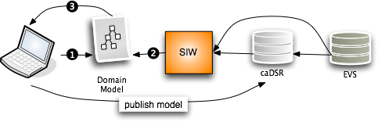

openMDR
Current caBIG Issues:
No support for “local” metadata or terminologies/ontologies.
Can’t or not intended to stand up a “local” caDSR .
The annotation tools and caDSR cant annotate or store a model that is annotated by more that one metadata registry.
Hard to or can’t copy content from NCI caDSR to your own caDSR.
caGrid tools currently can only create grid data services that use models which have gone through the SIW so currently need to use the above NCI source of metadata approach.

Slide 4
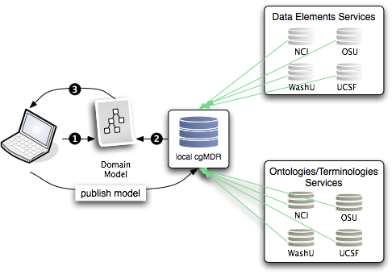
openMDR
Federated semantic metadata management utilizing and enhancing UK CancerGrid cgMDR.

Slide 5
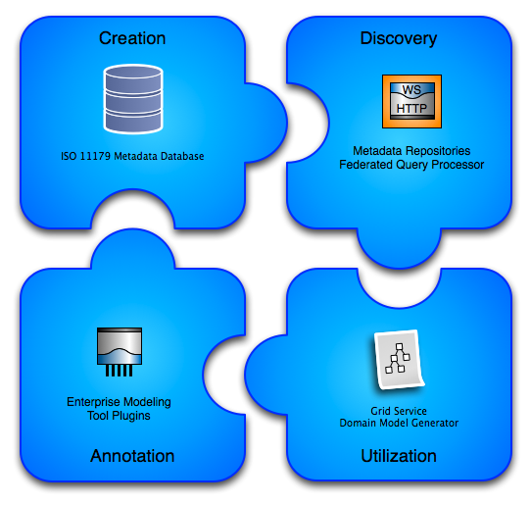
openMDR

Slide 6
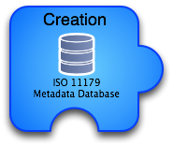
openMDR
Utilizing/enhancing cgMDR iso11179 database.
Build on the Exist XML database.
Capable of storing, versioning, and maintaining semantic metadata.
Metadata is annotated with conceptual information from a local or remote lexEVS system.
Web based frontend for creating and curating semantic metadata.

Slide 7
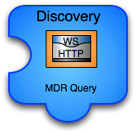
openMDR
caGrid grid service capable of talking to caDSR, many lexEVS and many openMDR systems enabling federated query of common data elements or concepts.
Enhances and wraps the cgMDR mdrConnector in order to parse the received information into a common format.
caGrid service enables it to be deployed in any local or production grid environment and configured and modified to talk to many semantic metadata systems.

Slide 8

openMDR
Enables utilizing the MDRQuery service for locating and utilizing common data elements from many semantic metadata sources for annotation of classes and attributes of the logical model.
Tags are created that identify the service and CDE locally unique id to enable more information to be retrieved by a consumer of the model if desired.
The model is annotated just as it could be with the SIW except there is no need to leave the EA environment.

Slide 9

openMDR
Grid services in caBIG require semantic metadata and currently the only way to generate this service metadata is to utilize caGrid tools which can only use the caDSR which only uses the EVS.
This tool can take models annotated with the openMDR annotation plug-in for EA and generate the required semantic service metadata. This metadata can then be used to generate a data service using the Introduce Data Service Wizard which prior to this tool would only be able to utilize the caDSR can now generate data services annotated with data models from almost anywhere.

Slide 10
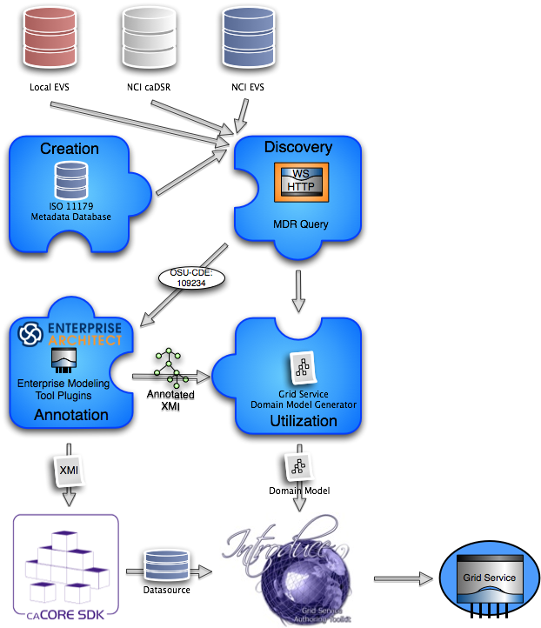
Draw logical model in EA.
Annotate logical model in EA utilizing openMDR EA pluggin.
Export annotated XMI and
  Run through caCore SDK if you want to build a data service or have schema generated.
  Run through Domain Model Generator to generated grid service metadata for exposing the semantic annotations for the logical model being used.
Generate service with Introduce.

Slide 11
What have we done so far?
  Refactor of cgMDR source to enable the following capabilities.
    Pulled code out of exist source tree so that openMDR is not tied specifically to any version of exist.
    Broke project up into 3 sub projects and added a 4th.
      mdrCore (iso 11179 database and web frontend for curation and browse)
      mdrQuery (refactored mdrConnector in cgMDR with a caGrid grid service which provides this query functionality
      mdrTools (currently an EA plugin which uses mdrQuery to provide model annotation.
      mdrDomainModelGenerator (consumes XMI generated by cgMDR EA and generates a Domain Model file required for caGrid to create the grid data service.
    Create a ivy based project build system which is consistent with the caGrid project build and development processes.
    All code is in the caGrid incubator project in the ESN.

Slide 12
This is a work in progress but we have a real community that is looking for a solution.
shannon.hastings@osumc.edu for more information until we get a mailing list set up.
The evolving wiki site can be found here:
  https://cagrid.org/display/MDR/Overview

Slide 13

Questions?
shannon.hastings@osumc.edu

