Slide 1
caGrid Technology Preview:
CQL 2.0
August 22, 2008
John Eisenschmidt eisenschmidtjw@mail.nih.gov
Scott Oster oster@bmi.osu.edu
David Ervin ervin@bmi.osu.edu

Slide 2
Agenda
The Technology Preview Process
What is CQL 2.0?
The CQL 2.0 Technology Preview
Survey Process
Survey Questions
Resources

Slide 3

The Technology Preview Process
Mechanism for vetting new and potentially disruptive technologies.
Provide a stand-alone, reference implementation that allows developers to “kick the tires”
Collect useful feedback from participants, which determines:
    If candidate is ready for release
    If candidate needs re-factoring, which may lead to another Technology Preview
Once final candidate is chosen, impact to service developers will be determined
Two Technology Preview Tracks
Track 1: Direct engagement with stakeholders
Ensure technology under scrutiny is installed and working on day one
Establish time commitments for stakeholders and caGrid team
Track 2: Open, Community Participation
During the same time period, the community may participate without direct engagement
Support is provided through the cagrid-users-l mailing list

Slide 4
What is CQL 2.0?
CQL, the caGrid Query Language, is used by Data Services to express queries against a data source using an object oriented language.
CQL 2.0, based on use cases from the domain workspaces, is the candidate successor to CQL
  Current implementation SDK-only, not a full grid service
[New] CQL 2.0 extends CQL to support:
  Aggregations
  Strongly typed attribute values
  Differentiation from Unary to Binary attribute restrictions
  Retrieval of associated objects
[Disruptive] CQL 2.0 is not backward compatible with CQL!
  Will replace CQL in an undetermined, forthcoming release of caGrid

Slide 5
The CQL 2.0 Technology Preview
Objective: To collect meaningful feedback from developers on the utility of the CQL 2.0 language
Engaged Stakeholder: ICR, Imaging, and Tissue Bank Workspaces
Preview will last 6 weeks, as follows:
  Week 0: Kickoff meeting, participants designated
  Week 1: Spend 2-4 hours with designee on background information, CQL 2.0 query training, and software setup
  Week 3: 1 hour call to get status and troubleshoot any issues
  Week 5: 1 hour call to get status and troubleshoot any issues
  Week 6: Formal debrief meeting; participants complete survey
Between meetings, participant is expected to test 2-4 hours per week
Approximate 30 hour commitment over a six week period:
6 hours training and meetings, 24 hours of testing

Slide 6
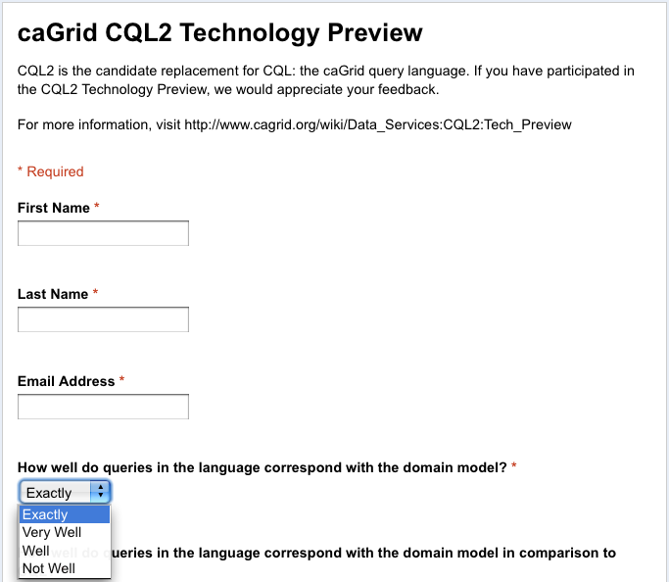
Survey Process
Participants are asked to complete a survey at the end of the Technology Preview.
The objective and subjective feedback are used to determine the outcome of the Technology Preview.
Note: Participants who do not directly engage with ARCH WS may still download the Technology Preview and complete the survey on their own.

Slide 7
Survey Questions
How well do queries in the language correspond with the domain model? *
How well do queries in the language correspond with the domain model in comparison to CQL? *
How straightforward is the Java API? *
How consistent is syntax in XML? *
How consistent is syntax in Java API? *
Are your existing CQL queries straightforwardly expressible in CQL2? *
In no, why?
How well does CQL2 help solve your use cases? *
What could be improved to solve your use cases?
What new features in CQL2 do you find valuable?
What important features do you still feel are missing from CQL2?
In your opinion, can the language be utilized in a user-level application? *
If no, why?
Do you think CQL2 is similar enough to other query languages (eg. CQL, SQL, HQL) that it could be easily utilized by persons with a working knowledge of those languages? *
If no, why?
Would you be comfortable using CQL2 as a replacement for CQL? *
If no, why?
Are there any specific timelines, requirements, backwards compatibility concerns, you have in relation to CQL2 replacing CQL?
What would you change about CQL2?

Slide 8
Resources
CQL 2 Data Services http://www.cagrid.org/wiki/Data_Services:CQL2
CQL 2 Technology Preview http://www.cagrid.org/wiki/Data_Services:CQL2:Tech_Preview
CQL 2 Use Cases http://www.cagrid.org/wiki/Data_Services:CQL2:Use_Cases

