Slide 1
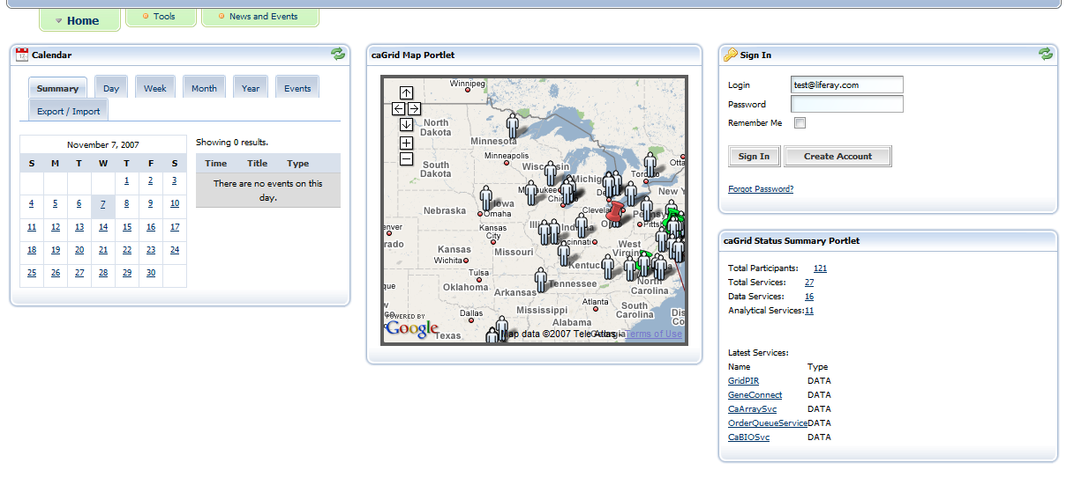
Links to details view of selected item
Links to list view of items
Notes:
Clicking icons in the map lead to detail displays in the Discovery portlet in the Tools tab.
Clicking numbers in Status portlet lead to list view displays in the Discovery portlet in the Tools tab. For example, clicking on the number 121 next to “Total Participants:” would causes the list of all participants to appear.
Clicking on a service name in the Latest Services list of the Status portlet links to a details view in the Discovery portlet in the Tools tab.

Slide 2
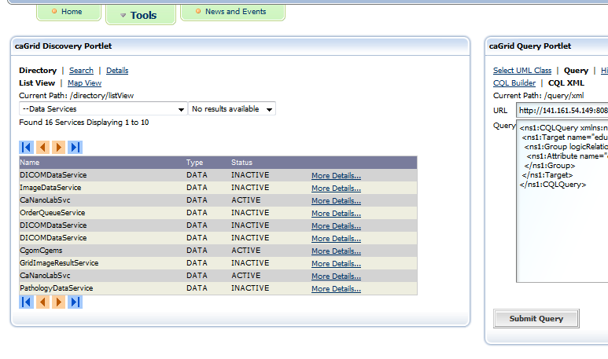
Notes:
List view of data services. Notices that the “Directory > List View” tab is selected.

Slide 3
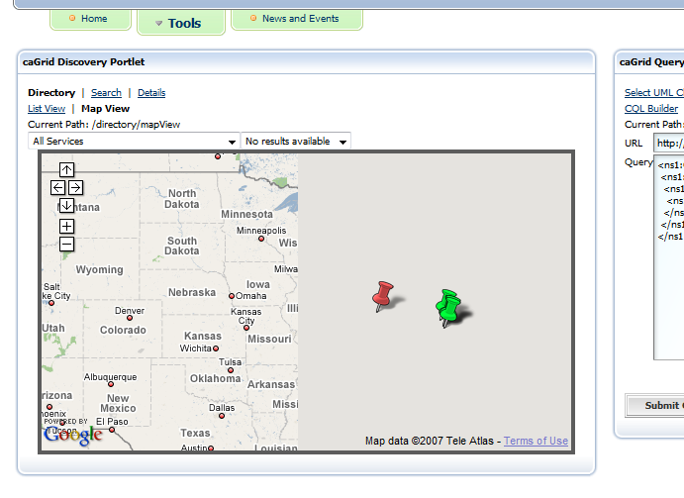
Notes:
Map View of data services. Notice the selected sub tab.

Slide 4
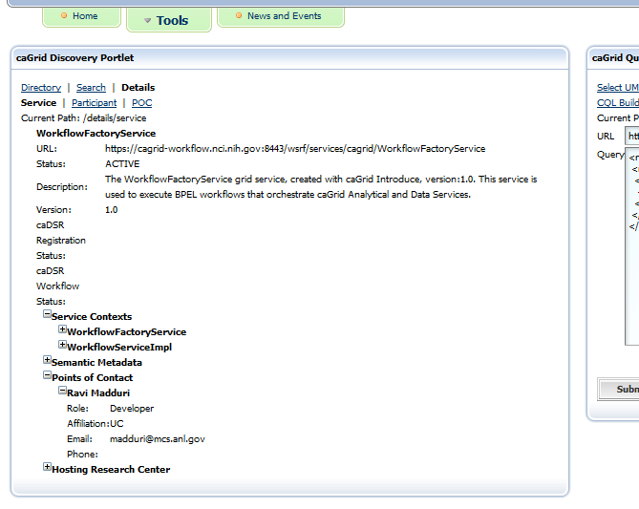
Notes:
Details view of service.

Slide 5
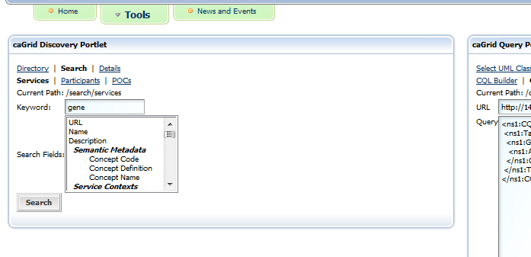
Notes:
“Search > Services” view.

Slide 6
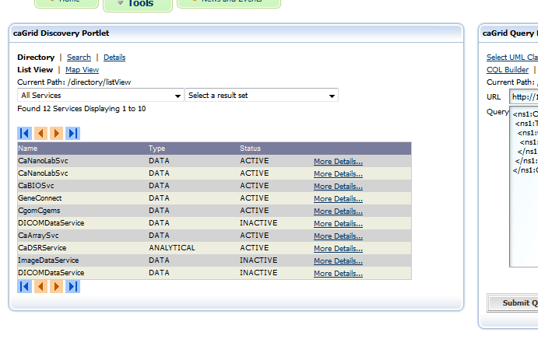
Notes:
Service search results List View.

Slide 7
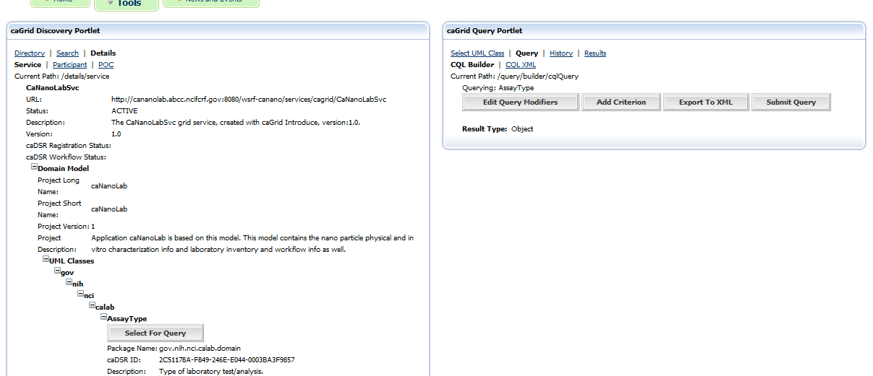
Notes:
The target UMLClass can be selected from the service details tree.

