Slide 1
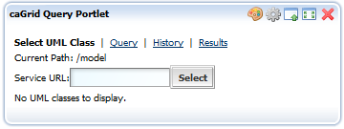
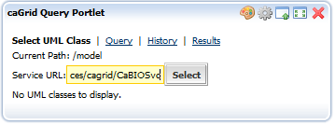
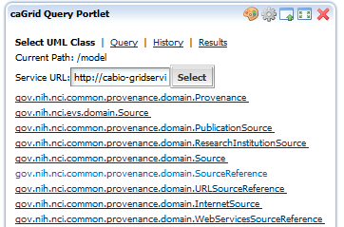
Top-level Navigation Tabs
Enter URL
Select UML class
Notes:
This set of slides describes the query portlet workflow.
The first step in building a query is selecting the UML class that is the “target” of the query. In order to do that, you need to select a data service so that you can see the list of available UML class objects. Normally, you would use the discovery portlet to select a service and UML class. Then the query portlet workflow would start from that point. But the discovery portlet and query portlet can be configured to work together or separately. In this set of slides, the query portlet is configured to work without the discovery portlet, so there needs to be some way to select a service and UML class. This first slide shows how this part works.
NOTE: On all of these screens, you’ll see something like “Current Path: /model”. This is just debugging information and should be ignored.
The user enters a service URL and presses the Select button. Then the list of available UML classes is displayed. The user clicks on one of the classes to select it as the query target.

Slide 2
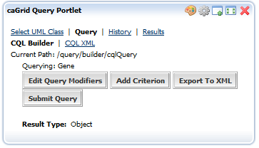
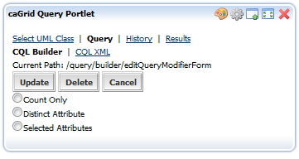
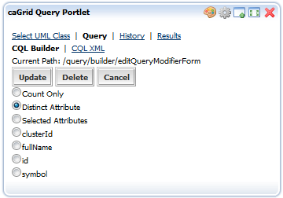
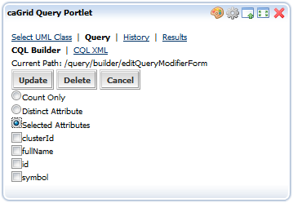
1
2
3
4
Notes:
After selecting a target UML class, the “Query > CQL Builder” sub tab is displayed. This tab provides a graphical representation of the CQL query. Here we can see that the user has selected the “Gene” UML class, and the result type is “Object”. This means that the user wants to receive the full XML representation of Gene objects in the result set.
When the user clicks on the “Edit Query Modifiers” button, a form appears (#2) that allows the user to select one of the following:
Count Only: only the count of objects will be returned
Distinct Attributes: only distinct values of a selected attribute will be returned
Selected Attributes: only the selected attributes of each object will be returned
If the user selects Distinct Attributes, then a list of radio buttons appears, allowing the user to select exactly one attribute (#3). If the user selects Selected Attributes, then a list of checkboxes appears, allowing the user to select one or more attributes (#4).
Right now, there is a Delete button, but this will be removed and instead, there will be an additional radio button titled “Object”, which is selected by default.

Slide 3
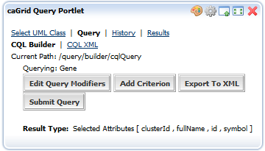
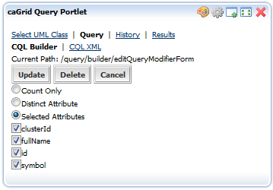
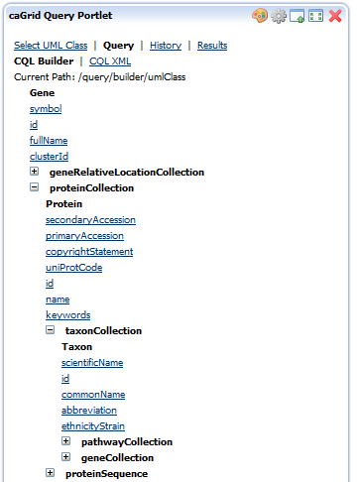
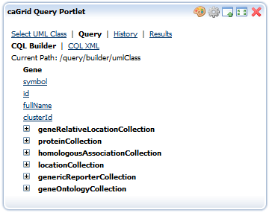
1
2
4
3
Notes:
Here the user has selected to see all attributes (#1). He then clicks the Update button and is presented with the updated CQL query (#2).
No the user wants to constrain the query. To do this, he must specify criteria that the target objects must fulfill. He clicks on the Add Criterion button and is presented with a tree representation of the target UML class (#3).
Here we can see that the Gene object has attributes (hyperlinked) and associations (expandable tree nodes). The user wants to select Gene objects that have something to do with the production of Mouse proteins. To do this, he expands the proteinCollection association and then the taxonCollection association (#4).
In screen #4 we can see that the Taxon (short for taxonomy) object has a commonName attribute. Clicking on this attribute will display a form in which we can supply a predicate and one or more values.

Slide 4
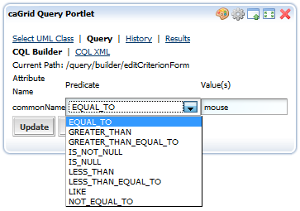
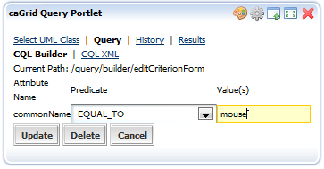
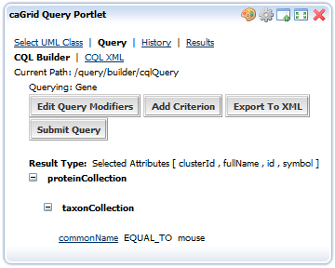
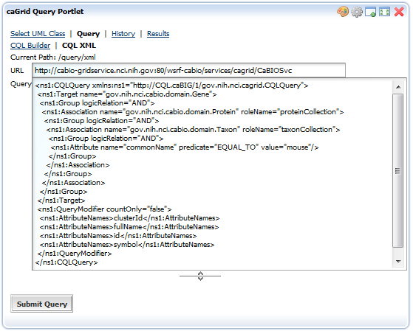
1
2
3
4
Notes:
In the Edit Criterion form, the user specifies the criterion value “mouse” (#1). The user can supply a comma-separated list of values. He can also select from a set of predicates (#2).
When the used presses the Update button, the updated CQL query is displayed (#3). Here we can see that the proteinCollection/taxonCollection/commonName attribute has been added. If the user clicks on the commonName hyperlink, the Edit Criterion form would be displayed again and allow the user to edit or delete the criterion.
The user can repeat the process of specify criterion until the CQL query suites his needs. The semantics of the query are that all criteria are grouped into a logical AND and multiple criterion values (e.g. “mouse” and “fly” for commonName) are grouped into a logical OR.
Once the query is complete, the user can choose to it to XML or submit it directly. Suppose the user chooses to view the query as XML. He presses the Export To XML button and the CQL query XML form is displayed (#4).
Here we can see the target service URL and the CQL query. Notice that the QueryModifiers are also present. From this screen the user can edit the CQL text and/or submit the query. Also note that the user could have navigated to this sub tab directly and enter the service URL and CQL query text without going through the builder workflow.
When the user presses the Submit Query button (#4) the History tab is displayed where the user can watch the progress of the query. If the user had pressed the Submit Query button on screen #3, the History tab would also have been displayed.

Slide 5
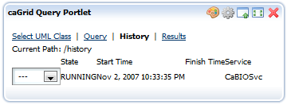
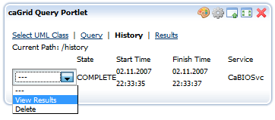
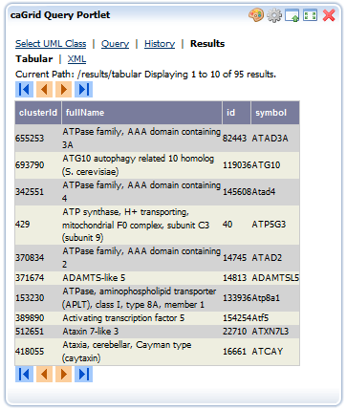
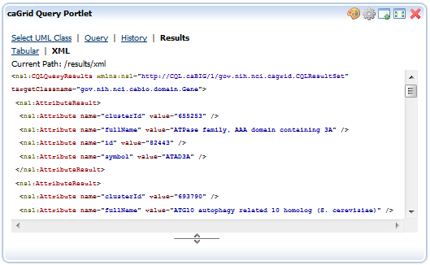
1
2
3
4
Notes:
Once the user has pressed the Submit Query button, the History tab is displayed where the user can see the status of all the queries that he has executed. In screen #1 we can see that the users query is still running.
Queries can be in the following states:
RUNNING: the query is still running
COMPLETE: the query completed successfully
ERROR: the query failed
CANCELED: the user chose to cancel the query
TIMED OUT: the system cancelled the query
Based on the state of the query, the user can perform different operations:
RUNNING: cancel, delete
COMPLETE: view results, reload, delete
ERROR: view error, reload, delete
CANCELED: reload, delete
TIMED OUT: reload, delete
Reloading a query causes it to be loaded into the CQL XML query sub tab, where the user can edit it, or run it again.
The query history display updated dynamically using AJAX. Once the query is in a COMPLETE state, the user chooses to view the results (#2).
By default, the “Results > Tabular” sub tab is displayed (#3), where the user can see the tabular representation of the XML results. In this tab, the user can scroll through the results using the scroll controlls. The user can view the XML results by clicking on the “Results > XML” sub tab (#4).
That is basically it for the workflow.

