Slide 1
caGrid Monthly User Group Meeting
April 17, 2008
11:00am-12:00pm Eastern

Slide 2
Agenda
Overview of New caGrid 1.2 Transfer Service (45 min)
Q & A discussions (15 min)

Slide 3
caGrid 1.2
Transfer Tools
Shannon Hastings, OSU, hastings@bmi.osu.edu
April 16, 2008

Slide 4
caGrid: response to bulk data requirements
Many user groups in caGrid have expressed the need to transfer large data files in the grid without paying the penalty of serialization or deserialization or having to have the entire data in core memory. Early on in the project we created support for utilizing GridFTP for solving these usage scenarios. Several issues with this current approach have left us searching for another solution. Some of the issues are as follows:
GridFTP server is not cross platform (currently on C platform builds of Globus).
GridFTP requires a separate Globus-C installation as caGrid uses the JavaWS Core installation of Globus.
GridFTP has to be extended to be able to make authorization callouts to a java based middleware such as caGrid.
GridFTP installation and configuration is quite advanced for our user community.
Globus does not currently support SOAP attachments.

Slide 5
caGrid: new requirements
In order to better serve our user group we have come up with the following requirements for an alternative non-grid (3rd party) high performance delivery mechanism:
Cross platform.
Utilize the container that will be hosting JavaWS Core Globus and caGrid in order to not require external tool installation.
One click/command install with no required configuration.
Utilize GSI sockets for securely transporting the data using the same proxy certificates issued in caGrid.
No deserialization or serialization required on server or client.
No minimum requirement for core memory.
Support upload and download of data, i.e. data pushed to a service from the client and data received in the client sent by the service.

Slide 6

caGrid Transfer
caGrid Transfer will address all of the preceding requirements:
Simple, utilizing a Transfer Service and Transfer Servlet which will work together in the same container to help deliver the data stream over an HTTP/HTTPS connection.
Secure, the data, if in a secure container, will only be streamed over a GSI Socket where the credentials match the same credentials of the caller which created the data.
Common, Introduce Extension.
No configuration installation (simply run ant deploy)
Metadata extendable to add in recommendations from BDF WG.
Available as of caGrid 1.2
caGrid will currently be supporting both techniques (GridFTP and HTTP)
http://www.cagrid.org/mwiki/index.php?title=CaGridTransfer

Slide 7
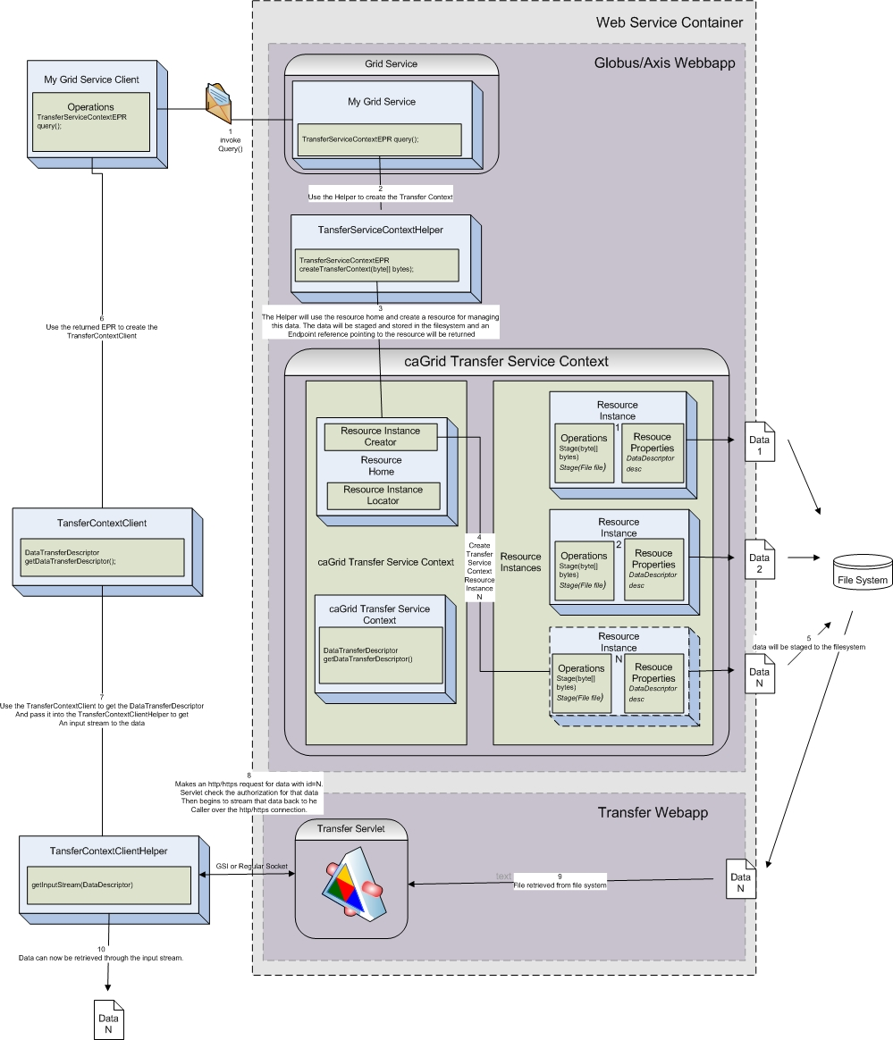
Architecture
Utilizes same container as grid service deployment
One command deployment
Automatically secures the data
TransferServiceHelper enables the service to stage data to be transferred as well as receive data that has been staged by a cleint.
Transfer Webapp deals with transferring and receiving the data over HTTP and HTTPS.

Slide 8
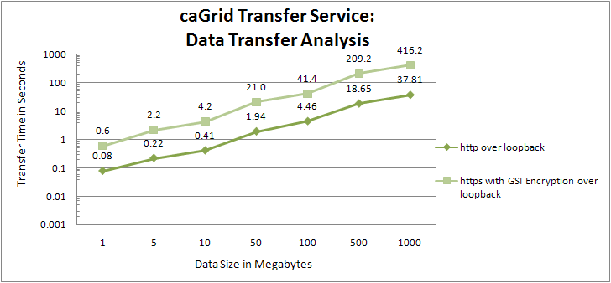
Performance

Slide 9
Usage Prerequisites
Must be proficient in building and deploying services with Introduce.
Suggesting taking Introduce 1.2 tutorial:
http://www.cagrid.org/wiki/Introduce:1.2:Tutorial
Must deploy the Transfer service to the container in order for any service in that container to use it.

Slide 10
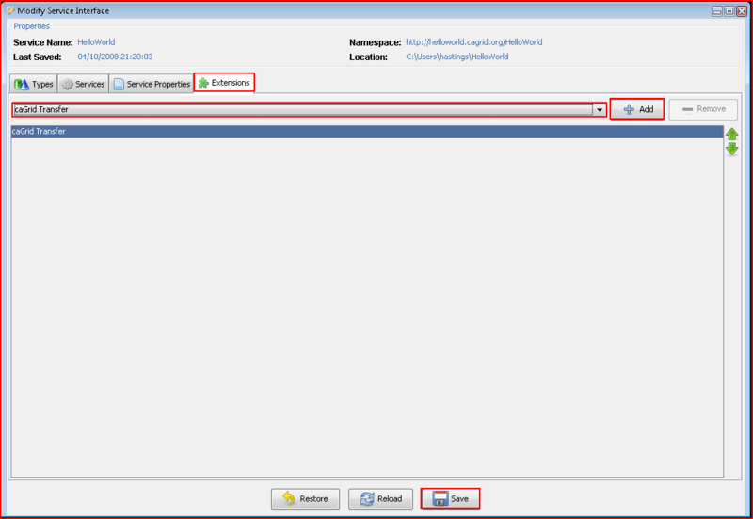
Example Usage
Step 1: In Introduce you must first add the caGrid Transfer extension to the service. This can be done by selecting the extensions tab of Introduce, adding the caGrid Transfer extension, and saving the service.

Slide 11
Example Usage (download)
Step 2: Add a method to the service that will return a TransferServiceContextReference. This can be acomplished by:
Selecting the services tab,
Select the service you wish to use Transfer with,
Select the “Add Method” button.
Make the method take in what ever inputs are required to produce the data you which to send to the client.
Make sure you select the TransferServiceContextReference as the output type of the operation.
Select Done on the Method Viewer
Select Save on the Introduce Modification Viewer.
Now we have added an operation to your service that returns a Transfer reference which a client can use to retrieve data from.

Slide 12
Example Usage (download)
Step 3: Implement the method on the service so that it can produce the data to return the client, stage that data to the Transfer service, and return the new TransferContextReference to the Client.
public org.cagrid.transfer.context.stubs.types.TransferServiceContextReference getSomeData() throws RemoteException { // create some data to sent
byte[] data = new String("This is my bulk data").getBytes();
// create a descriptor for that data
DataDescriptor dd = new DataDescriptor(null, "My Data");
// create the transfer resource that will handle delivering the data and // return the reference to the user
return TransferServiceHelper.createTransferContext(data, dd);
}

Slide 13
Example Usage (download)
Step 4: Implement the client so that it can retrieve the TransferContextReference, get a handle to the TransferContextClient, and use the TransferClientHelper to retrieve the data the service has prepared.
HelloWorldClient client = new HelloWorldClient(args[1],GlobusCredential.getDefaultCredential());
// create transfer is a method that staged some data and returned the Reference
TransferServiceContextReference ref = client.getSomeData();
// create a client that enables me to talk to my transfer resource TransferServiceContextClient tclient = new TransferServiceContextClient(ref.getEndpointReference(),GlobusCredential.getDefaultCredential());
// use the TransferClientHelper to get an InputStream to the data
InputStream stream = TransferClientHelper.getData(tclient.getDataTransferDescriptor(),GlobusCredential.getDefaultCredential());

Slide 14
Resources
For more information on the Transfer service, Introduce, and cagrid in general please go to the caGrid Wiki Site.
http://cagrid.org

