Slide 1
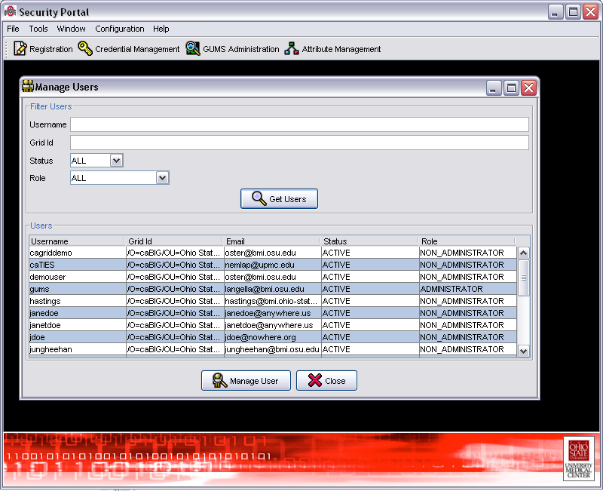
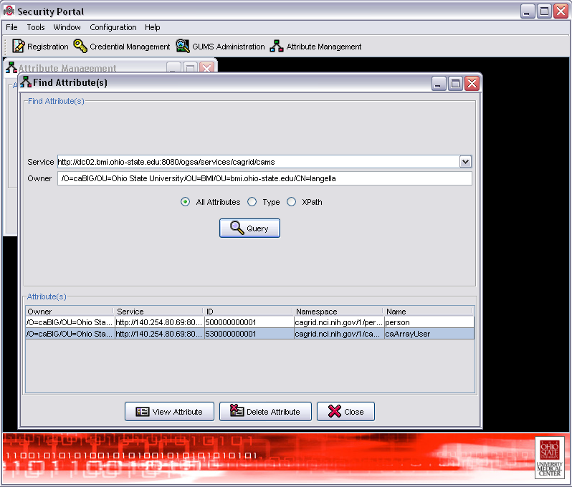
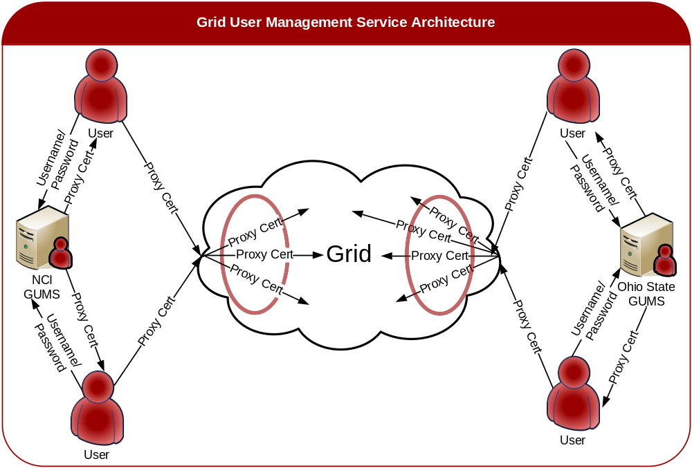
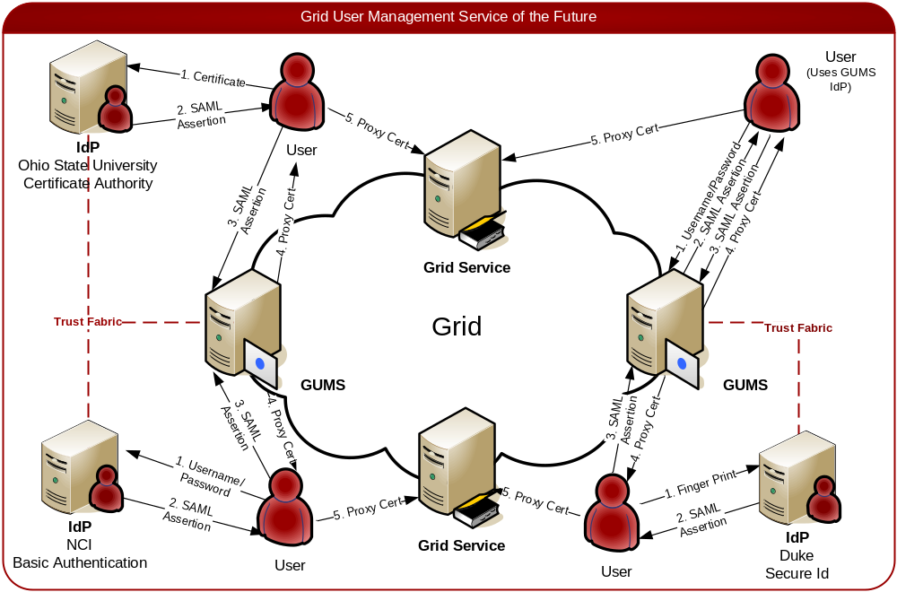
Grid Security Services
Stephen Langella, Scott Oster, Shannon Hastings, Tahsin Kurc, Joel Saltz
Grid User Management Service (GUMS)
The Grid User Management Service (GUMS) is an OGSA compliant Grid service, which provides support for registering and managing users in a Grid environment. It simplifies identity management by managing the Grid credentials (private key, certificate) of Grid users. A rich set of user management methods are available in the GUMS infrastructure, allowing administrators to easily manage grid users. The GUMS supports service-side storage and management of Grid credentials, removing the need for users to copy credentials from machine to machine. A Grid user can use GUMS to create a Grid proxy simply by supplying a username and password. The Grid proxy can then be used to authenticate the user to the grid.
caGrid Attribute Management Service (CAMS)
The caGrid Attribute Management Service (CAMS) is an OGSA compliant Grid service for managing user attributes in a Grid environment. The CAMS manages attributes for Grid identities (of both owners and consumers of Grid-enabled resources). Services running on the Grid can use the CAMS for requesting user attributes in order to make dynamic runtime decisions, such as attribute-based authorization decisions or business logic routing decisions. Grid services can also leverage the CAMS for integrating with backend legacy systems. For example, in order to fulfill a user’s request, a grid service may need to access a local resource through the resource’s own authorization system. The service can obtain the required authorization attributes to the local authorization system from the CAMS and use them to authenticate the user locally. The CAMS supports access control for protecting attributes so that only granted users and services may access a user’s attributes.
Highlights
  In-depth administrative functionality for requesting, creating, and managing Grid-wide accounts.
  Simplifies management of Grid Credentials
  Built on top of the Globus Toolkit 3.2.1
  Supports Single Sign On via Grid proxies
  Runs as a Secure Grid Service
  Rich client API
  Graphical User Interface
Highlights
  Built on top of the Globus Toolkit 3.2.1 and Mobius
  Manages grid user attributes
  Strongly-typed Attribute Standardization via Mobius Global Model Exchange
  GUMS leverages CAMS for attribute management
  Access Control on user attributes
  Enables attribute-based authorization
  Runs as a Secure Grid Service
  Rich client API and Graphical User Interface
Additional Information
Both GUMS and CAMS are being used as part of the core caGrid security infrastructure in caBIG (cancer Biomedical Informatics Grid). caBIG is an initiative funded by the National Cancer Institute to develop and deploy standards, common applications, and a Grid infrastructure to support multi-institutional cancer research. More information on caBIG can be obtained at https://cabig.nci.nih.gov/.
Ohio State University Department of Biomedical Informatics – http://bmi.osu.edu
Mobius – http://www.projectmobius.org
Additional Questions – Email Stephen Langella at langella@bmi.osu.edu
Future Roadmap
  WSRF support
  Integration with existing Identity Providers
  Pluggable Certificate Authorities
  Support for provisioning Service Credentials
  SAML based authentication
  Support for Dynamic Registration Decisions
  New GUMS Certificate Authority
  Support for expiring credentials
  Platform Independence

