Slide 1

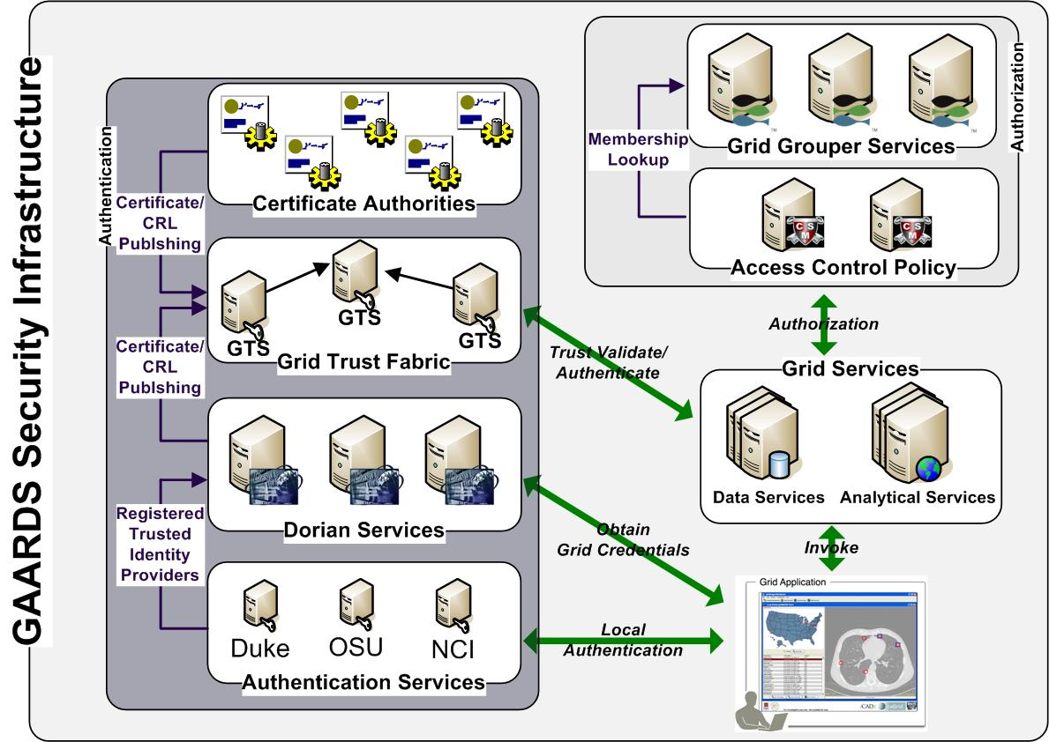
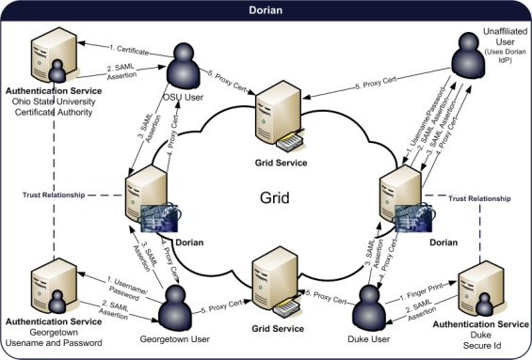
Enterprise Grid Security
http://www.gaards.org
Stephen Langella, Scott Oster, Shannon Hastings, David Ervin, Joshua Phillips, Justin Permar, Tahsin Kurc, Joel Saltz.
The GAARDS Security Infrastructure provides services and tools for the administration and enforcement of security policy in an enterprise Grid. GAARDS was developed on top of the Globus Toolkit and extends it) to provide enterprise services and administrative tools for: 1) grid user management, 2) identity federation, 3) trust management, 4) group/VO management 5) Access Control Policy management and enforcement, and 5) Integration between existing security domains and the grid security domain. GAARDS services can be used individually or grouped together to meet the authentication and authorization needs for Grids. Below is a list of some of the core services provided by GAARDS:
Dorian – A grid service for the provisioning and management of grid users accounts. Dorian provides an integration point between external security domains and the grid, allowing accounts managed in external domains to be federated and managed in the grid. Dorian allows users to use their existing credentials (external to the grid) to authenticate to the grid.
Grid Trust Service (GTS) - The Grid Trust Service (GTS) is a grid-wide mechanism for maintaining and provisioning a federated trust fabric consisting of trusted certificate authorities, such that grid services may make authentication decisions against the most up to date information.
Grid Grouper - Provides a group-based authorization solution for the Grid, wherein grid services and applications enforce authorization policy based on membership to groups defined and managed at the grid level.
Authentication Service – Integrates existing credential providers into the grid under a standardized grid service interface, providing applications with a unified approach to communicate with credential providers.
Dorian
Dorian is a grid service for the provisioning and management of grid users’ accounts. Dorian provides an integration point between external security domains and the grid, allowing accounts managed in external domains to be federated and managed in the grid.
Dorian Features
Integration point between external security domains and the grid security domain.
Existing user credentials can be used to access grid resources.
Manages grid credentials for each user.
Local account creation and management.
Issues and Manages Service Credentials
Graphical Administration UI
Grid Trust Service
In order to authenticate and authorize users and other services, grid services need to maintain a list of certificate authorities that they trust as a source for issuing credentials. In a grid environment provisioning trusted certificate authorities and certificate revocation lists to both clients and servers in the grid is a complicated task. The Grid Trust Service (GTS) is a federated grid infrastructure enabling the provisioning and management of a grid trust fabric.
GTS Features
Grid-enabled federated solution for registering, managing, and distributing certificate authority certificates and CRLs, facilitating the enforcement of trust agreements against the latest trusted roots.
Allows the definition and management of trust levels, such that CAs may be grouped and discovered by the level of trust that is acceptable to the consumer.
Facilitates the curation of numerous independent trust overlays across the same physical Grid.
Graphical UI for trust fabric administration.
Grid Grouper
Grid Grouper provides a group-based authorization solution for the Grid, wherein grid services and applications enforce authorization policy based on membership to groups defined and managed at the grid level.
Grid Grouper Features
Service for managing/accessing groups.
Basic Group Management.
Support for subgroups.
Support for composite groups (set logic).
Facilitates group-base authorization
UI for administering Grid Grouper.
Send questions and comments to:
Stephen Langella, langella@bmi.osu.edu

