Slide 1

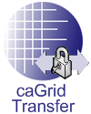
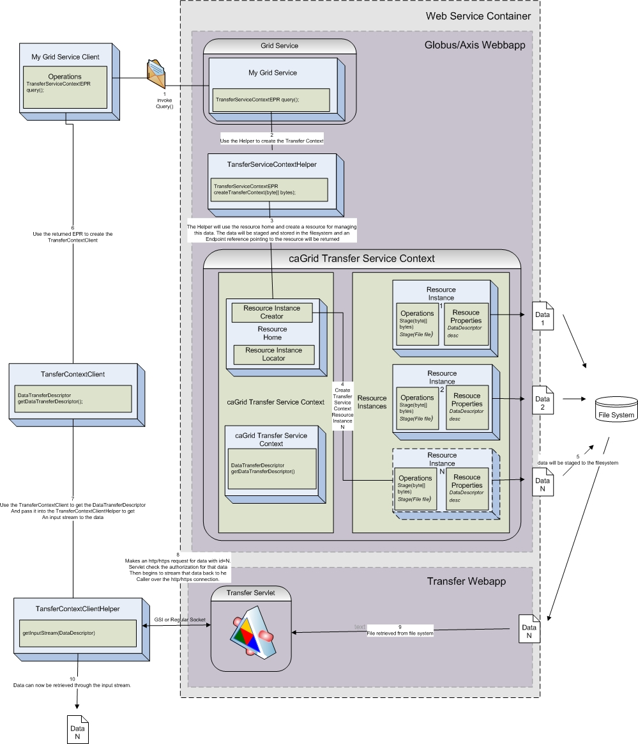
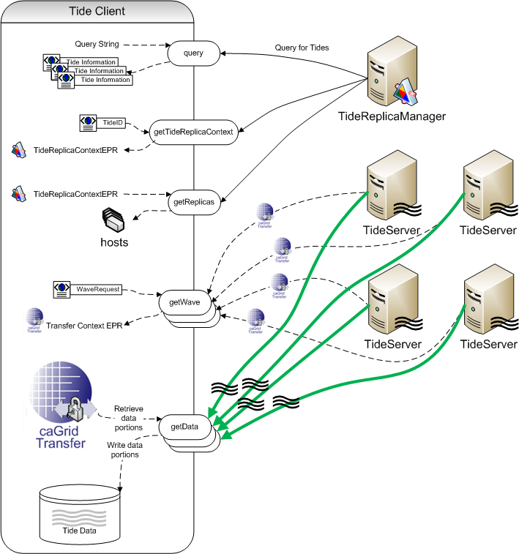




caGrid Transfer:
High Throughput Grid Data Transfer
caGrid Transfer is an Introduce Extension and supporting transfer service which will enable services and clients to download and upload bulk data easily and efficiently to and from grid services and clients.
Tide
The Tide system is designed to be a bittorrent like grid based parallel data transfer solution utilizing the caGrid Transfer mechanisms. It borrows some aspects from the overall bittorrent model however is different is some aspects. The key difference, other than utilizing grid based protocols for negotiating all transfers, is that in the grid, currently, we don't see the massive ad-hoc user community that you might find in bittorrent. That is, because the data we are talking about transferring may only be read by certain people from a certain group or with certain credentials. By limiting the potential data consumers there will not be much use, at least early on, for supporting swarms style data transfer. That is, data that is being peer to peer transferred to consumers who are reading the same data at the same time. This scenario will be unlikely to occur judging from our use cases. So Tide attempts to be very simple in the way that it stores, publishes, and advertises data replicas. The Tide software is in Incubation in caGrid and may be available in future releases.
Motivation
Many user groups in caGrid have expressed the need to transfer large data files in the grid without paying the penalty of serialization or deserialization or having to have the entire data in core memory.
Early on in the project we created support for utilizing GridFTP for solving these usage scenarios. Several issues with this current approach have left us searching for another solution. Some of the issues are as follows:
caGrid BDT uses GridFTP as the underlying 3rd party transfer mechanism.
GridFTP server is not cross platform (currently on on C platform builds of globus).
GridFTP requires a seperate globus-C installation as caGrid uses the JavaWS Core installation of globus.
GridFTP has to be extended to be able to make authorization callouts to a java based middleware such as caGrid.
GridFTP installation and configuration is quite advanced for our user community.
Globus does not currently support SOAP attachments or MTOM in it’s 4.0.X version.
Features
In order to better serve our user group we have come up with the following requirements for an alternative non-grid high performance delivery mechanism:
Cross platform (utilize the container that will be hosting JavaWS Core Globus).
One click/command install with no required configuration.
Work within the same web application container as caGrid is deployed.Utilize GSI sockets for securely transporting the data using the same proxy certificates issued in caGrid.
No deserialization or serialization required on server or client.No minimum requirement for core memory.Support upload and download of data.
Shannon Hastings, David Ervin, Stephen Langella, Scott Oster, Tony Pan
The Ohio State University Software Research Institute
http://cagrid.org

