Slide 1

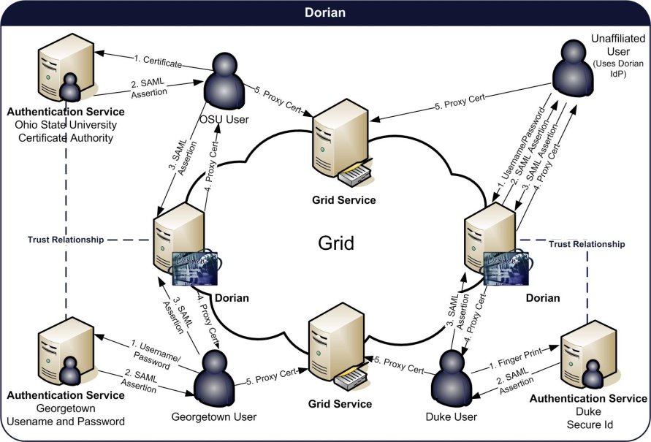
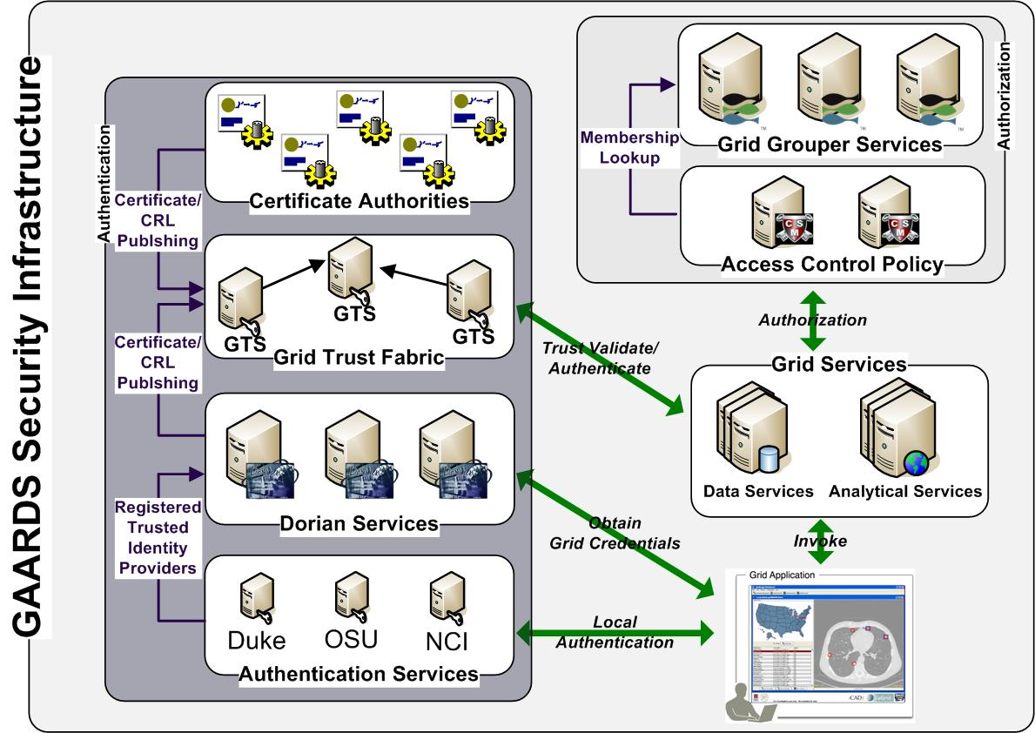
Enterprise Grid Security
http://www.gaards.org
Stephen Langella, Scott Oster, Shannon Hastings, David Ervin, Joshua Phillips, Justin Permar, Tahsin Kurc, Joel Saltz.
The GAARDS Security Infrastructure provides services and tools for the administration and enforcement of security policy in an enterprise Grid. GAARDS was developed on top of the Globus Toolkit and extends it to provide enterprise services and administrative tools for: 1) grid user management, 2) identity federation, 3) trust management, 4) group/VO management 5) Access Control Policy management and enforcement, and 6) Integration between existing security domains and the grid security domain. GAARDS services can be used individually or grouped together to meet the authentication and authorization needs for Grids. GAARDS comprises several principal components: Dorian, Grid Trust Service, Grid Grouper, Authentication Service, Common Security Module, and the GAARDS graphical user interface.
Dorian
Identity management and federation is becoming an ever-present problem in large multi-institutional Grid environments. One underlying problem is to enable participating institutions to manage the identities of their own members by leveraging existing institutional identity management systems, while at the same time facilitating the participation in larger Grids through the deployment of Grid-wide user credentials. Dorian is a Grid service for the provisioning and management of Grid user accounts. Dorian provides an integration point between external security domains and the Grid.
Dorian Features
Administrative UI for account administration.
Manages grid credentials for each user.
Enables users to authenticate and create grid proxies, which they may use to access the grid.
Local account creation and management.
Integration point between external security domains and the grid security domain.
Existing user credentials can be used to access the grid.
Automated account creation and provisioning.
Leverages Hardware Security Module (HSM) for key management.
Grid Trust Service (GTS)
In order to authenticate and authorize users and other services, Grid services must maintain a list of certificate authorities they trust as a source for issuing credentials. Provisioning trusted certificate authorities and certificate revocation lists to both clients and servers in the Grid is a complicated task. The GTS is a federated Grid infrastructure enabling the provisioning and management of a Grid trust fabric.
GTS Features
Grid-enabled federated solution for registering, managing, and distributing certificate authority certificates and CRLs, facilitating the enforcement of trust agreements against the latest trusted roots.

Slide 2
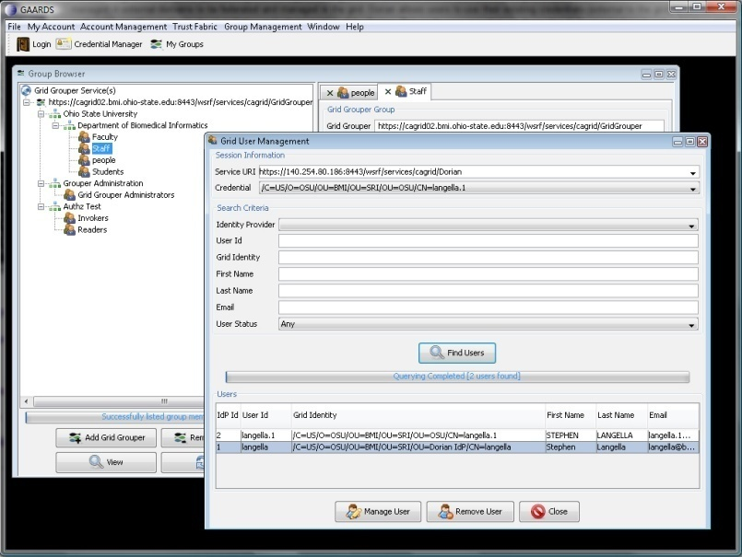
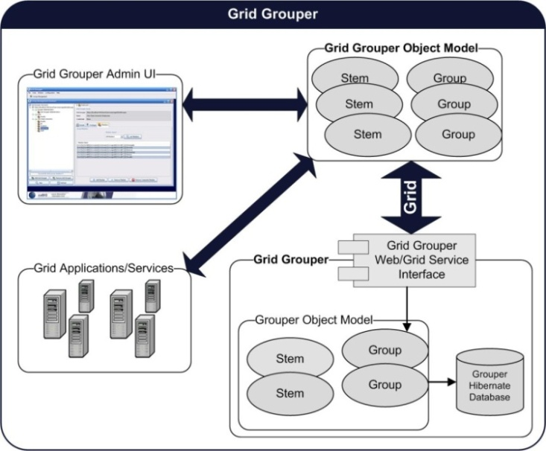
Allows the definition and management of trust levels, such that CAs may be grouped and discovered by the level of trust that is acceptable to the consumer.
Facilitates the curation of numerous independent trust overlays across the same physical Grid.
Validation Service, which allows for the centralized enforcement of certificate verification and validation policies.
Administrative UI for administrating the trust fabric.
Grid Grouper
Grid Grouper provides a group-based authorization solution for the Grid, wherein grid services and applications enforce authorization policy based on membership to groups defined and managed at the grid level. Grid Grouper is built on top of Grouper, an Internet2 initiative focused on providing tools for group management.
Grid Grouper Features
Web/Grid service for managing/accessing groups.
Basic Group Management.
Support for subgroups.
Support for composite groups (set logic).
Set logic based membership queries.
UI for administering Grid Grouper.
Authentication Service
The role of the Authentication Service is to provide a uniform grid interface for authenticating to existing credential providers. The Authentication Service serves as a integration point between local credential providers and the Grid. The Authentication Service provides a framework for issuing SAML assertions for existing credential providers such that they may easily integrated with Dorian and other grid credential providers.
Common Security Module (CSM)
The Common Security Module (CSM) provides a centralized approach to managing and enforcing access control policy. CSM can be leveraged by grid services to authorize clients attempting to access their resources. CSM has been integrated with Grid Grouper such that access control policy managed by CSM may be based on groups managed by Grid Grouper.
Graphical UI
GAARDS provides a fully functional graphical user interface for using and administrating GAARDS services.
Future Work
In the future GAARDS will provide a Credential Delegation Service, enabling clients and services to remotely access delegated credentials. GAARDS will also provide a WebSSO framework allowing web applications to be integrated with the Grid.
Question or Comments?
Please send mail to Stephen Langella: langella@bmi.osu.edu

