Slide 1
caGrid Technology Preview:
CQL 2.0
Architecture Workspace
July 25, 2008
John Eisenschmidt eisenschmidtjw@mail.nih.gov
caGrid Project Manager

Slide 2
Agenda
The Technology Preview Process
What is CQL 2.0?
The CQL 2.0 Technology Preview
Survey Process
Survey Questions
Resources

Slide 3

The Technology Preview Process
Prior to the release of new, potentially disruptive technologies:
Directly engage with stakeholders
  Ensure technology under scrutiny is installed and working on day one
  Establish time commitments for stakeholders and caGrid team
Provide a stand-alone, reference implementation that allows developers to “kick the tires”
Collect useful feedback from participants, which determines:
      If preview is ready for release
      If preview needs re-factoring prior to release
      The latter may lead to another Technology Preview
      Simultaneously, the preview is announced to community, who may participate without direct engagement. Support is provided through the cagrid-users-l mailing list, and we ask that they complete the survey after the preview.

Slide 4
What is CQL 2.0?
CQL, the caGrid Query Language, is used by Data Services to express queries against a data source using an object oriented language.
CQL 2.0, based on use cases from the domain workspaces, is the candidate successor to CQL
  Currently SDK-only, not a stand-alone service
[New] CQL 2.0 extends CQL to support:
  Aggregations
  Strongly typed attribute values
  Differentiation from Unary to Binary attribute restrictions
  Retrieval of associated objects
[Disruptive] CQL 2.0 is not backward compatible with CQL!
  Will replace CQL in an undetermined, forthcoming release of caGrid

Slide 5
The CQL 2.0 Technology Preview
Objective: To collect meaning feedback from developers on the utility of the CQL 2.0 language
Engaged Stakeholder: TBPT Workspace
Preview will last 6 weeks, beginning in August, as follows:
  Week 0: Kickoff meeting, ARCH and TBPT will designate participants
  Week 1: Spend 2-4 hours with designee on background information, CQL 2.0 query training, and software setup
  Week 3: 1 hour call to get status and troubleshoot any issues
  Week 5: 1 hour call to get status and troubleshoot any issues
  Week 6: Designee completes survey; formal debrief meeting
Between meetings, designee is expected to test 2-4 hours per week
Approximate 30 hour commitment over a six week period:
6 hours training and meetings, 24 hours of testing

Slide 6
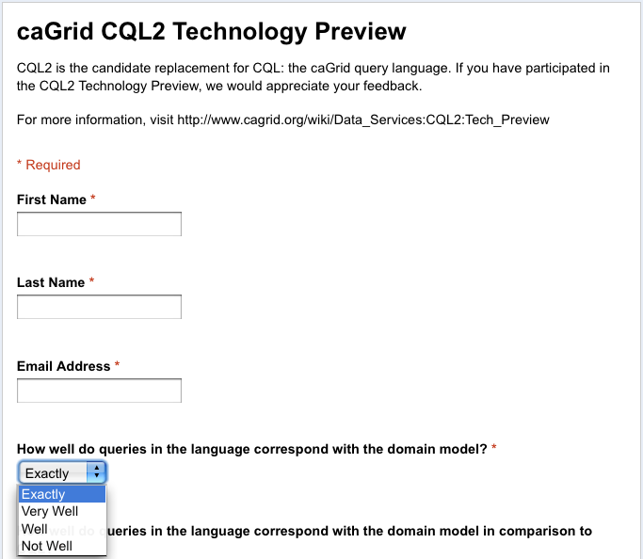
Survey Process
Participants are asked to complete a survey at the end of the Technology Preview.
The objective and subjective feedback are used to determine the outcome of the Technology Preview.
Note: Participants who do not directly engage with ARCH WS may still download the Technology Preview and complete the survey on their own.

Slide 7
Survey Questions
How well do queries in the language correspond with the domain model? *
How well do queries in the language correspond with the domain model in comparison to CQL? *
How straightforward is the Java API? *
How consistent is syntax in XML? *
How consistent is syntax in Java API? *
Are your existing CQL queries straightforwardly expressible in CQL2? *
In no, why?
How well does CQL2 help solve your use cases? *
What could be improved to solve your use cases?
What new features in CQL2 do you find valuable?
What important features do you still feel are missing from CQL2?
In your opinion, can the language be utilized in a user-level application? *
If no, why?
Do you think CQL2 is similar enough to other query languages (eg. CQL, SQL, HQL) that it could be easily utilized by persons with a working knowledge of those languages? *
If no, why?
Would you be comfortable using CQL2 as a replacement for CQL? *
If no, why?
Are there any specific timelines, requirements, backwards compatibility concerns, you have in relation to CQL2 replacing CQL?
What would you change about CQL2?

Slide 8
Resources
CQL 2 Data Services http://www.cagrid.org/wiki/Data_Services:CQL2
CQL 2 Technology Preview http://www.cagrid.org/wiki/Data_Services:CQL2:Tech_Preview
CQL 2 Use Cases http://www.cagrid.org/wiki/Data_Services:CQL2:Use_Cases

