Slide 1
Integrating an Identity Provider
Stephen Langella
Stephen.Langella@osumc.edu
October 29, 2008
http://www.cagrid.org

Slide 2
Outline
Grid Authentication Overview
GAARDS Overview
Implementing an Authentication Service
Project Information

Slide 3
Grid Authentication Overview
Authentication – The process of proving you are who you say you are or your identity to another party.
The Grid uses Public Key Infrastructure (PKI) for authentication.
Public Key Infrastructure (PKI)
Comprehensive security technology and policies using cryptography and standards to enable users to:
Identify (authenticate) themselves to network services.
Digitally sign email and other electronic docs and services.
Encrypt email and other documents to prevent unauthorized access.
Using PKI, each party has a private key and certificate which they use to authenticate with one another.

Slide 4
Grid Authentication Overview
Private Key
A cryptographic key known only to the user, employed in public key cryptography in decrypting or signing information.
Certificate
Data structure (X.509 standard), signed by a Certificate Authority.
Contains the parties public key which is bound to their private key.
Contains information regarding the identity of the party, for example personal identity of server name.
Certificate Authority or asserting party, asserts the identity of the party issued the certificate.
A digital ID Card.
Public
Parties prove their identity to one another by presenting their certificates to one another.
Parties prove that they are the owner of their certificate using their private key.

Slide 5
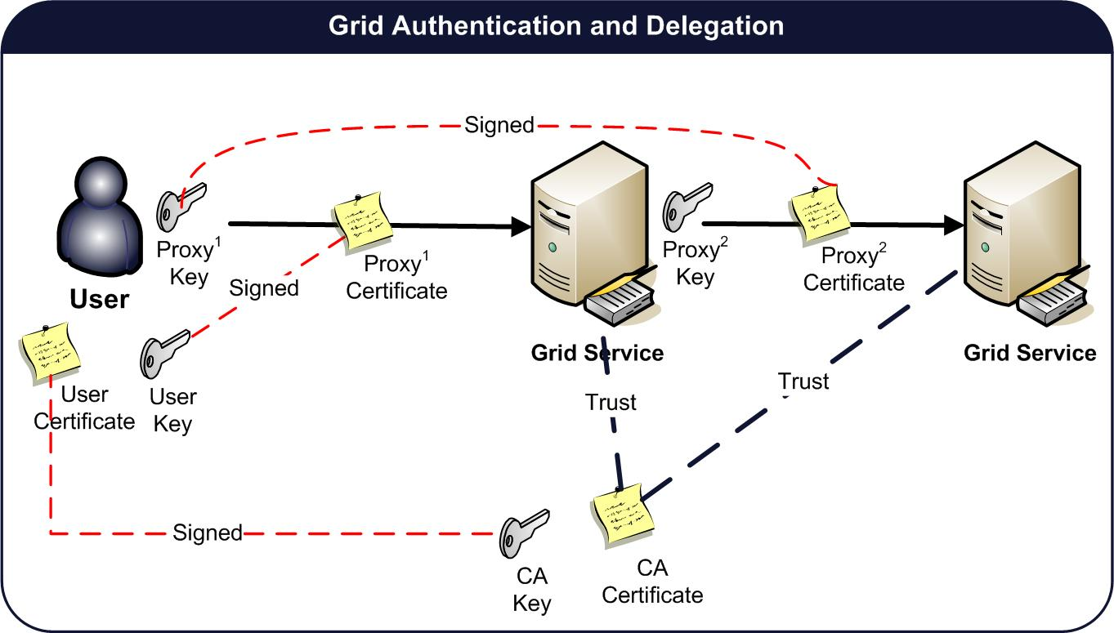
Grid Authentication

Slide 6
PKI Complexities
User required to manage long term certificate and private key.
How are they obtained?
Traditionally user generate a key pair and certificate request locally, then contact (email) a CA administrator to get a signed certificate.
Mobility Issues
User generally work on more that one computer
Certificate and private key need to be available to users on each machine.
Traditionally users need to copy around certificate and private key.
Hassle for the users, some of which don’t have the expertise to accomplish
Security Concerns.
Identity Vetting is difficult in large federations such as caBIG.
caBIG policies require in person identity vetting.
How do you coordinate in person identity vetting across the federation.
Why cant they leverage their existing accounts to access the grid?

Slide 7

Dorian
Grid Account Management
Administrative interface for account provisioning and management.
Built in Certificate Authority
Manages Grid Credentials for each user.
Enables users to authenticate and create grid proxies, which they may use to access the grid.
Users may request service/host credentials for the Grid services they administer.
Identity Management and Federation
Integration point between external security domains and the grid.
User may use their existing credentials to authenticate to the Grid.
Automated Account Creation and Provisioning
Built in Identity Provider
Comprehensive Administrative UI

Slide 8
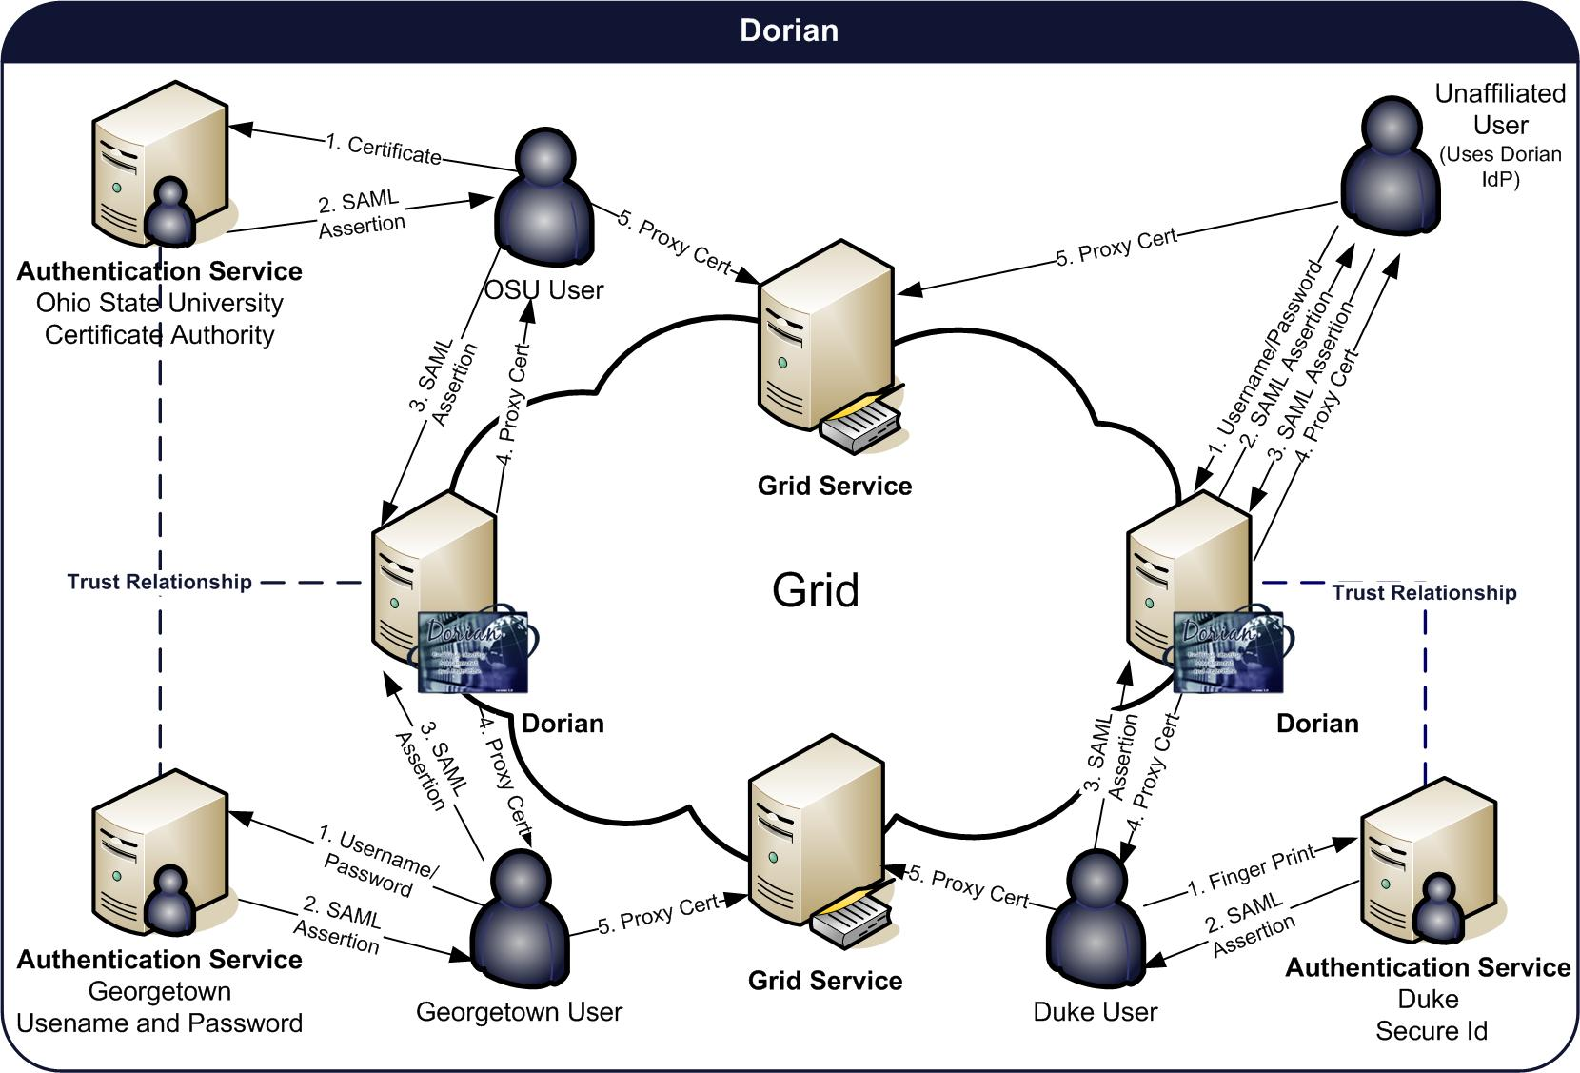
Dorian

Slide 9
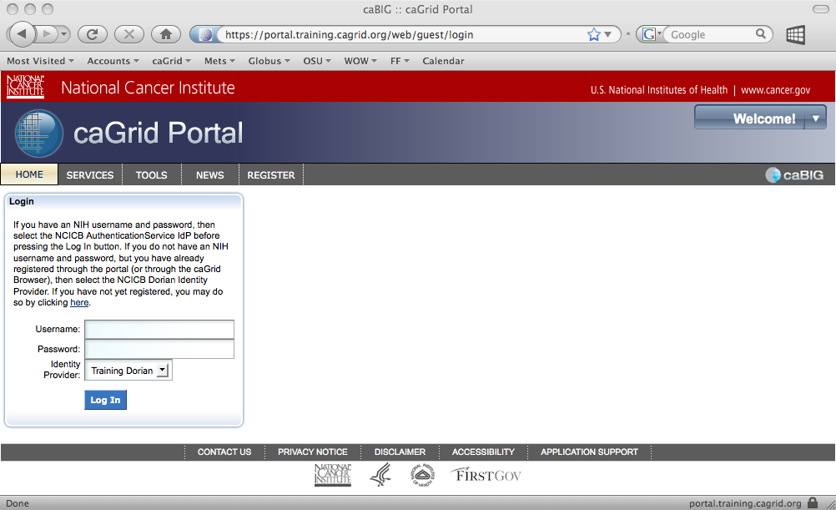
Organizational Identity Providers
Institutions leverage varying technologies for Identity Management
Active Directory
LDAP
Custom / Proprietary / Home Grown
Grid applications cannot be expected to know how to authenticate users with every possible identity management technology.
A standard interface / API is needed such that applications can authenticate users against any identity management technology
OSU
Active
Directory
UT
LDAP

Slide 10
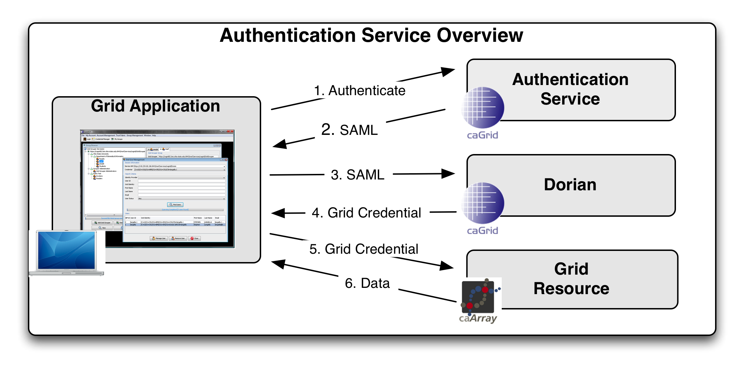
Authentication Service
Provides a uniform web service interface providing applications with a single approach for authenticating users across a federation.
Allows existing identity providers to be seamlessly integrated into a production Grid environment.
Users that are registered with an identity provider may use their existing credentials to access resources on the Grid.
Together the Authentication Service and Dorian provide a solution for federating identity in a grid environment, allowing users to use their existing credentials to access secure grid resources.

Slide 11
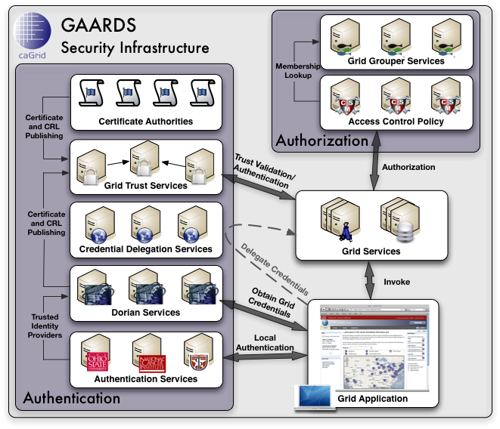
GAARDS (Other Components)
Grid Trust Service (GTS)
Creation and Management of a federated trust fabric.
Supports applications and services in deciding whether or not signers of digital credentials can be trusted.
Supports the provisioning of trusted certificate authorities and corresponding CRLS
Credential Delegation Service (CDS)
Service that enables users/services (delegator) to delegate their Grid credentials to other users/services (delegatee) such that the delegatee(s) may act on the delegator's behalf.
Grid Grouper
Group management service for the grid
Provides a group-based authorization solution for the Grid
Enforce authorization policy based on membership to groups

Slide 12
GAARDS (Other Components)
Common Security Module (CSM)
Centralize approach to managing and enforcing access control policy authorization.
Web Single Sign On (WebSSO)
Effort to provide the Single Sign On capabilities for the web applications as well the grid services using a single solution.
Integrates web technologies with GAARDS and Grid technologies.
GAARDS UI
Comprehensive user interface for administrating the GAARDS security infrastructure.

Slide 13
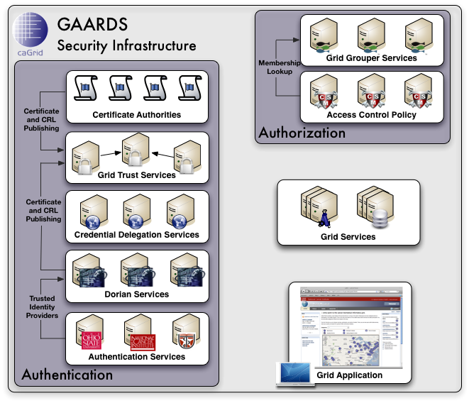
GAARDS In Action
To access secure Grid resources, a user needs to obtain a Grid credential

Slide 14
GAARDS In Action

Slide 15
GAARDS In Action
Authenticate with local institution and obtain proof of authentication (SAML Assertion)

Slide 16
GAARDS In Action
Obtain Grid Credential from Dorian using SAML Assertion

Slide 17
GAARDS In Action
Invoke Secure
Grid Service
Using Credential Provided by Dorian

Slide 18
GAARDS In Action
Validate that the
Credential provided by the user is issued by
a trusted provider

Slide 19
GAARDS In Action
Determine if user is authorized to access requested resources.

Slide 20
Integrating an Identity Provider into the Grid
Integrating an Identity Provider into the Grid
Ensure that your organization meets caBIGTM Security Policies
Implement and operate an Authentication Service for you organization.

Slide 21
caBIGTM Security Policies
Security Working Group (SWG)
Works with National Cancer Institute Center for Biomedical Informatics and Information Technology (CBIIT) to establish, review, update, and distribute security policy.
Federal E-Authentication Initiative
Adopted as authentication guidelines for caBIGTM
Guidelines specify four levels of assurance for evaluating identity providers.
Level 1 – e.g., no identity vetting (LOA1)
Level 2 – e.g., specific identity vetting requirements (LOA2)
Level 3 – e.g., cryptographic tokens required (LOA3)
Level 4 – e.g., cryptographic hard tokens required (LOA4)
Currently we are expecting organization to meet LOA1 or LOA2 (preferably)
http://www.cio.gov/eauthentication/

Slide 22
caBIGTM Security Policies
Federal E-Authentication Level 1
No identity vetting
Provides some assurance that claimant has not changed
Allows a wide range of authentication technologies
Passwords (Most Often Used)
Strict password value requirements
Strict requirements on transport and storage of passwords.
Federal E-Authentication Level 2
Identity Proofing
Allows a wide range of authentication technologies
Passwords (Most Often Used)
Stricter (than LOA1) password value requirements
Strict requirements on transport and storage of passwords.

Slide 23


Authentication (The Big Picture)
Authentication Service
Authentication Service
Authentication Service
Authentication Service
Authentication Service
Authentication Service
Level of Assurance 1
Grid Credential Provider ABC
Level of Assurance 3
Level of Assurance 2
Grid Credential Provider XYZ
Level of Assurance 4
Level of Assurance 3
Grid Trust Service Federation (Trust Fabric)
Secure Grid Resources

Slide 24
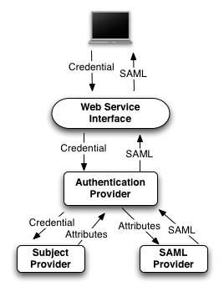
Implementing an Authentication Service
Authentication Service Architecture
Authentication Provider - Responsible for validating the credential provided and for creating and signing the SAML Assertion that proves that the authentication was successful.
Subject Provider - validates the provided credential with organization’s identity provider and obtains the user attributes that are required to be in the SAML Assertion.
SAML Provider - Is responsible for encoding the user attributes provided by the AuthenticationProvider into a SAML Assertion.
Each AuthenticationService component can be replaced with a custom implementation
Authentication Service provides default implementations for all components allowing out of the box integration with some identity providers.

Slide 25
Implementing an Authentication Service
Default Implementations
Default Authentication Provider - Delegates the authentication of users to a SubjectProvider (see Subject Provider). Upon successfully authenticating a user, the SubjectProvider provides the Default AuthenticationProvider with the attribute required to issue the assertion, which it in turns passes to a SAMLProvider (see SAML Provider) who in turn issues the SAMLAssertion and signs it.
Default Subject Provider - Provides out of the box capability for authenticating users and obtaining user attributes with LDAP based identity providers.
Default SAML Provider -Provides an out of the box solution for issuing the required SAML Assertions. The Default SAML Provider uses a user configured certificate and private key for issuing and signing SAML assertions.

Slide 26
Implementation Approaches
1: Implement the Authentication Provider
This option should used in the case where the Identity Provider being integrated has the ability to authenticate users and issue Dorian-compliant SAML Assertion.
2: LDAP Based Identity Providers (Default Authentication Provider and Default Subject Provider)
This option should be used in the case where your Identity Provider is LDAP based system and is not capable of issuing SAML Assertions.
3: Default Authentication Provider and Custom Subject Provider
This option should be used in the case where your Identity Provider is NOT and LDAP based system and is NOT capable of issuing SAML Assertions. (ex Kerberos/LDAP)

Slide 27
Approach 1 Implement the Authentication Provider
This option should used in the case where the Identity Provider being integrated has the ability to authenticate users and issue Dorian-compliant SAML Assertion (i.e. Shibboleth)
Requires implementation of the AuthenticationProvider interface.
Implement a Single Method (authenticate)
Validates a provide credential.
Returns a signed SAML Assertion specifying information about the user and that they successfully authenticated.
SAMLAssertion authenticate(Credential credential)

Slide 28
Approach 2 LDAP Based Identity Providers
This option should used for LDAP Based Identity Providers. It uses the Authentication Service’s default implementations,
No implementation required
Configuration Only (.java.login.config)
myapp{
gov.nih.nci.security.authentication.loginmodules.LDAPLoginModule required
ldapHost="ldaps://ldap.example.edu:636"
ldapSearchableBase="DC=xyz,DC=abc"
ldapUserIdLabel="sAMAccountName"
ldapAdminUserName="CN=CABIG,OU=Authentication Accounts,DC=xyz,DC=abc"
ldapAdminPassword=“password”
USER_FIRST_NAME="givenName"
USER_LAST_NAME="sn"
USER_EMAIL_ID="mail";
};

Slide 29
Approach 3 Implement the Subject Provider
This option should be used in the case where your Identity Provider is NOT and LDAP based system and is NOT capable of issuing SAML Assertions. (i.e. Kerberos/LDAP)
Requires implementation of the SubjectProvider interface.
Implement a Single Method (authenticate)
Validates a provide credential.
If the credential is valid, as JASS Subject is returned
User Id
First Name
Last Name
Email Address
Subject getSubject(Credential credential)

Slide 30
Additional Information
Online Guide to Integrating an Identity Provider
http://www.cagrid.org/wiki/Dorian:1.2:Programmers_Guide:Integrate_an_Identity_Provider_with_Dorian
caGrid Website (http://www.cagrid.org)
Download Software
Documentation
Tutorials
Technical Paper and Presentations
caGrid Knowledge Center (http://knowledge.cagrid.org)
Technical Support and Guidance
caGrid Users Mailing List
https://list.nih.gov/archives/cagrid_users-l.html
cagrid_users-l@list.nih.gov

