Slide 1
Technical Challenges in Building Large Scale Cyber Infrastructure: caGrid Experiences
Scott Oster
Scott.Oster@osumc.edu
iPlant Collaborative:
Cyber Infrastructure Workshop
January 8th, 2009
Biosphere 2, Tucson, AZ

Slide 2
The caBIG® Initiative
caBIG Vision A virtual network of interconnected data, individuals, and organizations that whose goal is to redefine how research is conducted, care is provided, and patients/participants interact with the biomedical research enterprise.
caBIG Goals
Connect the cancer research community through a shareable, interoperable electronic infrastructure
Deploy and extend standard rules and a common language to more easily share information
Build or adapt tools for collecting, analyzing, integrating and disseminating information associated with cancer research and care

Slide 3
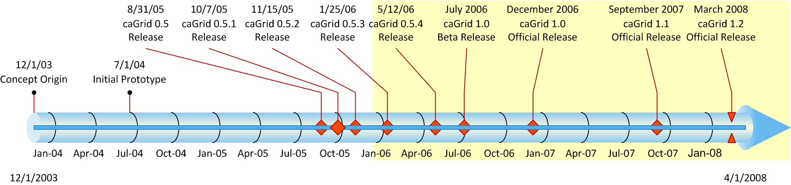
What is caGrid?
Provides the Grid infrastructure for caBIG (the “G” in caBIG)
An open source, domain neutral (not cancer-specific) grid-based software infrastructure consisting of componentized services, toolkits, APIs, and applications
Based on federation (data, security, etc)
Model Driven, Semantically-Annotated Data Virtualization

Slide 4
Issue: Disparate systems
Lack of common infrastructure for applications, databases, etc
Variety of programming languages
Variety of platforms and operating systems
Inability to interoperate with other systems throughout virtual organization

Slide 5
Approach: Disparate systems
Create and leverage a standards-based Grid (caGrid)
WSRF web services using SOAP/HTTP(s)
Creation of compatibility guidelines and review process
Define a uniform query interface and language for data providing systems
Provide common infrastructure services for most federation scenarios
Focus on tools for virtualizing existing systems and APIs behind these grid interfaces
Open Issue: some systems require more manual work than others
Open Issue: tradeoff between specificity and universal applicability

Slide 6
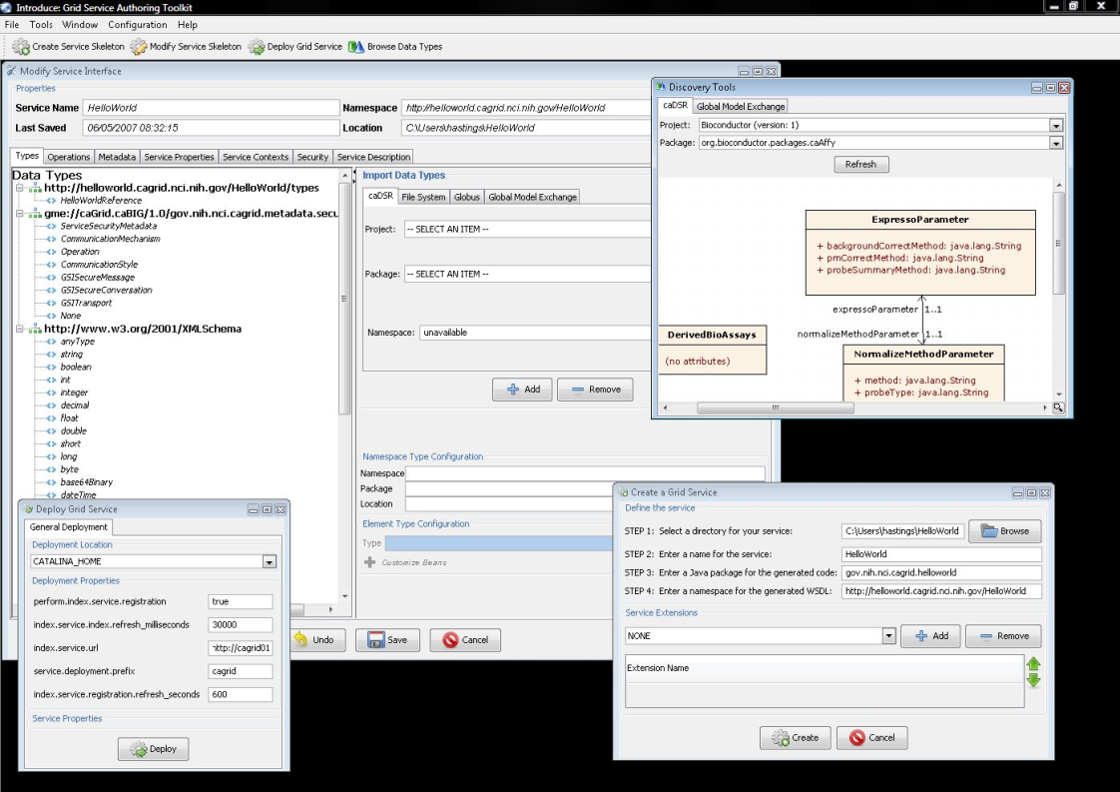
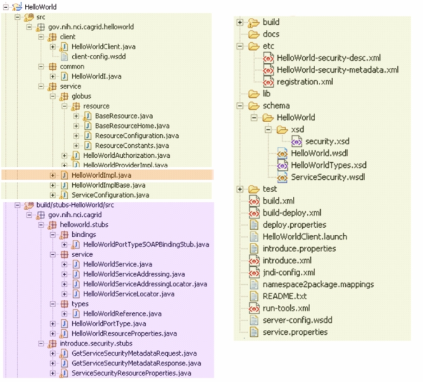
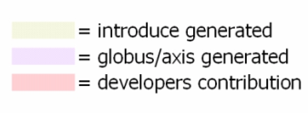
Introduce
Graphical Development Environment for Grid Services
Provides simple means to create a service skeleton that a developer can then implement, build, and deploy
Provides a set of tools which enable the developer to add/remove/modify/import methods of the service
Automatic code generation (WSDL, service and client APIs, JNDI, WSDDs, security descriptors, metadata, etc)

Slide 7
Issue: Lack of common Data Formats
Tools use widely varying and/or proprietary data formats
Lack of formal definition
Not all suitable for communication with remote systems
Lack of uniform way to discover and understand the formats

Slide 8
Approach: Lack of common Data Formats
Adopt XML as data exchange format
Leverage XML Schemas for definition
Global Model Exchange service for publishing, managing, and discovering XML Schemas
Leverage UML for logical definition of data models
Facilitate reuse through formal definition and management in a registry
Formal binding of logical model (UML) and exchange model (XML)
Community review of the use of standards for new systems
Open Issue: Data translation still necessary when existing system can’t be easily changed (though some caBIG tools exist to address this; e.g caAdapter)
Open Issue: tradeoff between reuse and creating the new “perfect model”

Slide 9
Issue: Data Interoperability
Common data formats allow for syntactic data interoperability but are not sufficient for ensuring common semantics
May work with wholesale adoption of common domain-specific models, but breaks down cross-model
Need to understand the meaning of the value domains and terminology of a data format or system
Assumptions of meaning can be dangerous, even deadly, in the medical domain

Slide 10
Semantics Example
<Agent>
<name>Taxol</name>
<nSCNumber>007</nSCNumber>
</Agent>
Class/ Attribute | Example Data | CIA Definition | NCI Definition
Agent |  | A sworn intelligence agent; a spy | Chemical compound administered to a human being to treat a disease or condition, or prevent the onset of a disease or condition
Agent.nSCNumber | 007 | Identifier given to an intelligence agent by the National Security Council | Identifier given to chemical compound by the US Food and Drug Administration Nomenclature Standards Committee
Agent.name | Taxol | CIA code name given to intelligence agents | Common name of chemical compound used as an agent

Slide 11
Approach: Data Interoperability
Community maintained and curated shared ontology
Software infrastructure provides access to the data semantics and controlled vocabulary of all models
Definitions, synonyms, relationships, etc
Logical models annotated with this terminology and concepts
Community review of the use of standards and harmonization for new systems
Open Issue: High initial cost to entry; high overhead to maintaining quality

Slide 12
Issue: User Accounting
Most legacy systems built with local users and permissions
can’t require users to maintain hundreds of accounts, but need to still allow local policy
Central account management and identity vetting not tractable
but there are too many organizations with differing infrastructures to try to establish point to point relationships

Slide 13
Approach: User Accounting
Provide Single Sign On to grid via X.509 proxy certificates
Grid Authentication and Authorization with Reliably Distributed Services (GAARDS)
Federate Identity Management (Dorian)
Rely on participating institutions to vouch for identity of their members
Standardize on identity assertion language and attributes
Integrate existing institutional identity management systems as Registration Authorities, into aggregate Certificate Authorities
Distribute revocations and trust roots via Grid Trust Service (GTS); discussed shortly

Slide 14
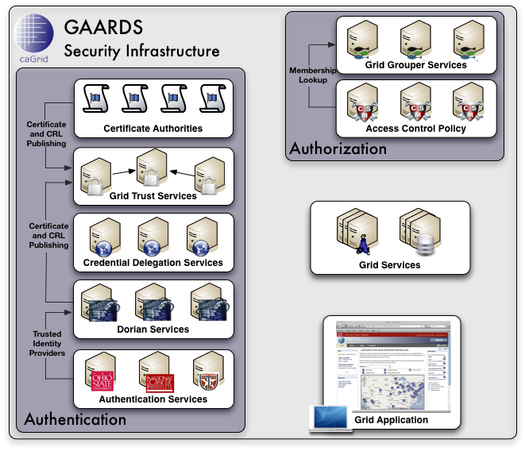
GAARDS In Action
To access secure Grid resources, a user needs to obtain a Grid credential

Slide 15
GAARDS In Action

Slide 16
GAARDS In Action
Authenticate with local institution and obtain proof of authentication (SAML Assertion)

Slide 17
GAARDS In Action
Obtain Grid Credential from Dorian using SAML Assertion

Slide 18
GAARDS In Action
Invoke Secure
Grid Service
Using Credential Provided by Dorian

Slide 19
GAARDS In Action
Validate that the
Credential provided by the user is issued by
a trusted provider

Slide 20
GAARDS In Action
Determine if user is authorized to access requested resources.

Slide 21
Issue: Complicated Trust Arrangements
When hundreds of organizations are sharing data and providing access to each other’s systems, defining a trust model is complicated, even for public data
For non-public data/systems, the simplest/safest policy is “deny all”
For many data sets and services, the owning organization may be virtual
Central authority is socially and technologically intractable
Rapid propagation of information on compromised systems/individuals is critical

Slide 22
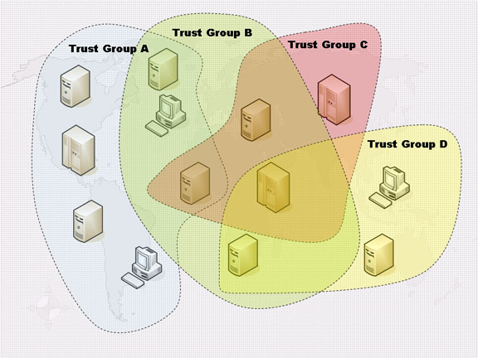
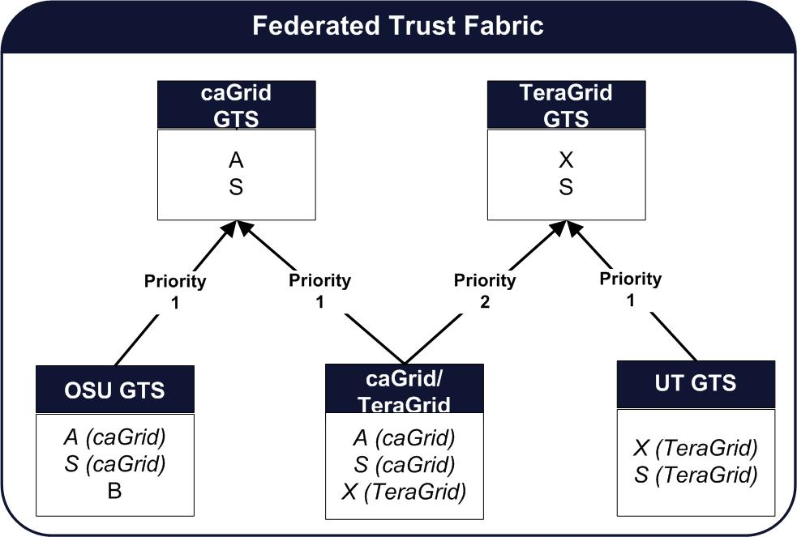
Approach: Complicated Trust Arrangements
Federated Trust Models via Grid Trust Service (GTS)
Establish and manage trust relationships between institutions through adherence to mutually agreed upon policy
Promote global policy distribution, but allow arbitrary local overrides
Capable of inheriting and combining trusted authorities
Provide enterprise tools and services for management and automate distribution of information
Allows one to build a scalable Trust Fabric

Slide 23
Issue: Evolving Infrastructure
Standards in Web/Grid service domain are turbulent at best
Competing interests of “big business” and multiple standards bodies
Major revisions of toolkits generally not backwards compatible
Interface stability vs new features
Don’t want multiple grids
Upgrade or perish? Staying behind means lack of support
Application layer abstractions help developers, but don’t address “wire incompatibility”

Slide 24
Approach: Evolving Infrastructure
Most traditional solutions are in conflict with strongly-typed requirements or complicate service development (unless extensibility built into spec)
e.g. Lax processing; must ignore/must understand with schema overloading; multiple (protocol) service interfaces
Abstract specifications from developers with tooling
Focus on rigid “data format” specifications, allow more freedom on composition into messages
Open Issue: Doesn’t address wire incompatibility
Open Issue: No good solution
Do we need to just get it “good enough” and stabilize?

Slide 25
Summary
The bad news:
Large-scale, distributed knowledge sharing is hard
The good news:
The potential rewards are large
A wealth of existing software and exemplar policies are available
Disparate Systems
Lack of Common Data Formats
Data Interoperability
Finding Resources
Data Size
User Accounting
Data Privacy
Intellectual Capital
Complicated Trust Arrangements
Computationally Intensive
Evolving Infrastructure

Slide 26
Additional Information
caGrid Website (http://www.cagrid.org)
Download Software
Documentation
Tutorials
Technical Paper and Presentations
caGrid Portal (http://cagrid-portal.nci.nih.gov)
Discover and interact with 100+ caGrid services running in caBIG
caGrid Knowledge Center (http://knowledge.cagrid.org)
Technical Support and Guidance
Non abridged version of this talk:
Keynote from Challenges of Large Applications in Distributed Environments (CLADE) Workshop 2007:
http://users.sdsc.edu/~wilkinsn/CLADE_2007/CLADE2007-keynote-oster.ppt

Slide 27
Technical Challenges in Building Large Scale Cyber Infrastructure: caGrid Experiences
Scott Oster
Scott.Oster@osumc.edu
iPlant Collaborative:
Cyber Infrastructure Workshop
January 8th, 2009
Biosphere 2, Tucson, AZ

