Slide 1
caGrid 1.3 Security
Stephen Langella
Stephen.Langella@osumc.edu
October 27, 2008
http://www.cagrid.org

Slide 2
Outline
GAARDS Overview
caGrid 1.3 Security Features
Project Information

Slide 3
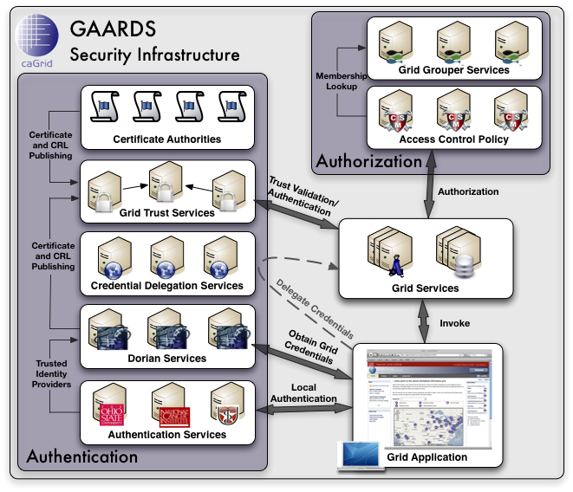
GAARDS Security Infrastructure
GAARDS provides services and tools for the administration and enforcement of security policy in an enterprise Grid.
GAARDS is the security infrastructure for caGrid.

Slide 4
GAARDS Overview
Authentication Service
Integrates existing credentials providers into the grid.
Provides a uniform grid interface for authenticating to existing credential providers.
Applications can communicate with any credential provider.
Dorian
Grid Account Management
Allows accounts managed in external domains to be federated and managed in the grid.
Dorian allows users to use their existing credentials (external to the grid) to authenticate to the grid
Issues Host Credentials.

Slide 5
GAARDS Overview
Grid Trust Service (GTS)
Creation and Management of a federated trust fabric.
Supports applications and services in deciding whether or not signers of digital credentials can be trusted.
Supports the provisioning of trusted certificate authorities and corresponding CRLS
Credential Delegation Service (CDS)
Service that enables users/services (delegator) to delegate their Grid credentials to other users/services (delegatee) such that the delegatee(s) may act on the delegator's behalf.
Grid Grouper
Group management service for the grid
Provides a group-based authorization solution for the Grid
Enforce authorization policy based on membership to groups

Slide 6
GAARDS Overview
Common Security Module (CSM)
Centralize approach to managing and enforcing access control policy authorization.
Web Single Sign On (WebSSO)
Effort to provide the Single Sign On capabilities for the web applications as well the grid services using a single solution.
Integrates web technologies with GAARDS and Grid technologies.
GAARDS UI
Comprehensive user interface for administrating the GAARDS security infrastructure.

Slide 7
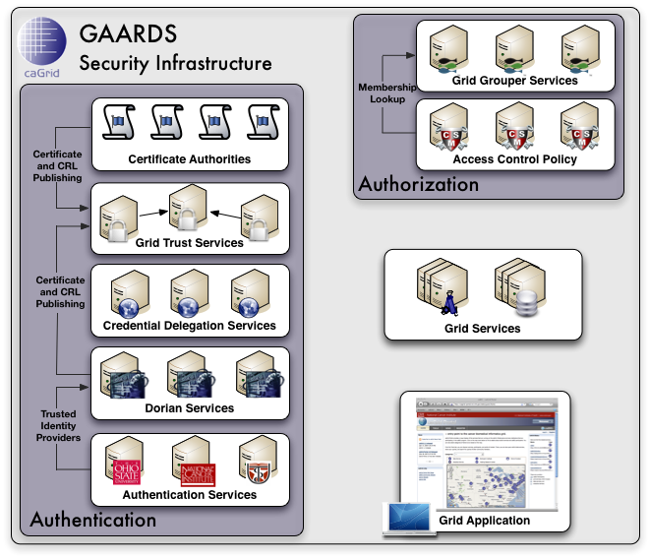
GAARDS In Action
To access secure Grid resources, a user needs to obtain a Grid credential

Slide 8
GAARDS In Action

Slide 9
GAARDS In Action
Authenticate with local institution and obtain proof of authentication (SAML Assertion)

Slide 10
GAARDS In Action
Obtain Grid Credential from Dorian using SAML Assertion

Slide 11
GAARDS In Action
Invoke Secure
Grid Service
Using Credential Provided by Dorian

Slide 12
GAARDS In Action
Validate that the
Credential provided by the user is issued by
a trusted provider

Slide 13
GAARDS In Action
Determine if user is authorized to access requested resources.

Slide 14
caGrid 1.3 Security Features
Authentication Service
Dorian
GAARDS UI
WebSSO

Slide 15

Authentication Service (1.3)
Authentication Profiles
Enables the Authentication Service to support multiple mechanisms for Authentication.
Username and Password
One Time Password (Secure Id)
Extensible – additional profiles can be added based on community needs.
Enables organizations to be integrated into the Grid at e-Authentication Levels 2 and 3.

Slide 16
Authentication Service (1.3)
Authentication Profile Metadata
Authentication Service publishes service metadata that describes which authentication profiles is supports.
General user interfaces can be built that provide inputs for the user based on the credential that is required by the Authentication Service
Authentication Service Interface Overhauled
To support the authentication profiles the service interface for the authentication service was overhauled
The new interface will work with 1.0. 1.1, 1.2 clients using username and password

Slide 17
Authentication Service (1.3)
Authentication Service Client API
New, easier to use client API provided.
Support new authentication profiles
Works with 1.0, 1.1, 1.2, and 1.3 Authentication Services.
Existing API still supported for username and password
Applications that work on existing API will continue to function with the 1.3 libraries.
Integrating LDAP / LDAPS based Identity Providers has been simplified

Slide 18

Dorian (1.3)
Dorian Identity Provider supports Authentication Service (1.3) interface
Supports Authentication Profiles
Provides Authentication Profile metadata.
Trusted Identity Provider Metadata
Dorian published metadata about the identity providers it trusts.
Display Name
Authentication Service URL
Authentication Service Metadata
This allows user interfaces to be built that automatically include new identity providers when they are added.

Slide 19
Making Sense of This
Dorian
(Training, LOA1, LOA2)
Trusted IdP Metadata
Authentication Services Dorian Trusts
Authentication Profile
Credential Required by the Authentication Service

Slide 20
Dorian (1.3)
Short Term End Entity Certificates
Short term end entity certificates will be used instead of Grid Proxies.
No longer need to store long term private key and certificate for each user.
Better integration with existing applications that use X.509 but do not support proxies.
Useful for digitally signing documents and email
Dorian tracks each issued short term certificate or user session.
Administrators can suspend individual short term certificates or sessions.

Slide 21
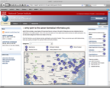



Proxy vs Short Term Certificates
Proxy Certificate
Short Term Certificate
Authentication Service
Authentication Service
Dorian
Grid Service
Dorian
Grid Service

Slide 22
Proxy vs Short Term Certificates
*** User authenticates with their organization using there everyday credentials ***
Proxy Certificate
Short Term Certificate
Credential
Credential
Authentication Service
Authentication Service
Dorian
Grid Service
Dorian
Grid Service

Slide 23
Proxy vs Short Term Certificates
*** Authentication Service provides SAML Assertion proving authentication***
Proxy Certificate
Short Term Certificate
SAML
Assertion
Authentication Service
SAML
Assertion
Authentication Service
Dorian
Grid Service
Dorian
Grid Service

Slide 24
Proxy vs Short Term Certificates
*** Client generates key pair which will make up proxy/short term certificate***
Proxy Certificate
Short Term Certificate
SAML
Assertion
Key
Pair
Authentication Service
SAML
Assertion
Key
Pair
Authentication Service
Dorian
Grid Service
Dorian
Grid Service

Slide 25
Proxy vs Short Term Certificates
*** Client sends SAML Assertion and Public Key to Dorian***
Proxy Certificate
Short Term Certificate
Private
Key
Authentication Service
Private
Key
Authentication Service
SAML
Assertion
SAML
Assertion
Public
Key
Public
Key
Dorian
Grid Service
Dorian
Grid Service

Slide 26
Proxy vs Short Term Certificates
*** Dorian validates that the SAML Assertion is signed by a Trusted IdP***
Proxy Certificate
Short Term Certificate
Private
Key
Authentication Service
Private
Key
Authentication Service
SAML
Assertion
SAML
Assertion
Is the provided SAML Assertion signed by a Trusted IdP?
Is the provided SAML Assertion signed by a Trusted IdP?
Public
Key
Public
Key
Dorian
Grid Service
Dorian
Grid Service

Slide 27

Proxy vs Short Term Certificates
*** Proxy: Dorian loads User’s certificate and Private key***
*** Short Term: Dorian loads Dorian’s CA Private Key ***
Proxy Certificate
Short Term Certificate
Private
Key
Authentication Service
Private
Key
Authentication Service
SAML
Assertion
SAML
Assertion
Public
Key
User’s
Private Key
User’s Certificate
Public
Key
Signed
Dorian
Dorian CA
Private Key
Grid Service
Dorian
Dorian CA
Private Key
Grid Service

Slide 28
Proxy vs Short Term Certificates
*** Proxy: Dorian issues a proxy certificate signed by the User’s private key***
*** Short Term: Dorian issues a certificate signed by the Dorian’s Private Key ***
Proxy Certificate
Short Term Certificate
Private
Key
Authentication Service
Private
Key
Authentication Service
SAML
Assertion
Proxy
Certificate
Signed
SAML
Assertion
Short Term
Certificate
Public
Key
User’s
Private Key
User’s Certificate
Public
Key
Signed
Signed
Dorian
Dorian CA
Private Key
Grid Service
Dorian
Dorian CA
Private Key
Grid Service

Slide 29
Proxy vs Short Term Certificates
*** Dorian returns issued certificate to client ***
Proxy Certificate
Short Term Certificate
Private
Key
Authentication Service
Private
Key
Authentication Service
Proxy
Certificate
Short Term
Certificate
Dorian
Grid Service
Dorian
Grid Service

Slide 30
Proxy vs Short Term Certificates
*** Issued certificate and locally generated private key make up a credential ***
Proxy Certificate
Short Term Certificate
Proxy
Certificate
Private
Key
Authentication Service
Short Term
Certificate
Private
Key
Authentication Service
Dorian
Grid Service
Dorian
Grid Service

Slide 31
Proxy vs Short Term Certificates
*** Issued certificate and locally generated private key make up a credential ***
Proxy Certificate
Short Term Certificate
Proxy
Certificate
Private
Key
Authentication Service
Short Term
Certificate
Private
Key
Authentication Service
Dorian
Grid Service
Dorian
Grid Service

Slide 32
Proxy vs Short Term Certificates
*** Client uses issued credential to authenticate with Grid Services***
Proxy Certificate
Short Term Certificate
Proxy
Certificate
Private
Key
Authentication Service
Short Term
Certificate
Private
Key
Authentication Service
Dorian
Grid Service
Dorian
Grid Service

Slide 33
Dorian (1.3)
Auditing
Record of most interactions with Dorian will be maintained.
Gives administrators big picture, enhancing overall security
Helps administrators debug user issues
Helps in obtaining 21CFR11 compliance
Auditing framework is extensible
Can develop and plug-in modules for handling events
Email notification
AIM notification
Text Message Notification

Slide 34
Dorian (1.3)
Host Certificate Changes
Currently Dorian uses the Globus approach for issuing the subject of host certificates.
Web browsers and other applications are not familiar with this approach and reject these certificates.
The issued subject for host certificates will be changed from the Globus method to the more standard method expected by today’s web browsers.
Example
O=caBIG,OU=caGrid,OU=Training,OU=Services,CN=host/dorian.training.cagrid.org
O=caBIG,OU=caGrid,OU=Services,CN=dorian.training.cagrid.org

Slide 35
Dorian (1.3)
Service Interface
Administrative interface changed to address new features and is not backwards compatible
Additional operations added to user interface to support new features, and is backwards compatible.
Client API
New, easier to use User Client API
New, easier to use Administrative Client API
Existing User Client API still supported.
Existing Administrative Client API is no longer supported.

Slide 36
GAARDS UI (1.3)
Auto discovery of Trusted Identity Providers.
Support for Authentication Profiles
Enhanced support for MAC OS
Enhanced support for Linux
Several usability enhancements

Slide 37
Web Single Sign On (1.3)
Auto discovery of Trusted Identity Providers.
Support for Authentication Profiles
Single Sign Out
Out of the box Liferay integration
Documentation Enhancements
Systems Tests

Slide 38
Project Information
caGrid Website (http://www.cagrid.org)
Download Software
Documentation
Tutorials
Technical Paper and Presentations
caGrid Knowledge Center (http://knowledge.cagrid.org)
Technical Support and Guidance
caGrid Users Mailing List
https://list.nih.gov/archives/cagrid_users-l.html
cagrid_users-l@list.nih.gov

