Slide 1
caGrid and ISO 21090 Data Types

Slide 2
Analytical Services
Support for ISO 21090 data types in Introduce-generated analytical services
Provided by an extension to the Introduce toolkit
Software update for 1.3
Integrated into 1.4 codebase

Slide 3
Analytical Services (cont)
Implemented as a Types Discovery Extension
Other examples: caDSR, GME, File System
Simple, one-click operation
Adds ISO narrative and extension XSD
Copies CBIIT ISO 21090 libraries
Configures data types with JAXB serialization

Slide 4
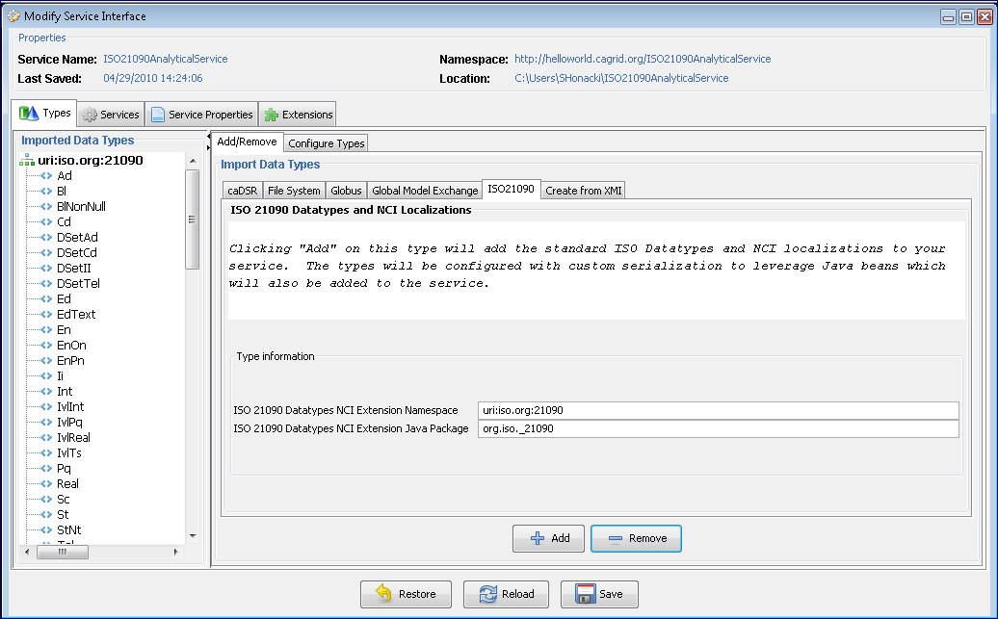
Analytical Services (cont)

Slide 5
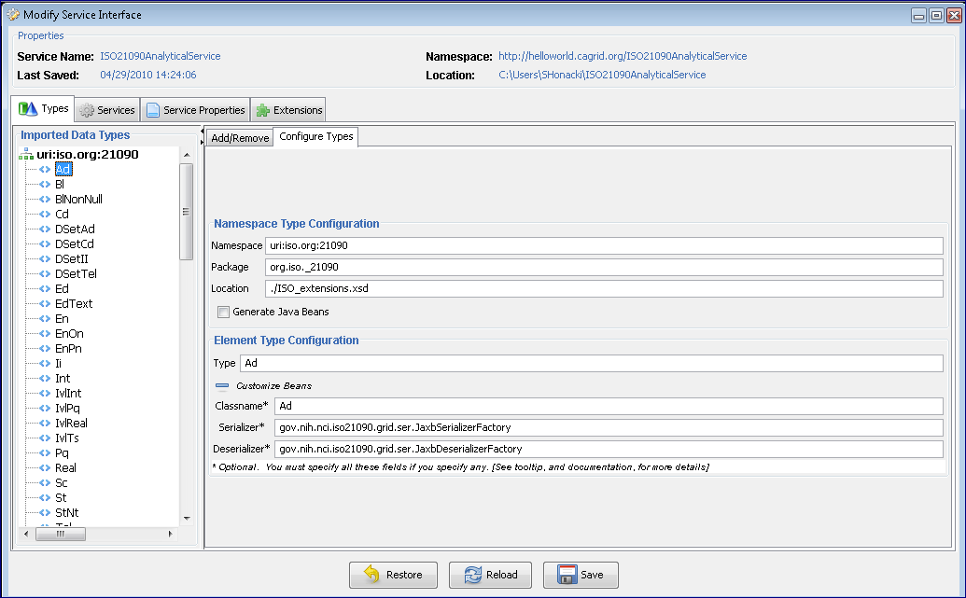
Analytical Services (cont)

Slide 6
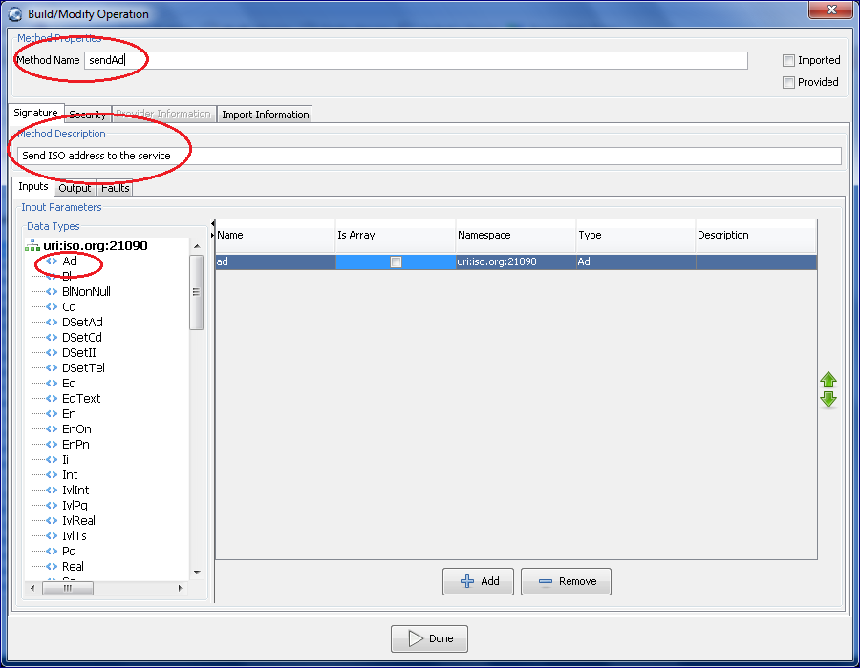
Analytical Services (cont)

Slide 7
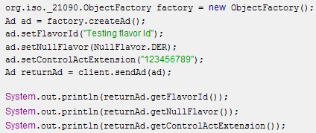
Analytical Services (cont)
Using ISO types in a client:
Straightforward API
Matches the ISO narrative schema and the CBIIT core ISO implementation

Slide 8
Data Services
Support for ISO 21090 data types in Introduce-generated caGrid data services
Considerations in domain model
Specialized ISO datatype serialization
Integration of caCORE SDK 4.3

Slide 9
Data Services (cont)
Data Service style for caCORE SDK 4.3
Simple wizard-like interface
Minor differences between earlier implementations of caCORE SDK support
Provided as an extension to the Introduce toolkit
Software update for caGrid 1.3
Included out-of-the-box for caGrid 1.4

Slide 10
Data Services (cont)
Integration with caCORE SDK 4.3
All-new CQL to HQL translation engine
ISO data types are "flattened" at the database level into the same table as their containing user type
The existing paradigm of creating an inner select statement when traversing Associations doesn't work

Slide 11
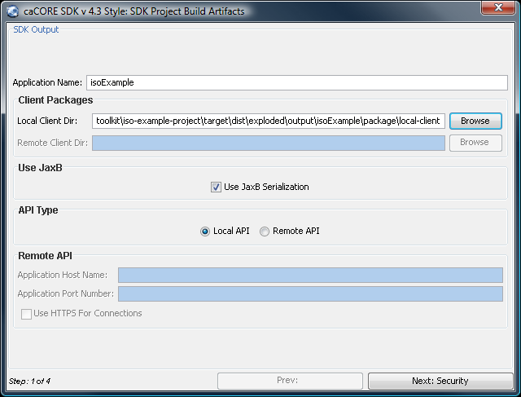
Data Services (cont)

Slide 12
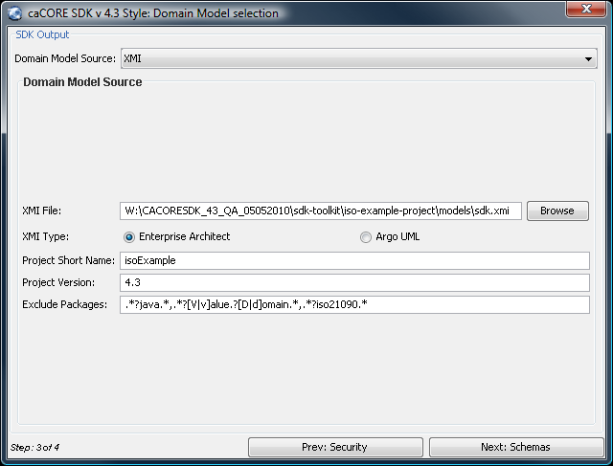
Data Services (cont)

Slide 13
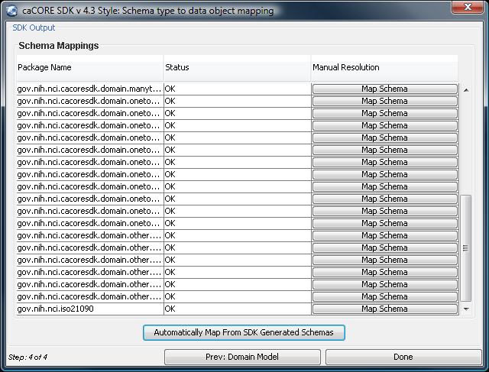
Data Services (cont)

Slide 14
Data Services (cont)
Domain Model considerations
caDSR doesn’t support registering models with ISO 21090 types
May be generated from an XMI document
Complex ISO types can’t be treated like attributes
Domain model renders them as first-class data types
Associations from user types to ISO types
Compatibility with existing tools

Slide 15
Data Services (cont)
XML schema and serialization
Resolved by integration with the ISO analytical services extension
Makes use of the localized CBIIT ISO types
gov.nih.nci.iso21090.Ad vs org.iso._21090.AD
Transparent to clients

Slide 16
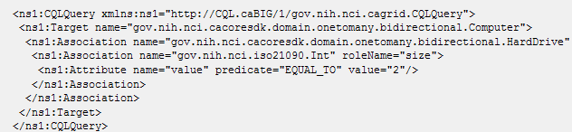
Data Services (cont)
Query considerations
Since the use of ISO types appears as an association within the domain model, CQL queries can be generated as usual

Slide 17
Data Services (cont)
Query Results considerations
Since ISO types are expected to behave as “attributes” at an object API level, they are serialized along with the top-level user type
<ns1:CQLQueryResultCollection targetClassname="gov.nih.nci.cacoresdk.domain.inheritance.onechild.Human" xmlns:ns1="http://CQL.caBIG/1/gov.nih.nci.cagrid.CQLResultSet">
<ns1:ObjectResult>
<ns2:Human xmlns:ns2="gme://caCORE.caCORE/3.2/gov.nih.nci.cacoresdk.domain.inheritance.onechild">
<ns2:hairColor xsi:type="ns3:ST" value="Hair_Color1" xmlns:ns3="uri:iso.org:21090"/>
<ns2:id xsi:type="ns4:II" reliability="ISS" scope="OBJ" displayable="true" extension="1" root="2.16.12.123.456.1" xmlns:ns4="uri:iso.org:21090"/>
<ns2:diet xsi:type="ns5:ST" value="DIET1" xmlns:ns5="uri:iso.org:21090"/>
</ns2:Human>
</ns1:ObjectResult>
</ns1:CQLQueryResultCollection>

Slide 18
Additional Information
ISO 21090 space at caGrid.org:
https://cagrid.org/display/iso21090

