Slide 1

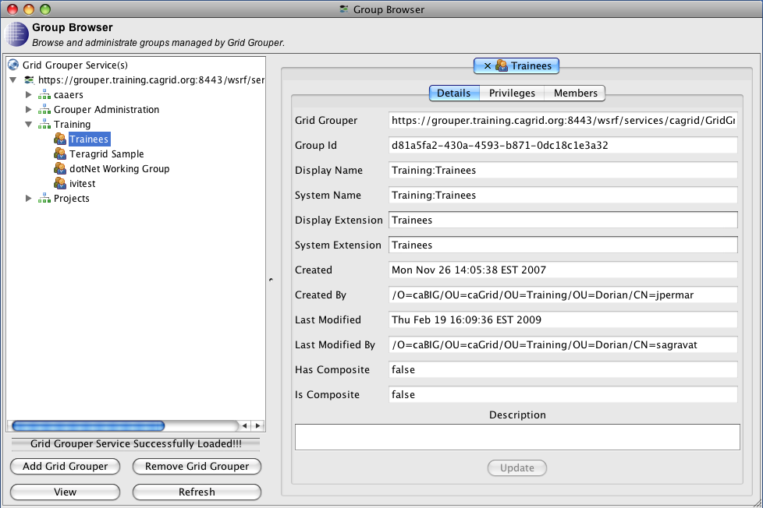
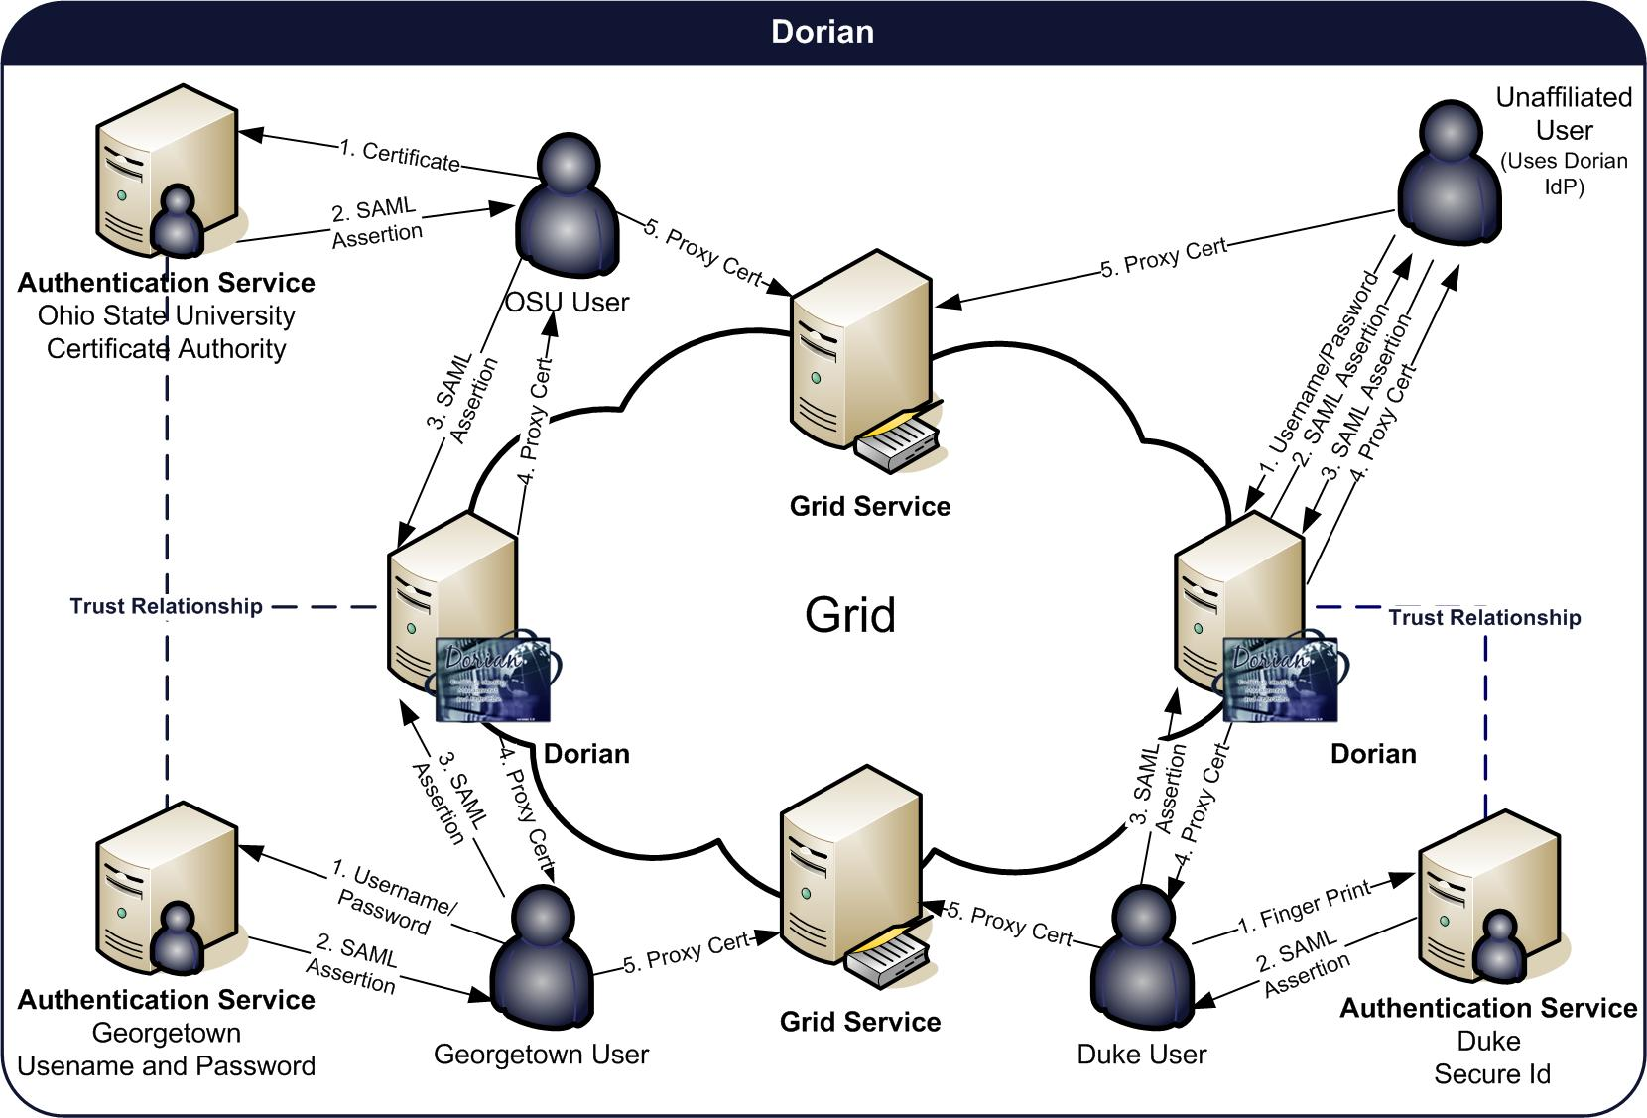
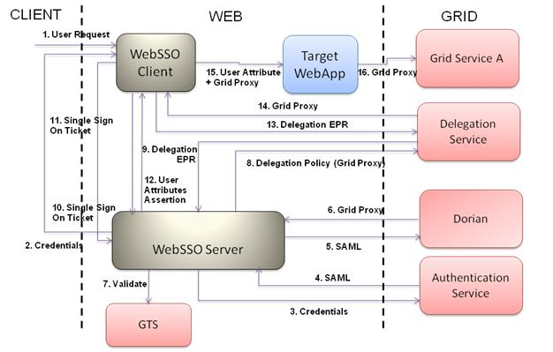
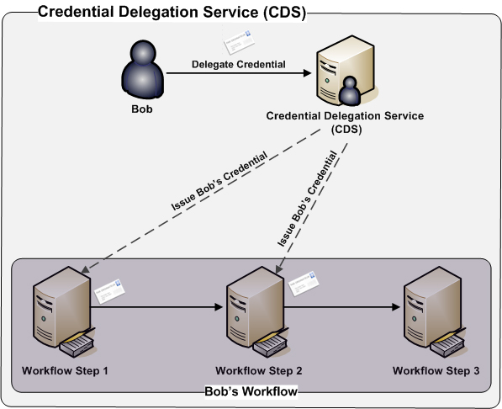
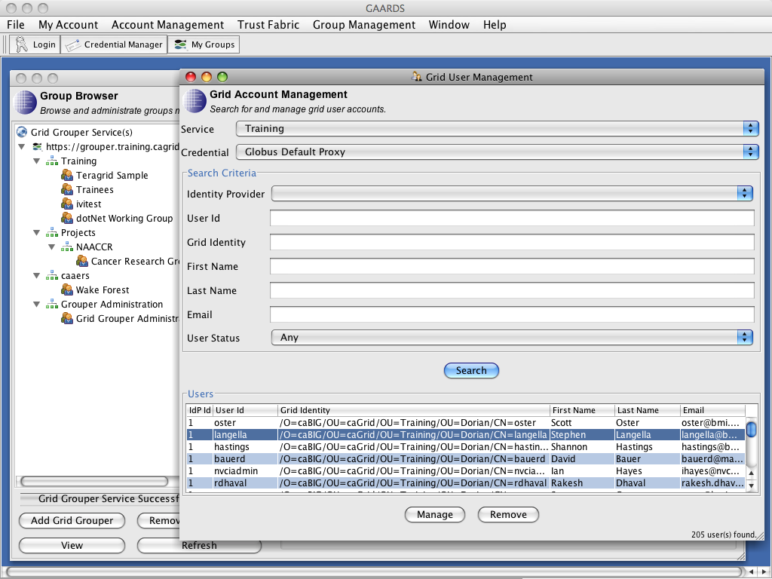
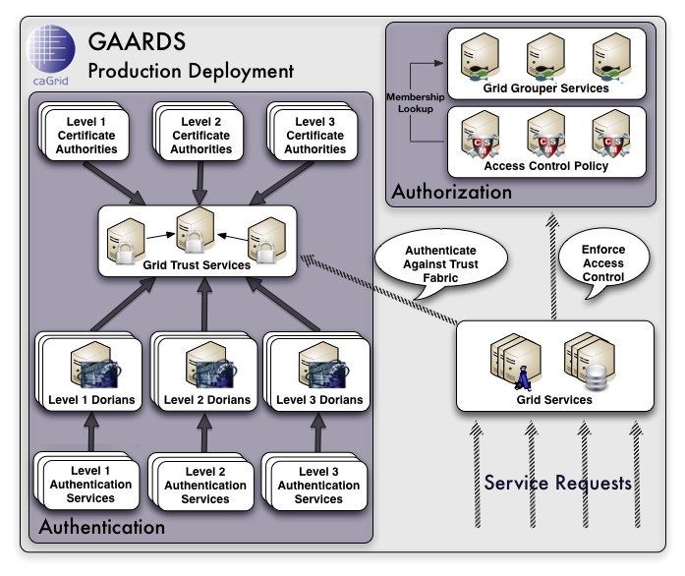
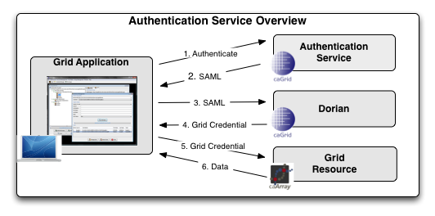

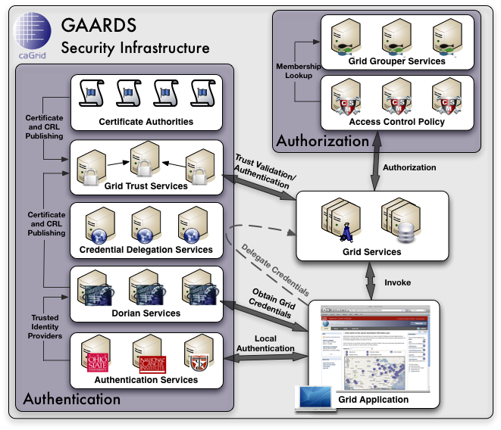

GAARDS Security Infrastructure
OVERVIEW
GRID TRUST SERVICE
GRID GROUPER
The Grid Authentication and Authorization with Reliably Distributed Services (GAARDS) provides services and tools for the administration and enforcement of security policy in an enterprise Grid. GAARDS was developed on top of the Globus Toolkit to provide enterprise services and administrative tools for: 1) grid account management, 2) identity federation, 3) trust management, 4) credential delegation, 5) group/VO management, 6) access control policy management and enforcement, and 7) integration between existing security domains and the grid security domain. GAARDS services can be used individually or grouped together to meet the authentication and authorization needs for Grids. Below is a list of some of the core services provided by GAARDS:
Dorian – A grid service for the provisioning and management of grid users accounts. Dorian provides an integration point between external security domains and the grid, allowing accounts managed in external domains to be federated and managed in the grid. Dorian allows users to use their existing credentials (external to the grid) to authenticate to the grid.
In order to authenticate and authorize users and other services, grid services need to maintain a list of certificate authorities that they trust as a source for issuing credentials. The Grid Trust Service (GTS) is a federated grid infrastructure enabling the provisioning and management of a grid trust fabric. The GTS provides a federated solution for registering, managing, and distributing certificate authority certificates and CRLs, facilitating the enforcement of trust agreements against the latest trusted roots. The GTS allows the definition of levels of assurance which can be used to group and distribute CAs to service providers based on the trust agreements they have in place.
Grid Grouper provides a group-based authorization solution for the Grid, wherein grid services and applications enforce authorization policy based on membership to groups defined and managed at the grid level. Grid Grouper is built on top of Grouper, an Internet2 initiative focused on providing tools for group management.
Grid Grouper Features
Web/Grid service for managing/accessing groups.
Basic Group Management.
Support for subgroups.
Support for composite groups (set logic).
Set logic based membership queries.
UI for administering Grid Grouper.
Authentication Service – Provides a framework for integrating existing credential providers into the grid under a standardized grid service interface, providing applications with a unified approach to communicating with credential providers.
Grid Trust Service (GTS) - A grid-wide mechanism for maintaining and provisioning a federated trust fabric consisting of trusted certificate authorities, such that grid services may make authentication decisions against the most up to date information.
Grid Grouper - Provides a group-based authorization solution for the Grid, wherein grid services and applications enforce authorization policy based on membership to groups defined and managed at the grid level.
Credential Delegation Service (CDS) - A Grid service that enables users/services (delegators) to delegate their Grid credentials to other users/services (delegatees) such that the delegatee(s) may act on the delegator's behalf.
Web Single Sign-On (WebSSO) -provides a comprehensive, Single Sign On solution for web applications. WebSSO integrates with the GAARDS infrastructure allowing web applications to interact with secure Grid resources on behalf of the user that is logged on.
WEB SINGLE SIGN-ON
The WebSSO framework provides a comprehensive, Single Sign On solution for web applications. WebSSO integrates with the GAARDS infrastructure allowing web applications to interact with secure Grid resources on behalf of the user that is logged on. The WebSSO framework allows users to seamlessly cross web application and grid application boundaries using a single logon.
CREDENTIAL DELEGATION SERVICE
The Credential Delegation Service (CDS) is a WSRF-compliant Grid service that enables users/services (delegators) to delegate their Grid credentials to other users/services (delegatees) such that the delegatee(s) may act on the delegator's behalf. The CDS enables secure workflow, distributed queries, web single sign on, and other secure distributed interactions in the Grid.
When delegating their credentials, delegators specify a delegation policy. The delegation policy specifies to the CDS who may be issued the delegators credential. Currently the CDS supports multiple delegation policies, these include a list based delegation policy and a Grid Grouper based delegation policy. Additional delegation policies can easily be plugged into the CDS.
DORIAN
Issues credentials to hosts and services.
Comprehensive user interface for administrating accounts.
Identity Management and Federation
Integration point between external security domains and the grid security domain.
Existing user credentials can be used to access the grid.
Automated account creation and provisioning
Dorian is a federated account management system for the Grid. Dorian simplifies the complexity of Grid security for users, allowing them to use their existing credentials to access resources on the Grid.
Dorian’s Features
Grid Account Management
Built-in certificate authority.
Manages grid credentials for each user.
Enables users to authenticate and create grid proxies, which they may use to access the grid.
Local account creation and management.
GAARDS UI
GAARDS provides a comprehensive UI for administering and using GAARDS services.
AUTHENTICATION SERVICE
The Authentication Service enables existing identity providers to be seamlessly integrated into a production Grid environment such that users that are registered with an identity provider may use their existing credentials to access resources on the Grid. The Authentication Service provides a uniform web service interface providing applications with a single approach for authenticating users across a federation. In other words if each organization provides an Authentication Service for their Identity Provider, then applications can be developed to authenticate users using the Authentication Service interface, allowing users from any identity provider to authenticate with any application. Together the Authentication Service and Dorian provide a solution for federating identity in a grid environment, allowing users to use their existing credentials to access secure grid resources.
http://www.cagrid.org
Stephen Langella¹, Scott Oster¹, Shannon Hastings¹, Kunal Modi², Santhosh Garmilla²
¹ Software Research Institute, The Center for IT Innovations in Healthcare, Ohio State University
² Ekagra Software Techhnologies

