Slide 1
GAARDS
Stephen Langella
Stephen.Langella@osumc.edu
Globus World 2010
http://www.cagrid.org

Slide 2
Outline
GAARDS Overview
Deployment Overview
Ongoing and Future Work

Slide 3
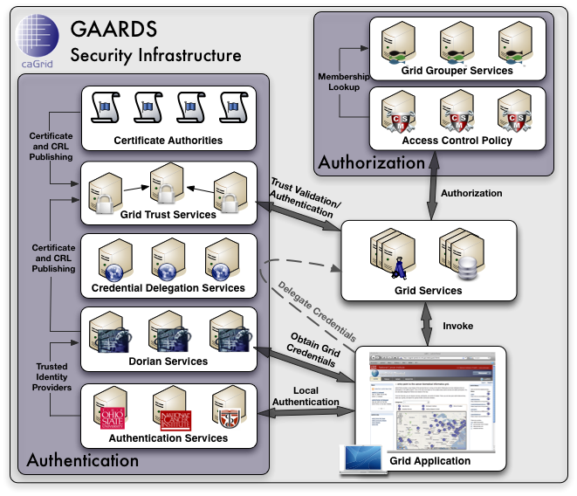
Overview of GAARDS
Provides an enterprise security solution for web and grid service environments.
Features
Federated Identity Management
Trust Provisioning and Management
Group/VO Management
Access Control Provisioning and Enforcement
Delegation Services
Web Single Sign On

Slide 4
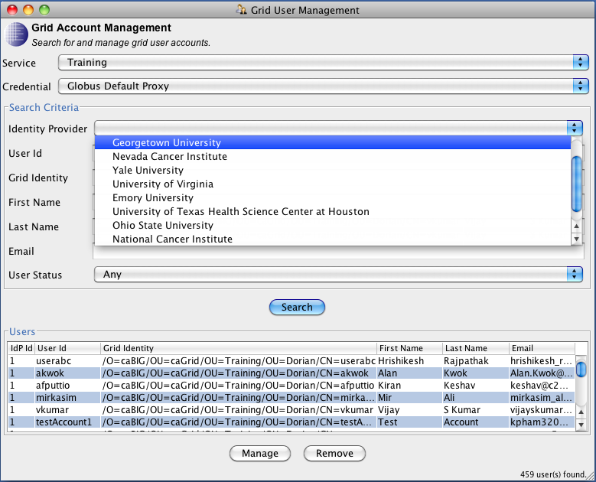
Federated Identity Management
Authentication Service and Dorian provide the foundations of federated identity management.
Dorian
Users leverage their existing credentials to access federated environments
Dorian manages federation accounts for users based on existing credentials
Dorian simplifies the complexity of using X.509 credentials, issuing user and host X.509 credentials to users with accounts, which can be used for authenticating in the federation.
Dorian provides complete administration facilities for provisioning and managing user accounts.
Built in Identity Provider
Authentication Service
Uniform interface/framework for integrating identity providers into a federation.

Slide 5
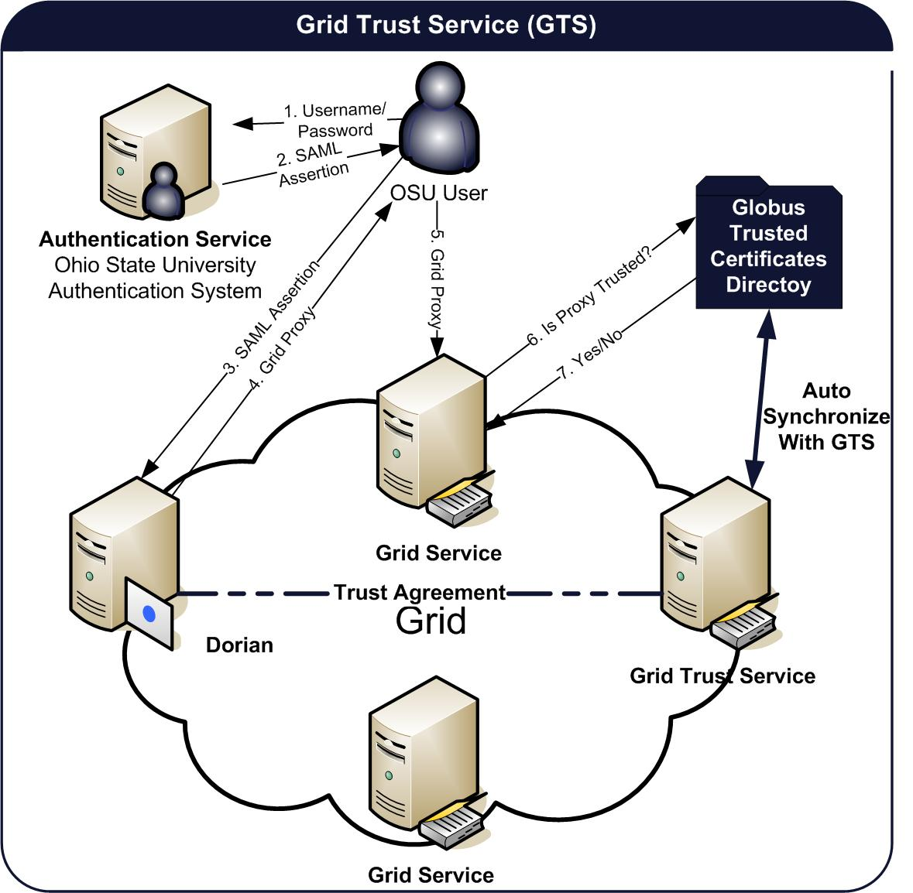
Trust Provisioning and Management
Grid Trust Service (GTS)
Creation and Management of a federated trust fabric.
Supports applications and services in deciding whether or not signers of digital credentials can be trusted.
Supports the provisioning of trusted certificate authorities and corresponding CRLS
Define and manage levels of assurance.
Distributed GTS, Enabling the creation of a scalable trust fabric.

Slide 6
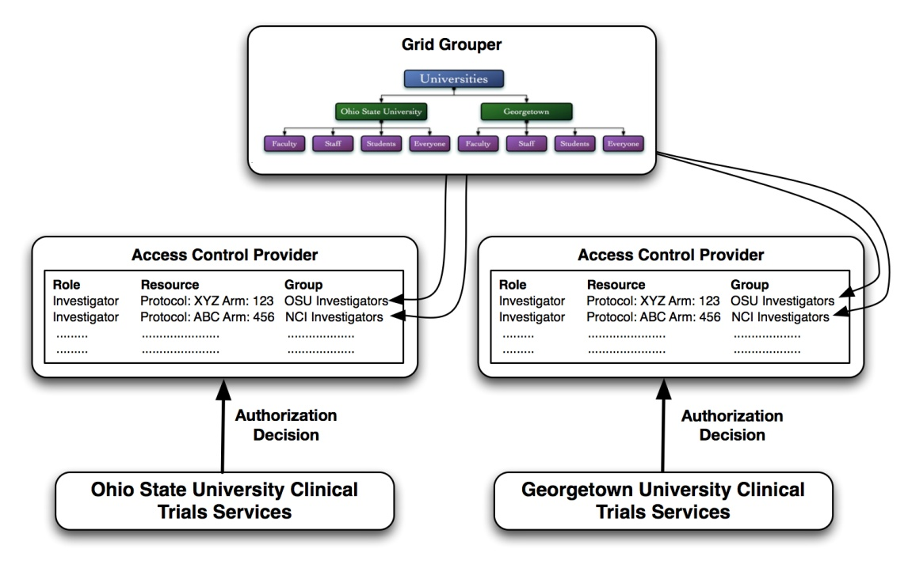
Access Control
GAARDS gives service providers complete control of enforcing access control policy.
Service providers may integrate any authorization/access control system(s).
caGrid provides tools/services for enforcing access control.
Grid Grouper
Group management web service.
Hierarchal organization of groups
Common Security Module (CSM)
Enforces local access control on resources
Policy can be based on groups managed by Grid Grouper

Slide 7
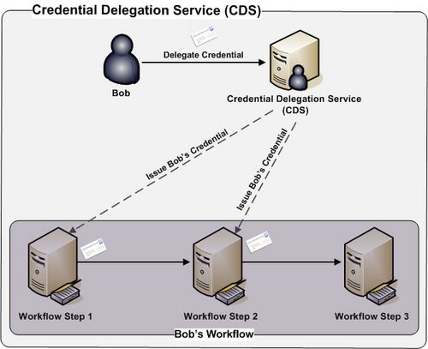
Credential Delegation Service (CDS)
Credential Delegation Service (CDS) - A Web/Grid service that enables users/services (delegator) to delegate their Grid credentials to other users/services (delegatee) such that the delegatee(s) may act on the delegator's behalf.

Slide 8
Web Single Sign On
GAARDS provides a web single sign on solution that enables single sign on across multiple web applications and integrates with backend Grid/Federation services.
Web
Application 1
Grid
Resource 1
WebSSO
Managed
domain
Grid
Resource 2
Web
Application 2
User/ Browser
Grid
Resource 3

Slide 9
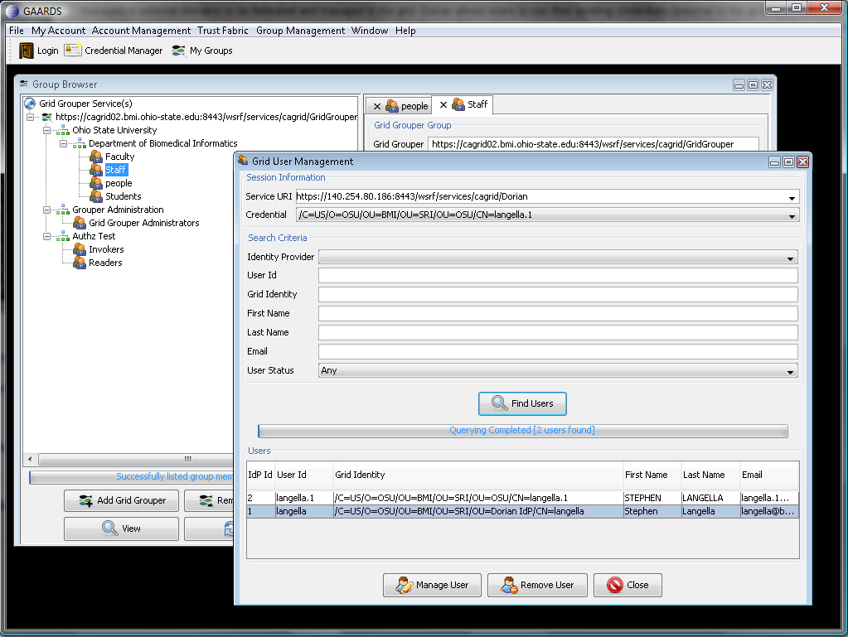
GAARDS Admin UI
GAARDS provides a comprehensive UI for using and administrating GAARDS

Slide 10
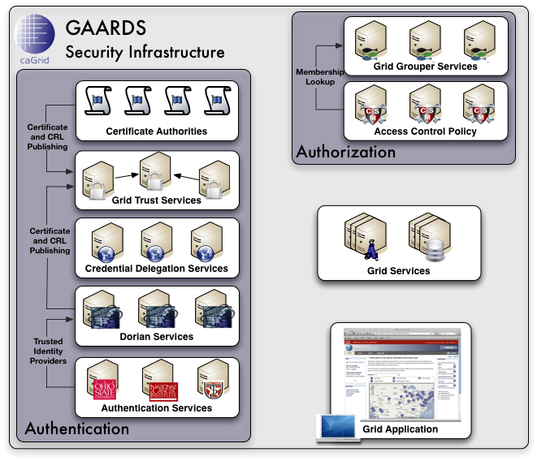
GAARDS In Action
To access secure Grid resources, a user needs to obtain a Grid credential

Slide 11
GAARDS In Action

Slide 12
GAARDS In Action
Authenticate with local institution and obtain proof of authentication (SAML Assertion)

Slide 13
GAARDS In Action
Obtain Grid Credential from Dorian using SAML Assertion

Slide 14
GAARDS In Action
Invoke Secure
Grid Service
Using Credential Provided by Dorian

Slide 15
GAARDS In Action
Validate that the
Credential provided by the user is issued by
a trusted provider

Slide 16
GAARDS In Action
Determine if user is authorized to access requested resources.

Slide 17
GAARDS Security Infrastructure

Slide 18
Deployment Scenario
Federal E-Authentication Initiative http://www.cio.gov/eauthentication/
Levels of assurance (Different Requirements)
Level 1 – e.g., no identity vetting (LOA1)
Level 2 – e.g., specific identity vetting requirements (LOA2)
Level 3 – e.g., cryptographic tokens required (LOA3)
Level 4 – e.g., cryptographic hard tokens required (LOA4)
Credential Assessment Framework Suite (CAF)
Federal Bridge Certification Authority (FBCA)
http://www.cio.gov/fbca/
The FBCA is an information system that facilitates an entity accepting certificates issued by another entity for a transaction.

Slide 19
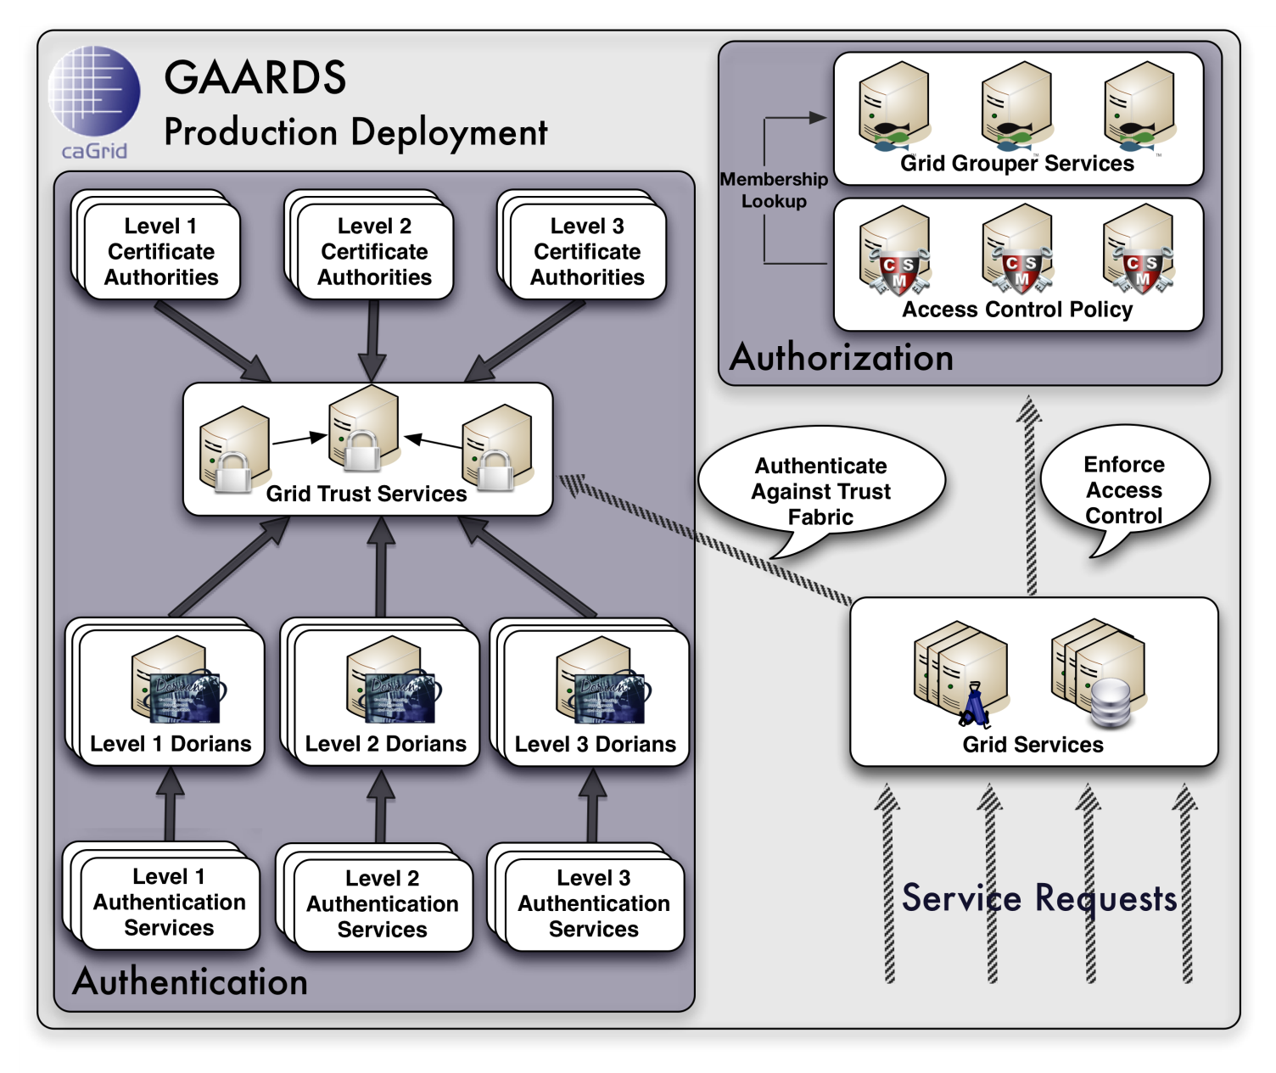
Deployment Scenario

Slide 20
Community Cloud
Makes caGrid/GAARDS services available under a Software as a Service (SaaS) model.
Remove the overhead of developing and deploying applications, allowing applications developers to focus on application development.
Provides developers a playground to test and develop services/applications without having to setup their own Grid.
Replication of production environment, providing all core services.
VM Environment for deploying and testing applications.
Training Cloud Statistics
450+ Users (Mostly Developers)
500+ Hosts

Slide 21
Ongoing and Future Work
GAARDS 1.4
Additional functionality to support caBIG, CVRG, CTSA, and BIRN communities.
Public/Authenticated directory searching of participants, currently this is restricted to administrators.
Account modification features added for individual users, currently this is restricted to administrators.
Group Subscription Support
Support for auto discoverable and configurable target grids.
Bug Fixes

Slide 22
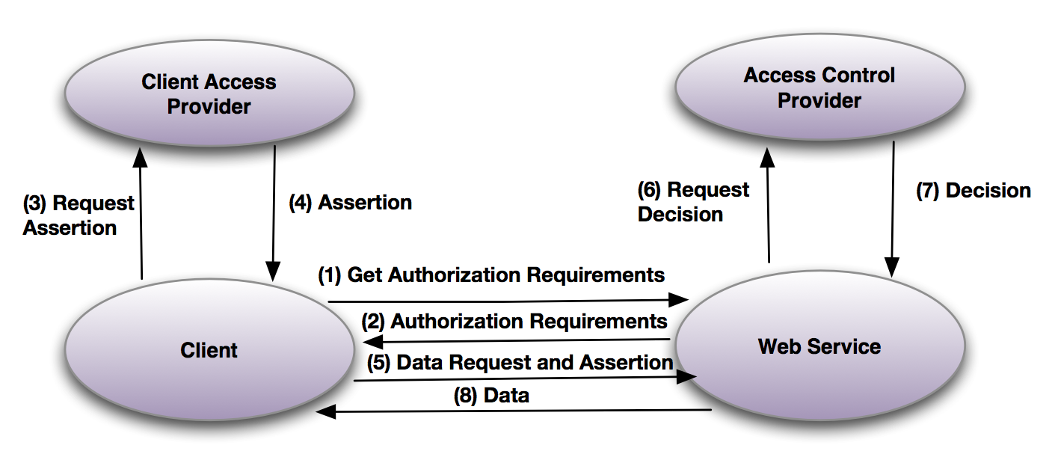
Ongoing and Future Work
GAARDS 2.0
Non backwards compatible release.
Migration of all services to Apache CXF / Globus Crux.
Support for WS-Security SAML Token Profile (SAML 2.0)
Investigation of supporting additional standards (WS Trust for Dorian) to enable existing services to be leveraged by the broader web services community.
Design and implementation of a generic authorization model.
Replace existing WebSSO framework (CAS) with SAML 2.0 framework, with support for integration with grid / web services integration.
Implement community requested features that could not be implemented previously because of backward compatibility.
Bug Fixes

Slide 23
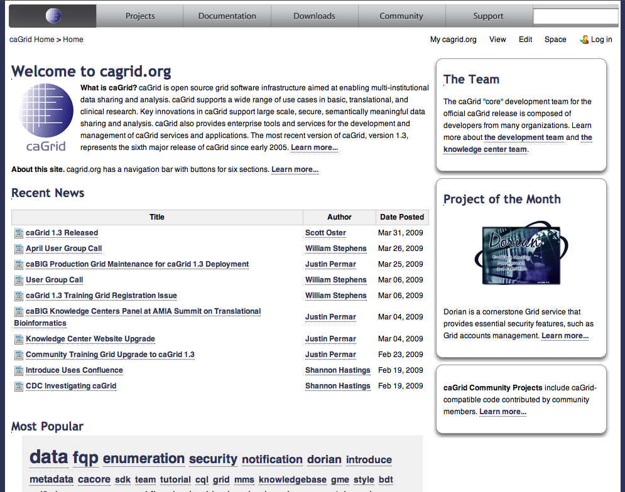
Questions
www.cagrid.org

