Slide 1
A Scala/Lift Powered CaGrid Client
Mark Grand
caGrid Knowledge Center
mgrand@emory.edu

Slide 2
Overview
I created a simple CaGrid client as an example of coding CaGrid web apps in Scala using the Lift framework.
This presentation shows highlights of my experience.
Notes:
Mention that there is much to cover

Slide 3
Why Scala?
Interoperability – Scala runs on JVM and .NET CLR. Scala can call any Java Code. Java code can call Scala code.
Multi-paradigm – Allows combining multiple programming paradigms.
Stronger type safety – A stronger and more abstract type system than Java. Can be combined with pattern matching to reduce low-level bugs.
Notes:
Supported paradigms include object oriented programming, functional programming, pattern matching, actors and continuations.
A combination of named objects and first class methods means that there is no need for dependency injection tools such as Spring.

Slide 4
Why Scala?
Scalable thread-safe programs – the combination of functional programming with immutable collections allows highly scalable thread-safe programs without the need for locks.
Statically typed -- type inference allows code to be written with few declarations.
Traits, which are like java interfaces with executable code, allow behaviors to be mixed and matched for classes or individual objects.
Notes:
You get the robustness of static typing without most of the verbosity.
Traits are similar to lisp’s mix-ins

Slide 5
Calling the caGrid API
Calling the caGrid API from Scala is similar to calling it from Java
private def
serializeResultToHTMLTableRows(cqlResult:CQLQueryResults):NodeSeq = {
val stringWriter = new StringWriter()
ObjectSerializer.serialize(stringWriter, cqlResult,
CqlSchemaConstants.CQL_RESULT_COLLECTION_QNAME)
val xmlResult = XML.loadString(stringWriter.toString())
val topElementName = xmlResult.label
val topAttributesString = xmlResult.attributes.toString()
val firstTableRow = <tr><td>&lt;{topElementName} {topAttributesString}&gt;</td></tr>
val middleTableRows =
xmlResult.child.map((node:Node)=> <tr><td>{node.toString}</td></tr>)
val lastTableRow = <tr><td>&lt;/{topElementName}&gt;</td></tr>
firstTableRow +: middleTableRows :+ lastTableRow
}
Notes:
This is a definition of a private method named serializeResultToHTMLTableRows. It takes one argument that is a CQLQueryResults object which encapsulates the results of a CQL query. It returns a sequence of XML nodes that will be HTML used to represent the contents of the CQLQueryResults object.
The first two lines use the caGrid API to serialize the CQLQueryResults object to a string containing its XML representation. The rest of the method uses the Scala library and XML literals to create the HTML. A single statement processes uses a functional programming paradigm to process all of the individual results into HTML table rows.

Slide 6
Type Inference
Type inference makes type most type declarations unnecessary
private def
serializeResultToHTMLTableRows(cqlResult:CQLQueryResults):NodeSeq = {
val stringWriter = new StringWriter()
ObjectSerializer.serialize(stringWriter, cqlResult,
CqlSchemaConstants.CQL_RESULT_COLLECTION_QNAME)
val xmlResult = XML.loadString(stringWriter.toString())
val topElementName = xmlResult.label
val topAttributesString = xmlResult.attributes.toString()
val firstTableRow = <tr><td>&lt;{topElementName} {topAttributesString}&gt;</td></tr>
val middleTableRows =
xmlResult.child.map((node:Node)=> <tr><td>{node.toString}</td></tr>)
val lastTableRow = <tr><td>&lt;/{topElementName}&gt;</td></tr>
firstTableRow +: middleTableRows :+ lastTableRow
}

Slide 7
XML is a Native Data Type
XML is a native data type supported by XML literals and a library API
private def
serializeResultToHTMLTableRows(cqlResult:CQLQueryResults):NodeSeq = {
val stringWriter = new StringWriter()
ObjectSerializer.serialize(stringWriter, cqlResult,
CqlSchemaConstants.CQL_RESULT_COLLECTION_QNAME)
val xmlResult = XML.loadString(stringWriter.toString())
val topElementName = xmlResult.label
val topAttributesString = xmlResult.attributes.toString()
val firstTableRow = <tr><td>&lt;{topElementName} {topAttributesString}&gt;</td></tr>
val middleTableRows =
xmlResult.child.map((node:Node)=> <tr><td>{node.toString}</td></tr>)
val lastTableRow = <tr><td>&lt;/{topElementName}&gt;</td></tr>
firstTableRow +: middleTableRows :+ lastTableRow
}

Slide 8
Why Lift?
The first well-know web application framework for Scala.
Secure – avoids common vulnerabilities including many of the OWASP (Open Web Application Security Project) Top 10
Developer centric – Lift apps are fast to build, concise and easy to maintain.
Screens are designed using HTML-based templates.

Slide 9
Why Lift?
Scalable – Lift apps are high performance and scale in the real world to handle high traffic levels
Interactive like a desktop app – Lift's Comet support is unparalleled and Lift's AJAX support is simple to use and very secure.
Shipped with SBT (Scala Build Tool) – can obtain dependent jar files from Ivy repositories, like those used for caGrid and caBIG.

Slide 10
Static HTML Elements Can be Replaced with Dynamic Elements
Static placeholder elements are replaced with dynamically generated.
<form class="lift:Helloworld.login?form=POST">
<table >
<tbody>
<tr>
<td style="background-color: white;">Authenticate Using</td>
<td style="background-color: white;">
<select name="authentication" value="all">
<option value="a">Service A</option>
<option value="b">Service B</option>
</select>
</td>
</tr>
<tr>
<td style="background-color: white;">User Name</td>
<td style="background-color: white;"><input name="user" maxlength="60" /></td>
</tr>
<!-– Due to limited space, table rows for password and lifetime are omitted -->
<tr>
<td style="background-color: white;" colspan="2" align="center"> <input type="submit" value="Login"></input> </td>
</tr>
</tbody>
</table>
</form>

Slide 11
Pattern Matching to Replace Static HTML
A pattern matching paradigm is used to replace static HTML with Dynamically generated HTML using css selector syntax.
"@user" #> SHtml.text(userName.is, userName(_)) & "@password" #> SHtml.password( pswd, pswd = _ ) & "@lifehours" #> SHtml.text(lifetimeHours.is, lifetimeHours(_)) & "@lifeminutes" #> SHtml.text(lifetimeMinutes.is, lifetimeMinutes(_)) & "type=submit" #> SHtml.submit("Login", processLogin) }

Slide 12
External Dependencies
SBT supports multiples ways to specify external dependencies, including embedding them in the project class in a form similar to Ivy. override def libraryDependencies = Set( "net.liftweb" %% "lift-webkit" % liftVersion % "compile", "net.liftweb" %% "lift-mapper" % liftVersion % "compile", "org.mortbay.jetty" % "jetty" % "6.1.22" % "test", "junit" % "junit" % "4.5" % "test", "ch.qos.logback" % "logback-classic" % "0.9.26", "org.scala-tools.testing" %% "specs" % "1.6.6" % "test", "com.h2database" % "h2" % "1.2.138", "apache" % "log4j" % "1.2.14", "joda-time" % "joda-time" % "1.6.2", // caGrid dependencies "apache" % "commons-logging" % "1.1", "apache" % "commons-discovery" % "0.4", "caGrid" % "authentication-service" % CaGridInstallation.Version % "*->client", "caGrid" % "dorian" % CaGridInstallation.Version % "*->client", "caGrid" % "opensaml" % CaGridInstallation.Version % "*->default", "caGrid" % "syncgts" % CaGridInstallation.Version % "*->client" ) ++ super.libraryDependencies

Slide 13
A quick walkthrough of demo client web pages

Slide 14
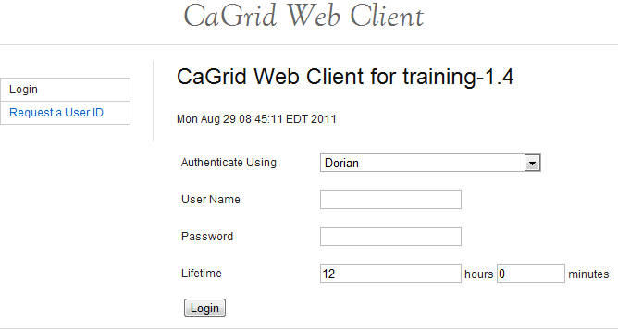
Client Login Page
Lift allows web pages to be embedded in a common template. The title on top and menu on the left are from Lift’s default template
Fields can be generated by replacing static HTML elements with dynamically generated elements.

Slide 15
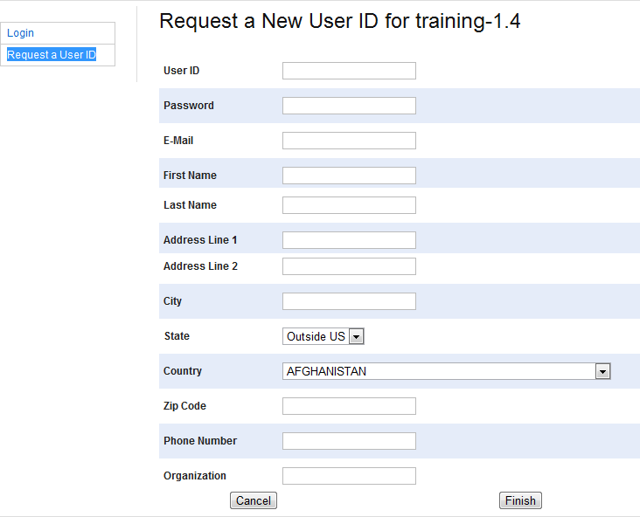
Client Request User ID Page
Lift can generate fields without relying on HTML elements in a template by introspecting on the object whose fields are to be populated.

Slide 16
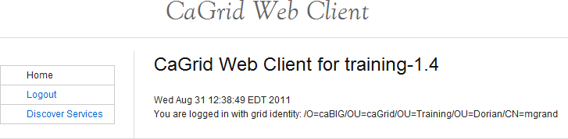
Client Home Page

Slide 17
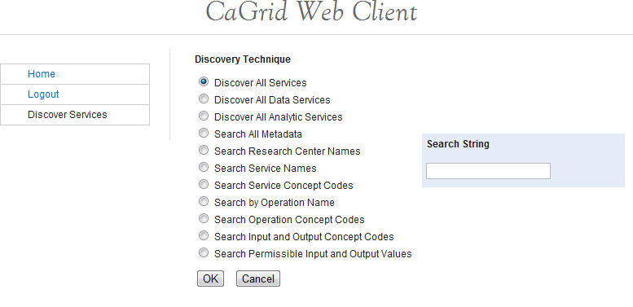
Discovery Page
Notes:
Clicking on the OK button brings us to the service selection page.

Slide 18
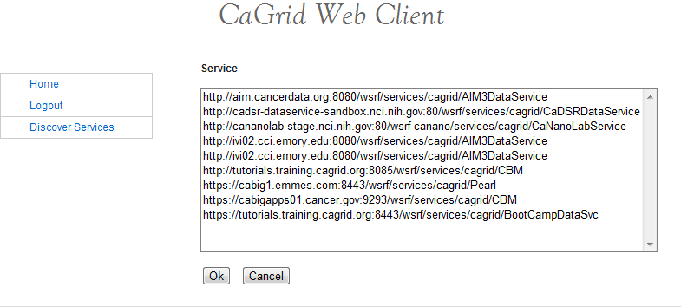
Service Selection Page
Notes:
Selecting a service and clicking OK brings us to the Service page.

Slide 19
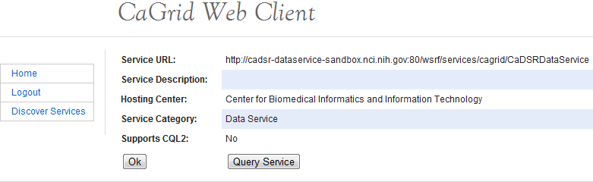
Service Page
Notes:
Look at service information.
Click OK to return to Home page.
Click Query Service to query the service.

Slide 20
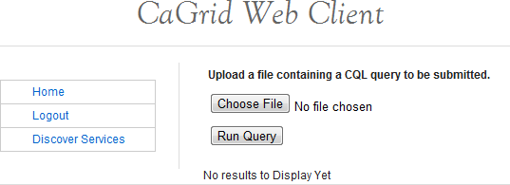
Query Page (Before Running Query)
Notes:
Click on Choose File to select and upload a CQL query file.
Click on RUN Query to run the query.

Slide 21
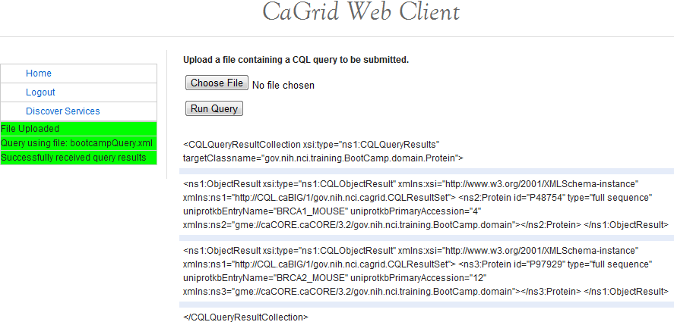
Query Page (After Running Query)
Notes:
The query results are displayed like this.
Status messages are displayed below the menu are and color coded.

Slide 22
More Information
A detailed tutorial and source code for the grid client is at https://cagrid.org/display/knowledgebase14/caGrid+on+LIFT

Slide 23
Configuration Using Named Objects
The Lift framework initializes an application by finding and instantiating a class named Boot.
class Boot extends Bootable with Logger { def boot { info("Booting up the web client service.")
Much configuration is done by calling methods of the LiftRules object. // where to search for snippets LiftRules.addToPackages("edu.emory.cci.caGrid.liftClient") // Use HTML5 for rendering LiftRules.htmlProperties.default.set( (r:Req) => new Html5Properties(r.userAgent))
This combination of named objects and first class methods avoid the need for dependency injection tools such as Spring.

Slide 24
Functional Programming Avoids Explicitly Coding Loops
Scala collection have methods and can pass each collection member to another method.
private def
serializeResultToHTMLTableRows(cqlResult:CQLQueryResults):NodeSeq = {
val stringWriter = new StringWriter()
ObjectSerializer.serialize(stringWriter, cqlResult,
CqlSchemaConstants.CQL_RESULT_COLLECTION_QNAME)
val xmlResult = XML.loadString(stringWriter.toString())
val topElementName = xmlResult.label
val topAttributesString = xmlResult.attributes.toString()
val firstTableRow = <tr><td>&lt;{topElementName} {topAttributesString}&gt;</td></tr>
val middleTableRows =
xmlResult.child.map((node:Node)=> <tr><td>{node.toString}</td></tr>)
val lastTableRow = <tr><td>&lt;/{topElementName}&gt;</td></tr>
firstTableRow +: middleTableRows :+ lastTableRow
}

Slide 25
Artifact Repositories
Because SBT is code centric, it can use the same object to find the caGrid installation directory for building the client as the client uses at run-time.
// The caGrid repository val cagridDirectory = CaGridInstallation.homeDirectory val irPath = new File(cagridDirectory, "integration-repository").getAbsolutePath() val localRepo = (Resolver.file("caGrid-local", new File(cagridDirectory, "integration-repository")) .ivys(irPath+"/[organisation]/[module]/ivy-[revision].xml") .artifacts(irPath+"/[organisation]/[module]/[revision]/[artifact]-[revision].[ext]") .artifacts(irPath+"/[organisation]/[module]/[revision]/[artifact].[ext]")) val rPath = new File(cagridDirectory, "repository").getAbsolutePath() val externalRepo = (Resolver.file("caGrid-external", new File(cagridDirectory, "repository")) .ivys(rPath + "/[organisation]/[module]/ivy-[revision].xml") .artifacts(rPath + "/[organisation]/[module]/[revision]/[artifact]-[revision].[ext]") .artifacts(rPath + "/[organisation]/[module]/[revision]/[artifact].[ext]"))
Notes:
Ivy needs to be told where to find artifacts implied by dependencies. This is done by defining repositories. The caGrid installation provides two local repositories.

Slide 26
The Type System and Pattern Matching Combine to Avoid Low-Level Bugs
Lift provides a container called box that can encapsulate a result.
def login(username:String, password:String, … ):Box[GlobusCredential] = { myCredential = try { … Box( dorian.requestUserCertificate(saml, lifetime)) } catch { case e:Exception => val msg = "Login failed“ error(msg, e) Failure(msg, Full(e), Empty) }
Using pattern matching to get the result allows the compiler to verify that cases are covered. val credentials = CaGrid.credentials.login(userName.is, pswd, lifetimePeriod) credentials match {
case Full(_) =>
S.notice( "Login succeeded for user: " + userName.is )
S.redirectTo("/home“) case Failure(msg, excp, _) => S.error(msg) }

Slide 27
The boot Method Creates the SiteMap
Lift uses SiteMap objects to control navigation and access to pages.
// Build SiteMap
def sitemap = SiteMap(
Menu("Login") / "index" >> youAreAlreadyLoggedIn,
Menu("Home") / "home" >> requireUserToBeLoggedIn,
Menu("Logout") / "logout" >> requireUserToBeLoggedIn,
Menu("Request a User ID") / "request_uid" >> youAreAlreadyLoggedIn,
Menu("Discover Services") / "discover" >> requireUserToBeLoggedIn,
Menu("Select Service") / "service_selection" >> Hidden >> requireUserToBeLoggedIn,
Menu("View Service Metadata") / "service" >> Hidden >> requireUserToBeLoggedIn,
Menu("Query Data Service") / "query" >> Hidden >> requireUserToBeLoggedIn
)

