Slide 1

Secure Grid Service Development
David Ervin
david.ervin@osumc.edu
Ohio State University
PHIN 2009
Atlanta
September 2009

Slide 2
Introduce
A framework which enables fast and easy creation of Globus and Standards based grid services.
Provide easy to use graphical service authoring tool.
Hide all “grid-ness” from the developer.
Utilize best practice layered grid service architecture.
Handle all core service architecture requirements for strongly typed and highly interoperable grid services.
Toolkit for creating and manipulating strongly typed grid services
Command line and GUI tools for service skeleton generation and automatic service/client code generation
Utilizes other core grid services and architecture components
caDSR and GME for schemas of registered data types
Security service architecture (Dorian, GridGrouper, CSM)
Advertisement and Registration configuration and
Index Service for discovery
Notes:
Globus grid service development is hard. Numerous classes, wsdl, and wsdd files must be written in a very specific and tedious way. Introduce hides that complexity from the grid service developer, and gives a single, concise Java class skeleton to implement. This allows domain experts to implement what they already know without requiring them to learn how to write a grid service first.
In caGrid all grid services are strongly typed: use published data standards and service metadata. Introduce leverages other core grid services to achieve this. The cancer Data Standards Repository (caDSR) and Global Model Exchange (GME) register and publish data types. The security infrastructure of Dorian, GridGrouper, and CSM can be used to secure your service. Introduce generated services advertise themselves in the index service to facilitate discovery.

Slide 3
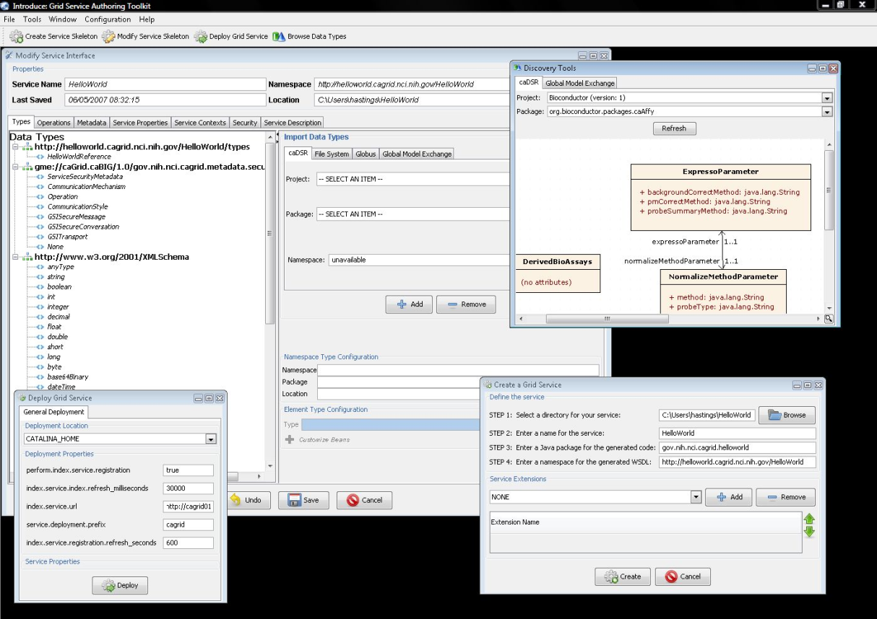
Introduce Graphical Development Environment (GDE)
GUI for creating and manipulating a grid service
Provides means of simple creation of service skeleton that a developer can then implement, build, and deploy
Automatic code generation of complete WSRF compliant grid service which is configured to provide:
Security
Advertisement
Discovery
Complete UnBoxed Client API
Provides a set of tools which enable the developer to add/remove/modify/import methods of the service as well create sub-services/resources.
Automatic code generation of all the required code, Globus grid service code/configuration, service configuration, implementation of the client, and stubbed implementation of the service
Notes:
The Introduce GUI provides a simple way of creating a service skeleton. It drives the automatic code generation of a completely WSRF compliant grid service which provides for security, advertisement, discovery, and an un-boxed client (and server!) API. It gives the service developer tools to add, remove, modify, and import methods from existing WSDL, as well as create service contexts and resources.

Slide 4
Introduce Requirements
Utilize best practice layered grid service architecture
Enable development of strongly-typed services
discovery and use of published data types
self describing services through use of metadata
advertisement and registration configuration with Index Service
Generate meaningful object-oriented client APIs
Customizable and extensible via the use of plug-ins
Allow for implementation of secure services
provide customizable service-, method-, and resource- level security
Notes:
When the caGrid team set out to develop introduce, we hit upon several fundamental requirements that the tool had to fulfil.

Slide 5
Addressing the Requirements
Grid Services
Introduce uses the Globus Toolkit and Axis for creating, registering, discovering, and invoking these service operations as grid services
Client uses the operation through a grid service interface and does not need to be aware of any implementation specific details of the grid service
Notes:
Introduce generated services are built up in layers of many components, which themselves are based on specifications. Fundamentally, an Introduce generated service is based on Globus’ implementation of the web services resources framework (WSRF). From there, service metadata which both semantically describes the operations and identifies the operator of the service is added. On top of the service itself, the security layer is added to control access to the service’s operations and contexts, as well as provide for transport security when information moves in and out of the service and over the wire.
Since the service is based on published specifications (GSI, WS-Security, WS-Addressing, etc), the client doesn’t need to know any implementation details about the service itself, and can simply “speak the protocol.”

Slide 6
Service Layers
Notes:
Another, combined way to visualize a caGrid service.
The business logic block in the center is the only portion of the grid service a service developer needs to know how to implement – the rest comes “for free” from Introduce and the grid infrastructure.

Slide 7
Addressing the Requirements (cont)
Strongly typed interfaces:
Introduce enables schema extraction from a GME or any other data model registry service so that the wsdl, beans, and service metadata can be automatically populated and the service will be using strongly typed with publicly accessible data types.
Data model schema, and any referenced schemas, are extracted and placed in the schema directory of the services build skeleton and imported into the services WSDL.
types can be used at service build time to automatically generate the objects and create strongly-typed grid service interfaces
Example from caGrid
Notes:
XML schema provides the definition for data types services use on the grid, and the schemas themselves can be registered in the GME (or any other data registry service). This facilitates strongly typed services using data types which are publicly accessible. Such schemas are copied into the service’s schema directory and referenced from the generated WSDL. Using this information, a strongly typed client and server side API is generated.
(Axis Wsdl2Java for example.)

Slide 8
Addressing the Requirements (cont)
Providing Service Metadata:
Leverage Globus’ use of Java Naming and Directory Interface (JNDI).
Service metadata is provided as resource properties on the base service’s singleton resource.
These resource properties are defined by xml schema.
The resource properties on the base service can be registered to the index service as service metadata.
This metadata can then be queried from the index service and used to locate particular services of interest.

Slide 9
Addressing the Requirements (cont)
Index Service Registration
Leverage Globus MDS in order to configure properties on the base resource of the service to be published to an MDS based Index Service.
Provide configuration options for registration of static and dynamic service metadata which can then be used at runtime for service discovery.
Example from caGrid

Slide 10
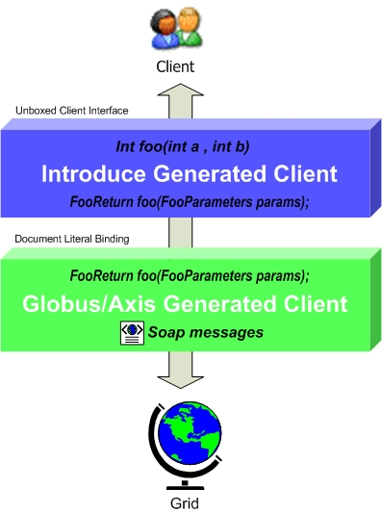
Addressing the Requirements (cont)
Providing Client Side Object Oriented API
Globus/Axis build process will automatically generate a client side object oriented API which is document literal.
Introduce generates a wrapper for this API which matches the service designers rpc style interface to make a clean mapping from client to service.
This wrapper will handle auto boxing/unboxing of the parameters into and out of document literal form.
Notes:
The generated client API matches the appearance of the operations defined in the Introduce interface. If, for example, the service developer specifies a method takes a String and an Integer, and returns a Date, the client API appears the same way, rather than using the document literal binding which Axis and Globus generate.

Slide 11
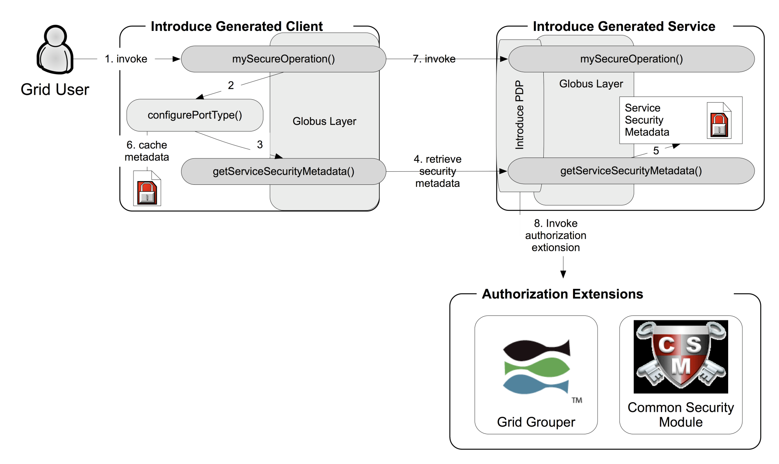
Addressing the Requirements (cont)
Security:
Enable configuration for each service and for each method in a service so the client can utilize this metadata to configure itself for connecting to the service.
Support complete GSI security configuration for authentication and support for an authorization plug-in framework.
Require service security metadata to be available anonymously via the grid service interface (getServiceSecurityMetadata()) or the grid service’s resource properties.
Introduce generated clients will automatically retrieve this metadata and use it to configure the client before making a call to the service.
Notes:
Security can be defined for the whole service, individual methods, or both. The service metadata describes to the client what type of authentication and authorization is required. Introduce generated services support complete GSI security configuration for authentication, and support a plug-in authorization system. Since the service security metadata must always be available, a special method (getServiceSecurityMetadata()) is added to the service interface and is accessible anonymously (transport security is still in effect). Introduce – generated clients hide the complexity of retrieving this metadata and configuring themselves on the first call to the grid service.
Grid user invokes the mySecureOperation() method on the Introduce client
The Introduce – generated client perpares to configure it’s port type instance
The client calls the getServiceSecurityMetadata method
Security metadata is retrieved from the service
The service responds to the request for security metadata by returning the document
The client caches this metadata for future use and will not perform the lookup again. The port type is configured
The secure operation is invoked
The service calls its authorization extension and determines if the grid user is allowed to use the method

Slide 12
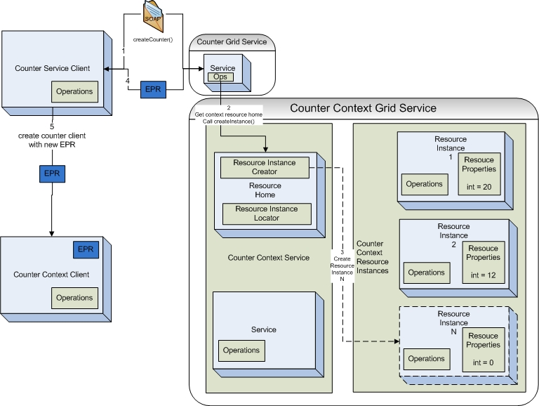
Introduce Service Resource Contexts
Enhanced Resource Pattern Support
Introduce supports automated code generation for resource creation so that factory patterns can be easily used in the service.
If an operation of a service returns a type EPR of another service Introduce will automatically generate the factory code that is required in the operation implementation.
Notes:
Introduce supports creating services which automatically create resource backed service contexts for easy use in the service using a factory pattern. This code is created when the service developer specifies an operation which returns a typed Endpoint Reference (EPR) of another service context.

Slide 13
Addressing the Requirements: Extensible Architecture
Introduce provides an extension framework where it’s core functionality can be extended to provide customized solutions by leveraging the Introduce toolkit.
There are many types of extensions in Introduce that can be added to the toolkit.
Service
Types Discovery
Authorization
GDE
Deployment
Extensions provide an “extension.xml” extension description and configuration. The “extensions” directory of introduce hold the extensions in separate folders enabling them to easily be added and removed from the Introduce toolkit.
Notes:
The extension framework of introduce provides several points at which developers can add custom functionality.
Service extensions are intended to create special types of services by automatically adding operations, jars, schemas, etc. Data services for example.
Types discovery extensions provide new ways to locate and utilize data types
Authorization extensions give services a pluggable way to manage authorization
GDE extensions simply change the way the Introduce UI appears, and Deployment extensions modify the service deployment process.
Extensions are installed by copying an XML document and any dependencies they may have into a folder within the Introduce directory structure. This keeps them modular and isolated for easy installation and removal.

Slide 14
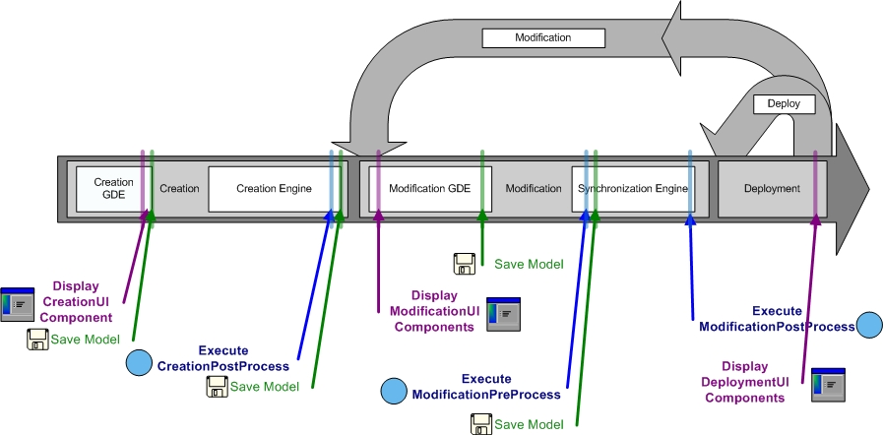
Addressing the Requirements: Extensible Architecture (cont)
Flow of execution for service extension components.
Notes:
This diagram shows the service creation and modification process with the points at which a service extension may inject its functionality labeled as blue circles.
The extension may perform some operations immediately following service creation, at modification time before Introduce makes changes to the service, and at modification time after Introduce has made changes.

Slide 15
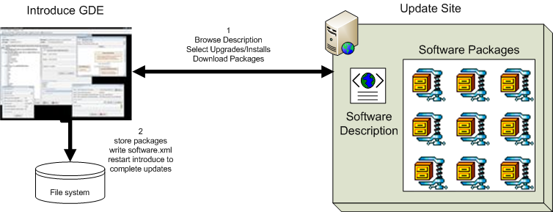
Introduce Software Updater
Update support enables introduce to role updates out and move to newer versions of itself and it’s extensions.
Notes:
In addition to pluggable extensions, Introduce features an update system which allows it to be upgraded and new extensions installed without a complete rebuild or reinstall of the toolkit. An update site maintains a list of available software packages, and a user of Introduce can use its built in upgrade system to locate and install them.

Slide 16
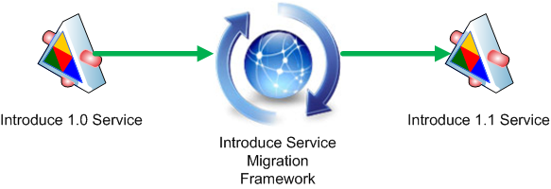
Introduce Service Migration
Introduce Service Migration Framework enables introduce and it’s extensions to provide upgraders which can run against services built with older versions of introduce and/or it’s extensions and migrate the services forward.
1.0 services and forward will now be able to be migrated to work with newer versions of introduce with very little effort on the developers part.
Notes:
Introduce also provides mechanisms to upgrade existing services from an older version of the grid framework to a new one. The process is very simple for a user; simply open the existing service with the newer version of Introduce, and a prompt appears asking if the service should be migrated forward. Service extensions may also define upgraders which can run at this time and move the functionality they provide to the new version as well.

Slide 17
Recap Core Service Architecture
Base service is a GT4 based WSRF capable grid service.
Utilize compositional inheritance, “operation importing” (in lieu of non-standard port type extensions) to enable the service to inherit required features such as providing service security metadata and access to resource properties.
Utilize JNDI for registration configuration, server side configuration properties, and resources and resource properties.
Provide client and service side wrappers which implement the service designers interface as opposed to the document literal interface generated by Axis.
Provide metadata registration to the index service by configuring the Resource to register it’s service groups to a predefined MDS based Index Service.
ServiceSecurityMetadata and it’s access operation enables programmatic bootstrapping of connection security configuration.

Slide 18
Grid Enablement process
An algorithm which is not connected to the grid.
Grid
API
Notes:
The next few slides will cover the process of moving an existing API or algorithm to the grid using the Introduce toolkit.

Slide 19

Exposing the Resource:
We will use the Introduce to describe the service and generate a grid service.
Grid
API
Notes:
Service namespace, package name, location on file system.

Slide 20

Exposing the Resource:
Will locate the schemas which describe the data models and will provide the wire protocol for transferring data instances.
GME
Grid
File System
API

Slide 21
Exposing the Resource:
Then we will describe the services layout, operations, security constraints, default properties, extensions, and service metadata .
Grid
API

Slide 22
Exposing the Resource:
Introduce will then generate the service which will be stubbed with the operations as described.
Grid
caGrid
Service
API
Notes:
Introduce has all the information it needs to copy the right XSDs in, generate WSDL documents, write code to connect with Globus, and deliver a simple skeleton class for the service developer to connect the existing API to the Grid.

Slide 23
Algorithm now available.
Now that the service is generated we can put in our business logic to implement the service to utilize the algorithms we are wrapping.
Grid
GridService
caBIO
Grid Service
caGrid
Service
Service implementation
API
Notes:
Service developer implements

Slide 24
How will users find this new service
The services metadata can be registered to a caGrid Index Service so that a user/service can locate and use the service
Grid
GridService
caBIO
Grid Service
caGrid
Service
Service implementation
API

Slide 25
How will users find this new service
When the service starts up in the container it will automatically register its metadata to a caGrid Index Service.
Grid
GridService
caBIO
Grid Service
caGrid
Service
Service implementation
API
Index Service
Notes:
When deployed and started, the service registers itself to the index service for discovery in the grid.
Metadata is passed to the index service which describes the operations and includes semantic concept codes.

Slide 26
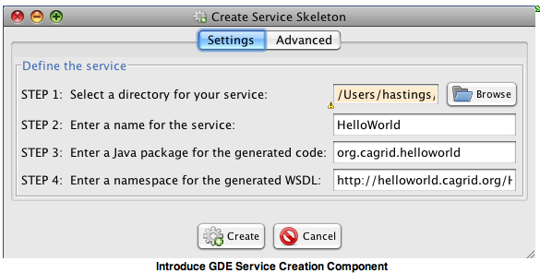
Service Creation
Creation Directory The creation directory is the location of which the grid service will be generated.
Service Name Service name is the name that will be used to generate the service. The service name must be a valid java identifier.
Package Name The package name is the base package to be used when generated the grid service source code.
Namespace The namespace is the namespace to be used when defining the WSDL of the service.

Slide 27
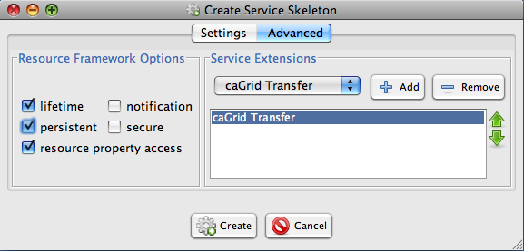
Advanced Service Creation
The advanced creation tab enables the developer to add specific extensions to the service such as Transfer or Enumeration capabilities as well as select the resource framework options like lifetime management and persistence capabilities.
Extensions and resource framework options can be changed after a service is created so it is not critical to get all the extension you might want added at this point but is helpful if you know what you are trying to build.

Slide 28
Introduce Service Creation Architecture
The Introduce Service Properties are a set of base properties
required for creating this service such as desired location to
create the service, namespace to use, package name to use,
and service name.
Notes:
The Introduce GUI drives the Introduce engine, which can also be invoked via the command line in conjunction with a few configuration files. It makes use of JET templates and custom code generation to create the Java and WSDL files required for the grid service.

Slide 29
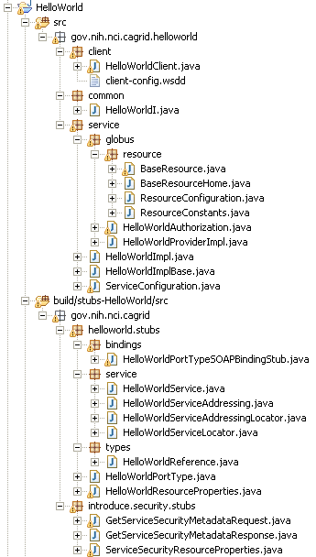
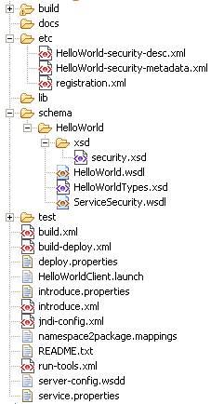
Created Skeleton Layout
= introduce managed
= globus/axis managed
= developer implements
Notes:
Introduce generates the vast majority of code and configuration required for the grid service.
Items highlighted in green are generated and managed by the Introduce toolkit. This includes the resource classes, client API, authorization providers, and base service implementation.
Items in grey are generated by Globus and Axis. These are typically beans generated from XSD or WSDL and service stubs.
The single class highlighted in red is the skeleton service implementation, which is to be completed and managed by the service developer.

Slide 30

Created Skeleton Layout (cont)
= service metadata registration configuration
= describes the services security configuration
= services WSDL file for axis
= introduce properties for this service
= ant build files
= client configuration file for axis
= deployment time service properties
= introduce representation of service
= JNDI service resources configuration
= namespace mappings for axis
= server configuration file for axis

Slide 31
Inside the Introduce created service
Services have many moving and configurable parts which support features such as:
Advertisement
Discovery
Invocation
Security (Authentication/Authorization)
Stateful Resources
The Introduce Toolkit can keep all these features in sync as the developer creates and modifies the grid service

Slide 32
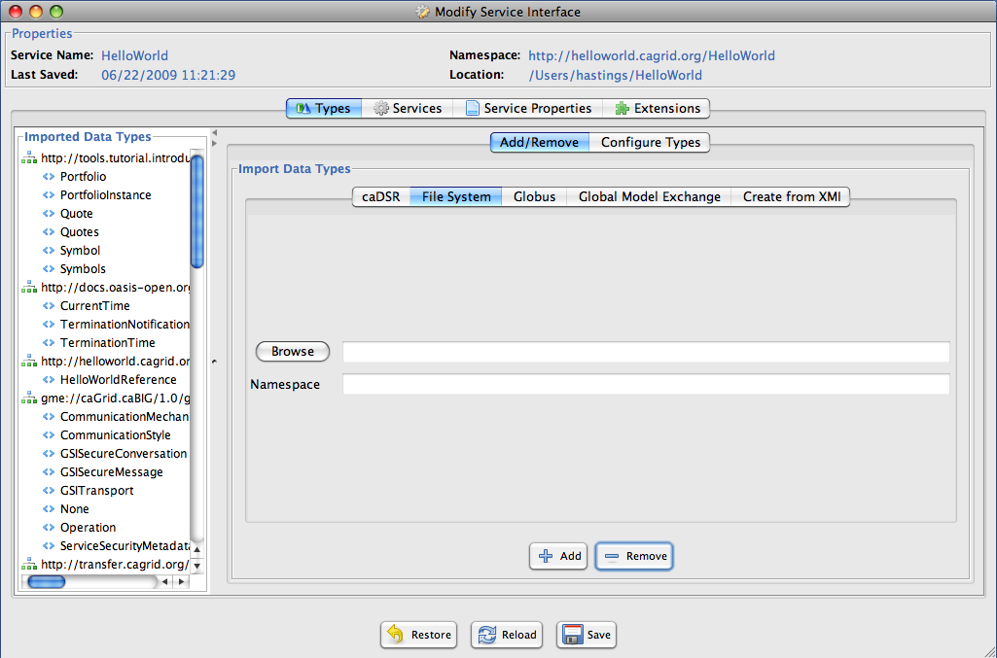
Modification
Add/Remove/Modify
Data Types
Operations
Resource properties
Service properties
Service contexts (services and resources)
Service, method, and resource level security configuration
Notes:
The service modification aspect of Introduce allows the developer to add / remove / or modify data types, operations, resource properties (metadata), service contexts, and security configuration.

Slide 33
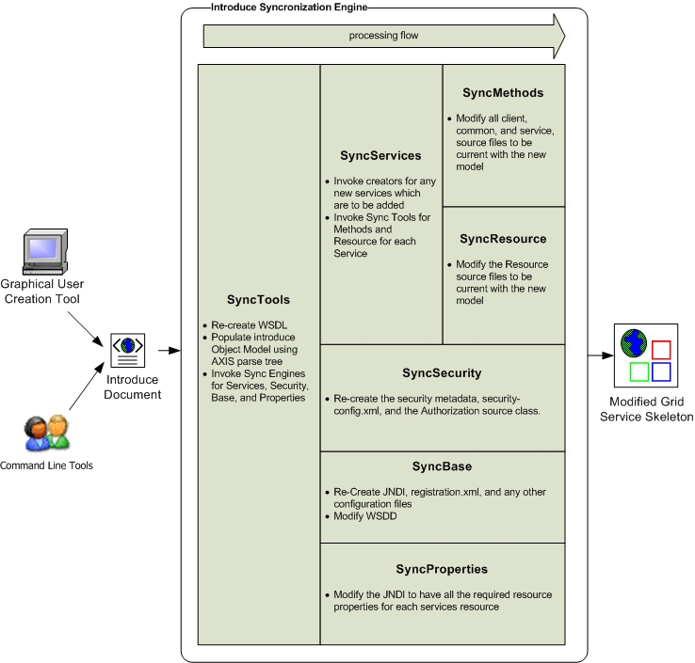
Introduce Service Modification Architecture
The Introduce Service Description document is the input to the introduce engine. The user can hand craft this document and call the engine via command line or API or can use the Introduce GDE to create and modify this document and execute the synchronization engine
Notes:
The Introduce service description document is the primary input to the Introduce engine. This can be hand-crafted, generated by the API, or created as part of the Introduce GUI tool.

Slide 34
Stateful Web Services
A resource is an independent entity stored by the container which stores state information.
A Web Service is a stateless open standards interface allowing to access web-based applications.
A WS-Resource is the pairing of a Web-Service with a resource, effectively making the pair accessible and stateful.
Notes:
The services generated by Introduce utilize the Web Services Resources Framework (WSRF) specification and implementation by Globus. This allows for the creation of stateful web services.

Slide 35
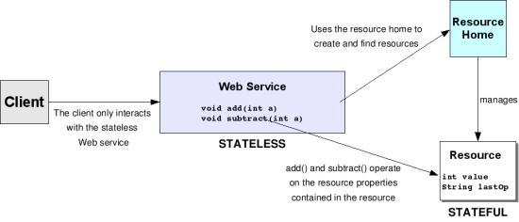
Stateful Web Services
Introduce generated stateful services utilize a resource home to manage the resource instances for a service. The resource home can be used to create new instances of the resource as well as to look up and use instances that are being referred to by the client.
Notes:
Resource home creates and manages new resource instances accessible by a unique key value, and that key becomes part of an Endpoint Reference (EPR) which the client uses to identify which resource they are interacting with in subsequent calls to the grid service.

Slide 36
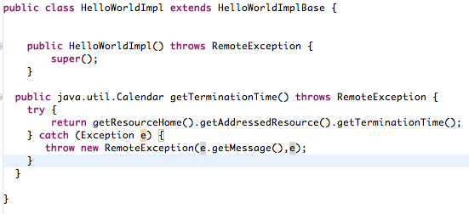
Stateful Web Services
The service can use the resource home to locate the state the client is trying to act on and use that resource when implementing the business logic.
Notes:
WS-Lifetime supports “termination time”

Slide 37
Service Authorization
The Globus authorization framework enables configuring Policy Decision Provider Chains (a list of classes that will be invoked for a true false value which are deciding whether or not to grant access to the caller) to be used to protect access to a service, method, or resource.
Access protection is always resource first, then method, then service.
For instance, if a resource instance is configured with a PDP Chain that chain will be invoked if the resource is being accessed even if there is a PDP chain for the operation . The lowest level of protection is resource, then operation, then service.
Introduce enables configuring PDP chains on the service and methods and has example of how to hook chains into resources as they are created.
Notes:
Policy Decision Provider (PDP) chains can be built up to form an authorization policy for the service’s resources.
The lowest level of access protection is done at the resource level, then is analyzed per method, and finally the general service security policy.
Introduce allows configuration of these chains on the service and methods of the service. The generated code contains a stubbed out example of how to hook such chains in.

Slide 38
Secure Resource
In order to add PDP to a resource it must be done dynamically as resources are created dynamically. Introduce provides some basic utilities to enable services to protect resources to only be accessible by the caller that created them. This enables community services to factory-create resources which are private to the caller.
thisResource.setSecurityDescriptor(gov.nih.nci.cagrid.introduce.servicetools.security.SecurityUtils.createCreatorOnlyResourceSecurityDescriptor());
Notes:
Service resources are created dynamically, so the PDP chain must be added dynamically. Introduce includes some common, basic utilities which can be use to protect resources. For example, a resource can be configured to be accessible only to the caller which created them. Resources created in this way are private to the client which initially created them.

Slide 39
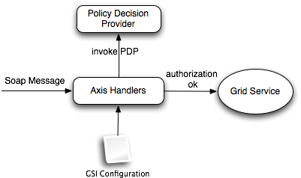
Service Authorization
The services security configuration file configures the Globus PDP chains for the service and operation levels.
This file “<serviceName>-security-desc.xml” is auto generated by Introduce and lives in the etc directory of the service.
Notes:
The security descriptor document configures the Globus PDP chains for the service and its operations. This is created by Introduce and is placed in the service’s etc directory.

Slide 40
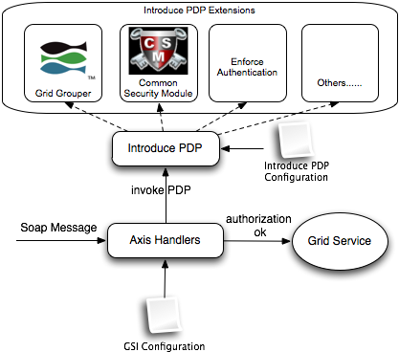
Service Authorization
Introduce provides a PDP that is extendable and comes with plugins that know how to authorize users based on many different external resources such as GridGrouper or CSM or through other policies such as enforcing that the user is not connecting anonymously i.e. has been authenticated by a trusted identity provider.
Notes:
Introduce provides a PDP system which is pluggable and extendable. caGrid includes several such extensions which can interact with external resources such as Grid Grouper and CSM.

Slide 41
More Information
http://cagrid.org
Tutorials
Documentation
Examples
Software Downloads
Support Forums
Much Much More

Slide 42
Additional Information
caGrid Website (http://www.cagrid.org)
Download Software
Documentation
Tutorials
Technical Paper and Presentations
caGrid Knowledge Center (http://knowledge.cagrid.org)
Technical Support and Guidance
caGrid Users Mailing List
https://list.nih.gov/archives/cagrid_users-l.html
cagrid_users-l@list.nih.gov

