Slide 1
caGrid 1.3: Technical Changes Overview
Scott Oster
Scott.Oster@osumc.edu
caGrid Lead Architect
April 16, 2009

Slide 2
Agenda
Release History
Service Changes
Development Campaigns / Technical Details
Web Resource Changes
Support Overview
Questions

Slide 3

caGrid Releases
caGrid 1.3 is a point release of the caGrid 1.x stream. Services and applications developed using caGrid {1.0, 1.1, 1.2}, will function against caGrid 1.3 versions of those services.
Version | Release Date
caGrid 1.3 | 31st March 2009
caGrid 1.2 | 31st March 2008
caGrid 1.1 | 17th September 2007
caGrid 1.0 | 15th December 2006
caGrid 1.0 Beta | 17th July 2006
caGrid 0.5.4 | 12th May 2006
caGrid 0.5.3 | 25th January 2006
caGrid 0.5.2 | 15th November 2005
caGrid 0.5.1 | 7th October 2005
caGrid 0.5 | 31st August 2005

Slide 4
caGrid 1.3 Core Services
All caGrid Core Services were redeployed on all caBIG® Grids
(OSU Training, QA, Stage, and Production) for this release.
The (12) caGrid 1.3 Core Services are:
* New for 1.3 ** Significantly Rewritten or Enhanced for 1.3
Metadata Services | Security Services | Business Activity Services
Global Model Exchange Service** | Authentication Service** | Federated Query Processor Service**
Index Service** | Credential Delegation Service | BPEL Workflow Service
Metadata Model Service* | Dorian Service** | Taverna Workflow Service*
 | Grid Grouper Service
 | Grid Trust Service (Master & Slave)

Slide 5
Deprecated Services
During the development of caGrid 1.3, the caGrid Team issued a request for comments on, and adopted, a Deprecation Policy. For details, see:http://cagrid.org/display/caGrid13/Deprecated+Services+and+APIs
After adoption of that policy, the caGrid 1.2 caDSR, caGrid 1.2 EVS, and caGrid 1.2 GME were retired:
caGrid 1.2 caDSR Service (based on caCORE 3.1)
Replaced by the caDSR 4.0 Data Service and the new caGrid 1.3 Metadata Model Service (MMS)
caGrid 1.2 EVS Service (based on caCORE 3.1)
Superseded by EVS 4.1 Grid Service
caGrid 1.2 GME Service
Replaced by new GME service
These retired services will continue to operate until Q2 2009, when the caCORE 3.1 API is decommissioned.
While still supported in caGrid 1.3, the BDT framework is deprecated

Slide 6
Development Campaigns
The scope for this release came from requests entered into Gforge and feedback received from all the domain workspaces. Those tasks fell into one of seven development campaigns:
caBIG® Gold Compatibility
caCORE SDK Integration
Data Services
Introduce Toolkit
Security
Continuous Innovation
Bug Fixes

Slide 7
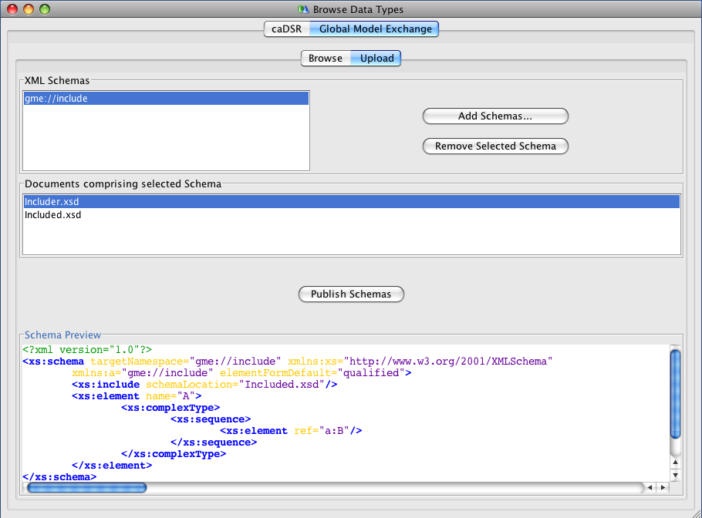
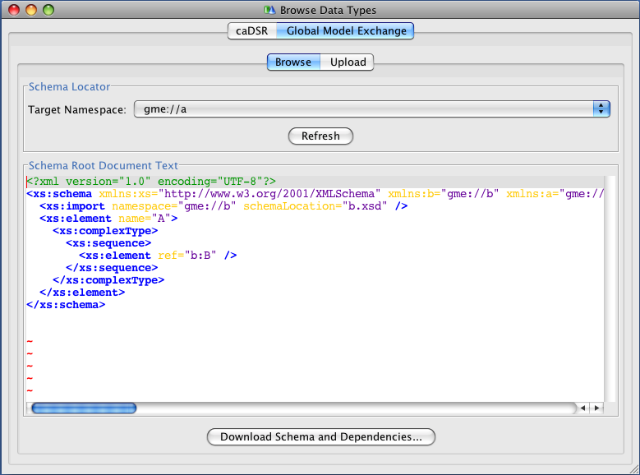
Gold Compatibility: Global Model Exchange (GME)
Completely re-implemented for caGrid 1.3 to address numerous feature requests and limitations
Now a fully managed Introduce service (previously was just a wrapper to the Mobius GME software)
Leverages…
Spring for configuration and data patterns
Hibernate for data persistence
Castor for custom domain model serialization
Xerces for 100% XML Schema support
Improved Introduce integration
Selected new features:
Now supports XML Schemas with includes, redefines, cyclic imports, arbitrary namespaces
Schema Deletion
MySQL 5 support

Slide 8
Gold Compatibility: Metadata Model Service (MMS)
As the caDSR Grid service was retired, its functionality was replaced with the caDSR Data Service and the new MMS
MMS provides the metadata-oriented functionality, such as generating Domain Models and semantically annotating Service Metadata
Simple migration path from caDSR grid service to MMS
Is a generic service which provides the ability to integrate any external metadata registry as a metadata source for annotations
Leverages Spring for deploy-time configuration
Default implementation uses the production caDSR as its source, but (multiple) other registries can be added to the same service
Not dependent on a particular model or software version of the caDSR
Makes full use of the new caDSR XML Schema namespace binding annotations
Fully integrated into Introduce for visualizing Domain Models and annotating metadata instances

Slide 9
Gold Compatibility: Index Service
Working with the Globus MDS team (ISI), the Index Service implementation was completely redesigned for better memory usage and performance
Leverages Apache Xindice XML Database for “out of memory” storage and query (previous version was all Heap-based).
Added multi-threading for metadata polling to greatly increase registration throughput
Slight change in behavior, but 100% backwards compatible to Discovery and Advertisement clients
Production Index Service now running smoothly with 130+ registrations
Local tests scaled up into the thousands
Modified default Introduce-generated advertisement settings to reduce the load on the Index Service while maintaining the same response time

Slide 10
Gold Compatibility: caDSR Model Registration
Registration of models, which Introduce puts in services it creates, in the caDSR (in process):
CQL
CQL Results
Service and Security Metadata
Will allow methods using those models to be properly semantically annotated in the Service Metadata

Slide 11
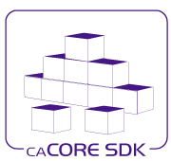
caCORE SDK Integration
Created Data Service Introduce extension for SDK 4.1.1
Upgraded Introduce XMI-based schema generation to leverage SDK 4.1.1
Shared libraries between SDK and caGrid:
Common CQL Processor for SDK and Data Services
Common Testing of caGrid and SDK

Slide 12
Data Services: Federated Query Processor (FQP)
Added configurable query execution parameters to allow control over behavior in the face of failure
Ability to return partial results, specify retries, or fail
Added new results metadata which gets updated during query execution containing:
Overall processing status (waiting, working, done, etc)
Details of each target service (range of data in results, faults, etc)
Support WS-Notification
Client can be notified of changes in execution status for example
Support for delegation via integration with Credential Delegation Service (CDS)
Client can use CDS to delegate to FQP, and request FQP to query data services using the delegated credential
Support for using caGrid Transfer to obtain query results
Performance enhancements, included multi-threaded queries

Slide 13

Introduce Toolkit: Security-related improvements
Created authorization extension framework for plugging in arbitrary authorization components
Migrated Grid Grouper and CSM Authorization to authorization extensions
Created an authorization extension to do “authentication only” (i.e. check that the user presented a credential)
Greater ability for client to control use of credentials
Clients now have a preferAnonymous operation which can be used to override service suggestions
Greater clarity of effect of options in GUI for security settings
Integrated GAARDS UI components to Introduce (e.g. ability to login, request credentials, etc)

Slide 14
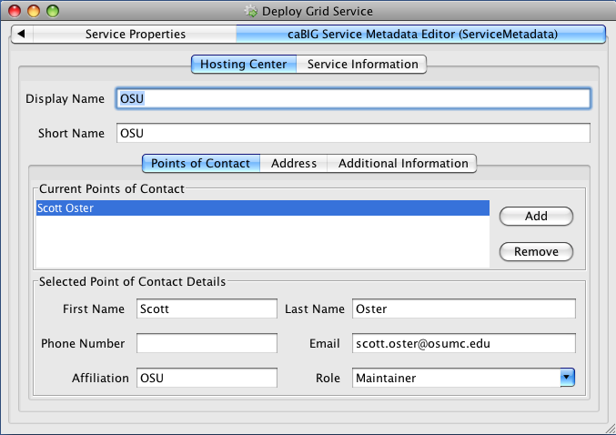
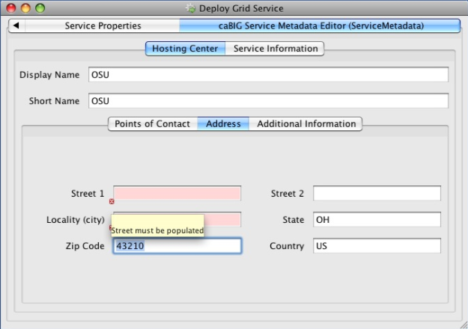
Introduce Toolkit: Other improvements
Added deploy-time validation extension framework
caGrid metadata validator ensures proper metadata is filled out or prevents deployment (e.g. point of contact, host information)
Developed Service Upgrade Support for previous versions
1.1 -> 1.3
1.2 -> 1.3
No Updater for 1.0 -> 1.3

Slide 15
Security: Authentication Enhancements
Addition of Authentication Profiles, adding support for authentication beyond just “username/password”
Support for one-time passwords profile included in this release
Authentication Service refactored to support; Dorian added implementation
Ability to securely discover Trusted Identity Providers
Dorian now maintains authentication service metadata (URL and identity) for its IDPs
Clients can discover Authentication Services for trusted IDPs by asking Dorian or viewing its new metadata exposing this information
GAARDS UI now leverages this

Slide 16
Security: WebSSO Enhancements
Created an Acegi client
Out of the box support for Liferay
Updated to newer CAS versions (server:3.2.2, client:3.1.1)
Implementation of Single Sign-Out
A user logging off of one application will be logged off of all participating in the SSO session
Added support for Authentication Profiles and discovery of Authentication Services via Dorian’s trusted IDP metadata
Created comprehensive integration tests which deploy and test the WebSSO server, sample applications, Dorian, and CDS

Slide 17
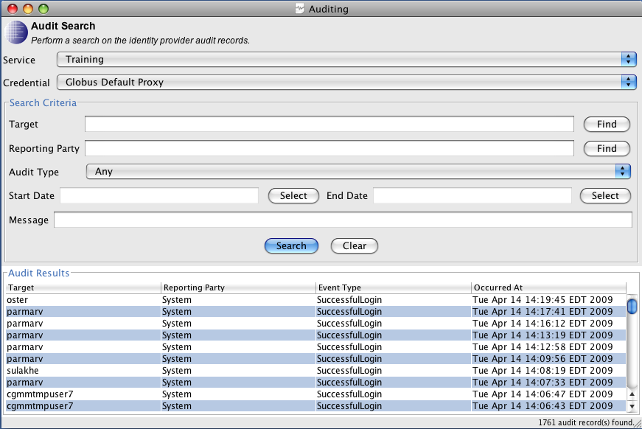
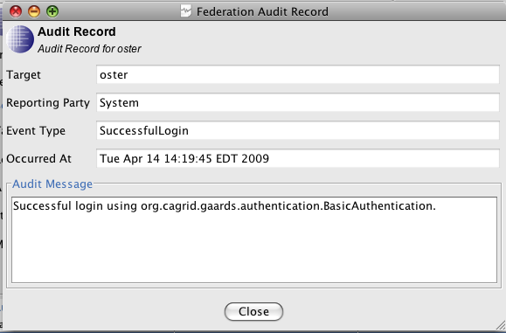
Security: Dorian
Service now leverages Spring for configuration
Implementation of Authentication Profiles and IDP metadata
Move from issuing Proxy Certificates to Short-Term Certificates
Added comprehensive auditing to service and ability to access audit records over the service interface (as an admin)
GAARDS UI support for querying and viewing audit records

Slide 18
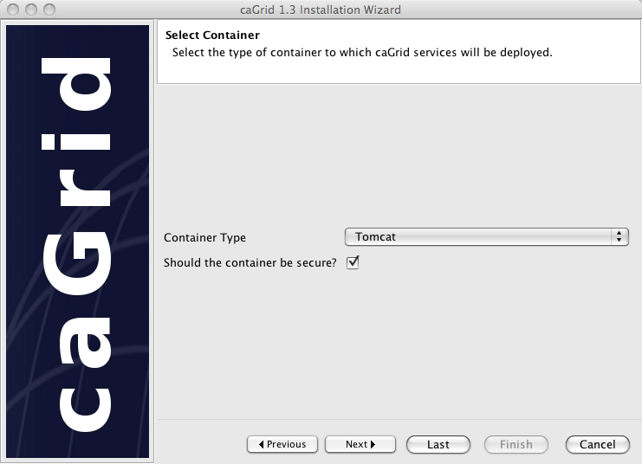
caGrid Installer
Refactored and refocused on desktop deployment (most common pattern)
Does not deploy/configure services anymore
Installs: prerequisites, configures caGrid, and configures containers (current CBIIT technology stack)
Added support for Jboss
Can launch GAARDS UI to request credentials directly during installation
No longer necessary to stop and start installation for secure container configuration
Can easily be used to retarget a container to a new grid (change target grids and install new credentials)
Better support for custom target grids
Other usability improvements such as avoiding re-downloading, setting execute permissions on scripts, minimizing steps, etc

Slide 19
Continuous Innovation
Support for CBIIT FY2008 Future Technology Stack
http://www.cagrid.org/wiki/CBIIT:TechStack:FY2008
Tomcat 5.5.27, JBoss 4.0.5
Expanded Independent Quality Assurance
Significantly improved test coverage
Most thoroughly tested version of caGrid ever
Complete redeployment of the NCI National Grid (all tiers)
Ongoing work toward high-available deployment patterns for caGrid

Slide 20
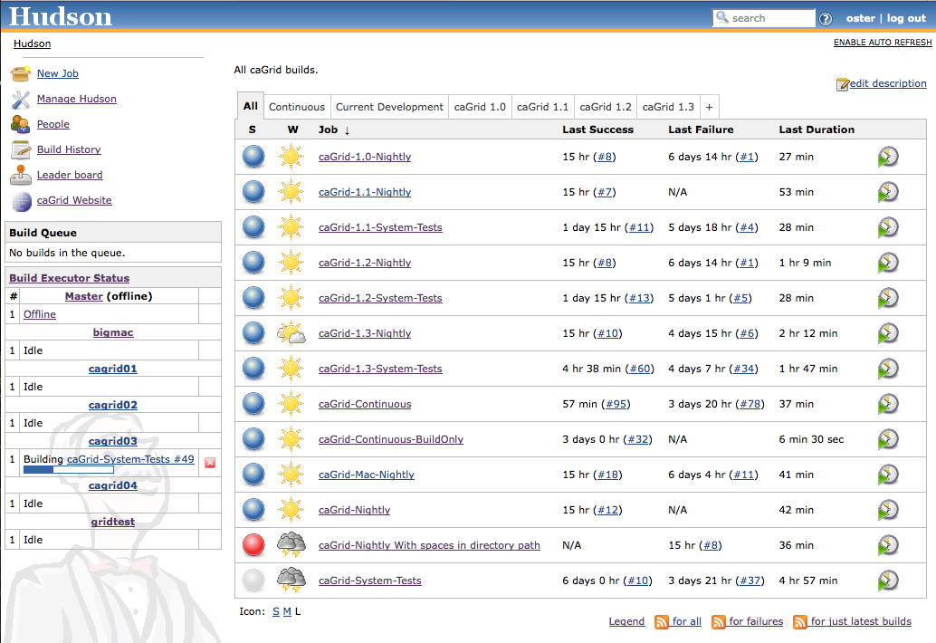
caGrid Quality Dashboard
caGrid automated testing now runs via a Hudson installation with a multi-platform build farm
Replaces previous more custom CruiseControl/DART installation
All historical releases are tested on a nightly basis
Current development continuously built and tested on multiple platforms
619 Unit tests
81 Integration/System tests
Detailed reports accessible via http://quality.cagrid.org/

Slide 21
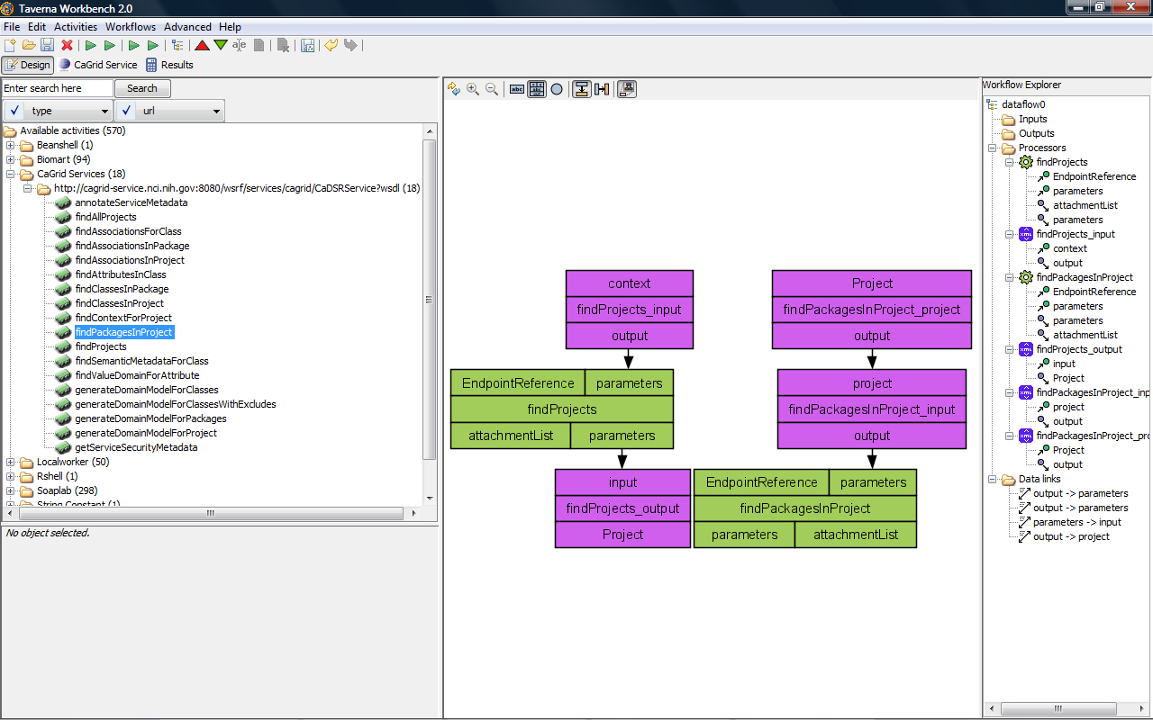
Workflow: Taverna
Added a new service Taverna Workflow Factory Service for executing Scufl (Simple Conceptual Unified Flow language) workflows, which is the language of the Taverna Workbench
Leverages the same service infrastructure as the existing BPEL-based workflow service
Updated client support to Taverna 2

Slide 22
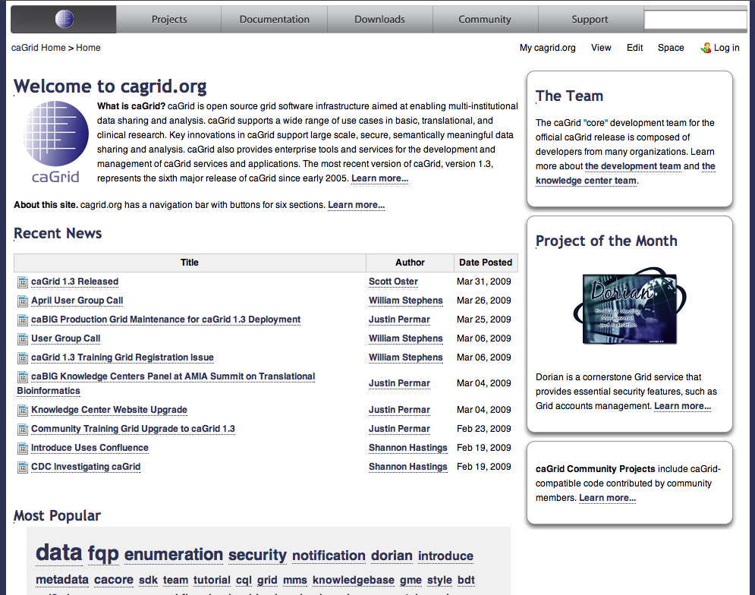
caGrid.org Wiki
caGrid 1.3 is first wiki-only release – no offline documents
caGrid.org wiki will continue to be the source of developer-written product documentation
caGrid KC Wiki will house higher level content supporting deployment, adoption, and integration scenarios
caGrid.org Wiki has been moved from Mediawiki to Conflence and content has been reorganized
Old content may still be accessed at http://mediawiki.cagrid.org

Slide 23
caGrid Support
Getting Support
Knowledgebase / Documentation
Forums / Mailing Lists
Teleconferences
Hands on time with caGrid KC technicians
Support Facilities
ESN Tech Stack
cagrid.org website
Training Grid
http://cagrid.org/display/support/Home

Slide 24
References
caGrid 1.3 Installation Instructions | http://cagrid.org/x/lyRM
caGrid 1.3 Installer | http://gforge.nci.nih.gov/frs/download.php/6357/caGrid-installer-1.3.zip
caGrid 1.3 Source Code | http://gforge.nci.nih.gov/frs/download.php/6354/caGrid-1.3.zip
caGrid 1.3 Documentation | http://cagrid.org/x/5YEX
caGrid 1.3 API Specifications | http://software.cagrid.org/caGrid-1.3-javadocs/
caGrid 1.3 Release Notes | https://gforge.nci.nih.gov/frs/shownotes.php?release_id=3288

Slide 25
caGrid 1.3: Technical Changes Overview
Scott Oster
Scott.Oster@osumc.edu
caGrid Lead Architect
April 16, 2009

