Slide 1



Adopting and Adapting caGrid: TRIAD

Slide 2
Overview
CTSA and caGrid: TRIAD
OSU Internal Grid
Expanded set of Data Service Wizards
Federated and Localized KM
Grid of Grids

Slide 3


caGrid and CTSA
caGrid is a generic and domain agnostic set of middleware and tools that enables service oriented science. Initially created for caBIG program effort and currently growing into a far reaching general community supported middleware system for data and analytics sharing. caGrid aims to be a platform to help solve some of the basic challenges in multi-institutional research collaboration and shares many of the goals and challenges that we see ourselves facing in data sharing in CTSA:
Physically and logically disparate community participants.
Multi-institutional security, interoperability, and policy issues.
Use of new technologies which require training, expertise, and process change.
Complex federal and local data integrity and privacy constraints.
Semantic and syntactic differences in data within and across research groups and institutions.

Slide 4
OSU CTSA caGrid Deployment
Using caGrid out of the box for our CTSA TRIAD informatics infrastructure enables leveraging the following capabilities:
Service oriented architecture utilizing Axis, Globus, and caGrid extensions.
Data model management via the Global Model Exchange.
Customizable security infrastructure leveraging GAARDS.
Graphical strongly typed grid service creation using Introduce.
Extendable and customizable grid service infrastructure.

Slide 5
TRIAD
Recently funded supplement to OSU CTSA program aims to create an open grid, steered by its users and stakeholders, to support analytical and data sharing across and within participating institutions.
Steering committee lead by participating institutions will establish security policy, trust, best practices, guidance, and dissemination.
Utilizes caGrid as core backbone grid infrastructure.
Provides support and education for adoption and outreach to communities in need.
Will extend caGrid in several areas:
federated and/or local metadata management utilized for semantically annotated grid service creation
provide alternative tools for data service creation on top of popular data warehousing tools such as I2B2 and RedCap.
provide wrapping wizards for exposing common commercial tools such as Velos and OnCore.

Slide 6
TRIAD
Our users will want other options for data service creation, security policy, metadata management, etc. Some of these things are not provided out of box with caGrid, however, caGrid is fully extendable and we plan to add other features to fulfill the requirements of our users.
Alternative methods for data service creation.
Alternative methods for storing and utilizing semantics for grid service creation.
Virtual Machine download and configurable grid node.
Stakeholder lead security policy organization.
Stakeholder lead steering committee.

Slide 7
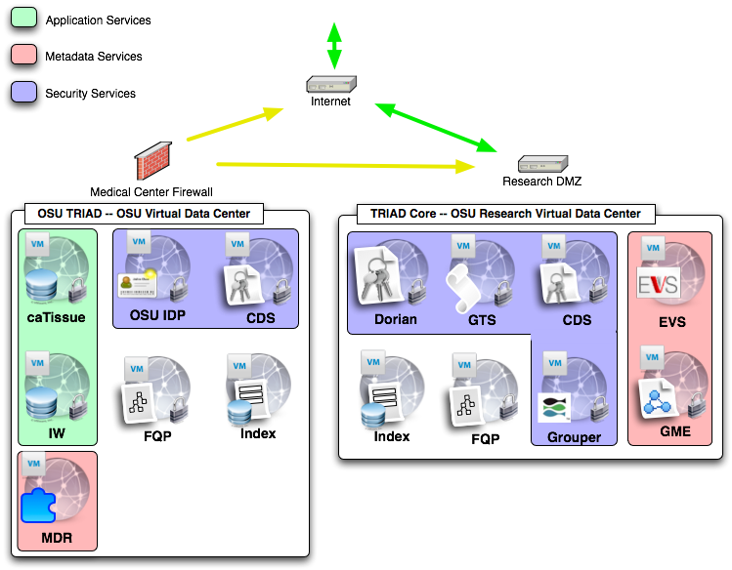
TRIAD
Notes:
Shows the initial Triad Core Grid deployment and the OSU Institution’s grid services. Talk about why it is important to have part of the grid behind a medical center firewall with respect to absolute protection of PHI, IRB satisfactions etc.

Slide 8
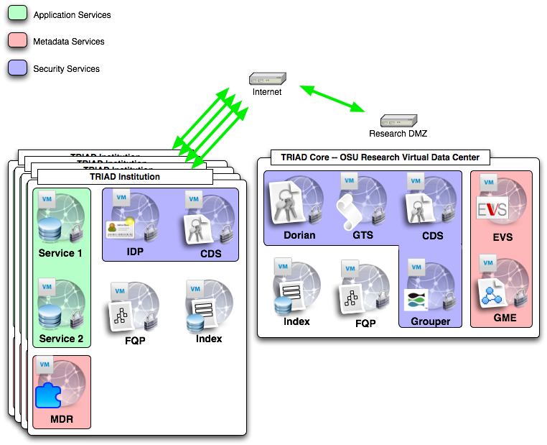
TRIAD
Notes:
Talk about how other institutes will simply plug in just like OSU did with it’s internal and external services. The core infrastructure will be maintained at OSU in the RDMZ so they will simple need to download and install TRIAD caGrid and configure the host credentials to set up a secure grid node. And we plan to provide this as a VM option.

Slide 9
TRIAD Steering Committee
Steering committee will be tasks with setting the direction, policies, and making sure all stakeholders are being represented.
Committee will have representatives from CTSA institutions for the different roles
Roles
Director
Infrastructure
Data Sharing
Imaging
Clinical Systems
Security
Informatics
Outreach
Research Application
IKFC Representative

Slide 10
Internal Grid: Vision
Ability to run retrospective analysis with clinical information sources
Increased efficiency and reduction of manual errors through automated processes
Investigator’s findings fed back into system through reverse information flow
Improved searching for researches through use of common system for multiple banks

Slide 11
Internal Grid: Approach
An instance of caGrid, utilizing TRIAD to support cancer research at The Ohio State University
Secure connections between independent data sets from the CCC and OSUMC
Knowledge collection supporting semantic interoperability between the preceding datasets and data types
Web application for secured query access to independent data sets

Slide 12
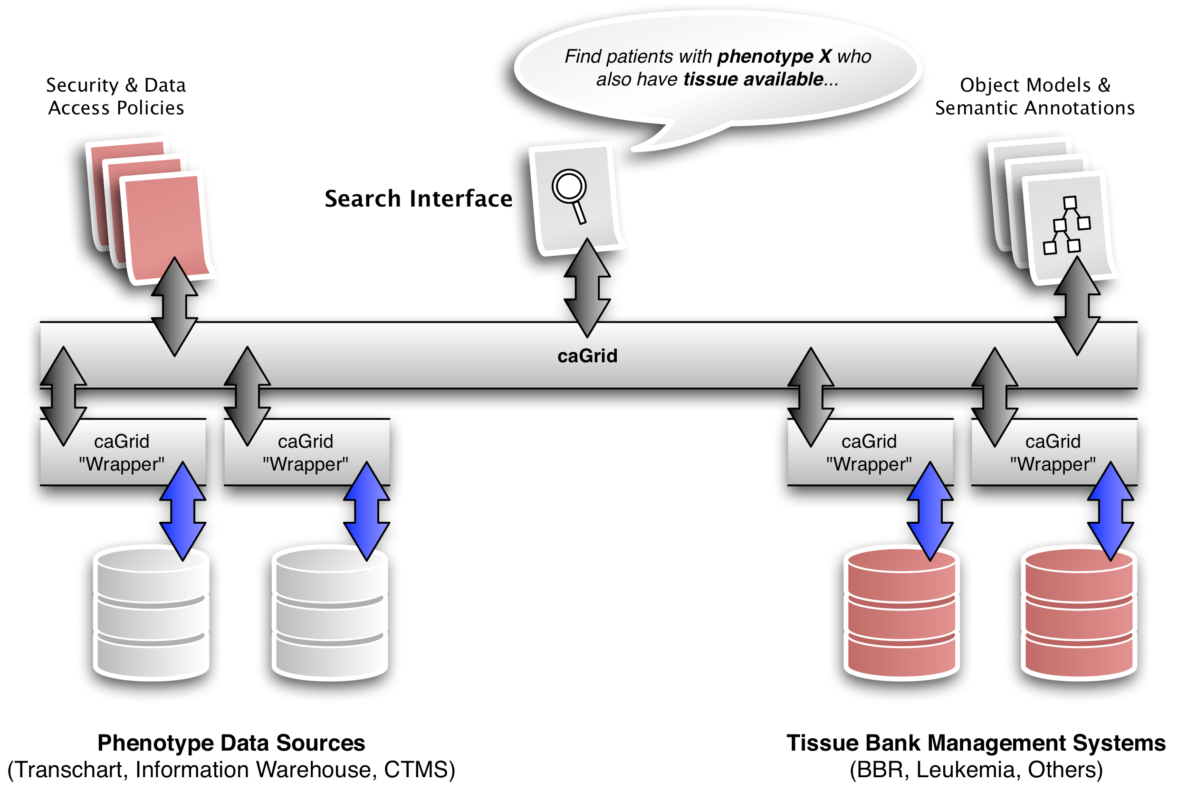
Internal Grid: Design

Slide 13
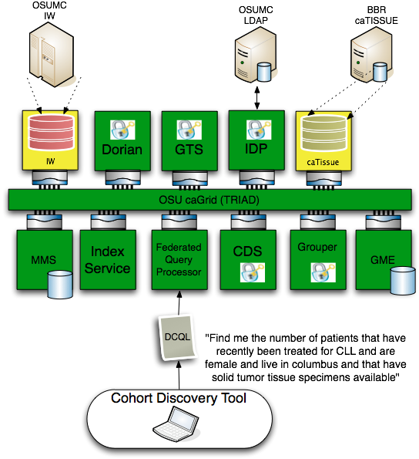
Progress

Slide 14
Progress
caTissue instance installed and loaded with initial set of data from CCC Bio-specimen repository.
800 samples initially loaded. Rate of growth has increased during summer usage
 | Samples added | Participants added
June | 1034 | 138
July | 1114 | 185
August | 1293 | 180

Slide 15
Progress
Deployment complete for caTissue’s secure data service
OSUMC Information Warehouse secure data service complete
Data services registered with new Index Service instance
Federated Query Processor instance created and tested against both data resources
Grid Grouper controls data service access

Slide 16
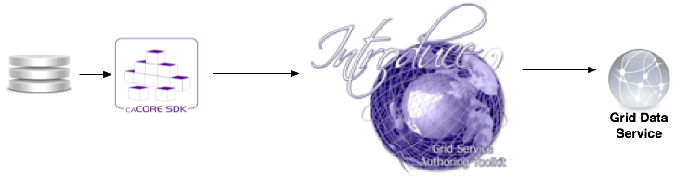
Data Services
Currently caGrid tools only enable grid data services to be automatically generated if the underlying system is a caCore system.

Slide 17
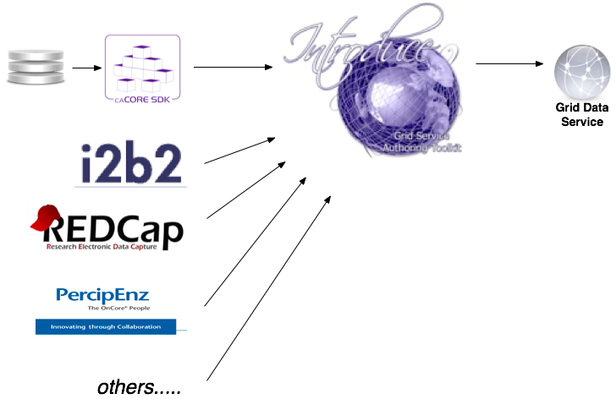
Enhanced Data Services
AIM to provide other data service generation wizards for exposing different types of common data centric applications.

Slide 18
I2B2 Grid Data Services
Utilize I2B2 (Partners), Ontomapper(UCSF), and Introduce to create caGrid based data services.
I2B2 provides the framework for storing and managing data.
Ontomapper provides the ability to annotate portions of an I2B2 data store with CDEs.
After a model is generated the Introduce I2B2 data service wizard enables creating the semantically annotated caGrid standard grid service.
Demoed beta of this functionality last month using the Human Studies Database model and data in an I2B2 at UCSF.

Slide 19
Knowledge Management
Challenges:
Utilize Standards based semantic metadata repositories such as caDSR and LexEVS.
Enable local creation and evolution of new semantic metadata from domain experts who may be using other semantic metadata creation and curation tools such as protégé, EVS, or cgMDR.
Utilize others local semantic metadata in conjunction with standards based metadata creating a more federated view of the knowledge represented in different domains.
Use this federated metadata approach to annotate the data traveling in a service oriented framework where data is being moved across knowledge domains and disparate organizations.

Slide 20
Knowledge Management
KM challenges when adopting caGrid:
caGrid does not directly address the need for a knowledge management infrastructure, however, it utilizes semantic information enabling the publishing of semantically annotated services.
caGrid currently utilizes the NCI tools and processes for centrally managed semantic metadata. (caDSR, EVS)
TRIAD aims to extend this effort with a flexible federated and local knowledge management pipeline enabling local creation of domain knowledge to be used in conjunction with standard metadata in order to expose semantically annotated services used for data sharing. Once this local metadata reaches an acceptance or adoption level it could then be published to a metadata standards registry.

Slide 21

openMDR
What are we trying to solve?
Give groups other choices for managing semantic metadata and still give them the ability to create caGrid semantically annotated grid services.
Currently caGrid tools can only use the caDSR, caCore, and SIW etc in order to create semantically annotated grid services.
User groups that don’t want for whatever reason to use the NCI caDSR or want to create a non authoritative or group authoritative metadata resource during development have no options.
Support for CTSA’s, Cooperative Groups, Regional Health Groups, Other domain.

Slide 22
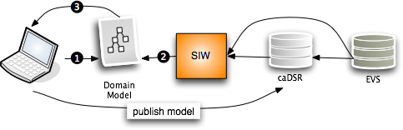
openMDR
Current caBIG Issues:
No support for “local” metadata or terminologies/ontologies.
Can’t or not intended to stand up a “local” caDSR .
The annotation tools and caDSR cant annotate or store a model that is annotated by more that one metadata registry.
Hard to or can’t copy content from NCI caDSR to your own caDSR.
caGrid tools currently can only create grid data services that use models which have gone through the SIW so currently need to use the above NCI source of metadata approach.

Slide 23
openMDR
Where are we going?
Enable another path for creating semantically annotated grid services.

Slide 24
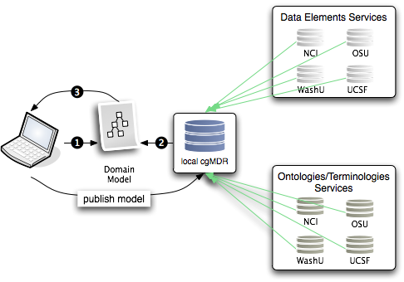
openMDR
Federated semantic metadata management utilizing and enhancing UK CancerGrid cgMDR and adding components to fill the gaps to provide another possible workflow for creating cagrid services that can leverage this alternative process.

Slide 25
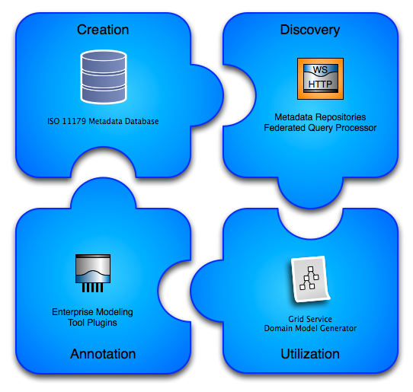
openMDR

Slide 26
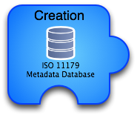
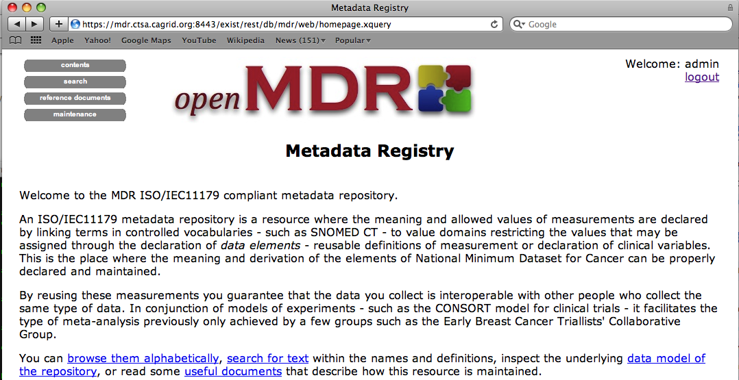
openMDR
Utilizing/enhancing the cancergrid cgMDR iso11179 database.
Built on the Exist XML database.
Capable of storing, versioning, and maintaining semantic and representational metadata.
Metadata is annotated with conceptual information from a local or remote lexEVS system.
Web based front-end for creating and curating semantic metadata.

Slide 27
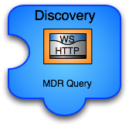
openMDR
caGrid grid service capable of talking to caDSR, many lexEVS and many openMDR systems enabling federated query of common data elements or concepts.
Enhances and wraps the cgMDR mdrConnector in order to parse the received information into a common format.
caGrid service enables it to be deployed in any local or production grid environment and configured and modified to talk to many semantic metadata systems.

Slide 28

openMDR
Enables utilizing the MDRQuery service for locating and utilizing common data elements from many semantic metadata sources for annotation of classes and attributes of the logical domain model.
Tags are created that identify the remote service and locally unique id of the CDE. (Good use case for leveraging identifiers.
The model is annotated just as it could be with the SIW except there is no need to leave the EA environment.

Slide 29
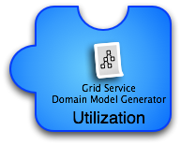
openMDR
Grid services in caBIG require semantic metadata and currently the only way to generate this service metadata is to utilize caGrid tools which can only use the caDSR which only uses the EVS.
This tool can take models annotated with the openMDR annotation plug-in for EA and generate the required semantic service metadata. This metadata can then be used to generate a data service using the Introduce Data Service Wizard which prior to this tool would only be able to utilize the caDSR can now generate data services annotated with data models from almost anywhere.

Slide 30
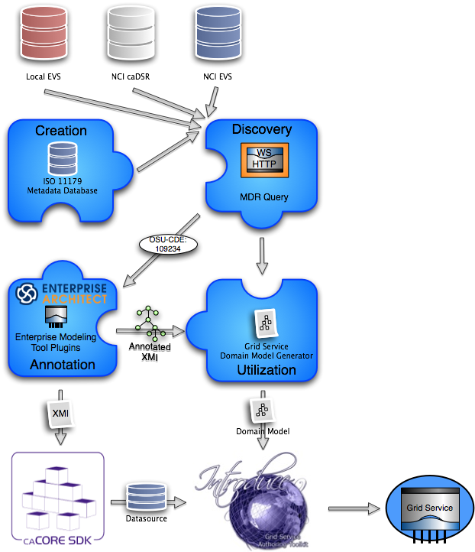
The new service creation workflow:
Draw logical model in EA.
Annotate logical model in EA utilizing openMDR EA plug-in.
Export annotated XMI and
Run through caCore SDK if you want to build a data service or have schema generated.
Run through MDR Domain Model Generator to generated grid service metadata for exposing the semantic annotations for the logical model being used.
Generate service with Introduce.

Slide 31
What have we done so far?
Refactor of cgMDR source to enable the following capabilities.
Pulled code out of exist source tree so that openMDR is not tied specifically to any version of exist.
Broke project up into 3 sub projects and added a 4th.
mdrCore (iso 11179 database and web front-end for curation and browse)
Refactored web front-end to not use XFroms and to use basic Forms for creating and editing all iso11179 data types.
mdrQuery (refactored mdrConnector in cgMDR with a caGrid grid service which provides this query functionality
mdrTools (currently an EA plugin which uses mdrQuery to provide model annotation.
mdrDomainModelGenerator (consumes XMI generated by cgMDR EA and generates a Domain Model file required for caGrid to create the grid data service.
Create a ivy based project build system which is consistent with the caGrid project build and development processes.
All code is in the caGrid incubator project in the ESN.

Slide 32

Questions?
shannon.hastings@osumc.edu

