Slide 1
CQL plug-in in caBIG workflows
Wei Tan
University of Chicago
Monika Machunik
(Google Summer of Code student)
Ravi Madduri
(Workflow Architect of caGrid)

Slide 2
Agenda
What is CQL?
What is CQL builder plug-in in Taverna?
Demo
References

Slide 3
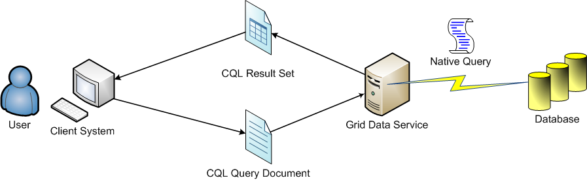
What is CQL?
CQL (Common/caGrid Query Language)
The caGrid query language used for all caGrid Data Services to express queries against a data source using an object oriented language.
It is defined in an XML document conforming to a well defined schema with the URI

Slide 4
What is CQL builder plug-in in Taverna?
Motivation
Most caBIG workflows involve data retrieving from caGrid data services.
Currently there is NOT a GUI for workflow users to construct a CQL.
Writing CQL clauses can be cumbersome and error-prone since most users are NOT familiar with caDSR and CQL syntax.
CQL builder
Supported by Google Summer of Code
Student: Monika Machunik; Mentor: Wei Tan
A GUI that Taverna users can use to build CQL
Without the need to write ANY CQL clauses by hand

Slide 5
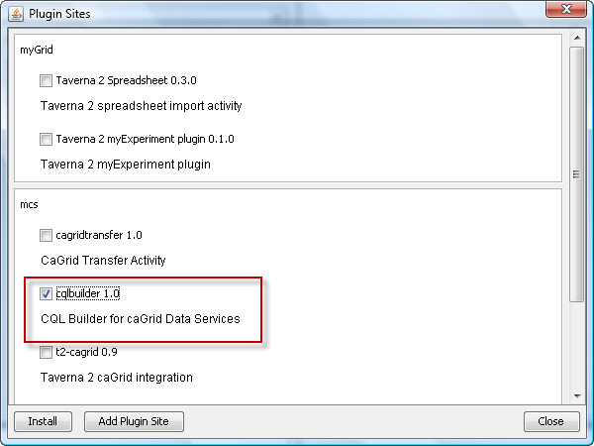
Installation
CQL builder can be easily installed as a Taverna plug-in
Plug-in site: http://www.mcs.anl.gov/~wtan/t2/
Will move to http://software.cagrid.org/taverna2/ once it is included in a formal caGrid release.

Slide 6
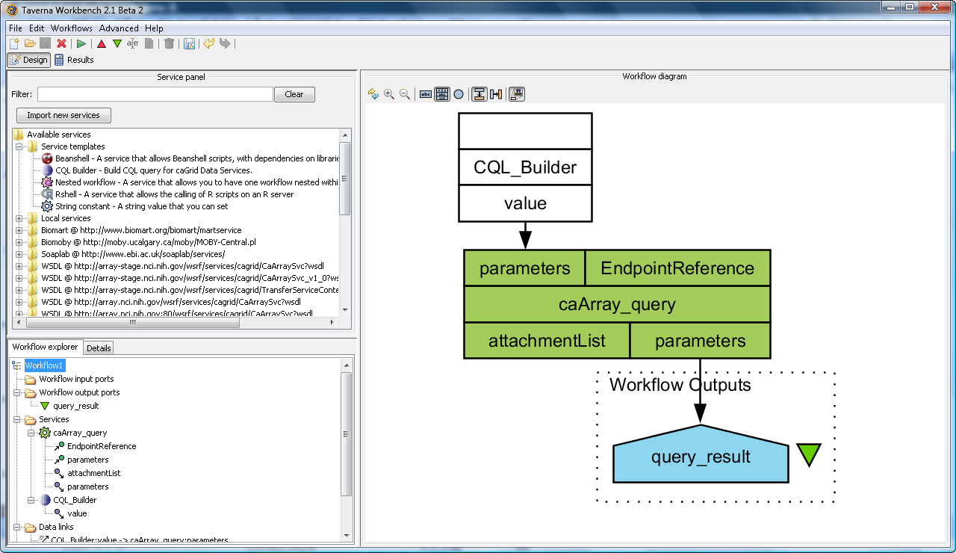
The GUI

Slide 7
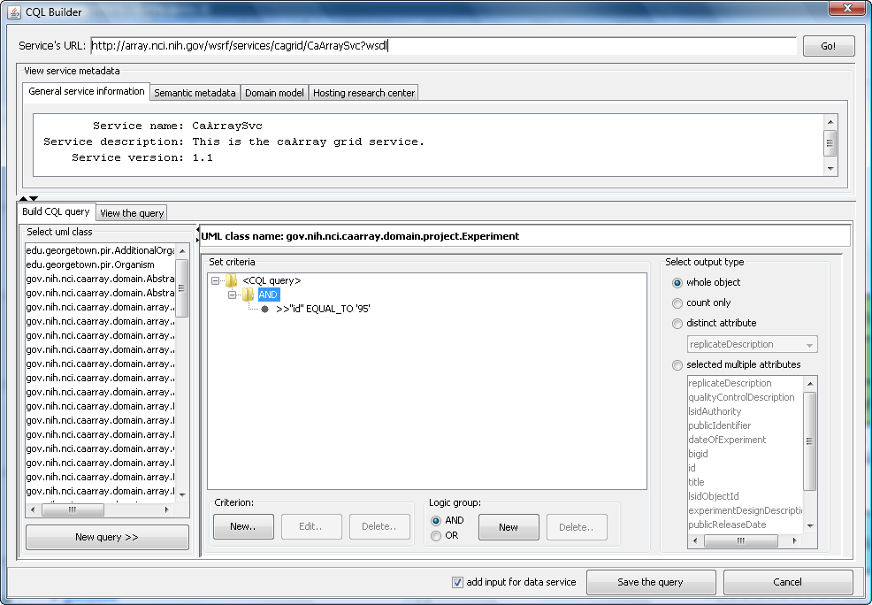
CQL builder GUI
1. URL of the data service
2. Service’s metadata
4. Output type
5. Criteria
3. UML classes to be queried

Slide 8
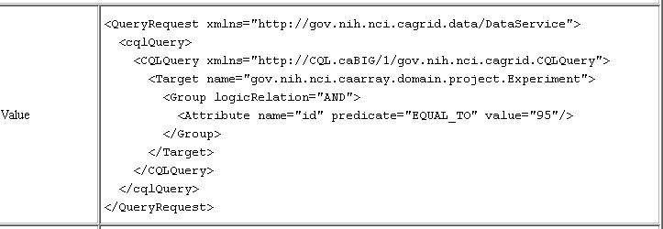
The generated CQL

Slide 9
Demo
CQL Builder Demonstration

Slide 10
Future work
Support CQL2
Use caGrid cql libraries instead of our own

Slide 11
Q&A
Contact
Wei Tan: wtan@mcs.anl.gov
Ravi Madduri: madduri@mcs.anl.gov
Wiki page: How to Create caGrid Workflow Using Taverna 2
https://wiki.cagrid.org/display/knowledgebase/How+to+Create+CaGrid+Workflow+Using+Taverna+2
References
Wei Tan, et al. A Comparison of Using Taverna and BPEL in Building Scientific Workflows: the case of caGrid. Concurrency and Computation: Practice and Experience. (2009)
Wei Tan, et al. Scientific workflows as services in caGrid: a Taverna and gRAVI approach.IEEE International Conference on Web Services (ICWS 2009), July, 2009.
Wei Tan, Ian Foster, Ravi Madduri. Scientific workflows that enable Web-scale collaboration: combining the power of Taverna and caGrid. IEEE Internet Computing. 2008, vol.12, no.6: 30-37

