Slide 1



Adopting and Adapting caGrid: TRIAD

Slide 2
Overview
CTSA TRIAD Grid
OSU Grid
Federated and Localized KM
Grid of Grids

Slide 3


caGrid and CTSA
caGrid is a generic and domain agnostic set of middleware and tools that enables service oriented science. Initially created for caBIG program effort and currently growing into a far reaching general community supported middleware system for data and analytics sharing. caGrid aims to be a platform to help solve some of the basic challenges in multi-institutional research collaboration and shares many of the goals and challenges that we see ourselves facing in data sharing in CTSA:
Physically and logically disparate community participants.
Multi-institutional security interoperability and policy issues.
Use of new technologies which require training, expertise, and process change.
Complex federal and local data integrity and privacy constraints.
Semantic and syntactic differences in data within and across research groups and institutions.

Slide 4
OSU CTSA caGrid Deployment
Using caGrid out of the box for our CTSA TRIAD informatics infrastructure enables leveraging the following capabilities:
Service oriented architecture utilizing Axis, Globus, and caGrid extensions.
Data model management via the Global Model Exchange.
Customizable security infrastructure leveraging GAARDS.
Graphical strongly typed grid service creation using Introduce.
Extendable and customizable grid service infrastructure.

Slide 5
TRIAD
Recently funded supplement to OSU CTSA program aims to create an open grid, steered by its users and stakeholders, to support analytical and data sharing across and within participating institutions.
Steering committee lead by participating institutions will establish security policy, trust, best practices, guidance, and dissemination.
Utilizes caGrid as core backbone grid infrastructure.
Provides support and education for adoption and outreach to communities in need.
Will extend caGrid in several areas:
federated and/or local metadata management utilized for semantically annotated grid service creation
provide alternative tools for data service creation on top of popular data warehousing tools such as I2B2 and RedCap.
provide wrapping wizards for exposing common commercial tools such as Velos and OnCore.

Slide 6
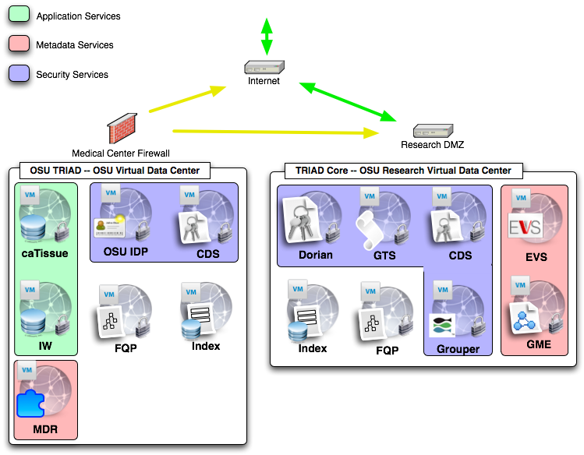
TRIAD

Slide 7
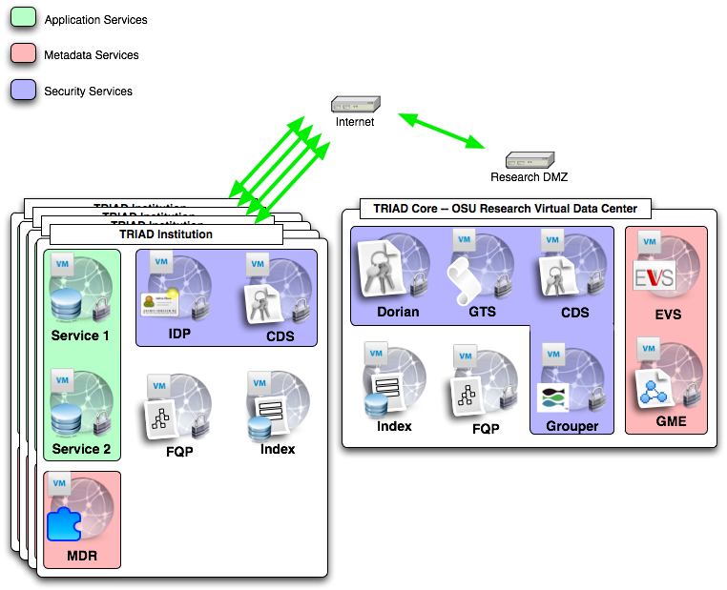
TRIAD

Slide 8
Overview
caBIG/caGrid is being utilized as part several different yet collaborating programs at the OSUMC
TRIAD, our caGrid based grid at OSU, is deployed and used for CTSA and OSUMC/CCC
Knowledge management efforts underway to enable leveraging internal/federated representations of knowledge to be used to create caGrid based semantic services.
Efforts underway to grid enable portions of the OSUMC Information Warehouse as well as other research and clinical data resources do create a virtual data warehouse within OSUMC/CCC
Efforts underway to create enhanced data mining and cohort discovery tools to increase researchers ability to locate and use clinical and research data.

Slide 9
Internal Grid: Vision
Ability to run retrospective analysis with clinical information sources
Increased efficiency and reduction of manual errors through automated processes
Investigator’s findings fed back into system through reverse information flow
Improved searching for researches through use of common system for multiple banks

Slide 10
Internal Grid: Approach
An instance of caGrid to support cancer research at The Ohio State University
Secure connections between independent data sets from the CCC and OSUMC
Knowledge collection supporting semantic interoperability between the preceding datasets and data types
Web application for secured query access to independent data sets

Slide 11
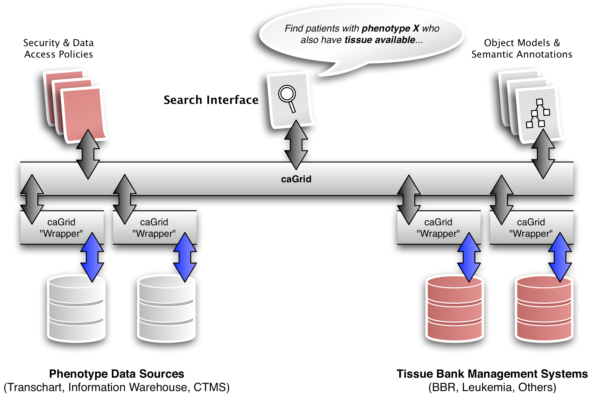
Internal Grid: Design

Slide 12
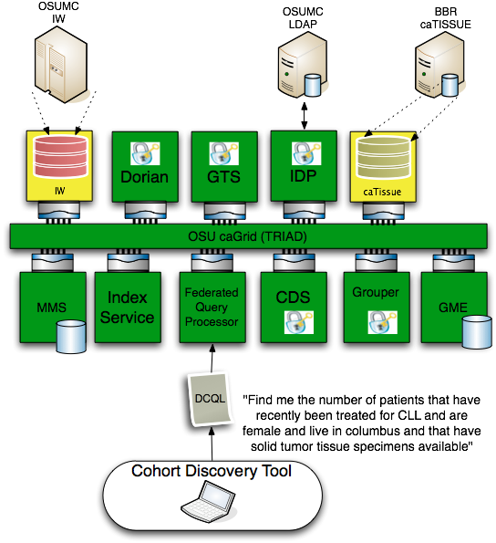
Progress

Slide 13
Progress
caTissue instance installed and loaded with initial set of data from CCC Bio-specimen repository.
800 samples initially loaded. Rate of growth has increased during summer usage
 | Samples added | Participants added
June | 1034 | 138
July | 1114 | 185
August | 1293 | 180

Slide 14
Progress
Test deployment complete for caTissue’s secure data service
Draft version of OSUMC Information Warehouse secure data service complete
Data services registered with new Index Service instance
Federated Query Processor instance created
Grid Grouper controls data service access

Slide 15
Next Steps
caTissue’s caGrid data service deployed to production machine
Complete final version of OSUMC IW data service pending database optimizations
Build DCQL queries to test FQP service
Explore creation of UI portlets which can integrate with caGrid Portal site
Build visual query creation tool for search UI

Slide 16
Knowledge Management
Challenges:
Utilize Standards based semantic metadata repositories such as caDSR and LexEVS.
Enable local creation and evolution of new semantic metadata from domain experts who may be using other semantic metadata creation and curation tools such as protégé, EVS, or cgMDR.
Utilize others local semantic metadata in conjunction with standards based metadata creating a more federated view of the knowledge represented in different domains.
Use this federated metadata approach to annotate the data traveling in a service oriented framework where data is being moved across knowledge domains and disparate organizations.

Slide 17
Knowledge Management
KM challenges when adopting caGrid:
caGrid does not directly address the need for a knowledge management infrastructure, however, it utilizes semantic information enabling the publishing of semantically annotated services.
caGrid currently utilizes the NCI tools and processes for centrally managed semantic metadata. (caDSR, EVS)
TRIAD aims to extend this effort with a flexible and federated knowledge management pipeline enabling local creation of domain knowledge to be used in conjunction with standard metadata in order to expose semantically annotated services used for data sharing. Once this local metadata reaches an acceptance or adoption level it could then be published to a metadata standards registrity.

Slide 18
Knowledge Management
Challenges:
Utilize Standards based semantic metadata repositories such as caDSR and LexEVS.
Enable local creation and evolution of new semantic metadata from domain experts who may be using other semantic metadata creation and curation tools such as protégé, EVS, or cgMDR.
Utilize others local semantic metadata in conjunction with standards based metadata creating a more federated view of the knowledge represented in different domains.
Use this federated metadata approach to annotate the data traveling in a service oriented framework where data is being moved across knowledge domains and disparate organizations.

Slide 19
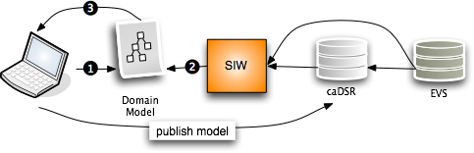
Current NCI Process
A central review process for curating semantic metadata which is stored in the single and managed instance of the NCI caDSR and annotated by concepts from the single and managed instance of the NCI EVS.
Build Domain Model in EA or ArgoUML
Annotate model with CDEs and concepts with the SIW.
Submit for review and cycle this process until accepted.

Slide 20
Current NCI Process
Current Issues:
No support for “local” metadata or terminologies/ontologies.
Can stand up a “local” caDSR , however, the annotation tools and caDSR cant annotate or store a model that is annotated by more that one metadata registry.
Hard to or can’t copy content from NCI caDSR to your own caDSR.
caGrid tools currently can only create grid data services that use models which have gone through the SIW so currently need to use the above single source of metadata approach.

Slide 21
cgMDR
cgMDR was created by the UK cancer grid to create a framework for supporting a light weight ISO 11179 standards metadata repository.
cgMDR has tools enabling semantic annotation from its own metadata repository but also can resolve metadata and terminologies from remote metadata resources such as the caDSR and EVS.

Slide 22
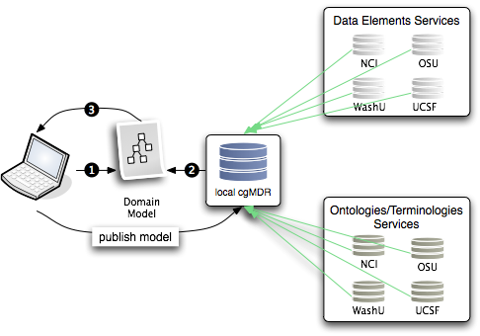
Proposed Process
Federated semantic metadata management utilizing and enhancing UK CancerGrid cgMDR.

Slide 23
Proposed Process
Using cgMDR helps to create a general process for utilizing a more federated view of semantic metadata.
Once local metadata reaches more acceptance it can be submitted to a standard metadata repository such as the NCI caDSR.
Gap areas still exist:
cgMDR does not enable storing XMI of Domain Models
caGrid data service creation framework cannot yet utilize the cgMDR annotated domain models

Slide 24

openMDR
What are we trying to solve?
Give groups other choices for managing semantic metadata and still give them the ability to create caGrid semantically annotated grid services.
Currently caGrid tools can only use the caDSR, caCore, and SIW etc in order to create semantically annotated grid services.
User groups that don’t want for whatever reason to use the NCI caDSR or want to create a non authoritative or group authoritative metadata resource during development have no options.
Support for CTSA’s, Cooperative Groups, Regional Health Groups, Other domain.

Slide 25
openMDR
Current caBIG Issues:
No support for “local” metadata or terminologies/ontologies.
Can’t or not intended to stand up a “local” caDSR .
The annotation tools and caDSR cant annotate or store a model that is annotated by more that one metadata registry.
Hard to or can’t copy content from NCI caDSR to your own caDSR.
caGrid tools currently can only create grid data services that use models which have gone through the SIW so currently need to use the above NCI source of metadata approach.

Slide 26
openMDR
Where are we going?
Enable another path for creating semantically annotated grid services.

Slide 27
openMDR
Federated semantic metadata management utilizing and enhancing UK CancerGrid cgMDR and adding components to fill the gaps to provide another possible workflow for creating cagrid services that can leverage this alternative process.

Slide 28
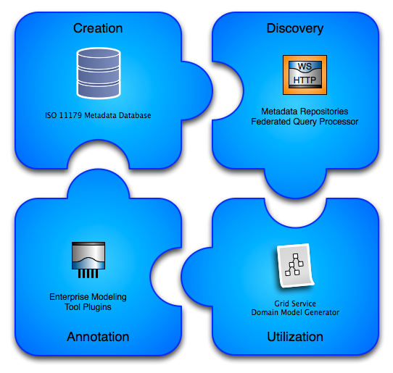
openMDR

Slide 29
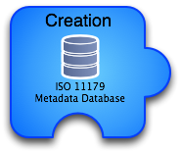
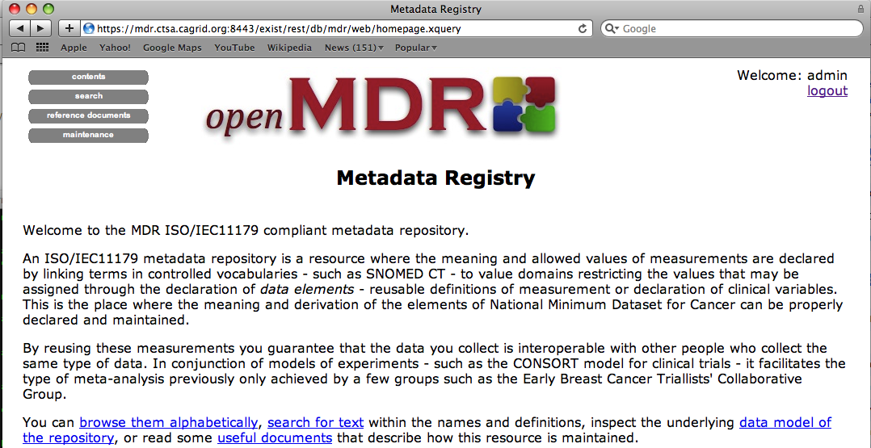
openMDR
Utilizing/enhancing the cancergrid cgMDR iso11179 database.
Built on the Exist XML database.
Capable of storing, versioning, and maintaining semantic and representational metadata.
Metadata is annotated with conceptual information from a local or remote lexEVS system.
Web based front-end for creating and curating semantic metadata.

Slide 30
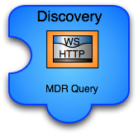
openMDR
caGrid grid service capable of talking to caDSR, many lexEVS and many openMDR systems enabling federated query of common data elements or concepts.
Enhances and wraps the cgMDR mdrConnector in order to parse the received information into a common format.
caGrid service enables it to be deployed in any local or production grid environment and configured and modified to talk to many semantic metadata systems.

Slide 31

openMDR
Enables utilizing the MDRQuery service for locating and utilizing common data elements from many semantic metadata sources for annotation of classes and attributes of the logical domain model.
Tags are created that identify the remote service and locally unique id of the CDE. (Good use case for leveraging identifiers.
The model is annotated just as it could be with the SIW except there is no need to leave the EA environment.

Slide 32
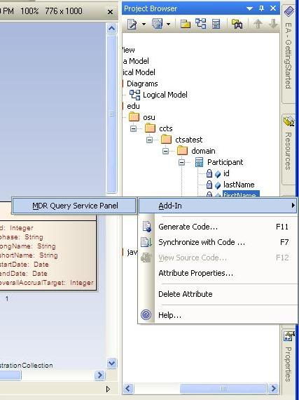
openMDR

Slide 33
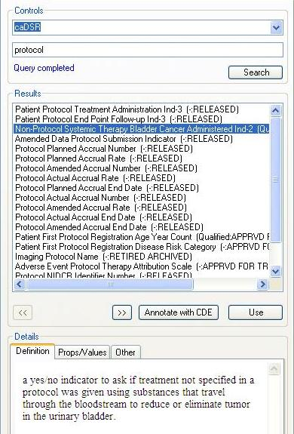
openMDR

Slide 34
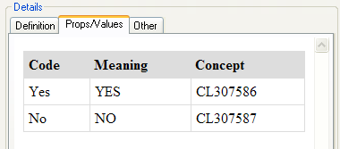
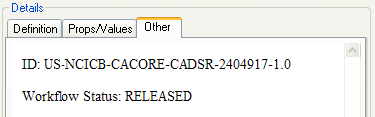
openMDR

Slide 35
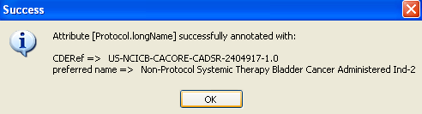

openMDR

Slide 36
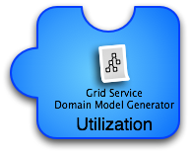
openMDR
Grid services in caBIG require semantic metadata and currently the only way to generate this service metadata is to utilize caGrid tools which can only use the caDSR which only uses the EVS.
This tool can take models annotated with the openMDR annotation plug-in for EA and generate the required semantic service metadata. This metadata can then be used to generate a data service using the Introduce Data Service Wizard which prior to this tool would only be able to utilize the caDSR can now generate data services annotated with data models from almost anywhere.

Slide 37
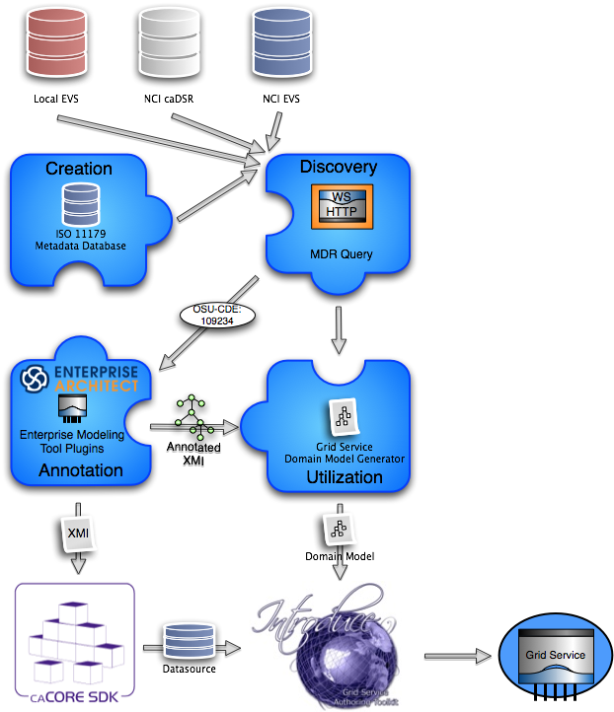
The new service creation workflow:
Draw logical model in EA.
Annotate logical model in EA utilizing openMDR EA plug-in.
Export annotated XMI and
Run through caCore SDK if you want to build a data service or have schema generated.
Run through MDR Domain Model Generator to generated grid service metadata for exposing the semantic annotations for the logical model being used.
Generate service with Introduce.

Slide 38
What have we done so far?
Refactor of cgMDR source to enable the following capabilities.
Pulled code out of exist source tree so that openMDR is not tied specifically to any version of exist.
Broke project up into 3 sub projects and added a 4th.
mdrCore (iso 11179 database and web front-end for curation and browse)
Refactored web front-end to not use XFroms and to use basic Forms for creating and editing all iso11179 data types.
mdrQuery (refactored mdrConnector in cgMDR with a caGrid grid service which provides this query functionality
mdrTools (currently an EA plugin which uses mdrQuery to provide model annotation.
mdrDomainModelGenerator (consumes XMI generated by cgMDR EA and generates a Domain Model file required for caGrid to create the grid data service.
Create a ivy based project build system which is consistent with the caGrid project build and development processes.
All code is in the caGrid incubator project in the ESN.

Slide 39
This is a work in progress but we have a real community that is looking for a solution.
Software for download will be coming in the next couple months.
The evolving wiki site can be found here:
https://cagrid.org/display/MDR/Overview

Slide 40

Questions?
shannon.hastings@osumc.edu

