Slide 1


Adopting and Adapting caGrid October, 2009

Slide 2
Overview
CTSA and caGrid: TRIAD
OSU CTSA
Expanded set of Data Service Wizards
Federated and Localized KM

Slide 3
caGrid and CTSA
caGrid is a generic and domain agnostic set of middleware and tools that enables service oriented science.
caGrid aims to be a platform to help solve some of the basic challenges in multi-institutional research collaboration and shares many of the goals and challenges that we see ourselves facing in data sharing in CTSA:
Physically and logically disparate community participants.
Multi-institutional security, interoperability, and policy issues.
Use of new technologies which require training, expertise, and process change.
Complex federal and local data integrity and privacy constraints.
Semantic and syntactic differences in data within and across research groups and institutions.

Slide 4
TRIAD
Initially funded as part of the OSU CTSA to provide an instance of caGrid and extensions to caGrid for the OSU CTSA.
Recently funded CTSA supplement to extend TRIAD to the national level to be a research informatics platform available to all CTSAs.
TRIAD Core Goals
Develop extensions for caGrid specific to addressing the needs of the CTSA community
Create and operate a National Grid enabling CTSA(s) to collaborate and share data with the goal of advancing scientific research.
Establish a National Steering Committee whom will oversee the operations and security of the TRIAD National Grid as well as provide strategic direction on the investment of resources and development of extensions to caGrid.
Build a highly active user community that will set forth the requirements and help drive the direction of TRIAD.

Slide 5
TRIAD
TRIAD is an instance of caGrid that leverages core components out of the box:
Service oriented architecture utilizing Axis, Globus, and caGrid extensions.
Data model management via the Global Model Exchange.
Customizable security infrastructure leveraging GAARDS.
Graphical strongly typed grid service creation using Introduce.
Extendable and customizable web service infrastructure.
TRIAD extends caGrid
Our users will want other options for data service creation, security policy, metadata management, etc.
Federated and/or local metadata management utilized for semantically annotated grid service creation
Provide alternative tools for data service creation on top of popular data warehousing tools such as I2B2 and RedCap.
Better integration with commercial products, such as Velos and OnCore. TRIAD will provide wrapping and integration of these tools.

Slide 6
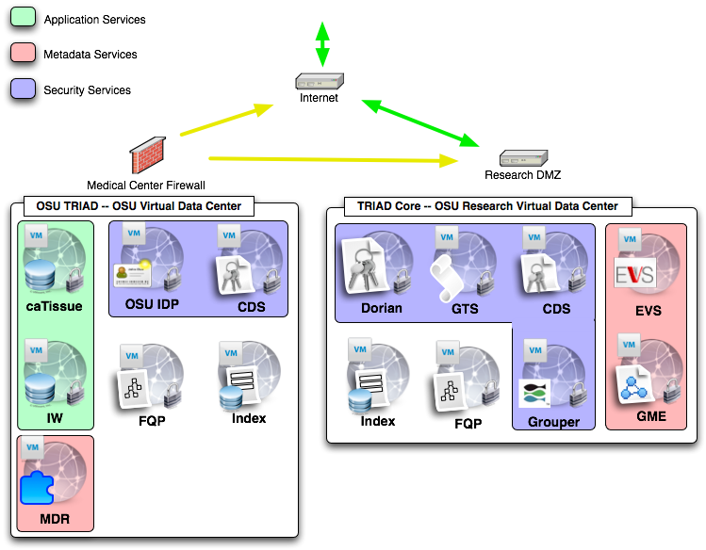
TRIAD
Notes:
Shows the initial Triad Core Grid deployment and the OSU Institution’s grid services. Talk about why it is important to have part of the grid behind a medical center firewall with respect to absolute protection of PHI, IRB satisfactions etc.

Slide 7
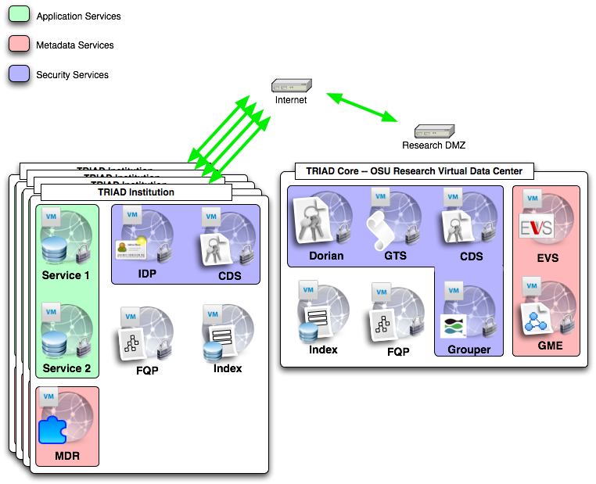
TRIAD
Notes:
Talk about how other institutes will simply plug in just like OSU did with it’s internal and external services. The core infrastructure will be maintained at OSU in the RDMZ so they will simple need to download and install TRIAD caGrid and configure the host credentials to set up a secure grid node. And we plan to provide this as a VM option.

Slide 8
TRIAD Steering Committee
Steering committee will be tasks with setting the direction, policies, and making sure all stakeholders are being represented.
Committee will have representatives from CTSA institutions for the different roles
Roles
Director
Infrastructure
Data Sharing
Imaging
Clinical Systems
Security
Informatics
Outreach
Research Application
IKFC Representative

Slide 9
OSU CSTA Informatics: Vision
Ability to run retrospective analysis with clinical information sources
Increased efficiency and reduction of manual errors through automated processes
Investigator’s findings fed back into system through reverse information flow
Improved searching for researches through use of common system for multiple banks

Slide 10
OSU Informatics: Approach
An instance of caGrid, utilizing TRIAD to support cancer research at The Ohio State University
Secure connections between independent data sets from the CCC and OSUMC
Knowledge collection supporting semantic interoperability between the preceding datasets and data types
Web application for secured query access to independent data sets

Slide 11
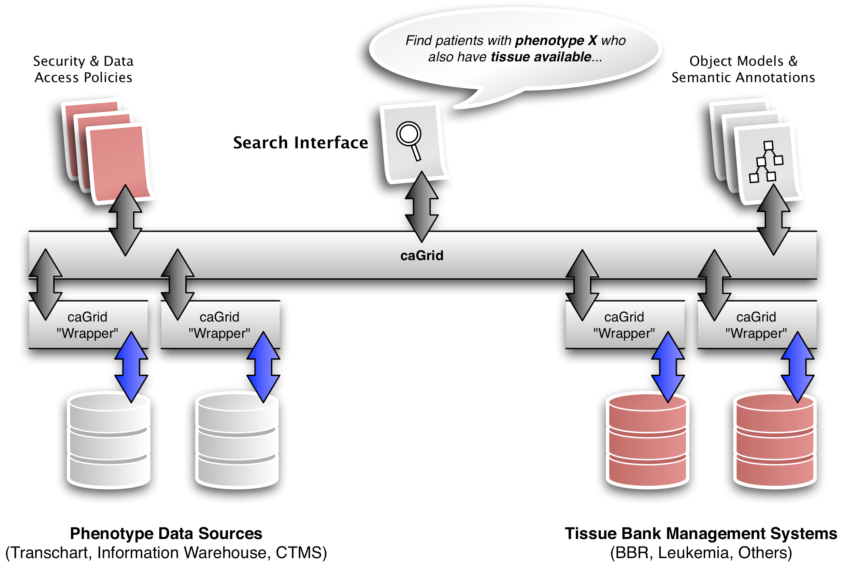
OSU Informatics : Design

Slide 12
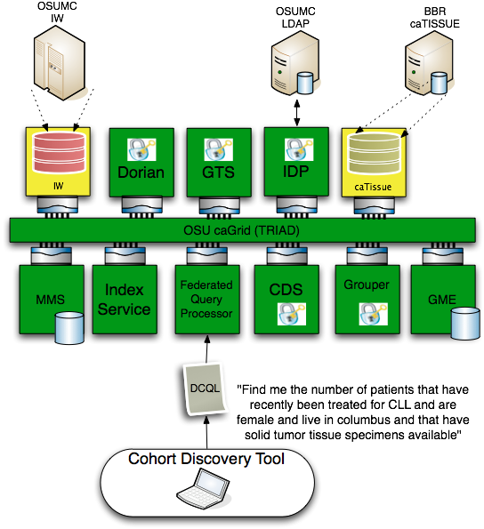

Slide 13
OSU CTSA Progress
caTissue instance installed and loaded with initial set of data from CCC Bio-specimen repository.
800 samples initially loaded. Rate of growth has increased during summer usage
 | Samples added | Participants added
June | 1034 | 138
July | 1114 | 185
August | 1293 | 180

Slide 14
OSU CTSA Progress
Deployment complete for caTissue’s secure data service
OSUMC Information Warehouse secure data service complete
Data services registered with new Index Service instance
Federated Query Processor instance created and tested against both data resources
Grid Grouper controls data service access

Slide 15
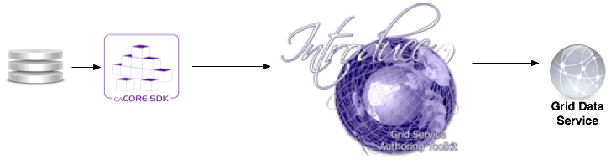
Data Services
Currently caGrid tools only enable grid data services to be automatically generated if the underlying system is a caCore system.

Slide 16
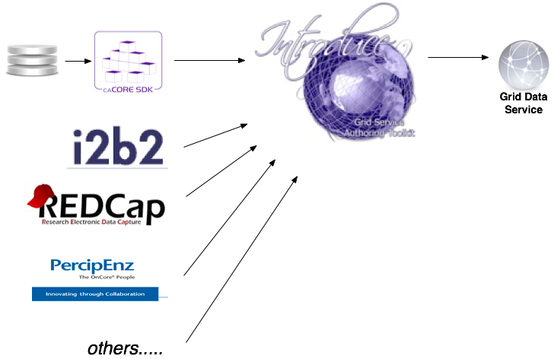
Enhanced Data Services
AIM to provide other data service generation wizards for exposing different types of common data centric applications.

Slide 17
I2B2 Grid Data Services
Utilize I2B2 (Partners), Ontomapper (UCSF), and Introduce to create caGrid based data services.
I2B2 provides the framework for storing and managing data.
Ontomapper provides the ability to annotate portions of an I2B2 data store with CDEs.
After a model is generated the Introduce I2B2 data service wizard enables creating the semantically annotated caGrid standard grid service.
Demoed beta of this functionality last month using the Human Studies Database model and data in an I2B2 at UCSF.

Slide 18
Knowledge Management
Challenges:
Utilize Standards based semantic metadata repositories such as caDSR and LexEVS.
Enable local creation and evolution of new semantic metadata from domain experts who may be using other semantic metadata creation and curation tools such as protégé, EVS, or cgMDR.
Utilize others local semantic metadata in conjunction with standards based metadata creating a more federated view of the knowledge represented in different domains.
Use this federated metadata approach to annotate the data traveling in a service oriented framework where data is being moved across knowledge domains and disparate organizations.

Slide 19

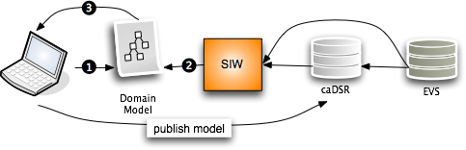
Current issues adopting current model in CTSA:
No support for “local” metadata or terminologies/ontologies.
Can’t or not intended to stand up a “local” caDSR .
The annotation tools and caDSR cant annotate or store a model that is annotated by more that one metadata registry.
Hard to or can’t copy content from NCI caDSR to your own caDSR.
caGrid tools currently can only create grid data services that use models which have gone through the SIW so currently need to use the above NCI source of metadata approach.

Slide 20
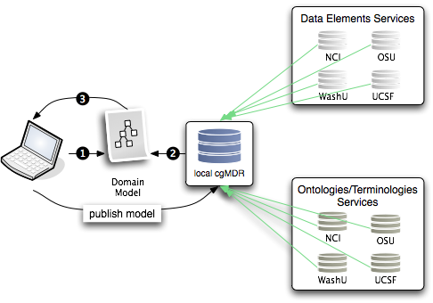
Federated semantic metadata management utilizing and enhancing UK CancerGrid cgMDR and adding components to fill the gaps to provide another possible workflow for creating cagrid services that can leverage this alternative process.

Slide 21
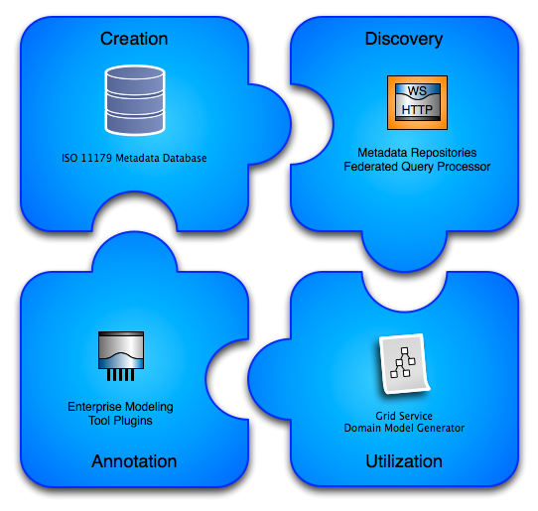

Slide 22
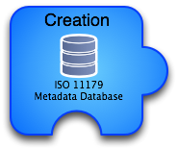
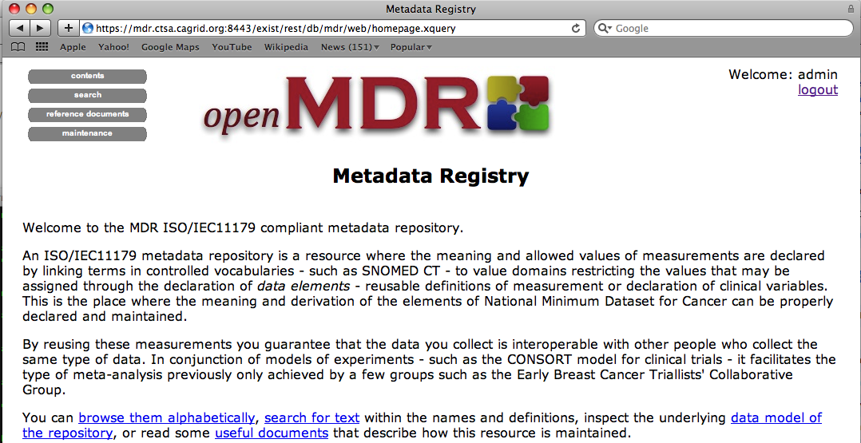
Utilizing/enhancing the cancergrid cgMDR iso11179 database.
Built on the Exist XML database.
Capable of storing, versioning, and maintaining semantic and representational metadata.
Metadata is annotated with conceptual information from a local or remote lexEVS system.
Web based front-end for creating and curating semantic metadata.

Slide 23
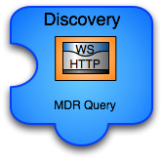
caGrid grid service capable of talking to caDSR, many lexEVS and many openMDR systems enabling federated query of common data elements or concepts.
Enhances and wraps the cgMDR mdrConnector in order to parse the received information into a common format.
caGrid service enables it to be deployed in any local or production grid environment and configured and modified to talk to many semantic metadata systems.

Slide 24

Enables utilizing the MDRQuery service for locating and utilizing common data elements from many semantic metadata sources for annotation of classes and attributes of the logical domain model.
Tags are created that identify the remote service and locally unique id of the CDE. (Good use case for leveraging identifiers.
The model is annotated just as it could be with the SIW except there is no need to leave the EA environment.

Slide 25
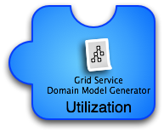
Grid services in caBIG require semantic metadata and currently the only way to generate this service metadata is to utilize caGrid tools which can only use the caDSR which only uses the EVS.
This tool can take models annotated with the openMDR annotation plug-in for EA and generate the required semantic service metadata. This metadata can then be used to generate a data service using the Introduce Data Service Wizard which prior to this tool would only be able to utilize the caDSR can now generate data services annotated with data models from almost anywhere.

Slide 26
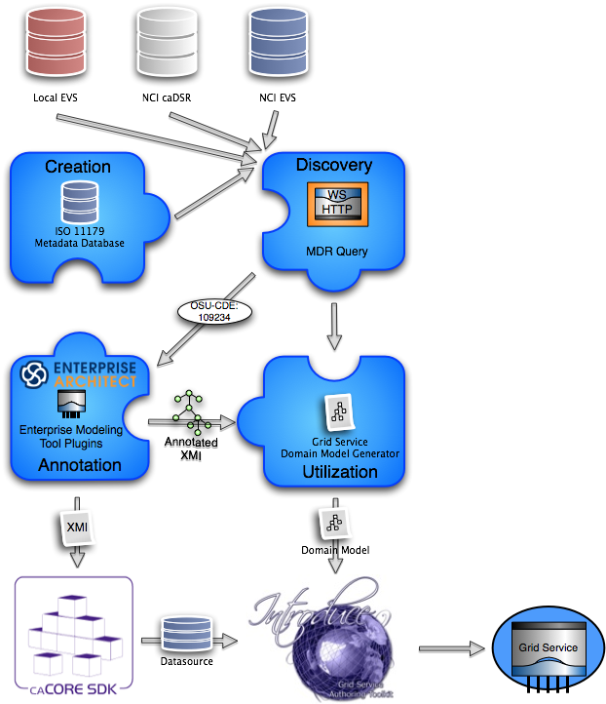
The new service creation workflow:
Draw logical model in EA.
Annotate logical model in EA utilizing openMDR EA plug-in.
Export annotated XMI and
Run through caCore SDK if you want to build a data service or have schema generated.
Run through MDR Domain Model Generator to generated grid service metadata for exposing the semantic annotations for the logical model being used.
Generate service with Introduce.

Slide 27

Questions?
shannon.hastings@osumc.edu

