Slide 1
caGrid Knowledge Center GAARDS UI Stand Alone
Joe George
joe.george@osumc.edu
October 21, 2010
https://cabig-kc.nci.nih.gov/CaGrid/KC

Slide 2
Installation
Download from cagrid.org or the caGrid GForge site when 1.4 is released
Unzip GAARDS distribution
Run batch file to start (Windows)

Slide 3
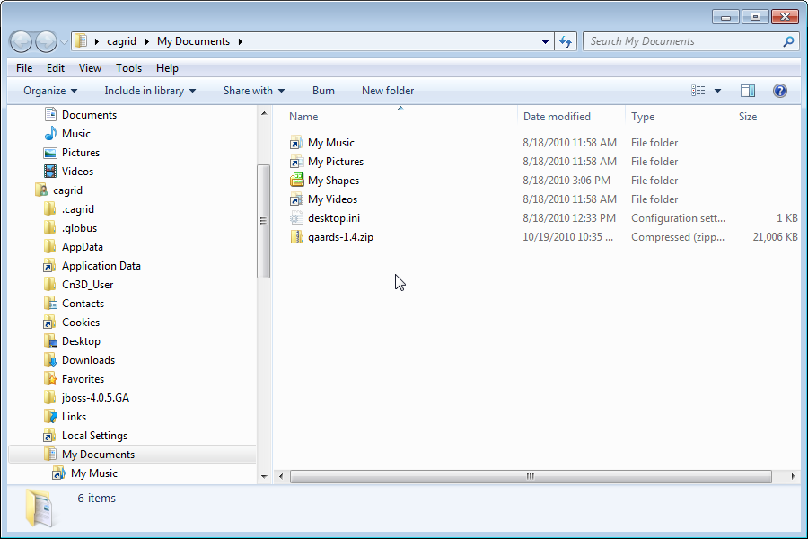
Download GAARDS

Slide 4
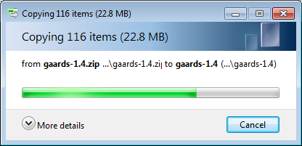
Unzip the distribution

Slide 5
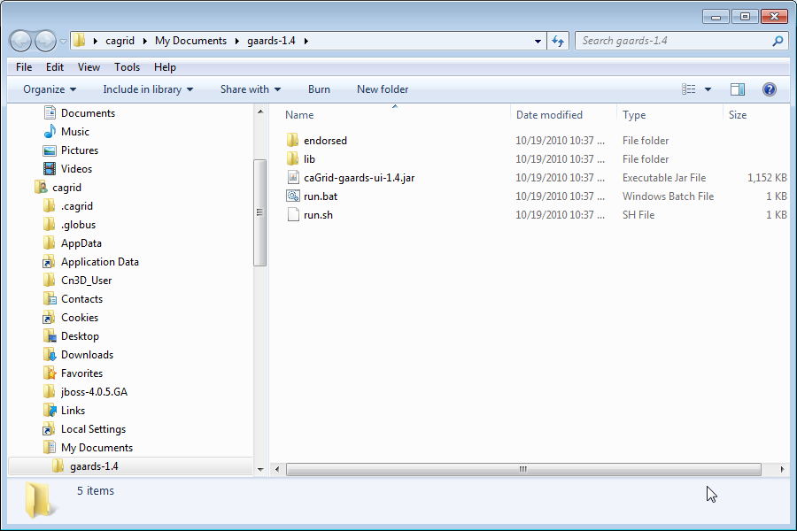
Double-Click “run.bat”

Slide 6
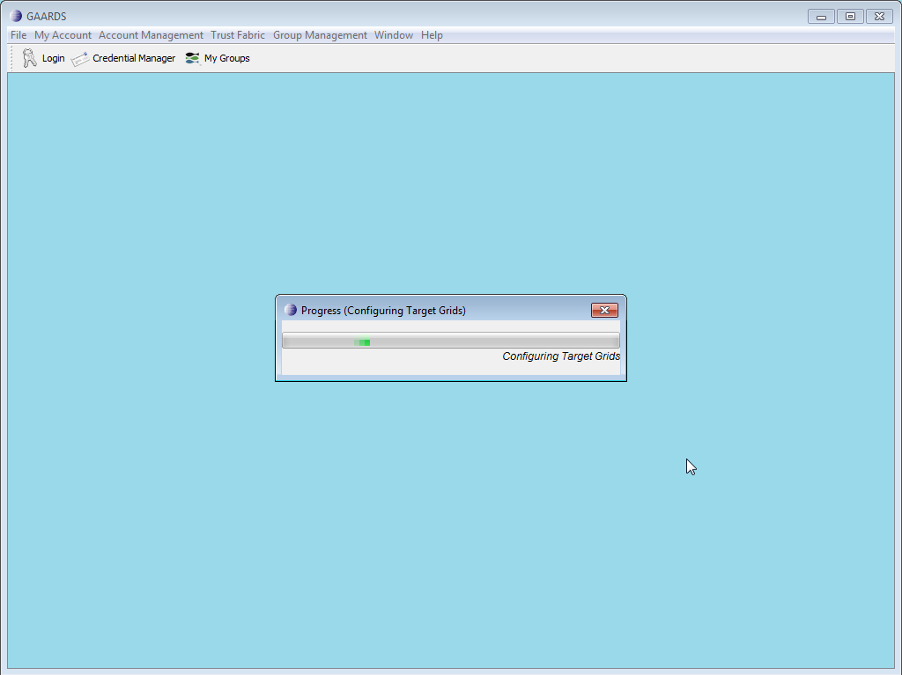
Starting Up
Configured to use the training grid by default
Checks for updated grid configuration files

Slide 7
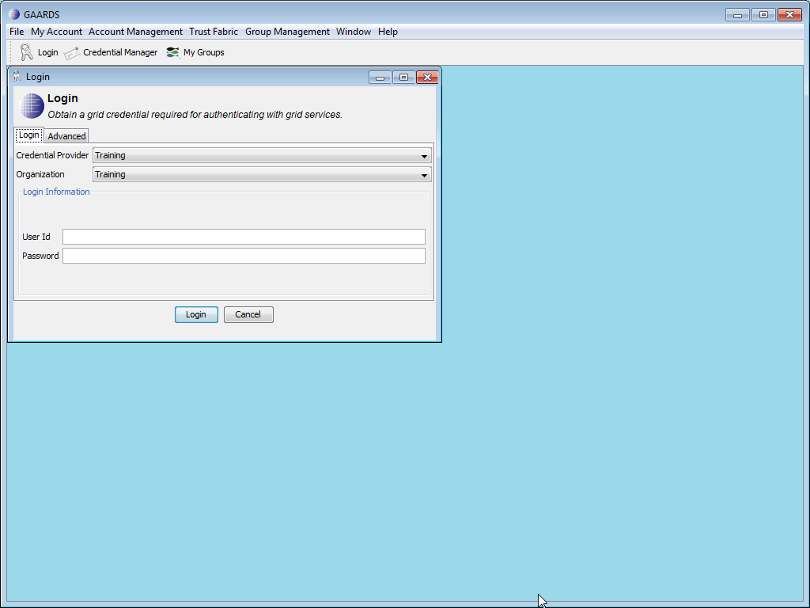

Slide 8
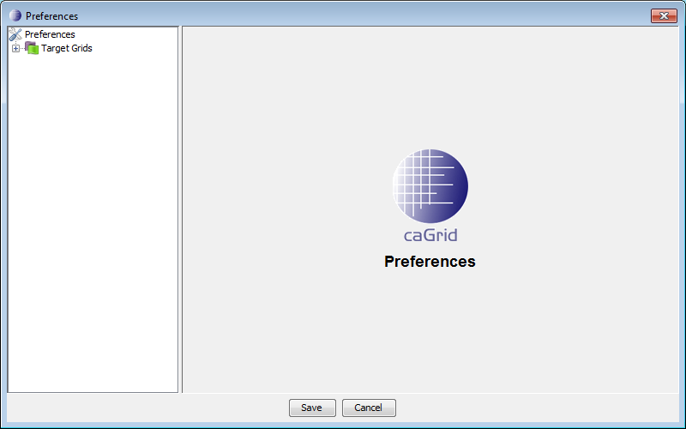
Grid Preferences

Slide 9
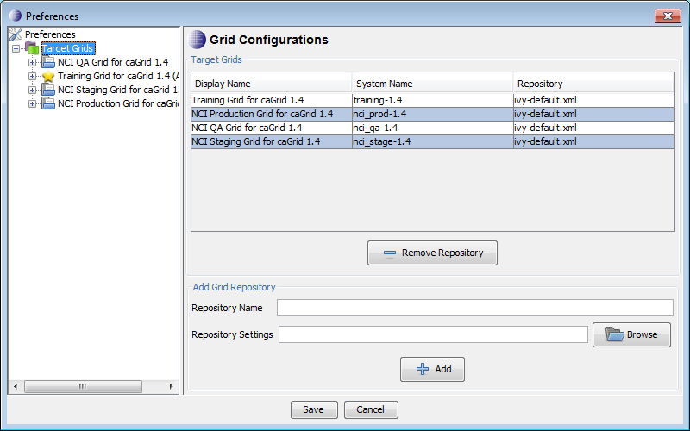
Default Grid Settings

Slide 10
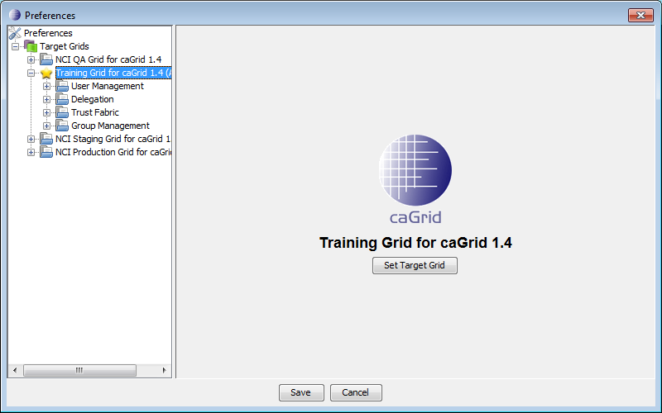

Slide 11
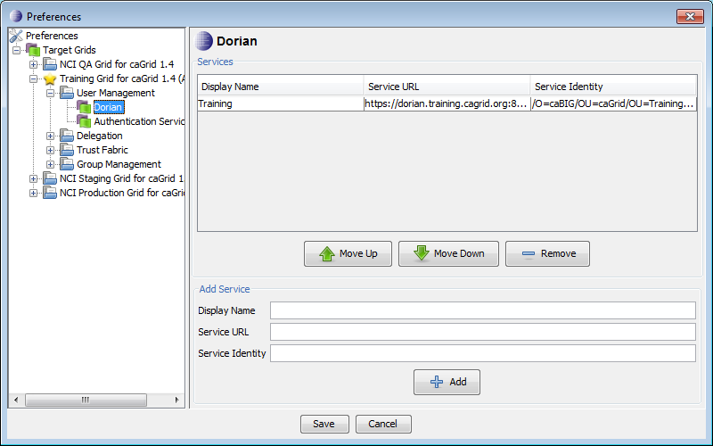

Slide 12
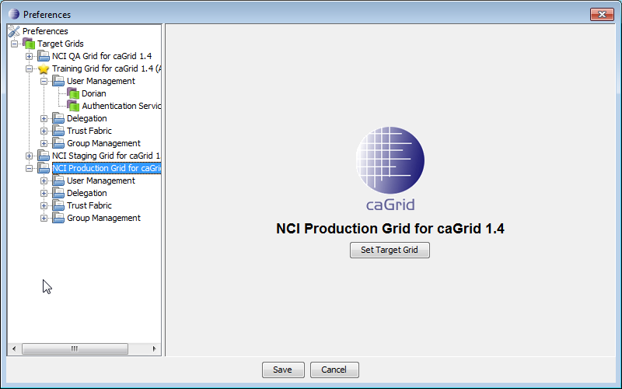
Switching Grid Configurations

Slide 13
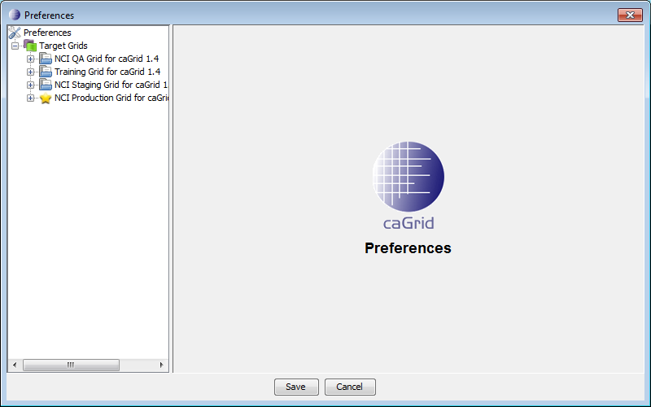

Slide 14
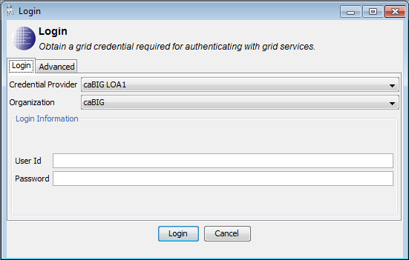

Slide 15
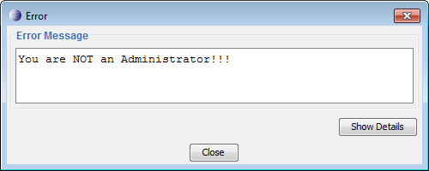
New Search Functionality
Currently, non-administrative users cannot search for users or hosts in GAARDS.

Slide 16
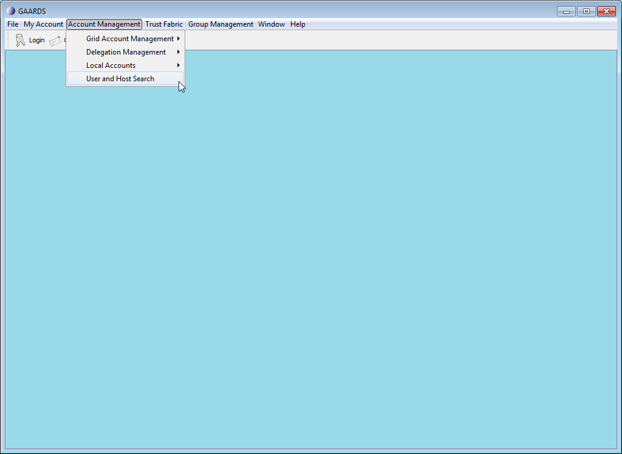

Slide 17
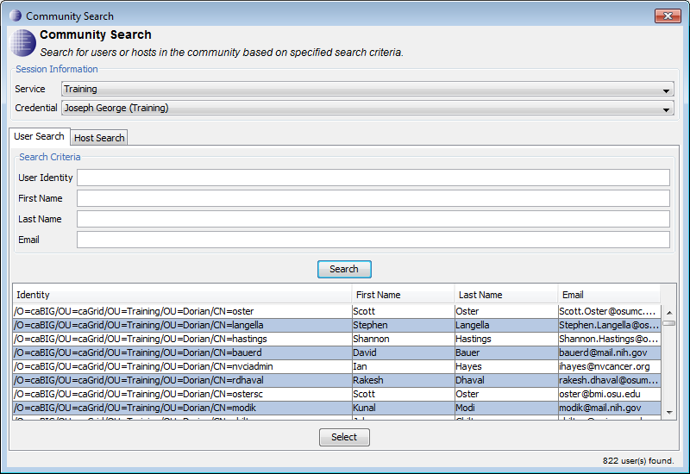

Slide 18
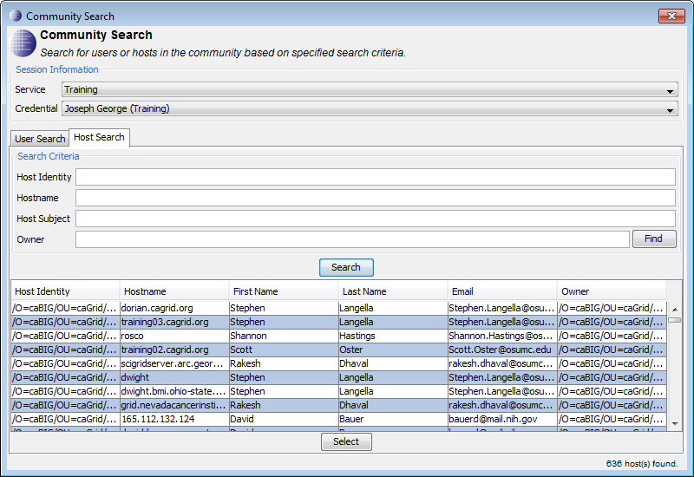

Slide 19



Knowledge Center Team
Ohio State University
Dr. Michael A. Caligiuri, Co-Director
Joe George, Senior Developer
Justin Permar, Operations Manager
William Stephens, Senior Developer
Dr. Albert Lai, Co-Director
Emory University
Dr. Tahsin Kurc, Senior Consultant
Dr. Joel Saltz, Co-Director
University of Chicago, Argonne National Lab
Rachana Ananthakrishnan, Senior Developer
Dr. Ian Foster, Scientific Advisor
Tom Howe, Senior Developer

