Slide 1
caGrid Knowledge Center User Group Teleconference 2010 caGrid 1.4 Identifiers Framework
October 21, 2010
https://cabig-kc.nci.nih.gov/CaGrid/KC

Slide 2
Overview
Overview
Conceptual Model of Identifier Framework
How does it work?
Resolve and Retrieve identifiers

Slide 3
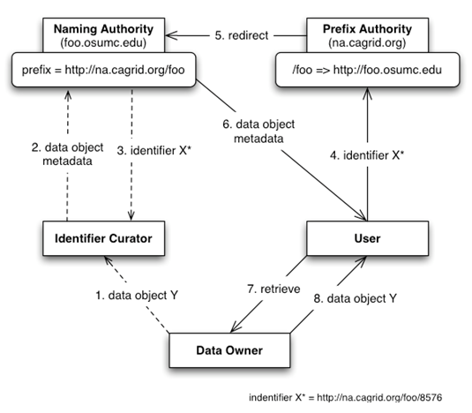
Conceptual Model of Identifier Framework

Slide 4
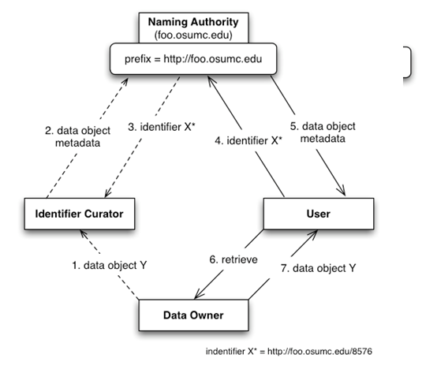
How does it work?

Slide 5


How does it work? (cont)
Structure of Identifier
Naming Authority
Prefix Authority
PURL (Persistent Uniform Resource Locator)
“PURL is a URL that does not directly describe the location of the resource to be retrieved but instead describes an intermediate, more persistent location which, when retrieved, results in redirection to the current location of the final resource."

Slide 6
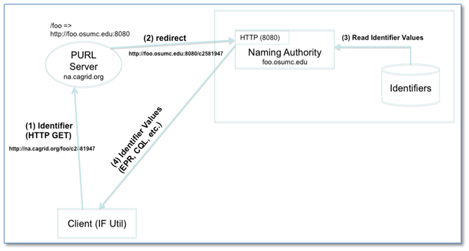
Resolution

Slide 7
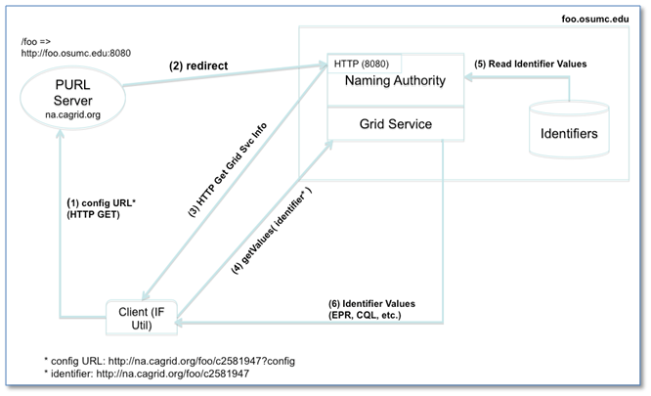
Resolution using grid service

Slide 8
Retrieval
Retrieval Profiles
Metadata
Definition

Slide 9

Questions/Comments?

