Slide 1

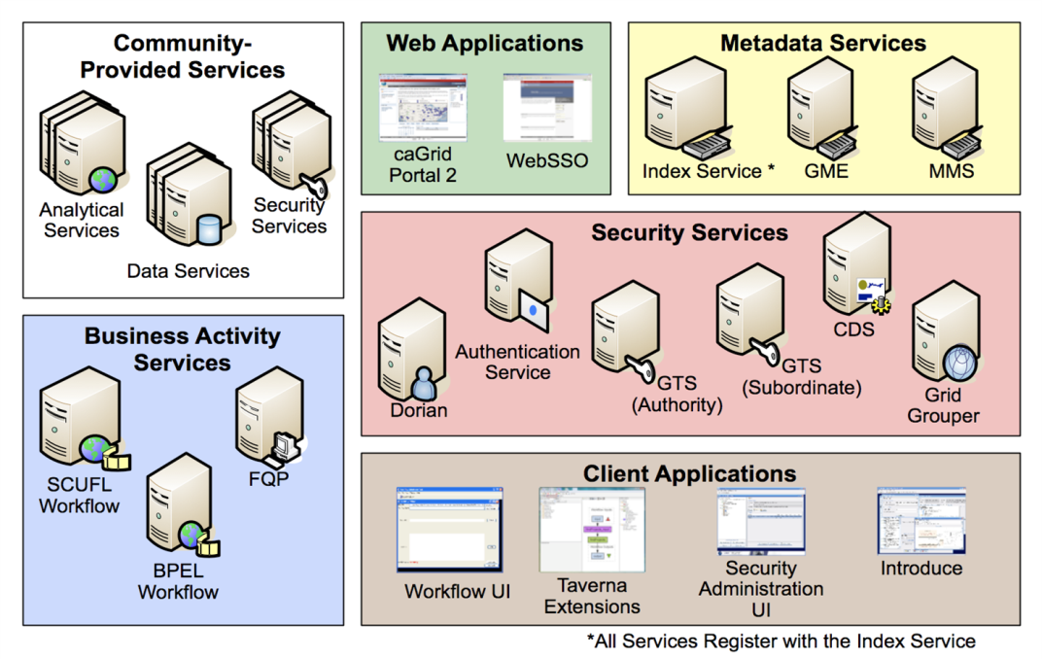
caGrid
Tile
http://www.foo.org
caBIG® is an information network enabling all constituencies in the cancer community - researchers, physicians, and patients - to share data and knowledge. The underlying service oriented infrastructure that supports caBIG® is referred to as caGrid. Driven primarily by scientific use cases from the cancer research community, caGrid provides the core enabling infrastructure necessary to deploy the caBIG® Grid. caGrid enables collaborating institutions to share information and analytical resources efficiently and securely, and allows investigators to easily contribute to and leverage the resources of a national-scale, multi-institutional environment. Although developed for Cancer, the caGrid infrastructure was designed as domain-agnostic grid infrastructure. caGrid is the informatics foundation enabling cardiovascular research in NHLBI’s CVRG. The Ohio State University Clinical and Translational Science Award (CTSA) has adopted caGrid to build a next-generation translational informatics platform.
caGrid 1.3
Technical Team
Ohio State University
Scott Oster
Stephen Langella
Shannon Hastings
Dave Ervin
Calixto Melean
Argonne National Labs
Ravi Madduri
Dinanath Sulakhe
Wei Tan
Semantic Bits
Manav Kher
Joshua Phillips
Ekagra Software Technologies
Kunal Modi
Santhosh Garmilla
National Cancer Institute
Krishnakant Shanbhag
5AM Solutions
John Eisenschmidt
SAIC
Larry Brem
caGrid
The underlying e-Science infrastructure that supports caBIG™
caGrid implements grid technologies and methodologies that enable local organizations to have ultimate control over access and management. caGrid 1.3, released in March 2009, includes important security features based on security policies and procedures from the caBIG™ Security Working Group, to enable data sharing across the caBIG™ Federation. It builds on and enhances earlier versions. The caGrid 0.5 "test bed" infrastructure was released in September, 2005, and included the initial set of software tools to effectively realize the goals of caBIG™. The release of caGrid version 1.0 in December, 2006, provided the implementation of the required core services, toolkits and wizards for the development and deployment of community provided services, APIs for building client applications, and some reference implementations of applications and services available in the production grid.
Because caBIG™ connects data and tools from 50+ disparate cancer centers and many other institutions, a critical infrastructure requirement is to support resource discovery. caGrid enables discovery by utilizing the rich structural and semantic descriptions of data
models and services that are available. Each service is required to describe itself using caGrid standard service metadata. When a grid service is connected to the caBIG™ grid, it registers its availability and service metadata with a central indexing registry service (Index Service). This service can be thought of as the “yellow pages” and “white pages” of caBIG™. A researcher can then discover services of interest by looking them up in this registry. caGrid provides a series of high-level APIs and user applications for performing this lookup which greatly facilitate the discovery process.
caGrid Provided Grid Services and Tools
Development Tools
Introduce
Metadata Services
Index Service
Global Model Exchange Service
Metadata Model Service
Security Services
Grid Trust Service
Grid Grouper Service
Dorian Service
Authentication Service
Credential Delegation Service
Business Activity Services
Federated Query Processor Service
Workflow Service
questions or comments
foo@bmi.osu.edu
http://cagrid.org

