Slide 1
caIntegrator
Integrative Analysis of Translational Research Data
Mervi Heiskanen, Ph.D.
NCI Center for Biomedical Informatics and Information Technology (CBIIT)
AACR Annual Meeting 2009

Slide 2
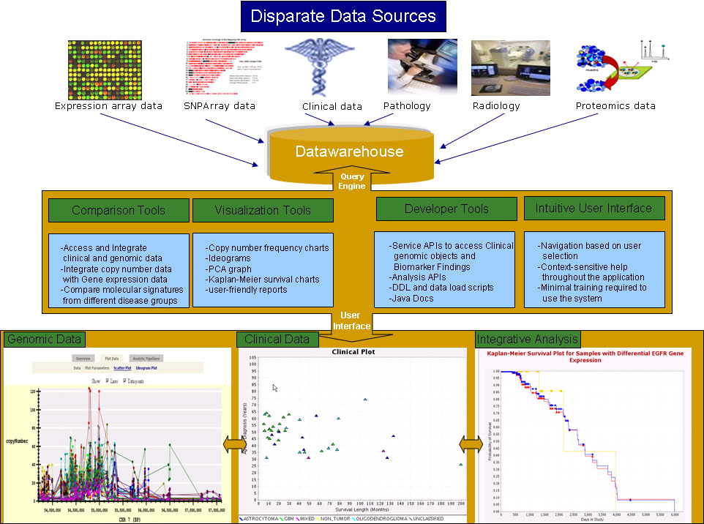
Data Integration via caIntegrator

Slide 3
caIntegrator goals
Have a single place where one can go to get all the information about a study
  Clinical Data
  Imaging Data
  Genomic Data
Provide ways to browse, query, visualize and analyze the data
  Explore and confirm hypotheses
  Publish results and lists, e.g. of interesting genes
Have a way to roll out new studies easily
Have a consistent user experience across different studies
Lay the groundwork for cross-study comparisons

Slide 4
Translational Research
NCI-CBIIT provides informatics support for several translational
studies:
Studies that bring together different data types: genomic data, biospecimen annotations, clinical & imaging data to improve diagnosis, predict outcomes and guide treatment.
  Rembrandt: REpository of Molecular BRAin Neoplasia DaTa
  Glioma molecular diagnostic initiative to facilitate cross platform validation of markers.
  I-SPY: Stage III Breast Carcinoma therapeutic trial
  to identify biomarkers that predict response to therapy throughout the course of the cancer treatment cycle .
  CGEMS: Cancer Genetic Markers of Susceptibility
  Initiative to conduct whole genome association studies to identify genes giving rise to risk of prostate and breast cancer.
  The NCI Director’s Challenge Lung Adenocarcinoma Study: combined use of clinical and molecular information to build prognostic models for early-stage lung cancer.

Slide 5
caIntegrator examples
Rembrandt application
Data publicly available in caArray and available for viewing in Rembrandt (caIntegrator).
First generation caIntegrator application
DC Lung Adenocarcinoma Study
Data publicly available in caArray now, available for viewing in caIntegrator Sep 09.
Next generation caIntegrator application: easy to create new studies, no programming is involved.

Slide 6
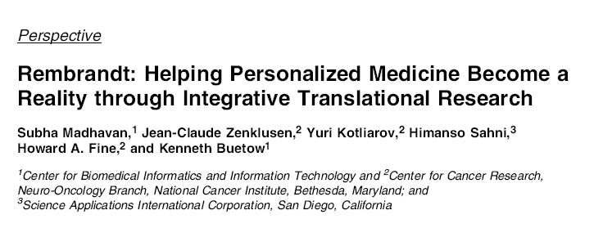
Mol Cancer Res. 2009 Feb;7(2):157-67

Slide 7
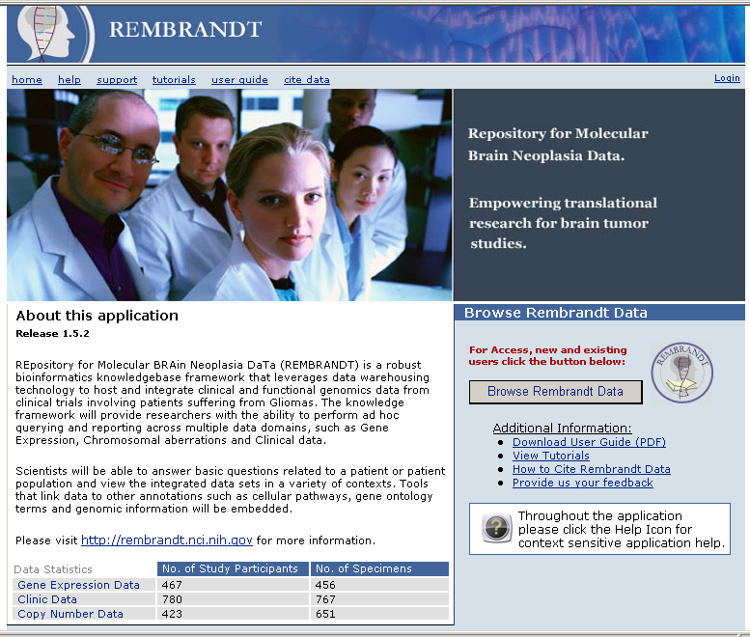
Rembrandt
REpository of Molecular BRAin Neoplasia DaTa
https://caintegrator.nci.nih.gov/rembrandt/

Slide 8
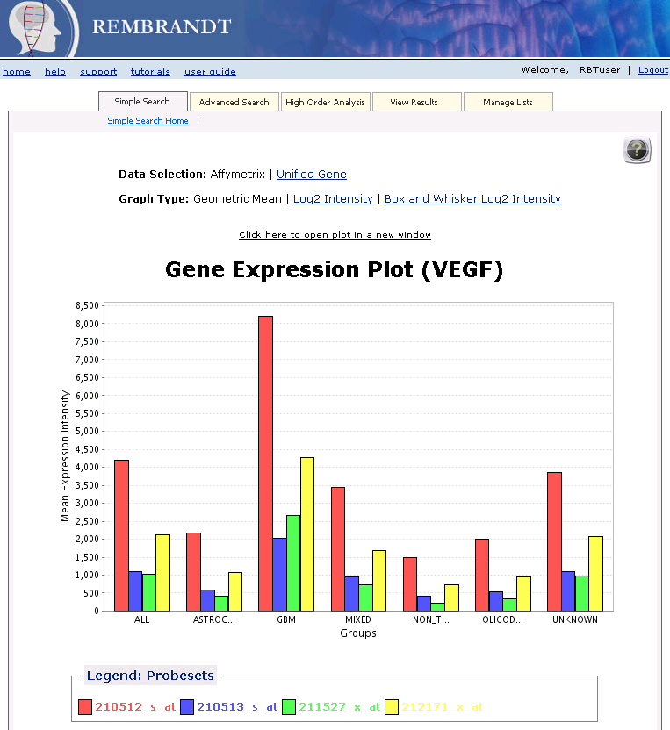
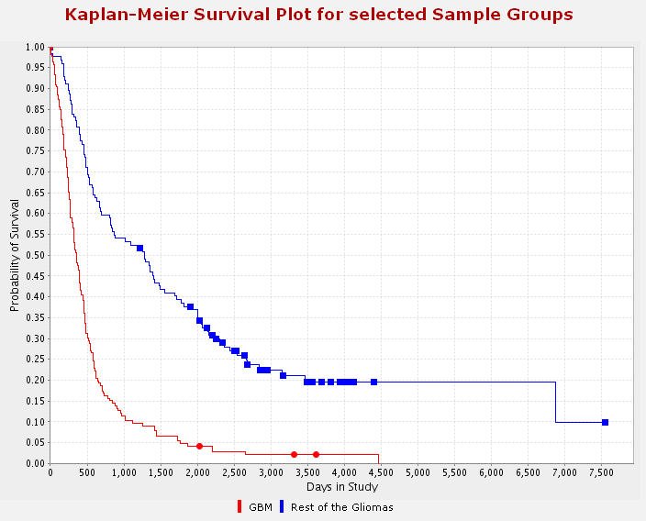
Graphical Representation of
Translational data
Gene expression plots
Kaplan-Meier Survival Plots
Clinical Scatter Plots
PCA Plots
Genome Plots (webGenome)
Link to GenePattern

Slide 9
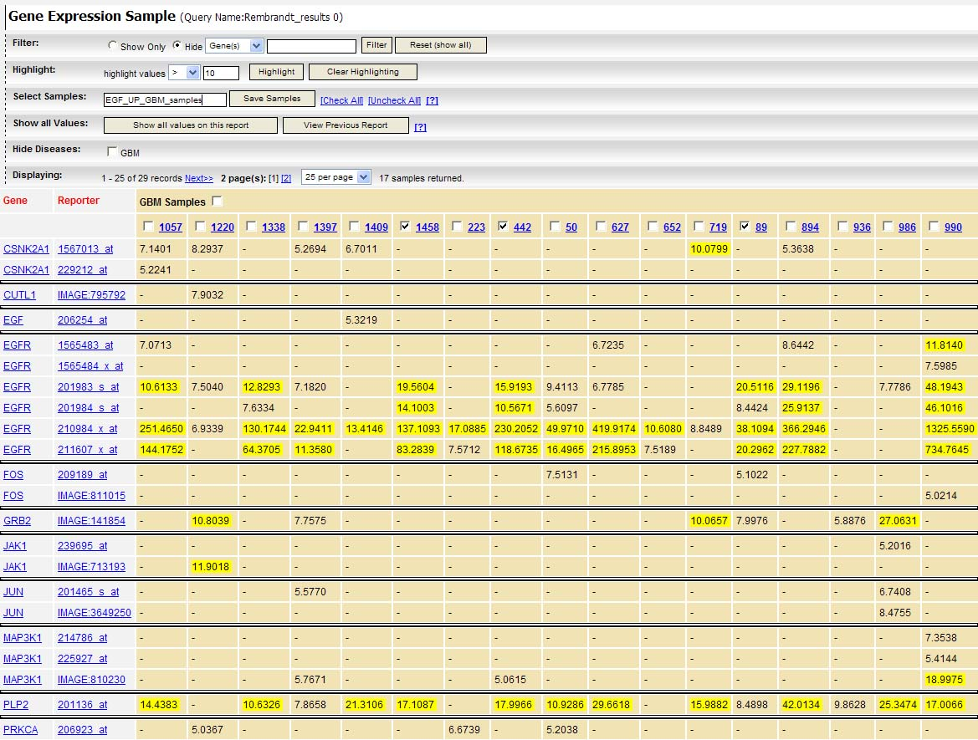
Query Reports:
Gene Expression Data Per Sample
Filter, highlight and select samples
Samples
Genes

Slide 10

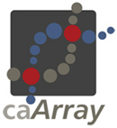






caIntegrator Data Flow
Analyze Study Data
Array Data
caIntegrator
Deploy and View Study
Clinical Data
TBD (CTODS)
Images
Image Annotations
TBD (AIM/NCIA)
Tissue Data

Slide 11
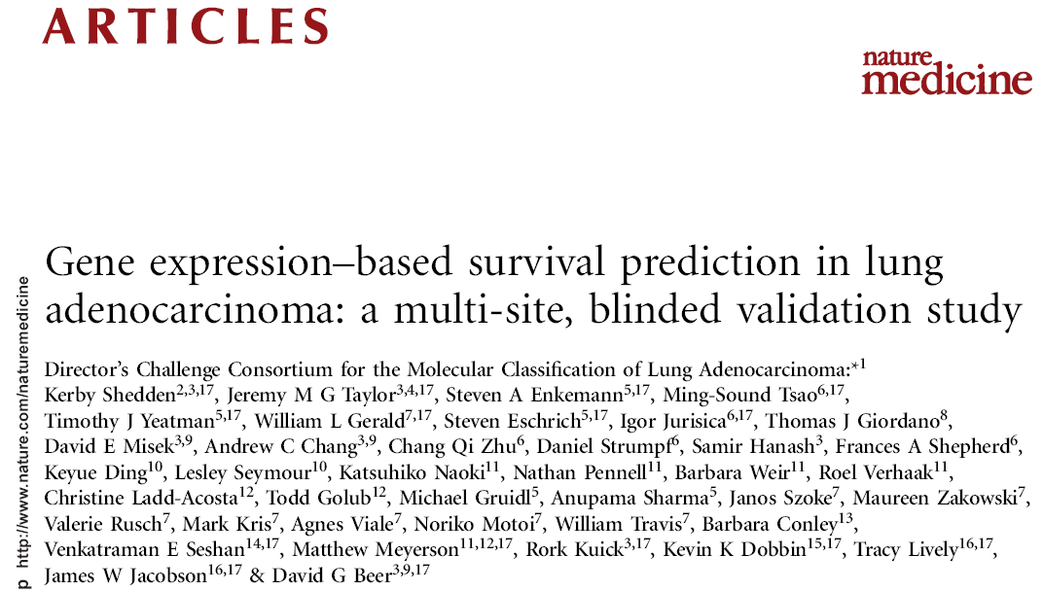
Nat Med. 2008 Aug;14(8):822-7
Notes:
Data available in caArray

Slide 12
caIntegrator: Create a New Study
Submit microarray data to caArray
Submit imaging data to NBIA
Prepare Clinical Annotation Spreadsheets
Connect to caIntegrator to create your study

Slide 13
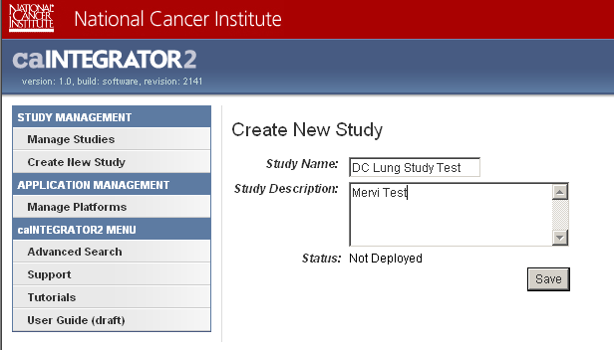
caIntegrator: Create a Study

Slide 14
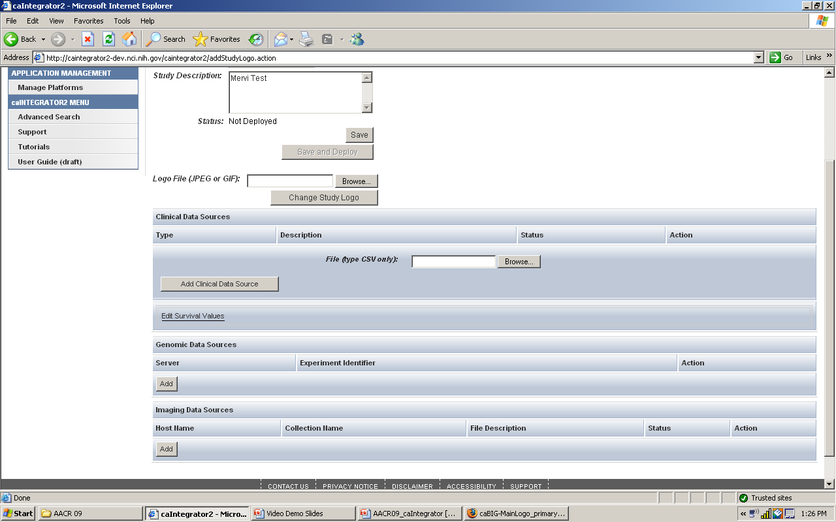
caIntegrator:
Add All the Different Data Types to Your Study
Clinical
Genomic-
caArray
Imaging-
NBIA

Slide 15
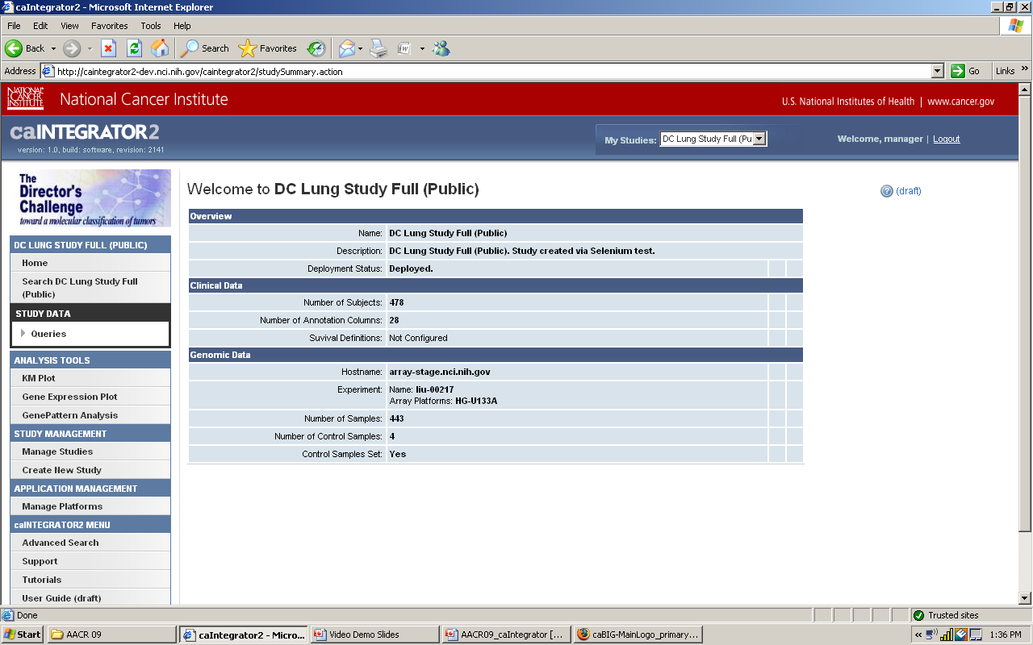
Analyze Study Data

Slide 16
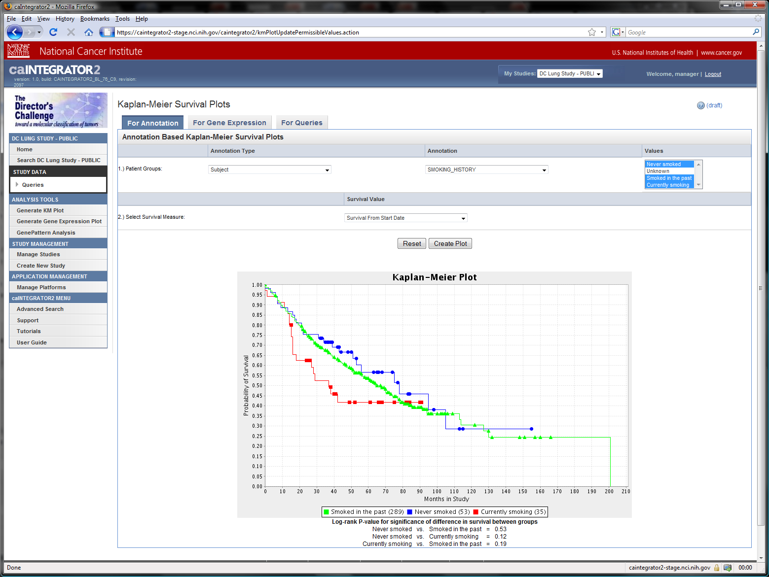
Kaplan-Meier Survival Plot smoking history

Slide 17
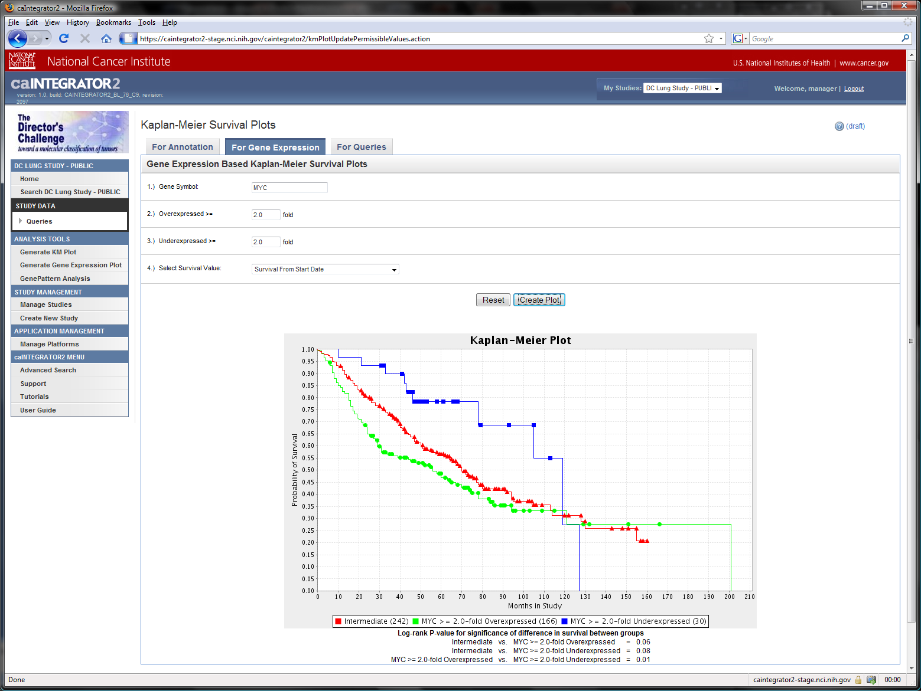
Kaplan-Meier Survival Plot: myc gene expression

Slide 18
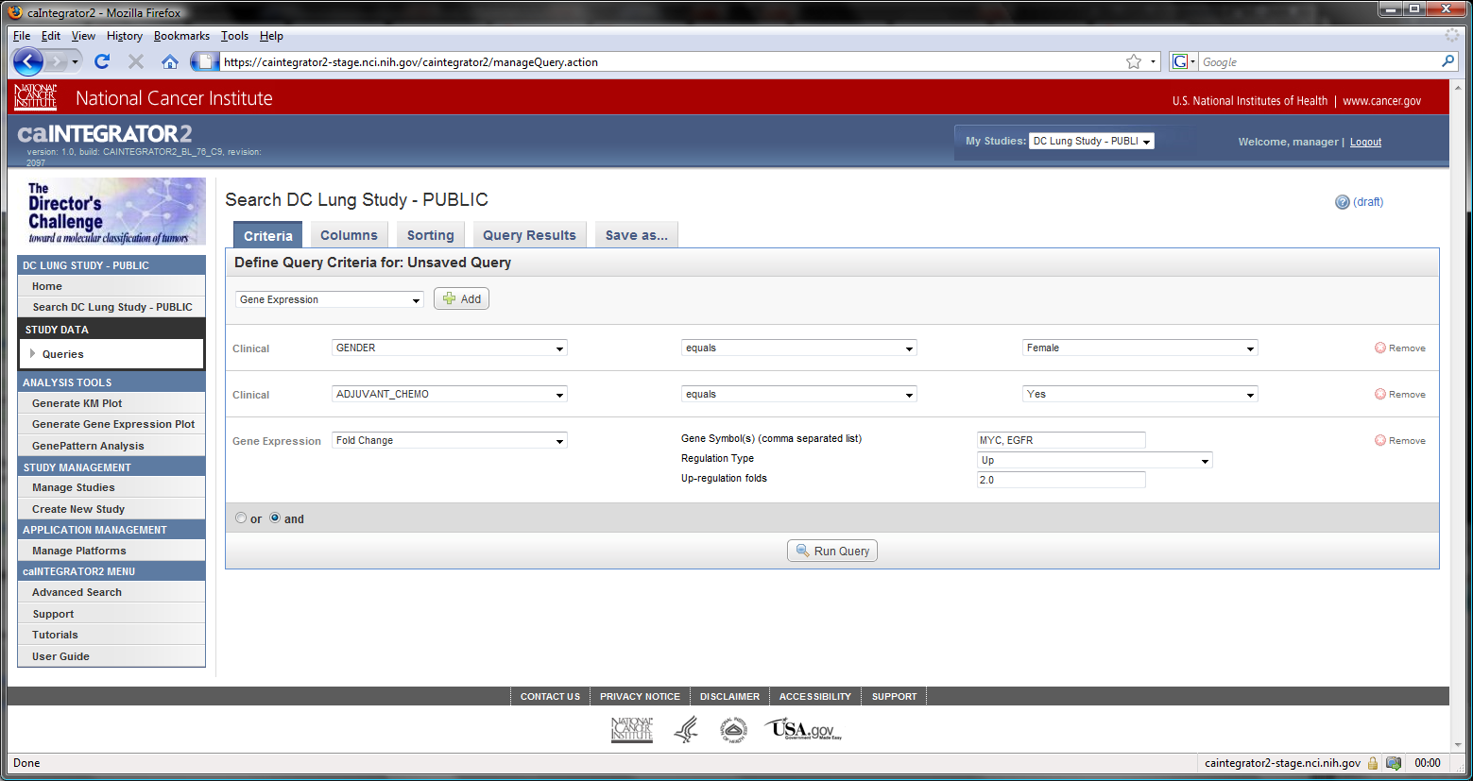
Search Data with Defined Query Criteria gender, adjuvant chemo, myc & EGFR up-regulation

Slide 19
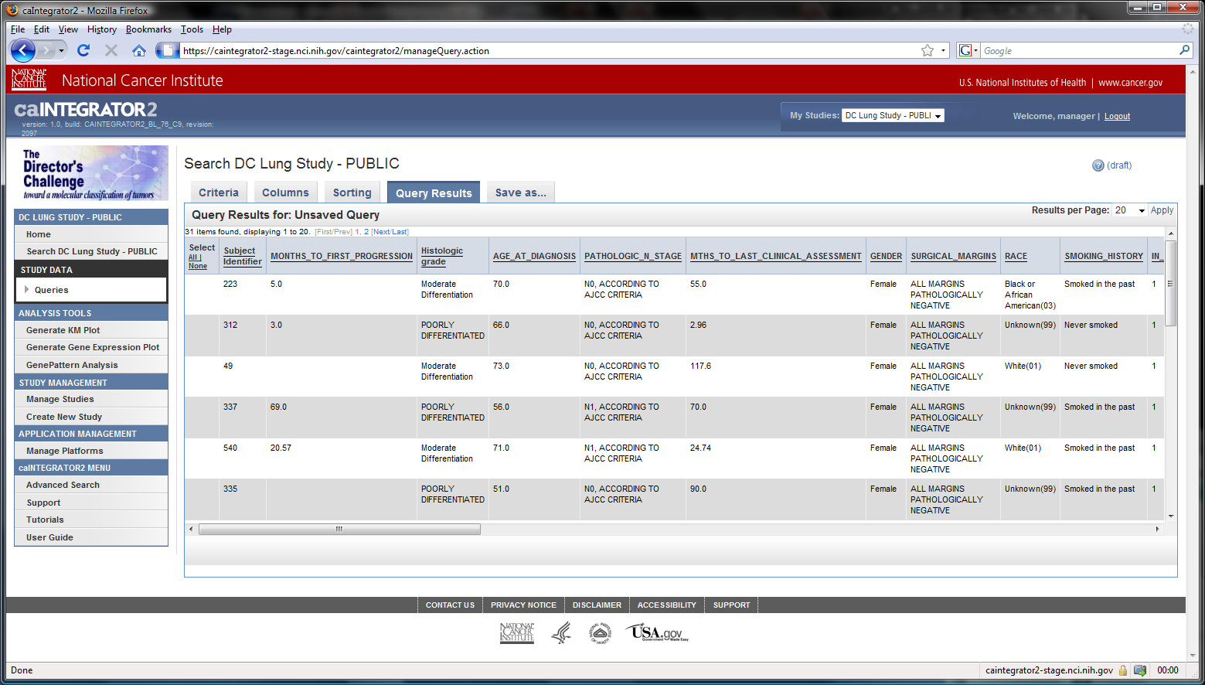
Query Results

Slide 20
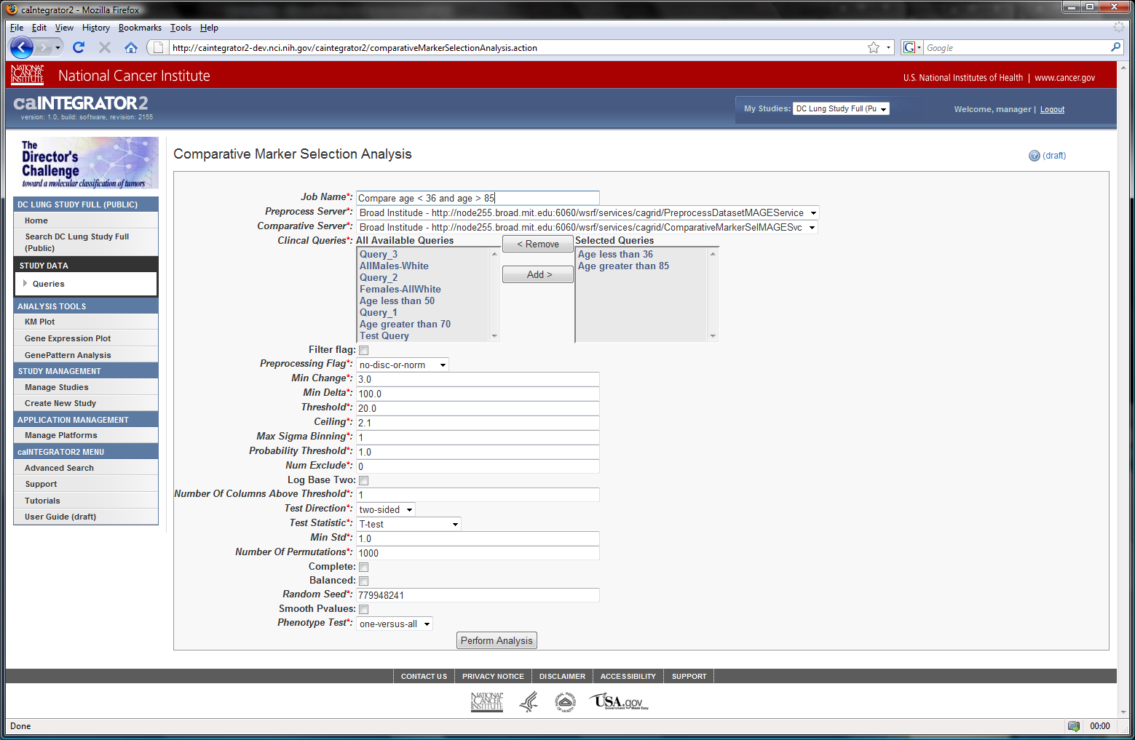
caIntegrator and GenePattern

Slide 21
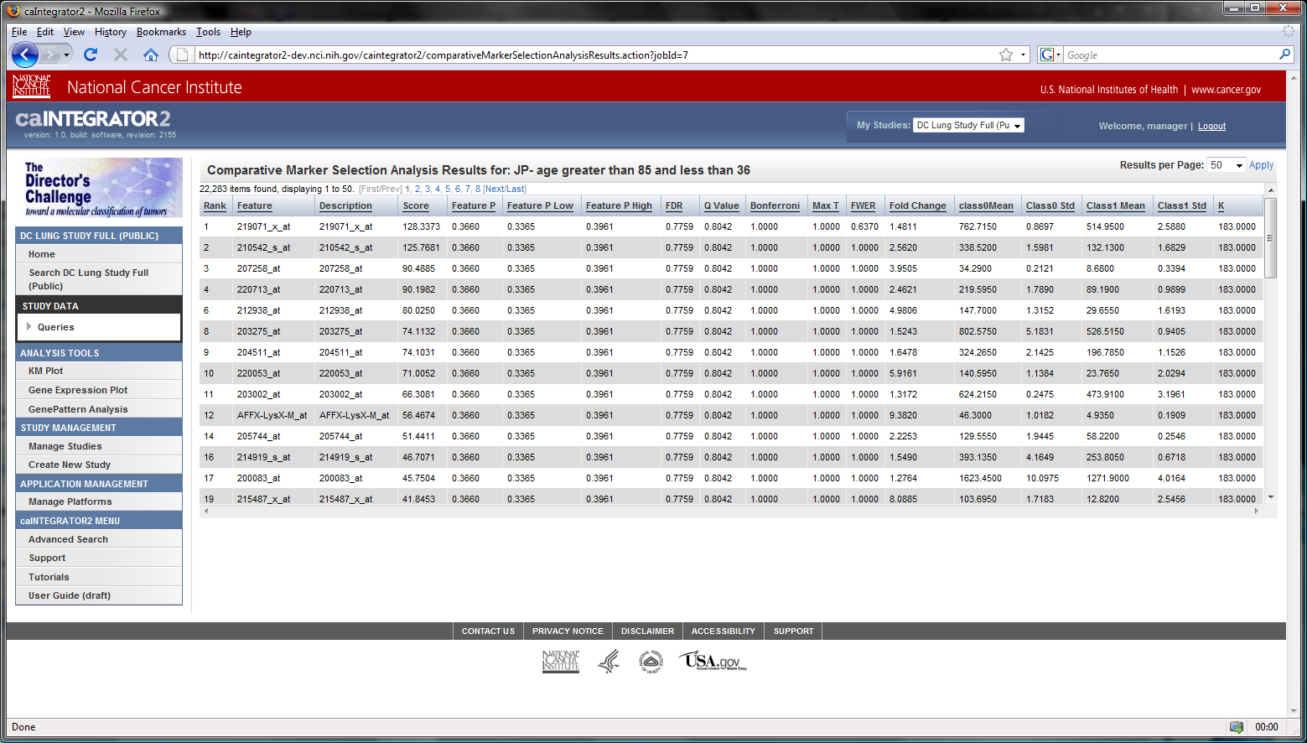
GenePattern results

Slide 22
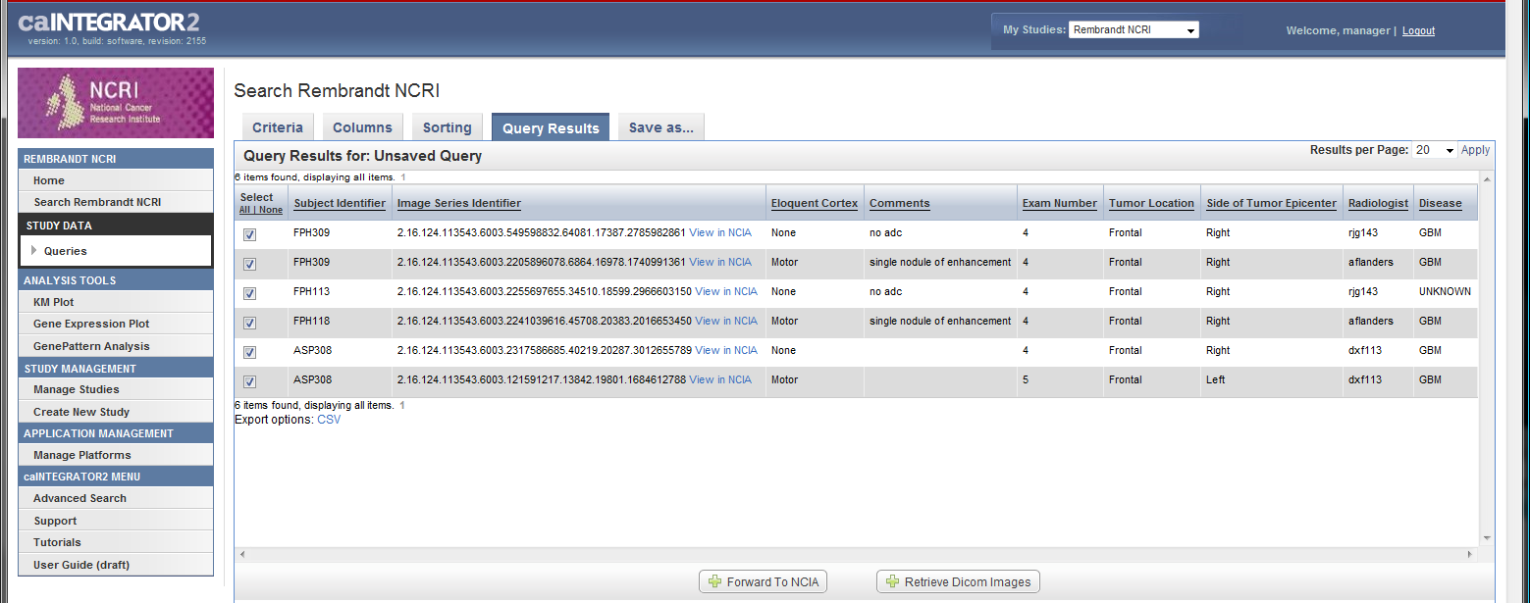
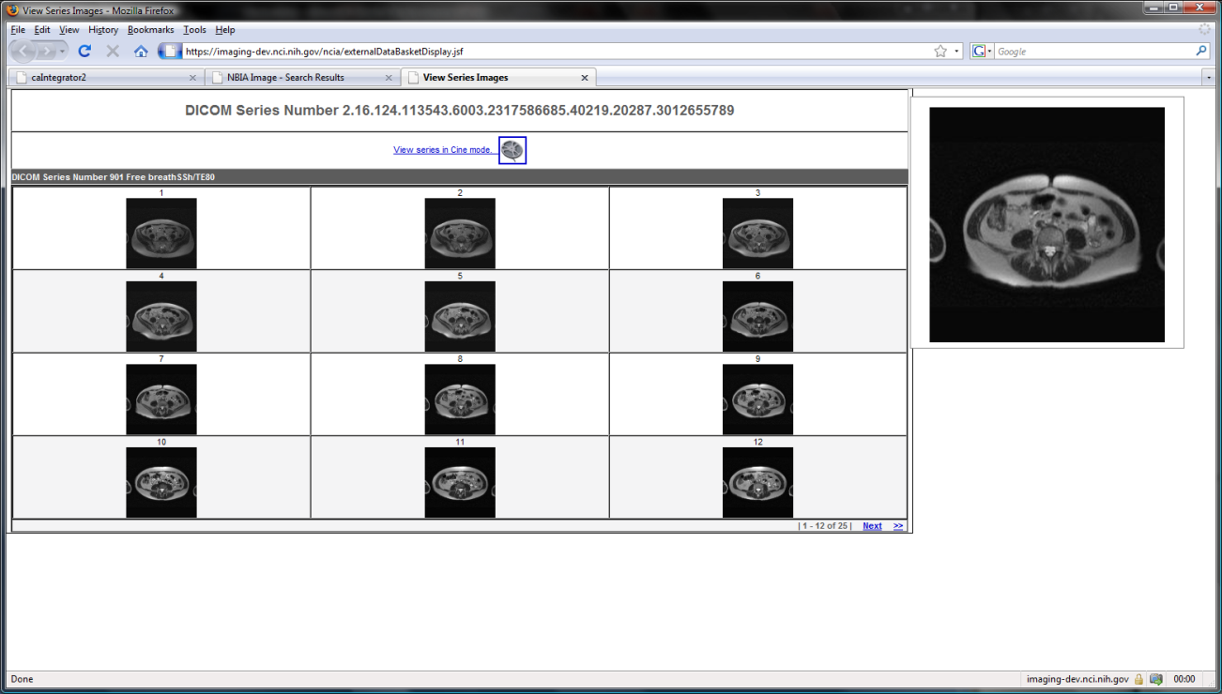
caIntegrator and the National Biomedical Imaging Archive (NBIA)

Slide 23
caIntegrator: Next Steps
More types of data
  mRNA expression data from more platforms
  Copy number and genotype data from caArray
  Biospecimen data from caTissue
Time points
  Clinical, array and imaging data can be associated with specific
  study time points (for instance, ‘Time of Diagnosis’ or ‘Six Months
  after Treatment Start’)
  Queries will be able to operate on data from specific timepoints
More analysis
  More seamless integration with GenePattern
  Integration with other analysis tools such as geWorkbench
  and BioConductor
Allow updates of study data
  New study subjects
  Updated clinical, imaging and array data for existing subjects

Slide 24
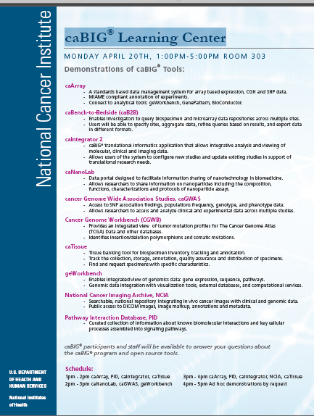
caIntegrator Information and Support
Molecular Analysis Tools
Knowledge Center
https://cabig-kc.nci.nih.gov/Molecular/KC/
Mervi Heiskanen
heiskame@mail.nih.gov

Slide 25
Acknowledgements
Anand Basu, NCI-CBIIT
Subha Madhavan, Georgetown University
Rembrandt Team: NCI CCR
DC Lung Study Team: NCI CDP
caIntegrator Development Team: Shine Jacob, Eric Tavela, TJ Andrews, Ngoc Nguyen, JP Marple, Will Fitzhugh et al
Questions?

