Slide 1
caIntegrator2 verification with Selenium
Getting started with web application testing using Selenium IDE

Slide 2
Why Do It ?
Front-end regression testing is currently a manual process and not easily reproducible.
Having a shared, team resource to test existing functionality should reveal problems earlier in the process.
Notes:
Emphasis is on shared team resource.

Slide 3
Why Selenium?
Pros:
  Firefox testing is easy to configure and run.
  Selenium IDE has a GUI and doesn’t require programming.
  Selenium IDE is a Firefox plug-in with auto updates.
  Selenium is an active open source project.
  Selenium IDE supports a record mode for quickly capturing and automating personal workflows.
  Selenium IDE tests could be used to create load tests in the future.
  Cons:
    The setup process for testing browsers other than Firefox is more complex.
    Selenium IDE Error messages can be cryptic: i.e. It is obvious that the test failed (great) but not obvious what the problem is (not great).
Notes:
- Integrated via bda.
-Historically for this project, few bugs are IE only.

Slide 4
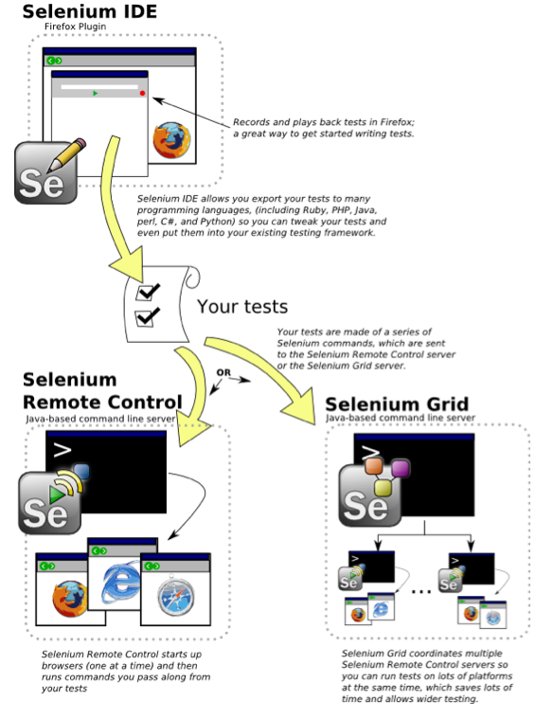
Selenium Overview
Selenium IDE – create tests and verify the app using Firefox.
Selenium Remote Control – a server application that executes your tests on a variety of browsers. (Firefox, IE, Opera)
Selenium Grid – separate server application which controls a “grid” of Selenium Remote Control servers to allow for load testing.
Notes:
- This talk is scoped to just selenium IDE.

Slide 5
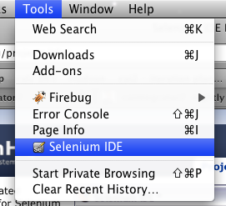
Tools
Some preliminary activities that are necessary to begin using the caIntegrator2 (caI2) tests.
To do:
  Locate the platform on which you want to test (Linux, windows, Mac) and be sure you have Ant (v 1.7.0 or later) installed there. Ant is available from http://ant.apache.org .
  Verify that you have Firefox 3.5 or newer.
  Download and install latest Selenium IDE (currently ver. 1.0.7) from
  http://seleniumhq.org/download/
  Verify that Selenium IDE is visible in the Firefox menu:

Slide 6
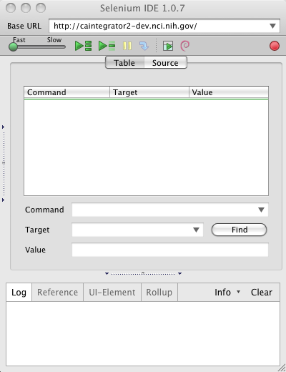
Digging In
Here are the steps to load and run the caI2 tests:
  checkout or update the caI2 repository on the OS that you wish to test
  Change directory to [caintegrator2root]/software/build
  Run “ant test:selenium:copy-tests” (this step is necessary to update the paths to be compatible with your OS of choice.)
  Start Firefox.
  Start Selenium IDE by selecting it in the Firefox -> Tools -> Selenium IDE.

Slide 7
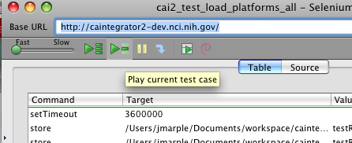
Digging In, Continued
  Open a new tab/window in Firefox and login to the caIntegrator2 tier that you want to test.
  In the Selenium menu select File -> Open -> “cai2_test_load_platforms_all”
  In the SeIDE field for Base URL, paste the url of the tier that you want to test.
  Examples:
    http://localhost:47210/caintegrator2
    http://caintegrator2-dev.nci.nih.gov/
  Select the “play current test case” button.

Slide 8
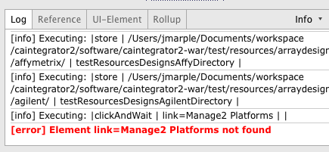
Digging In, Continued
  As the test runs, the caI2 screens will be shown in the Firefox window.
  As the test runs, the test result will be shown in the Selenium Log tab.
  If the test encounters errors, the test script will stop at the Selenium command on which it failed. Error messages will be shown in the bottom pane of the Selenium IDE window on the Log tab.
  If the test completes without errors, the Log tab will show the last command executed.

Slide 9
Demo

Slide 10
Future
Here are some potentially useful activities to expand this capability:
  Update the selenium RC configuration on Hudson and automate the nightly execution.
  Add a process requirement for passing the nightly continuous integration Hudson builds and Release to Production (GA) builds.
  Standup a Selenium RC server for the project which supports running tests using other browsers (in particular IE).

Slide 11
caI2 Process Impact
It’s a new framework and concept for caI2 - How to adopt this?
  As project, standardize initially on only 2 tests
    cai2_test_load_platforms_all : loads all platforms.
    cai2_test_deploy_pilot_study_new_load: deploys the pilot study.
  Add a requirement to each 2-week iteration to be able to pass the tests.
  Add additional tests for verifying other caI2 workflows as necessary such as Query Management and Perform Analysis.

Slide 12

Questions and Discussion

Slide 13
Jumpstart
Page Subhead Here
Front-end regression testing is currently a manual process. Having a reproducible way to regress existing functionality should reveal problems sooner.
To do:
  Use Firefox 3.5 or newer.
  Download and install latest Selenium IDE (currently ver. 1.0.7) from
  http://seleniumhq.org/download/
  Update your local copy of the caIntegrator2 repository (trunk).

