Slide 1
caIntegrator 2 Architecture Overview
March 4, 2008

Slide 2
Overview
What is caIntegrator 2?
Use-Case Model
Domain Model
Comparison with original caIntegrator
Logical architecture
Deployment architecture
Planned architectural changes

Slide 3
What is caIntegrator 2?
Provides a generic translational study model allowing deployment of any study
Links clinical data with genomic data and imaging data allowing for combined queries and analysis
Annotation can be attached to subjects, samples or images
GForge: https://gforge.nci.nih.gov/projects/caintegrator2
SVN: https://gforge.nci.nih.gov/svnroot/caintegrator2

Slide 4
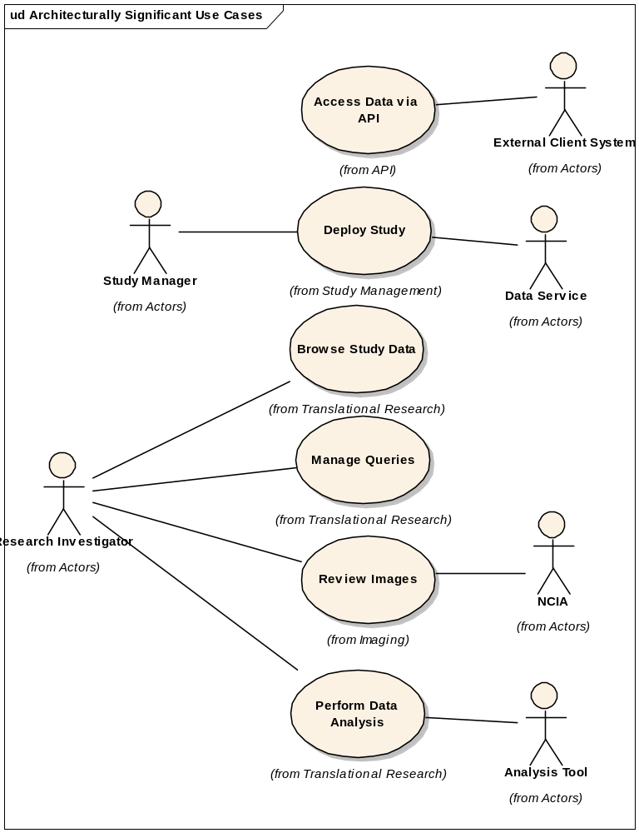
Architecturally Significant Use Cases

Slide 5
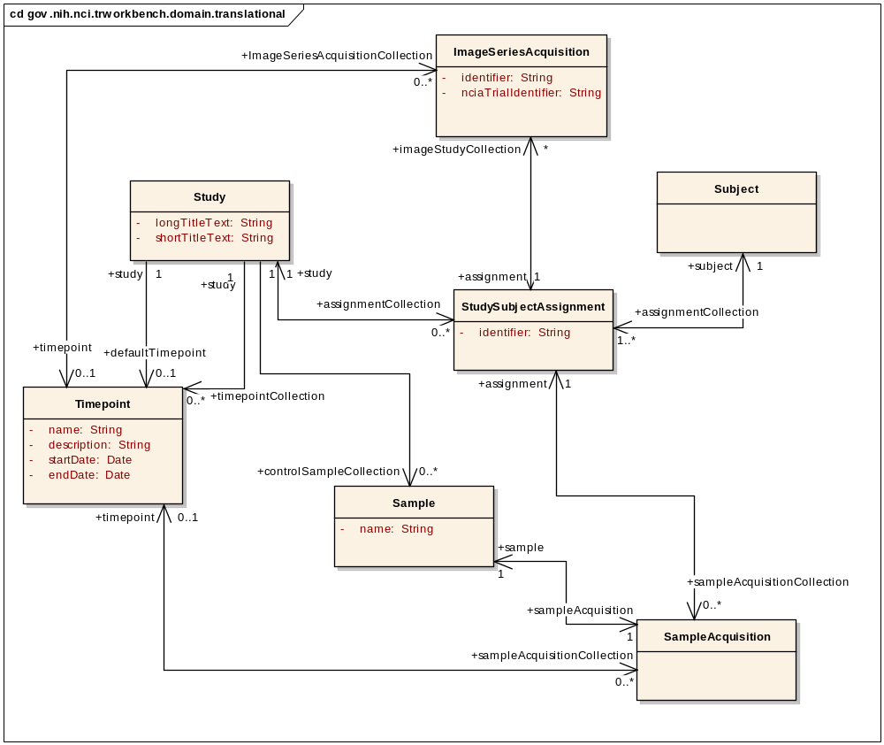
Domain Model – Translational

Slide 6
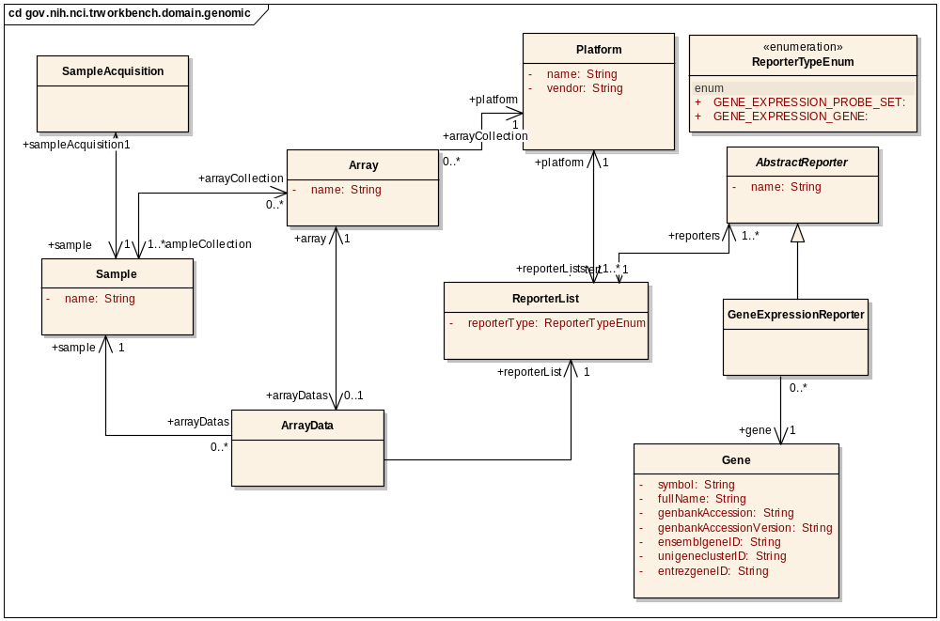
Domain Model – Genomic

Slide 7
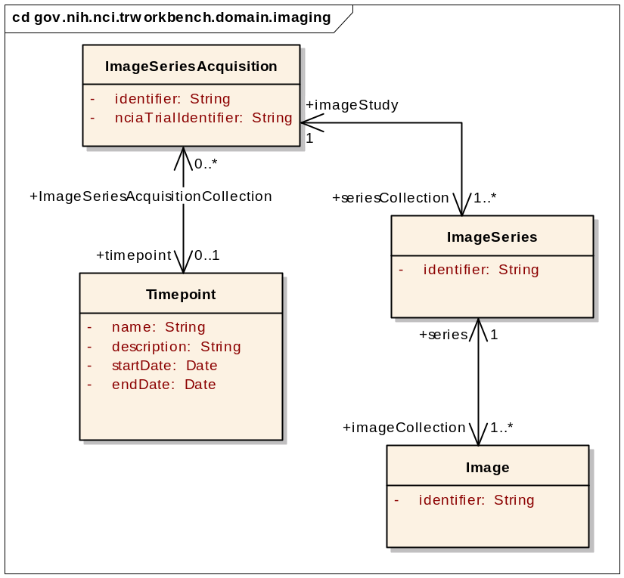
Domain Model – Imaging

Slide 8
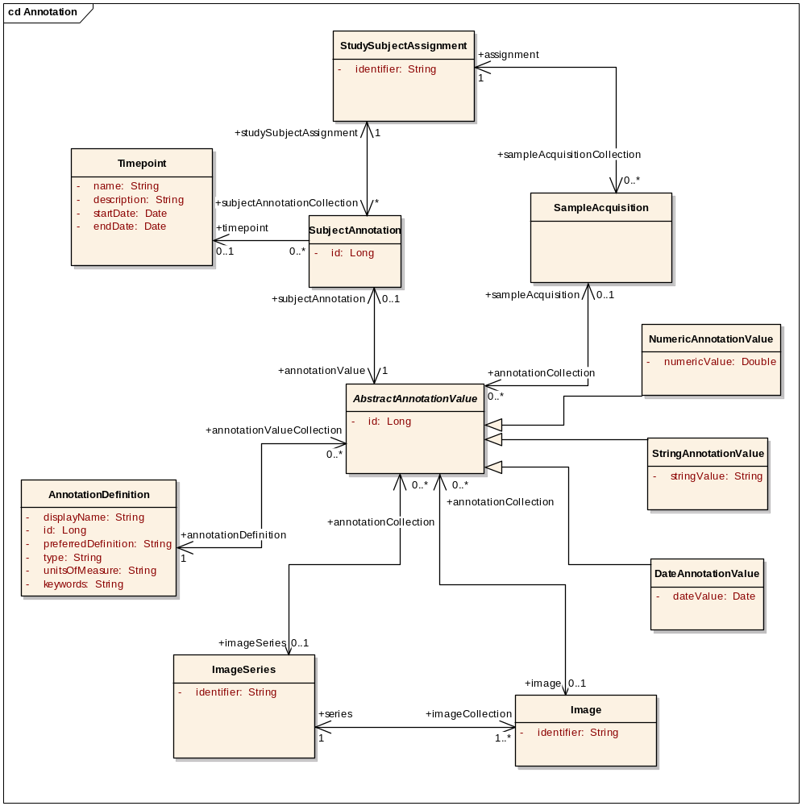
Domain Model – Annotation

Slide 9
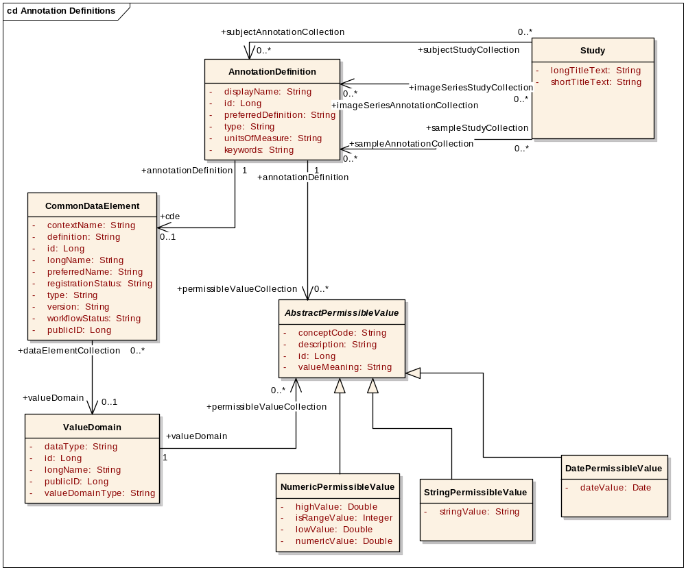
Domain Model – Annotation Definition

Slide 10
Comparison with caIntegrator
The caIntegrator project provides a set of models and components that must be incorporated into a new software project to deploy a new study.
caIntegrator studies explicitly model the annotation data to be recorded for a given study.
Studies based on the caIntegrator framework typically take about 6 months to deploy
caIntegrator 2 provides a generic metadata-based model that allows new studies to be deployed into a running caIntegrator 2 instance

Slide 11
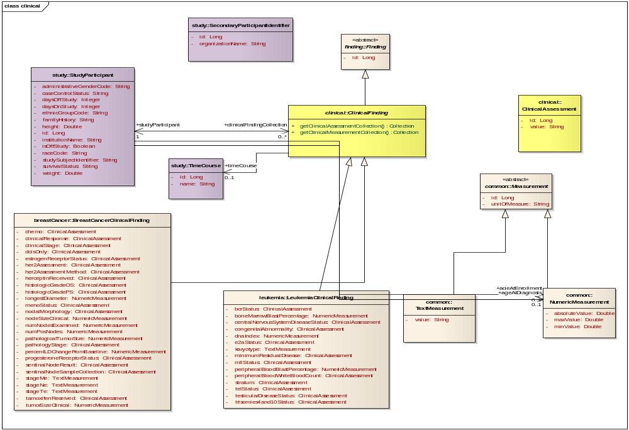
caIntegrator Clinical Annotation Model

Slide 12
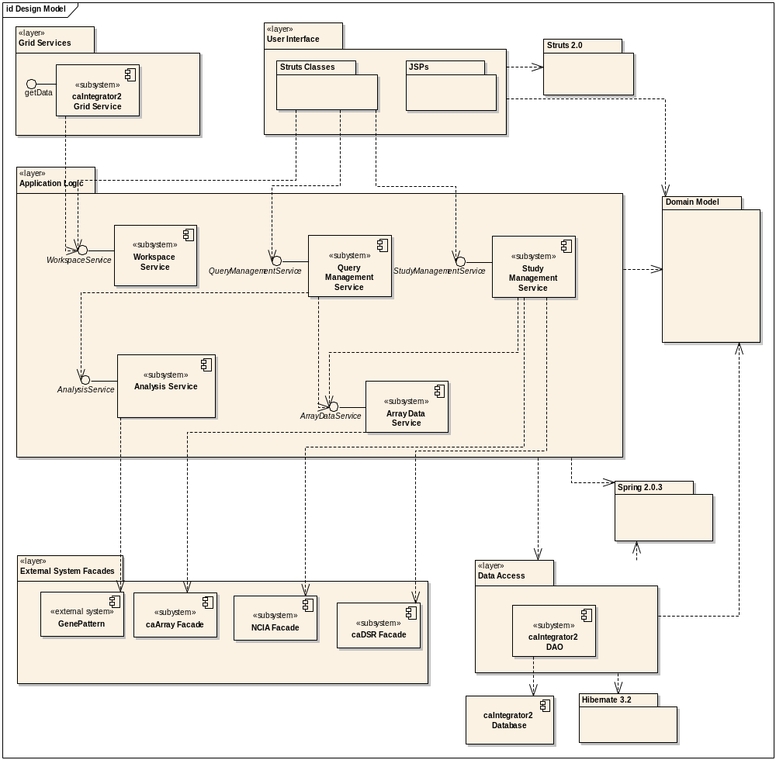
Logical View – Layers and Subsystems

Slide 13
Important Functionality
Study configuration – the following data sources may be specified
  CSV files for clinical and imaging annotation
  caArray connection information for genomic data
  NCIA connection information for imaging data
Query engine for clinical, imaging and genomic data
Array data storage implemented using NetCDF for efficient persistence and retrieval
Integration with GenePattern for analysis

Slide 14
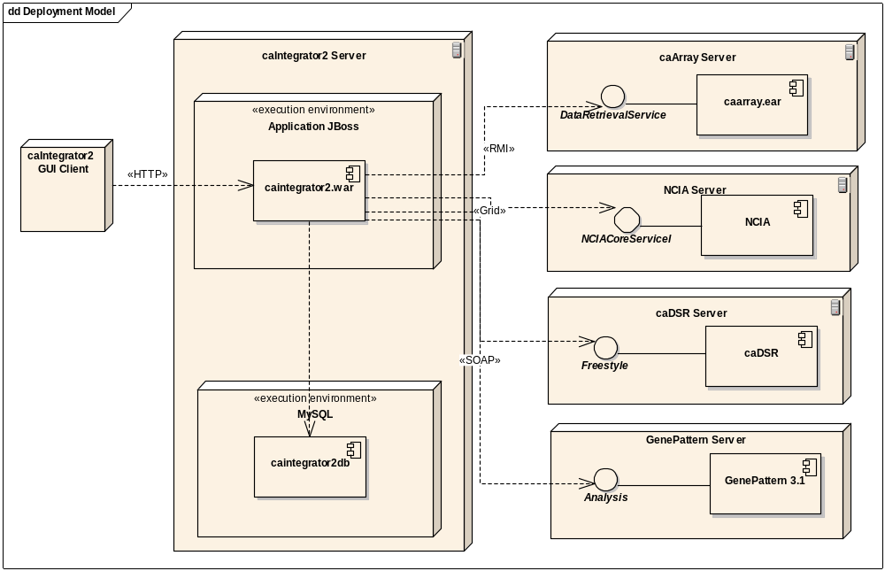
Deployment View

Slide 15
Planned Functionality
Copy number data support
Integration with grid interface to Bioconductor to generate segment data from copy number data
Integration with GenePattern grid interface to invoke GISTIC module
  Genomic Identification of Significant Targets in Cancer
Integration with caBIO for array and genomic annotation
Minimal grid interface
  Expect that few, if any, clients will want API access
  Will expand API as clients request functionality

Slide 16
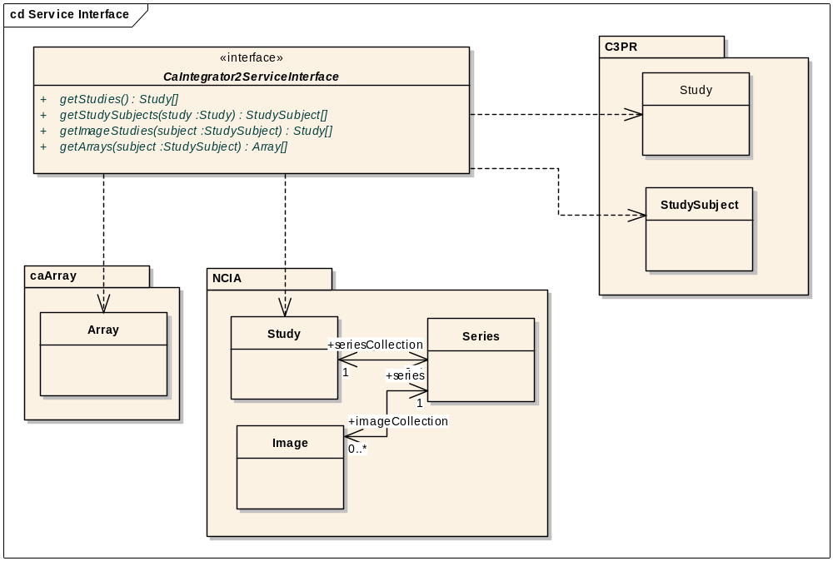
Proposed Analysis Service Grid Interface

Slide 17
Questions and Discussion

