Slide 1
GenePattern
GISTIC Analysis Service
Overview
For the GISTIC Analysis Service Silver Compatibility Review
Ted Liefeld
Broad Institute of MIT and Harvard

Slide 2
Agenda…
Overview of GenePattern
Overview of GISTIC
Architecture & API
Object Model

Slide 3
GenePattern Overview

Slide 4
GenePattern is…
A platform for integrative genomics that supports tool interoperability and reproducible in silico analyses.

Slide 5
Tool Interoperability
GeneCluster
Perl
Excel
dChip
Cluster/Treeview
Bioconductor
MATLAB

Slide 6
Analysis Reproducibility
Published research should contain sufficient information to completely reproduce the results of that research
This is especially true of in silico research
This information includes actual algorithms and data, not just methods

Slide 7
Requirements for an Integrative Genomics Platform
We needed a system with:
Comprehensive set of analyses
Interface accessible to all levels of user
Ability to chain tasks into reproducible pipelines
Ability to add new tools without programming
Local or distributed computing

Slide 8
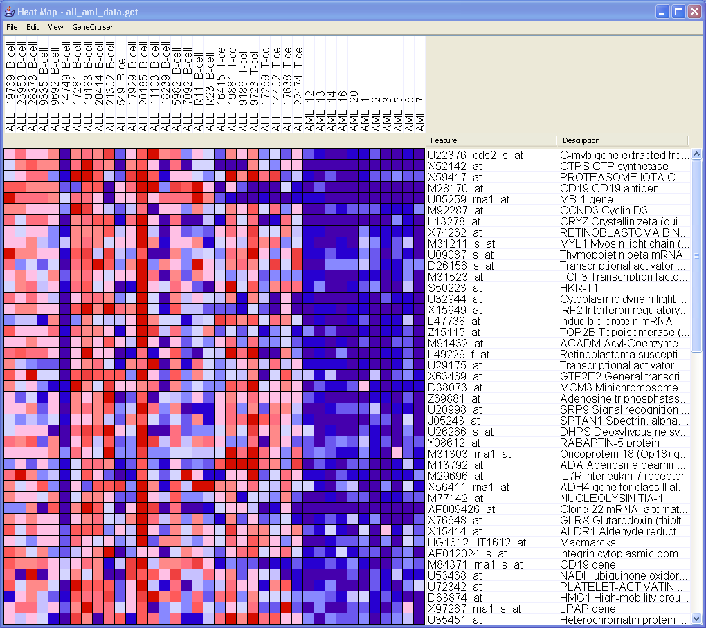
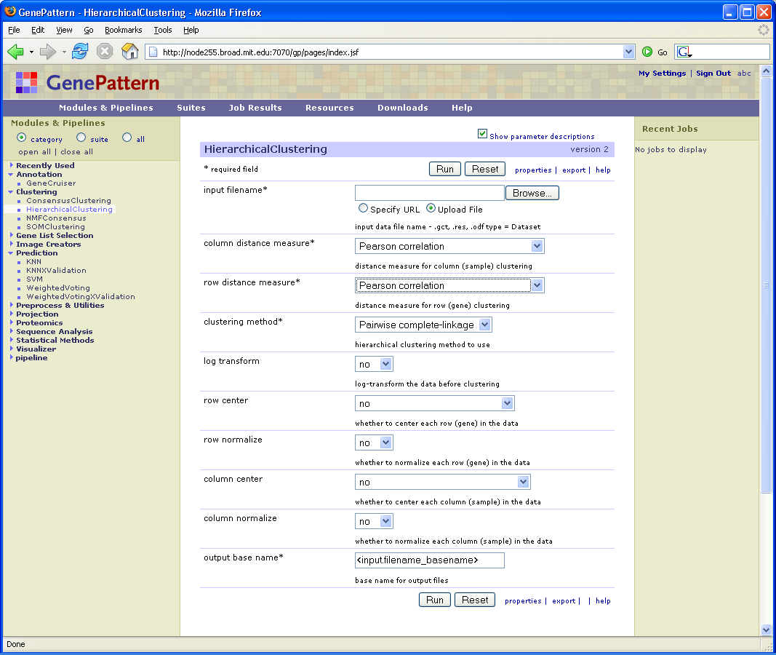
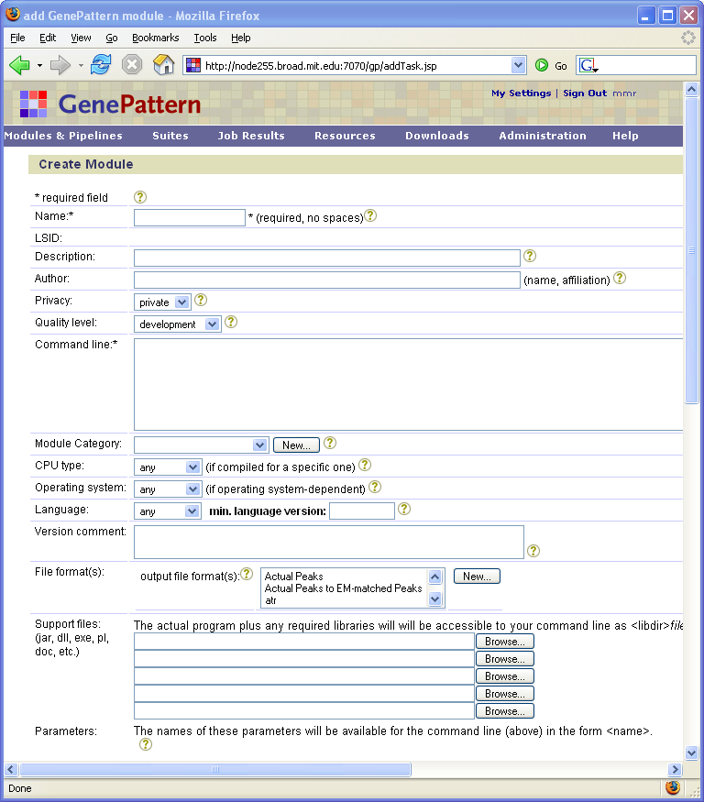
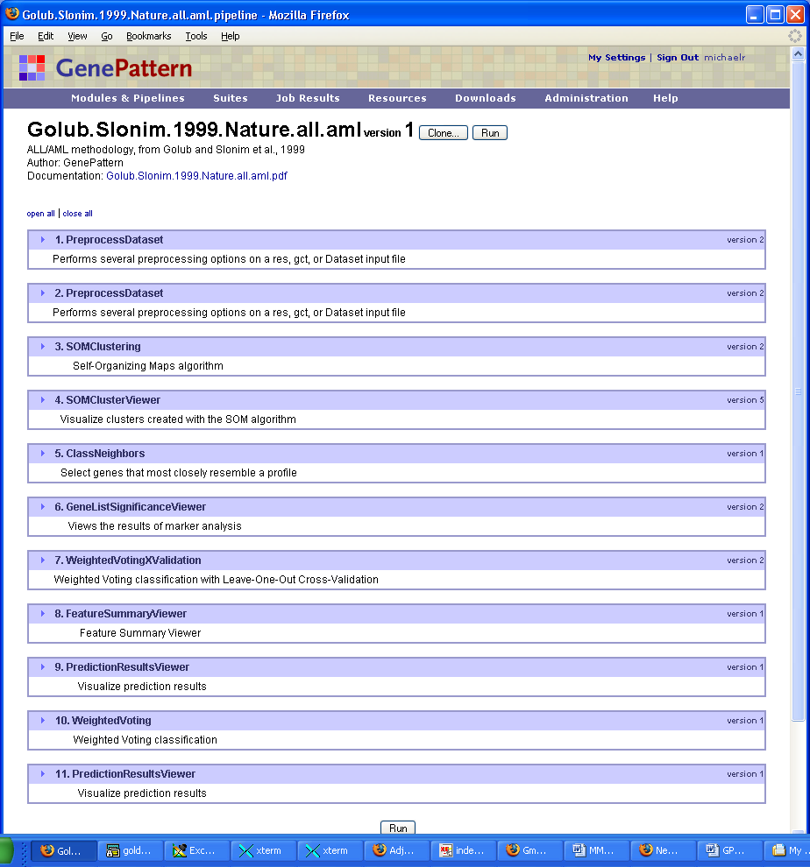
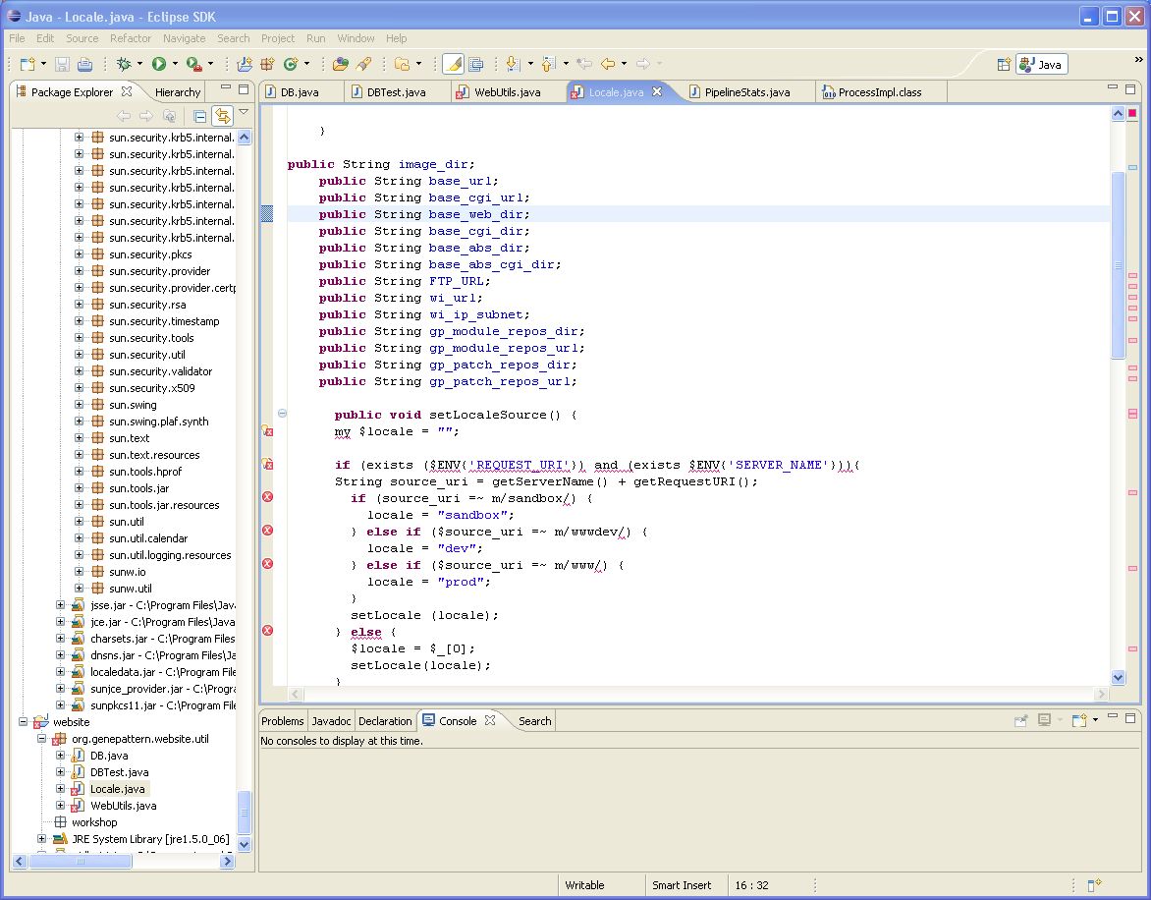

a platform for integrative genomics
Module Repository
Pipeline Environment
Client User Interfaces
all_aml_train
all_aml_test
KNN
PCA
Preprocess
Preprocess
WV
GSEA
SVM
NMF
SOM Clustering
Class
Neighbors
Weighted
Voting
Cross-Val
Weighted
Voting
Train/Test
SOM
Desktop
FWER
Module Integrator
SOM Cluster Viewer
Marker Selection
Viewer
Prediction
Results
Viewer
Prediction
Results
Viewer
Golub and Slonim et. al 1999
Web
Programming
Notes:
(This slide provides more context about how the tool either works with other tools, or how it might fit into an existing research “system.” A graphic to help set the stage is ideal – otherwise, provide a few key bullets.)

Slide 9
GenePattern Concepts
Server The GenePattern engine; manages the analyses.
Client The interface used to interact with the GenePattern server. Clients include a web interface, a Java desktop application, and a programming interface.
Analysis Module Algorithm or other operation that processes data and creates result files, e.g., Hierarchical Clustering.
Visualizer Module Self-contained application that shows a graphical representation of data and allows user interaction, e.g., Heat Map Viewer.
Pipeline Sequence of combined analysis modules and visualizers that can be run, shared, and edited as a single entity.
Suite Collection of modules grouped together, due to functional similarity (Proteomics suite), methodology subcomponent (Comparative Marker Selection suite) or as a user-defined module set.
Job When you run a module or pipeline, the GenePattern client sends your request to the GenePattern server. The server starts a job to run the analysis.
Module Repository Modules released and supported by the GenePattern Team. Hosted at the Broad Institute.
Public Server GenePattern server available for public use. Hosted at the Broad Institute.

Slide 10
caBIG Integration
caArray
  GenePattern has a caArrayImporter module
    Automatically retrieve data from caArray 1.0, 2.0, 2.1 repositories
caIntegrator
  GenePattern is integrated as the analysis engine for caIntegrator
  caIntegrator can send data file to GenePattern for analysis
geWorkbench
  GenePattern has adopted several algorithms as modules (ARACNE, MINDY)
  geWorkbench can act as a GenePattern client
Analysis Services
  GenePattern has published 5 caGrid analysis services and has 2 more expected in early Q4 08

Slide 11
The functional genomics pipeline
Experimental design
affects outcome data analysis
Data acquisition
microarray processing
Data preprocessing
scaling/normalization/filtering
Data analysis/Hypothesis generation
Supervised Analysis
Differential analysis, Classification, …
Unsupervised Analysis
Clustering, Bi-clustering, …
Validation/Annotation
Enrichment analysis
GO annotation, GSEA, …
“In silico” testing
Cross validation, train/test, etc,
“In vitro” testing
Back to the lab
Notes:
We organize this workshop around a generic analytic workflow, the “functional genomics pipeline”, which is a schematic representation of the set of tasks that are usually performed on microarray data (keeping in mind that case by case some of these tasks might be not carried out, others added, and their sequence altered).
The pipeline is a rather natural temporal organization of the tasks usually performed, starting from the
Experimental design: which involves the determination of the number of samples, what experimental conditions to be included, the number of replicates per condition, whether to collect time series, etc.
Data acquisition: involves the actual profiling of the selected samples by means of the microarray platform of choice (Affy in our case)
Data preprocessing: aimed at producing data cleaned as much as possible of unwanted sources of noise
The actual analysis, aimed at generating hypotheses that will need to be tested/validated

Slide 12
GenePattern Methods
Differential Analysis
Create expression data set - ExpressionFileCreator
  For Agilent: AgilentToGct
Reduce number of hypotheses/genes by variation filtering – PreprocessDataset
Make class file
Run Differential Analysis – ComparativeMarkerSelection
  Choose test statistic (say, t-score)
View results with ComparativeMarkerSelectionViewer
  If enough samples, compute p-values by permutation test (otherwise, use asymptotic test).
  Control for MHT by using the FDR correction
  Use HeatMapViewer to view results for top genes

Slide 13
GenePattern Methods
Classification
Split data into train and test set – SplitDatasetTrainTest
Filter data - PreprocessDataset
Explore different feature selection methods and different classifiers on train set by CV.
  KNNXValidation
  WeightedVotingXValidation
Once the “best” classifier and best classifier parameters have been selected (based on CV)
  KNN
  WeightedVoting
Examine results:
  PredictionReultsViewer
  FeatureSummaryViewer

Slide 14
Clustering methods in GenePattern
Representative based:
Find representatives/centroids
  K-means
  Self Organizing Maps (SOM)
Bottom-up (Agglomerative):
Hierarchically unite clusters
  Hierarchical Clustering
Clustering-like:
  NMFConsensus
  PCA
No BEST method! For easy problems – most of them work.
Each algorithm has its assumptions and strengths and weaknesses

Slide 15

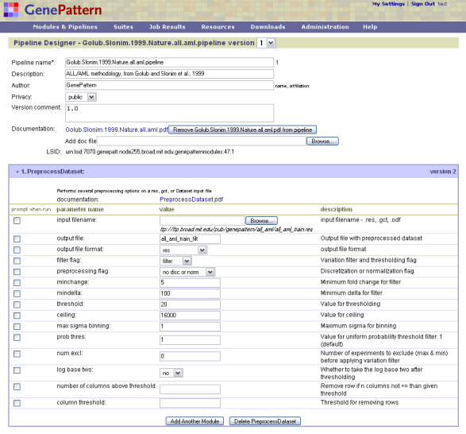
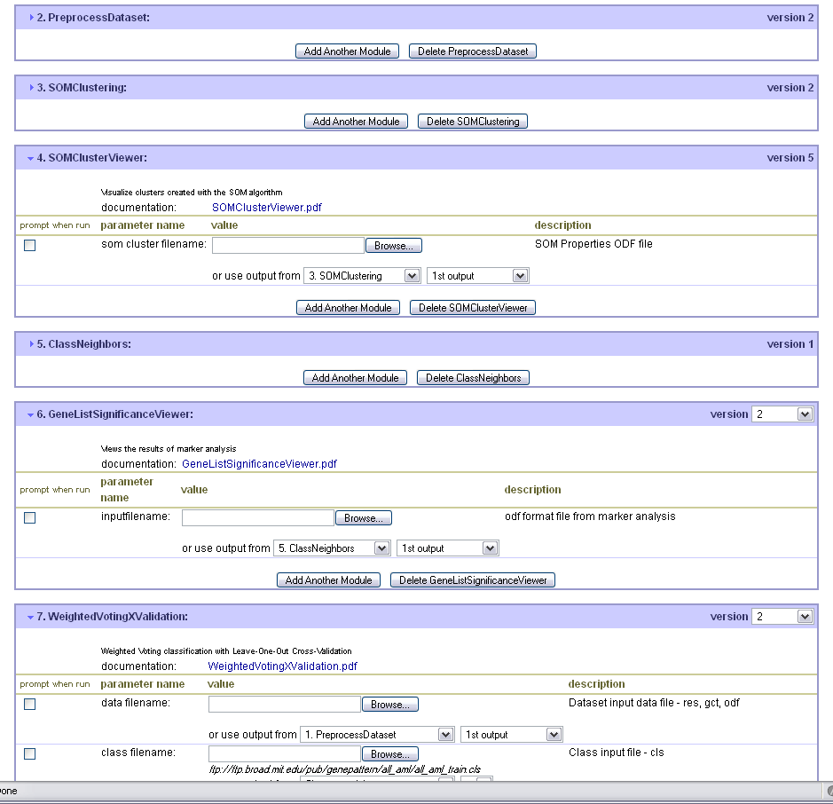

GenePattern Pipeline Environment
remote data source
[http://research.dfci.harvard.edu/justin/demo/nci60.res]
Threshold
impose a baseline and a ceiling
PreprocessDataset
extract breast samples
GeneNeighbors
compute nearest neighbors of
cyclin D1 in breast cells
SelectFeaturesColumns
extract ovary samples
SelectFeaturesRows
get expression data for breast neighbors in ovary cells
HeatMapViewer
project data as a heat map
The Broad Institute of MIT and Harvard

Slide 16
What can you do with pipelines?
Run an analysis that requires the coordination of several modules
Easily rerun the same analysis over multiple data sets
Experiment with parameters of a complex methodology
Encapsulate the algorithms and parameters you used for a method so it can be remembered later
Share a pipeline with others who want to reproduce your results

Slide 17
Runtime Settings in Pipelines
Pipelines can accept parameters at run time
  To change a parameter setting
  To provide a data file
  To arrange several modules to appear as one
Indicated by “Prompt when run” parameter setting

Slide 18
Additional Features
Module Integrator
SNP, Proteomic, Pathway analysis
Programming Environment(s)
  Available for Java, R, Matlab
  Integrate GenePattern with other webapps
GenePattern configurations
  Local - run on a desktop or laptop
  Large - run on a shared server
  Clustered - run using LSF, SGE, etc to distribute jobs to a compute farm

Slide 19
Overview of GISTIC
Genomic Identification of Significant Targets in Cancer (GISTIC)
  a statistical method for identifying regions of aberration that are more likely to drive cancer pathogenesis
GISTIC is a two step analysis
  calculate a statistic (G score) that involves both the frequency of occurrence and the amplitude of the aberration.
  assesses the statistical significance of each aberration by comparing the observed statistic to the results that would be expected by chance
    via a permutation test that is based on the overall pattern of aberrations seen across the genome
    account for multiple-hypothesis testing using FDR and assign a q value to each result, reflecting the probability that the event is due to chance fluctuation
For each significant region, the method defines a "peak region" with the greatest frequency and amplitude of aberration. Each peak is tested to determine whether the signal is due primarily to broad events, focal events, or overlapping events of both types.

Slide 20
GISTIC Reference

Slide 21
GISTIC Analysis Service Architecture
caGrid
Clients
GenePattern Clients
caGrid
Graphical
Client
Web
Browser
Client
caGrid
SOAP
HTTP
caGRID proxy
SOAP
SOAP
Analysis Task Manager
Consensus
Clustering
Algorithm
CMS
Algorithm
…
GISTIC
GenePattern Engine

Slide 22
GISTIC API
caGrid service APIs GISTIC matches other GenePattern services
Analysis Service
  Exposes API over caGRID
    runAnalysis(,,)
  Generated using caGRID tools (Introduce)
  Domain objects returned
    GisticResult ->ChromosomalSegment(s)
  Security - GISTIC does not implement caGrid security

Slide 23
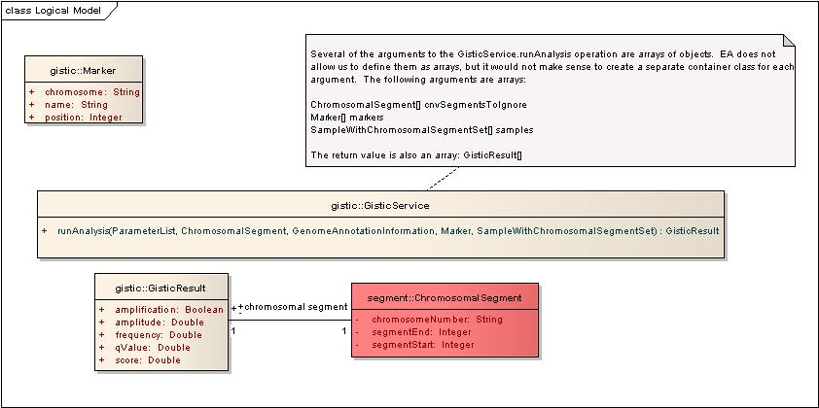
GISTIC API

Slide 24
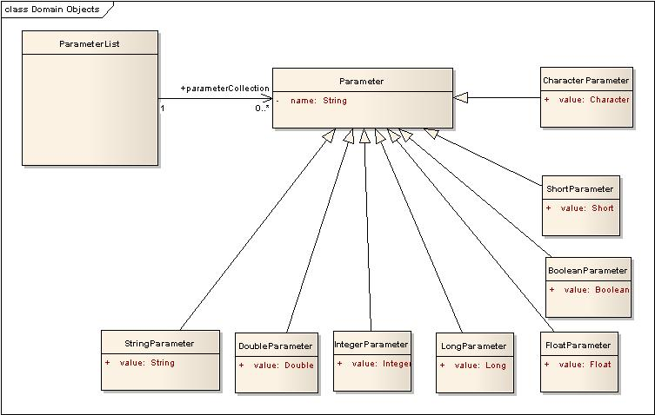
GISTIC API Parameters
GISTIC was implemented using the GenericParameters model of ASBP for tuning parameters

Slide 25
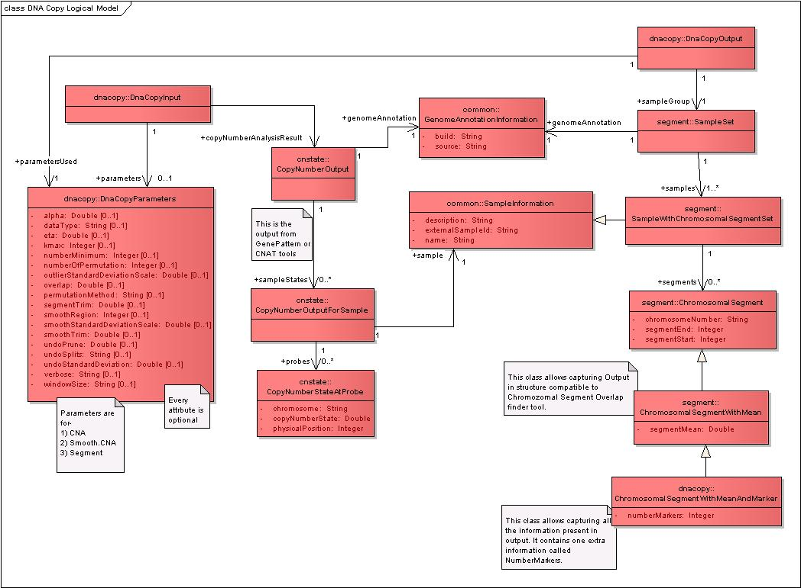
GISTIC API - DATA
The GISTIC data model is based on the WashU DNA Copy Number model with
small extensions for the GISTIC output (directly use their model for inputs)

Slide 26
GenePattern Community
Collaborations
  caBIG: cancer Biomedical Informatics Grid
  ICBP: Integrative Cancer Biology Program
  NCBC: National Centers for Biomedical Computing
    NCIBI (University of Michigan)
    MAGNet (Columbia University)
  Stanford University: SMD
  Microsoft: Reproducible Research
  European Nutrigenomics Organization (NuGO)
GenePattern Users
  First public release of version 1.0 on 1/30/2004
  Currently over 9000 registered users
  Online forum: 120 members
  Users mailing list: over 1200 members

Slide 27


Acknowledgements
Funding
NCI
NIH
NIGMS
Core Development
Jon Bistline
Peter Carr
Elijah Flakes
Qing Gao
Josh Gould
Barbara Hill
Heidi Kuehn
Jim Lerner
Ted Liefeld
Marc-Danie Nazaire
Jared Nedzel
Michael Reich
Jim Robinson
Helga Thorvaldsdottir
Module Contributors
Gaddy Getz
Mitch Guttman
Yujin Hoshida
Justin Lamb
D.R. Mani
Stefano Monti
Ken Ross
Aravind Subramanian
Pablo Tamayo
David Twomey
PI
Jill P. Mesirov

Slide 28
GenePattern Resources
Public GenePattern server
  genepattern.broad.mit.edu/gp
GenePattern Web site
  www.genepattern.org
Feature requests/bug reports/general help
  gp-help@broad.mit.edu
Online forum
  www.genepattern.org/forum
Mailing list to receive GenePattern news
gp-users@broad.mit.edu - sign up at
  www.genepattern.org/gp_mail.html
Gene Set Enrichment Analysis (GSEA)
  www.broad.mit.edu/gsea
  Molecular Signatures Database (MSigDB)
  www.broad.mit.edu/gsea/msigdb

