Slide 1
Unidata’s Common Data Model and
NetCDF Java Library API
Overview
John Caron
Unidata/UCAR
Nov 2008

Slide 2
Java = Programmer Productivity
Portability
Object Oriented
Libraries everywhere
Thriving open source development
Strong typing (aka type safety)
  needed for large development projects
Good tools: IDEs, debuggers, profilers
Very productive
Java is faster than C for some applications
  eg multithreaded server

Slide 3
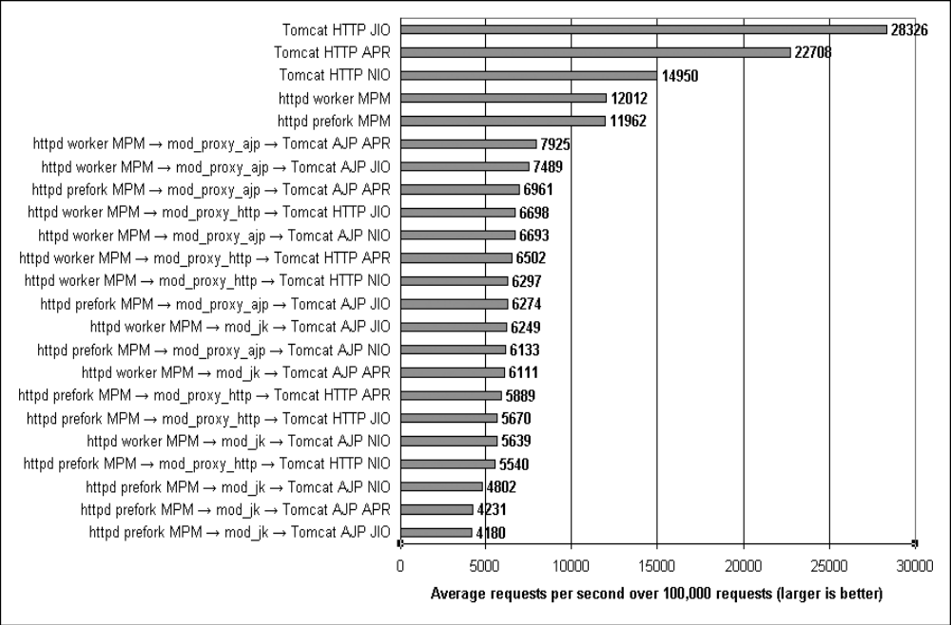
Tomcat: The Definitive Guide, Jason Brittain (O’Reilley 2007)

Slide 4
Java Virtual Machine /
Operating Systems
JVM options
  Linux, Solaris, Windows (Sun)
  Mac OS X (Apple)
  AIX, Linux, Windows, z/OS (IBM)
  HP-UX (Hewlett-Packard)

Slide 5
Java Negatives
Linking Java with C/Fortran apps is difficult
Arguably not suitable for large scale numerical computation
  Type safety, array safety, strict reproducibility
  Multicore CPU challenge could shift
Specialized languages can be more productive

Slide 6
NetCDF-Java library
100% Java
Open Source (LGPL, MIT)
Independent implementation
Used as a component in other software (partial)
  Integrated Data Viewer, THREDDS Data Server (Unidata)
  Panoply (NASA)
  ncBrowse (EPIC/NOAA)
  Java NEXRAD Viewer (NCDC/NOAA)
  MyWorld GIS (Northwestern)
  EDC for ArcGIS, ERRDAP (SFSC/NOAA)
  Live Access Server (PMEL/NOAA)
  ncWMS (Reading)
  Matlab plug-in (USGS)

Slide 7
Application
Scientific Feature Types
Datatype Adapter
NetCDF-Java/
CDM architecture
NetcdfDataset
CoordSystem Builder
NetcdfFile
THREDDS
I/O service provider
Catalog.xml
OPeNDAP
NetCDF-3
NIDS
NcML
NetCDF-4
GRIB
HDF5
GINI
Nexrad
DMSP
…

Slide 8
NetCDF Java Release Plans
Current Stable Release NetCDF-Java 2.2
  Maintenance, bug fixes only
Development version 4.0
  Extensive refactor, enhance performance
  Extended data types for NetCDF4
  Sequences : variable length Structures
  Scientific Feature Types refactor
  Nested Tables abstract model for point features (point, station, trajectory, profile)
  By the end of the year

Slide 9
Format Readers (CDM files)
General: NetCDF, OPeNDAP, HDF5, NetCDF4, HDF4, HDF-EOS
Gridded: GRIB-1, GRIB-2, GEMPAK
Radar: NEXRAD 2&3, DORADE, CINRAD, Universal Format, TDWR
Point: BUFR, ASCII
Satellite: DMSP, GINI, McIDAS AREA
Misc: GTOPO, Lightning, etc
Others in development (partial):
  AVHRR, GPCP, GACP, SRB, SSMI, HIRS (NCDC)
Notes:
Diversity of formats:

Slide 10
THREDDS Data Server
HTTP Tomcat Server
catalog.xml
Remote Access
THREDDS Server
WCS
OPeNDAP
HTTPServer
NetcdfSubset
NetCDF-Java
library
configCatalog.xml
Datasets
IDD Data
motherlode.ucar.edu

Slide 11
NcML Datasets
Application
Application
THREDDS dataset
NcML dataset
dataset
NcML dataset
dataset

Slide 12
NcML example
<?xml version="1.0" encoding="UTF-8"?>
<netcdf xmlns="http://www.unidata.ucar.edu/schemas/netcdf/ncml-2.2"
location=“/data/nids/N0R_20041119_2147">
<attribute name=“DataType" value=“Radar" />
<remove type=“attribute” name=“password" />
<variable name="Reflectivity" orgName=“R34768”>
<attribute name="units" value=“dBZ" />
</variable>
</netcdf>

Slide 13
TDS / NcML example
<datasetScan name="Ocean Satellite Data" path=“/data/ocean/sat/" dirLocation="R:/tds/netcdf/">
<netcdf>
<attribute name="Conventions" value="CF-1.0"/>
</netcdf>
</datasetScan>

Slide 14
TDS / NcML aggregation
<dataset name="WEST-CONUS_4km Aggregation" urlPath="satellite/3.9/WEST-CONUS_4km">
<netcdf >
<aggregation dimName="time" type="joinNew">
<scan location="/data/satellite/WEST-CONUS_4km/" suffix=".gini" />
</aggregation>
</netcdf>
</dataset>

Slide 15
Common Data Model

Slide 16
What’s a Data Model?
An Abstract Data Model describes data objects and what methods you can use on them.
An API is the interface to the Data Model for a specific programming language
A file format is a way to persist the objects in the Data Model.
A data access protocol like OPeNDAP plays the role of a file format (sort of).
An Abstract Data Model removes the details of any particular API and the persistence format.

Slide 17
Common Data Model
Scientific Feature Types
Point
Trajectory
Station
Profile
Radial
Grid
Swath
Coordinate Systems
Data Access
netCDF-3, HDF5, OPeNDAP
BUFR, GRIB1, GRIB2, NEXRAD, NIDS, McIDAS, GEMPAK, GINI, DMSP, HDF4, HDF-EOS, DORADE, GTOPO, ASCII

Slide 18
Application
Scientific Feature Types
Datatype Adapter
NetCDF-Java/
CDM architecture
NetcdfDataset
CoordSystem Builder
NetcdfFile
THREDDS
I/O service provider
Catalog.xml
OPeNDAP
NetCDF-3
NIDS
NcML
NetCDF-4
GRIB
HDF5
GINI
Nexrad
DMSP
…

Slide 19
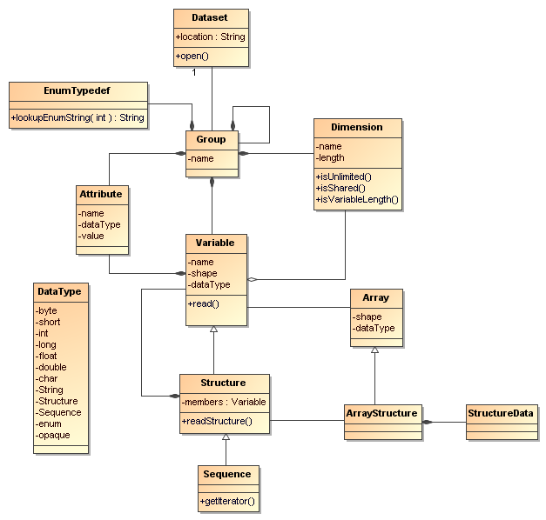
Common Data Model
(Data Access Layer)

Slide 20
NetCDF-4 Data Model
File
location: Filename
create( ), open( ), …
DataType
PrimitiveType
char
byte
short
int
int64
float
double
unsigned byte
unsigned short
unsigned int
unsigned int64
string
UserDefinedType
typename: String
Group
name: String
Enum
Dimension
name: String
length: int
isUnlimited( )
Opaque
Attribute
name: String
type: DataType
values: 1D array
Compound
VariableLength
Variable
name: String
shape: Dimension[ ]
type: DataType
array: read( ), …
User-defined types, including compound types, may be stored with other data.
A file has a top-level unnamed group. Each group may contain one or more named subgroups, variables, dimensions, and attributes. A variable may also have attributes. Variables may share dimensions, indicating a common grid. One or more dimensions may be of unlimited length.

Slide 21
Coordinate Systems

Slide 22
Coordinate Systems as Functions
Data variable V, with n dimensions
Vdim = {dim_{k} , k=0,n-1}
is a function from domain Vdim to R
V:Vdim → R
A coordinate variable for V is also a function
CV:Vdim → R
A coordinate system for V, CSV, is a set of m coordinate variables for V
CSV = {CV_{j} , j=0,m-1}
CSV:Vdim → R^{m}
The coordinates of the (i,j,k) data point are the m values
{CV₁(i,j,k), CV₂(i,j,k), CV₃(i,j,k),…}
A coordinate system must be invertible.

Slide 23
Coordinate Systems
NetCDF, OPeNDAP, HDF data models do not have integrated coordinate systems
  so georeferencing not part of API
  Need conventions to specify (eg CF-1, COARDS, etc)
Contrast GRIB, HDF-EOS, other specialized formats

Slide 24
Coordinate Variables
dimensions:
lat = 64;
lon = 128;
variables:
  float lat(lat);
  float lon(lon);
  float time;
  double temperature(lat,lon);
  coordinates=“lat lon time”;

Slide 25
Limitations of 1D Coordinate Variables
Non lat/lon horizontal grids:
  float temperature(y,x)
  float lat(y, x);
  float lon(y, x);
Trajectory data:
  float NKoreaRadioactivity(pt);
  float lat(pt);
  float lon(pt);
  float altitude(pt);
  float time(pt)

Slide 26
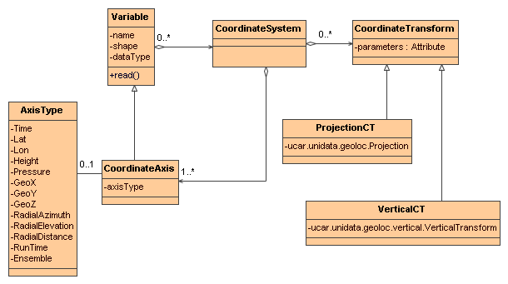
Coordinate Systems UML

Slide 27
Projections (CF)
albers_conical_equal_area
lambert_azimuthal_equal_area
lambert_conformal_conic
mcidas_area
mercator
orthographic
rotated_pole
stereographic (including polar)
transverse_mercator
UTM (ellipsoidal)
vertical_perspective

Slide 28
Vertical Transforms (CF)
atmosphere_sigma
atmosphere_hybrid_sigma_pressure
atmosphere_hybrid_height
ocean_s
ocean_sigma
existing3DField

Slide 29
Add your own Transform
Pluggable framework
  Add at runtime
  CoordTransBuilder.registerTransform()
Implement CoordTransBuilderIF

Slide 30
Scientific Feature Types

Slide 31
Scientific Feature Types
Based on datasets Unidata is familiar with
  APIs are evolving
Intended to scale to large, multifile collections
Intended to support “specialized queries”
  Space, Time
These form the basis for NetCDF-Java implementations
Two categories : Grids and Points

Slide 32
Gridded Data
Grid: multidimensional grid, separable coordinates
Radial: a connected set of radials using polar coordinates collected into sweeps
Swath: a two dimensional grid, track and cross-track coordinates
Unstructured Grids: finite element models, coastal modeling

Slide 33
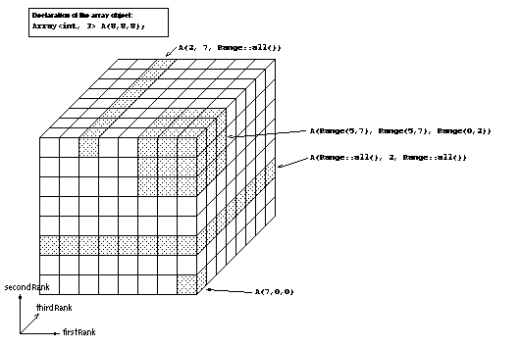
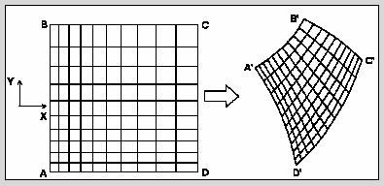
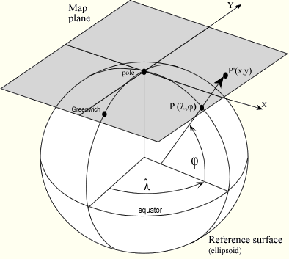
Gridded Data
Cartesian coordinates
Data is 2,3,4D
All dimensions have 1D coordinate variables (separable)
float gridData(t,z,y,x);
float t(t);
float y(y);
float x(x);
float z(z);
float lat(y,x);
float lon(y,x);
float height(t,z,y,x);

Slide 34
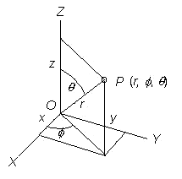
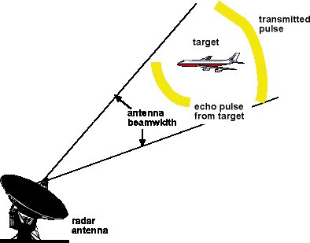
Radial Data
Polar coordinates
2D: radials collected into sweeps
Not separate time dimension
float radialData(radial, gate) :
float distance(gate)
float azimuth(radial)
float elevation(radial)
float time(radial)
float origin_lat;
float origin_lon;
float origin_alt;

Slide 35
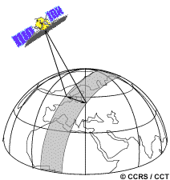
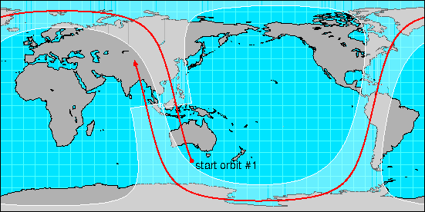
Swath
two dimensional
track and cross-track
not separate time dimension
orbit tracking allows fast search
float swathData( track, xtrack)
float lat(track, xtrack)
float lon(track, xtrack)
float alt(track, xtrack)
float time(track)

Slide 36
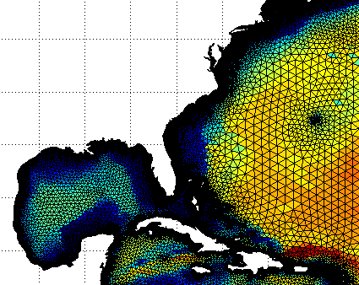
Unstructured Grid
Pt dimension not connected
Need to specify the connectivity explicitly
No implementation in the CDM yet
float unstructGrid(t,z,pt);
float lat(pt);
float lon(pt);
float time(t);
float height(z);

Slide 37
1D Feature Types (“point data”)
    float data(sample);
Point: measured at one point in time and space
Station: time-series of points at the same location
Profile: points along a vertical line
Station Profile: a time-series of profiles at same location.
Trajectory: points along a 1D curve in time/space
Section: a collection of profile features which originate along a trajectory.

Slide 38
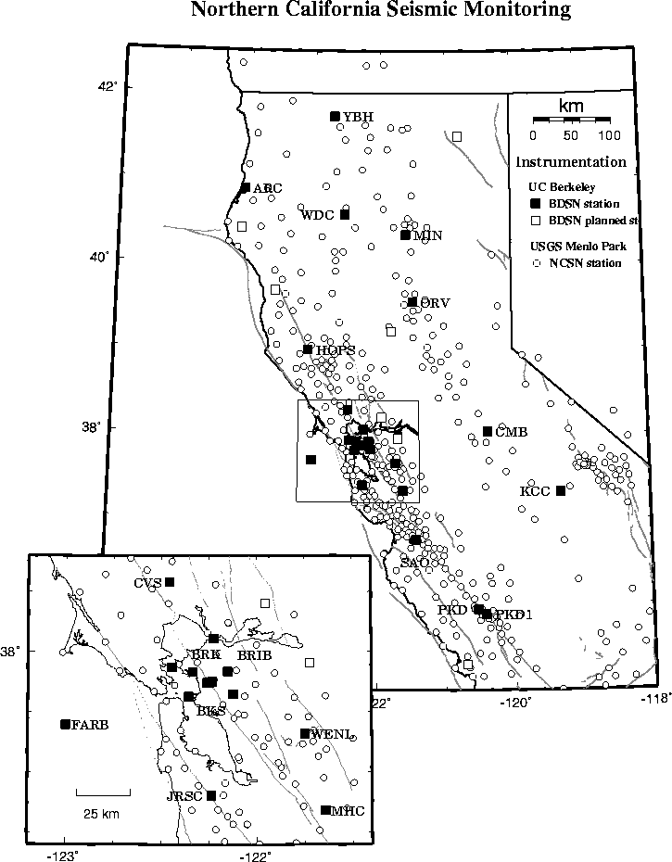
Point Observation Data
Set of measurements at the same point in space and time = obs
Collection of obs = dataset
Sample dimension not connected
float obs1(sample);
float obs2(sample);
float lat(sample);
float lon(sample);
float z(sample);
float time(sample);
Table {
lat, lon, z, time;
obs1, obs2, ...
} obs(sample);

Slide 39
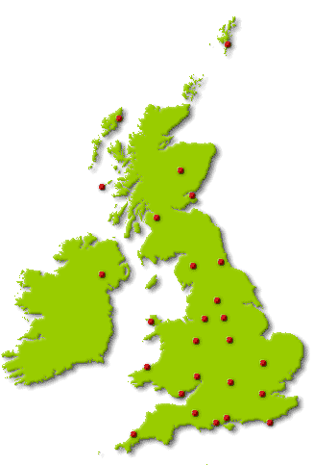
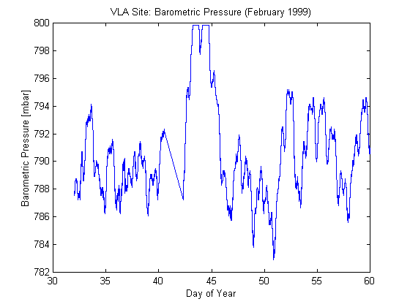
Time-series Station Data
float obs1(sample);
float obs2(sample);
float lat(sample);
float lon(sample);
float z(sample);
float time(sample);
float obs1(stn, time);
float obs2(stn, time);
float time(stn, time);
int stationId(stn);
float lat(stn);
float lon(stn);
float z(stn);
float obs1(sample);
float obs2(sample);
int stn_id(sample);
float time(sample);
int stationId(stn);
float lat(stn);
float lon(stn);
float z(stn);
Table {
stationId;
lat, lon, z;
Table {
time;
obs1, obs2, ...
} obs(*); // connected
} stn(stn); // not connected

Slide 40
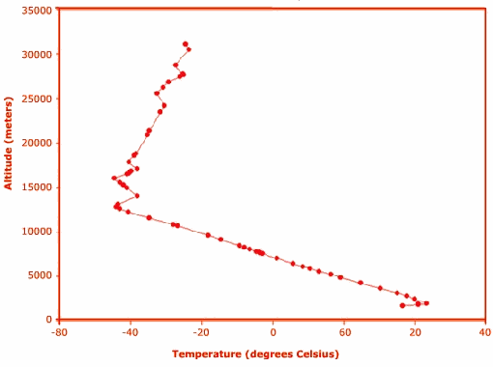
Profile Data
float obs1(sample);
float obs2(sample);
int profile_id(sample);
float z(sample);
int profileId(profile);
float lat(profile);
float lon(profile);
float time(profile);
float obs1(sample);
float obs2(sample);
float lat(sample);
float lon(sample);
float z(sample);
float time(sample);
float obs1(profile, level);
float obs2(profile, level);
float z(profile, level);
float time(profile);
float lat(profile);
float lon(profile);
Table {
profileId;
lat, lon, time;
Table {
z;
obs1, obs2, ...
} obs(*); // connected
} profile(profile); // not connected

Slide 41
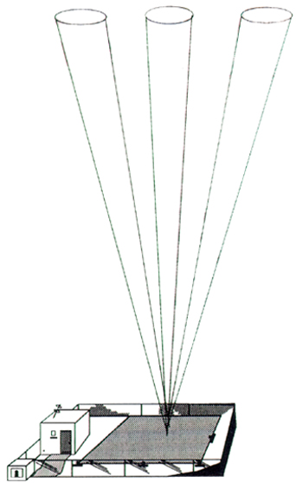
Time-series Profile Station Data
float obs1(profile, level);
float obs2(profile, level);
float z(profile, level);
float time(profile);
float lat(profile);
float lon(profile);
float obs1(stn, time, level);
float obs2(stn, time, level);
float z(stn, time, level);
float time(stn, time);
float lat(stn);
float lon(stn);
Table {
stationId;
lat, lon;
Table {
time;
Table {
z;
obs1, obs2, ...
} obs(*); // connected
} profile(*); // connected
} stn(stn); // not connected

Slide 42
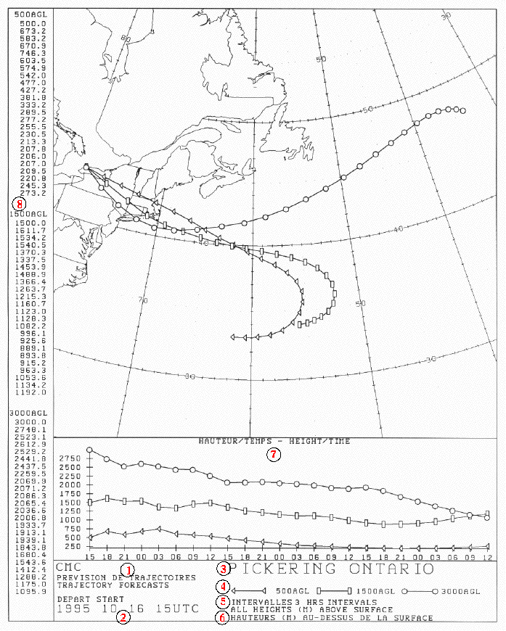
Trajectory Data
float obs1(sample);
float obs2(sample);
float lat(sample);
float lon(sample);
float z(sample);
float time(sample);
int trajectory_id(sample);
float obs1(traj,obs);
float obs2(traj,obs);
float lat(traj,obs);
float lon(traj,obs);
float z(traj,obs);
float time(traj,obs);
int trajectory_id(traj);
Table {
trajectory_id;
Table {
lat, lon, z, time;
obs1, obs2, ...
} obs(*); // connected
} traj(traj) // not connected

Slide 43
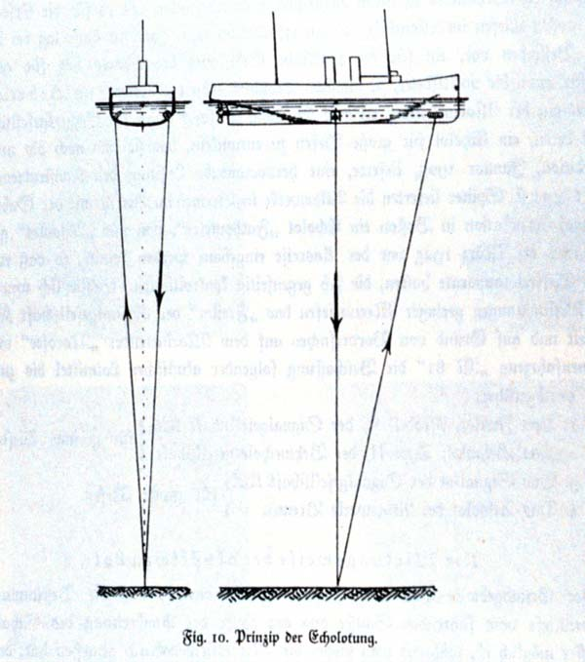
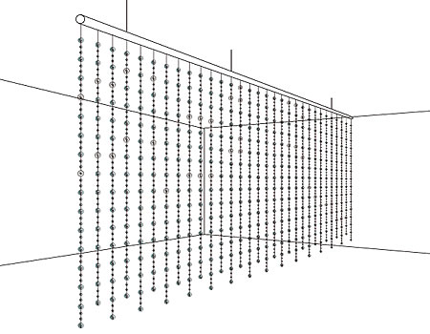
Section Data
float obs1(traj,profile,level);
float obs2(traj,profile,level);
float z(traj,profile,level);
float lat(traj,profile);
float lon(traj,profile);
float time(traj, profile);
Table {
section_id;
Table {
surface_obs // data anywhere
lat, lon, time
Table {
depth;
obs1, obs2, ...
} obs(*); // connected
} profile(*); // connected
} section(*) // not connected

Slide 44
Nested Table Notation (1)
A feature instance is a row in a table.
A table is a collection of features of the same type. The table may be fixed or variable length.
A nested (child) table is owned by a row in the parent table.
Both coordinates and data variables can be at any level of the nesting.
A feature type is represented as nested tables of specific form.
A feature collection is an unconnected collection of a specific feature type.
Table {
data1, data2
lat, lon, time;
Table {
z;
obs1, obs2, ...
} obs(17);
} profile(*);

Slide 45
Nested Table Notation (2)
A constant coordinate can be factored out to the top level. This is logically joined to any nested table with the same dimension.
dim level = 17;
float z(level);
Table {
data1, data2
lat, lon, time;
Table {
obs1, obs2, ...
} obs(level);
} profile(*);

Slide 46
Nested Table Notation (3)
Table {
stationId;
lat, lon;
Table {
time;
Table {
z;
obs1, obs2, ...
} obs(*); // connected
} profile(*); // connected
} stn(stn); // not connected
A coordinate in an inner table is connected; a coordinate in the outermost table is unconnected.
Table {
trajectory_id;
Table {
lat, lon, z, time;
obs1, obs2, ...
} obs(*); // connected
} traj(traj) // not connected
Table {
lat, lon, z, time;
obs1, obs2, ...
} point(sample);

Slide 47
Relational model
Nested Tables are a hierarchical data model (tree structure)
Simple transformation to relational model – explicitly add join variables to tables
Table {
stationId;
lat, lon, z;
Table {
time;
obs1, obs2, ...
} obs(42);
} stn(stn);
RTable {
stationId // primary key
lat, lon, z;
} stn
RTable {
stationId // secondary key
time;
obs1, obs2, ...
} obs;

Slide 48
Nested Model Summary
Compact notation to describe 1D point feature types
  Connectivity of points is key property
  Variable/fixed length table dimensions can be notated easily
  Constant/varying coordinates can be easily seen
Can be translated to relational model to get different performance tradeoffs
More details

Slide 49
Feature Type implementations
Netcdf-Java library
Grid | GridDatatype
Radial | RadialSweepFeature
Swath | -
Unstructured Grids | -
Point | PointFeature
Station | StationTimeSeriesFeature
Profile | ProfileFeature
Trajectory | TrajectoryFeature
StationProfile | StationProfileFeature
Section | SectionFeature

Slide 50
Encoding Feature Types in NetCDF
Using CF Conventions
CF-1.0 focused on Grids
Other types are being studied / proposed
Unidata proposal for point obs
NCAR/EOL working on Radial data (netCDF4)
NPOESS/GOES-R using netCDF4 for satellite (swath)
  Unidata has proposal to NOAA/NASA
Working group for unstructured grids
Happening now!

Slide 51


