Slide 1
CaIntegrator2
Build and Deployment Automation Training
July 2008

Slide 2
Agenda
First 45 minutes: Build process training
  Systems
  DEV
  QA
  PM
Second 45 minutes: Build architecture & tools
  DEV

Slide 3
Build and Deployment Story
Jane Developer starts the day by getting the latest changes from Subversion (SVN). Jane uses Eclipse to build as she makes changes to the code. After finishing her work and before checking in the code, Jane runs the build and deployment Ant scripts in her private workspace and targeting her local environment. After smoke-testing the local build and deployment Jane checks in all task-related changes into SVN.
A Continuous Integration (CI) server such as Hudson monitors SVN and detects Jane’s changes. It kicks a build. The build fails and Hudson notifies Jane of the failure. Jane gets the latest from SVN, fixes the broken code and checks in the changes to SVN. Hudson detects the latest changes; runs the build and notifies Jane that the build is now fixed.
Satisfied with the results from Hudson, Jane kicks a remote build through a command line or the AnthillPro build server to build and deploy to the DEV environment.

Slide 4
Build and Deployment Story
As the project milestone approaches and the development team is happy with the DEV build, John Teamlead tags the SVN (e.g. MYTAG_2008_06_19_BUILD_2078) and passes it to Mark Q. A.
Mark uses AnthillPro to build from a tag and deploys the application to the QA environment. After completing the build, Mark and his team test the latest changes in the QA environment. Satisfied with the results, Mark passes the SVN tag to Frank Systems.
Frank Systems builds from a tag using AnthillPro and deploys to STAGE. After finishing the last smoke tests and ensuring the software is ready for production, Frank uses AnthillPro to build from the same SVN tag to deploy to PRODUCTION.
Everybody celebrates.

Slide 5
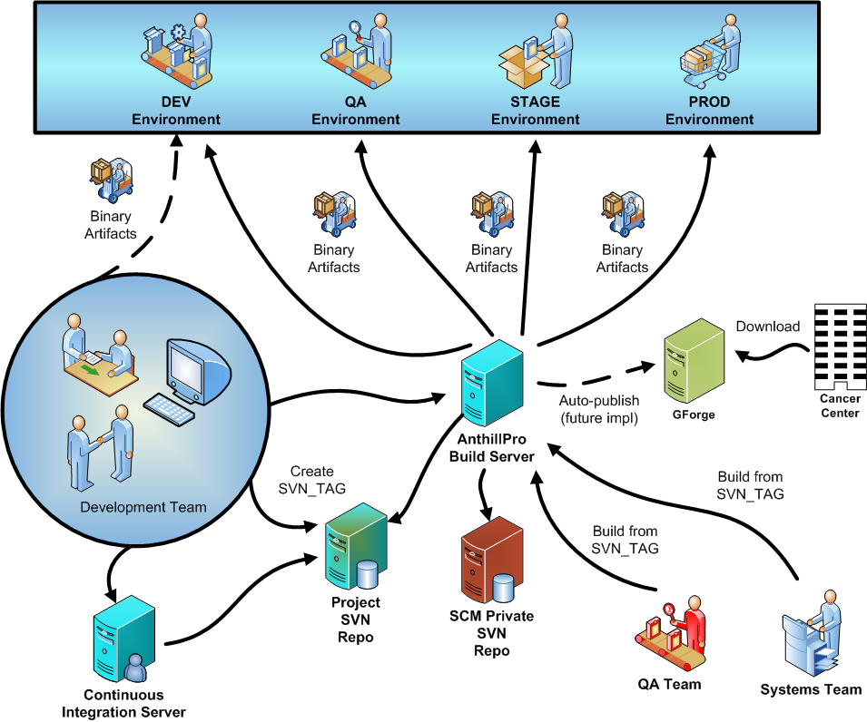

Slide 6
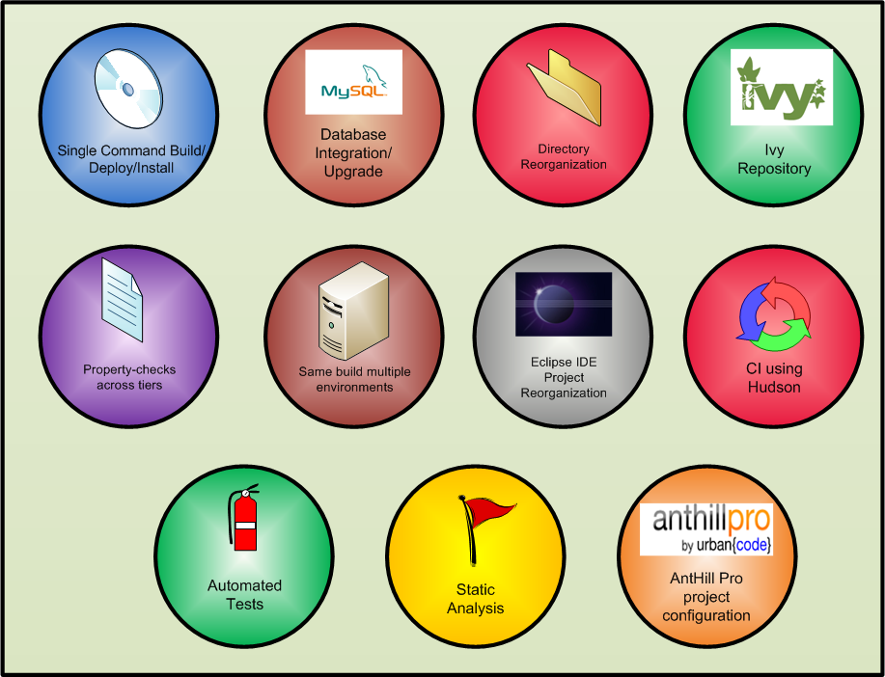
Features

Slide 7
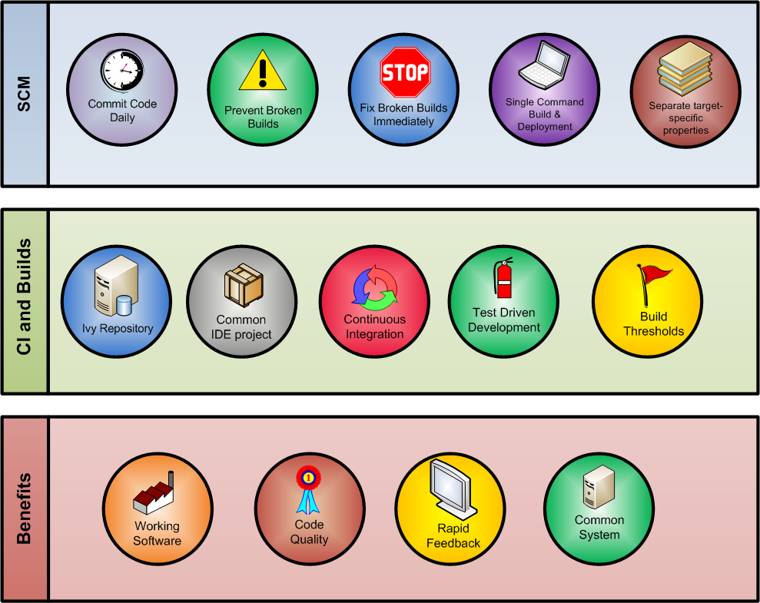
Practices and Benefits

Slide 8
Ivy
Benefits
  Dependency Management
  Centralized Storage
Approach
  Chained resolvers- local file-system resolver first followed by NCICB Ivy Enterprise Repository.
  SVN repository as ivy repository - The ivy repository is currently in the commonlibrary NCICB project.
  No external/public repositories
Constraints
  Limited write access to repository project
  Add only
  Updates need approval
  No deletes
  Not versioned with the rest of the code

Slide 9
Build and Deployment Contexts
Local Install (Developer Workstation/CI)
Local Upgrade (Developer Workstation/CI)
Remote Install (NCI/AnthillPro)
Remote Upgrade (NCI/AnthillPro)
Installer Install (…sounds off) (Cancer Centers)
Installer Upgrade (Cancer Centers)

Slide 10
Command-line Builds
ant build:all deploy:local:install
ant build:all deploy:local:upgrade
ant deploy:remote:upgrade –Dproperties.file=C:\dev\properties\dev-upgrade.properties
ant deploy:remote:upgrade –Dproperties.file=C:\dev\properties\qa-upgrade.properties

Slide 11
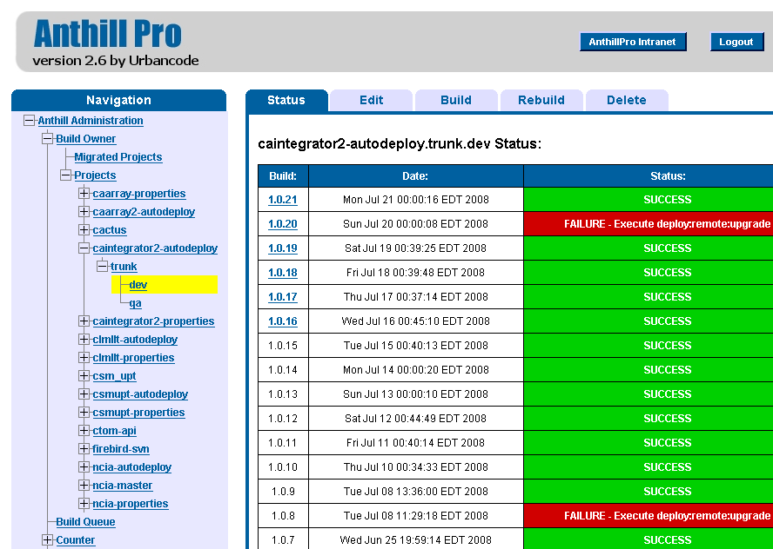
AnthillPro Builds

Slide 12
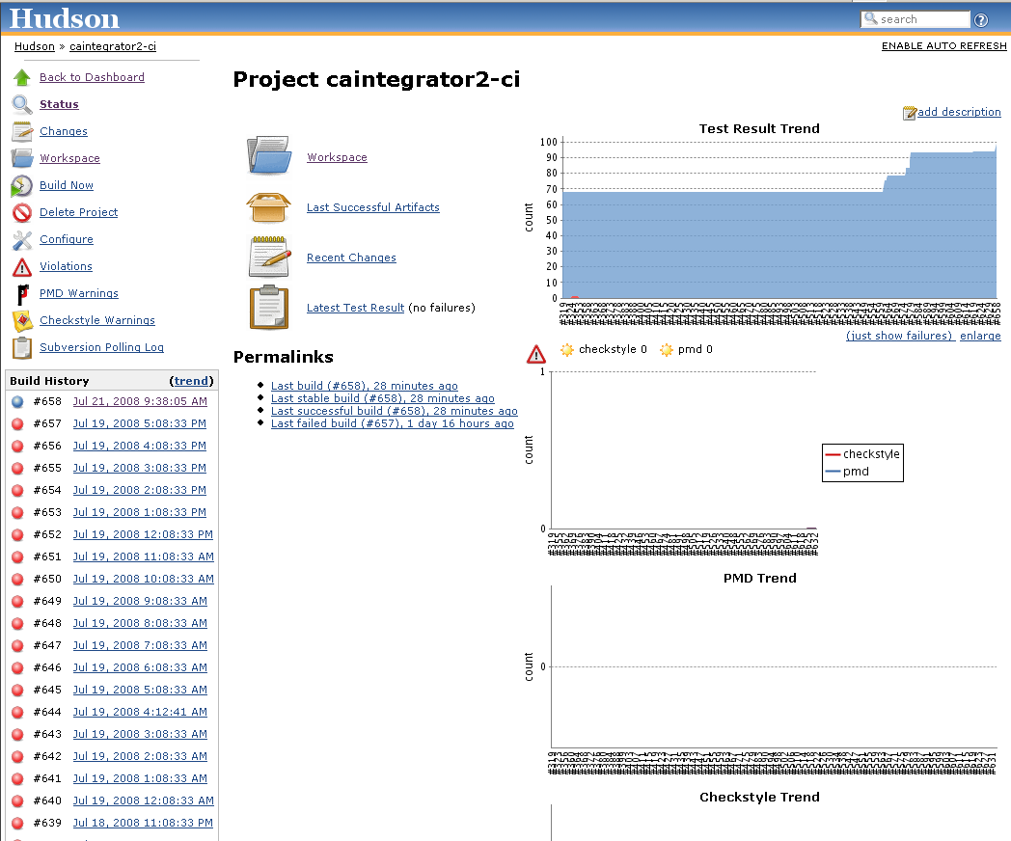
Hudson CI Server

Slide 13
More Info
BDA WIKI - https://wiki.nci.nih.gov/x/fJd8
Cai2 BDA WIKI - https://wiki.nci.nih.gov/x/E6F8
BDA FAQ - https://wiki.nci.nih.gov/x/UZx8
Paul Duvall – duvallp@mail.nih.gov
Steve Saksa – saksas@mail.nih.gov
Levent Gurses – gursesl@mail.nih.gov
Mahidhar Narra – narram@mail.nih.gov
Questions & Answers

