Slide 1
Quick Guide to Creating 508 Compliant PPTs
June 2009

Slide 2
Section 508 – Areas of Focus
To comply with Section 508 standards, it is important to review the following areas of your presentation:
  Document Properties and Language
  File Naming Conventions
  Text as in Outline View
  Using the Slide Layout provided by PowerPoint
  Using Alternative Text on Graphics
  Annotating Complex Graphics using Alternative Text
  Grouping Graphics
  Creating Hidden Placeholders
  Using Tables
  Hyperlinks
NOTE: The rules outlined in this Quick Guide apply to presentations created with all versions of PowerPoint. Most of the examples on the following pages demonstrate techniques using Microsoft Office 2003. If you are using Microsoft Office 2007, please read through the guide and also see special notes on slides 15-17.

Slide 3
What is Section 508?
Section 508 requires Federal agencies to make their Electronic and Information Technology (EIT) accessible to employees and customers with disabilities.
Visit http://www.access-board.gov/sec508/guide/act.htm to read the full Rehabilitation Act.

Slide 4
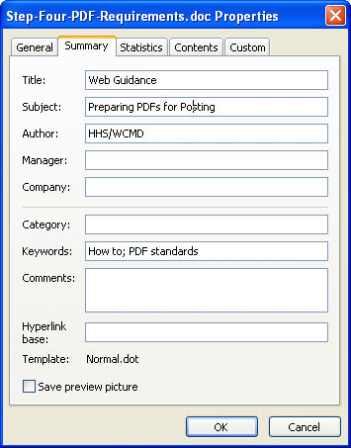
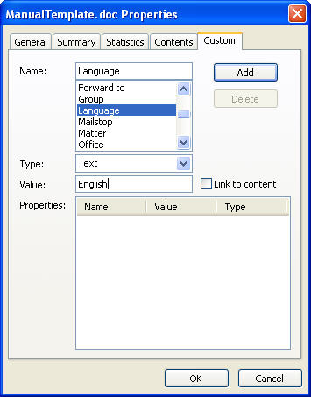
Specify Document Properties and Language
Section 508 requires that document properties be specified.
To specify properties, expand File menu and select “Properties.”
Fill out: the title of the document, subject, author (do not use your name; rather, use your institution), company (use NCI), and keywords. Remainder of fields are optional.
Next specify a high-level language
  Choose the “Custom” tab
  Select “Language” from the list
  Type is “Text”
  Value enter in “English”
  Click “Add” and then “OK”

Slide 5
File Naming Convention
No spaces, or special characters in file name (!, @, #, $, %, ^, &, *, etc. )
Use underscores (_) in place of spaces.
File names without spaces or special characters to allow assistive technology devises to read the names.
Correct Example:
translationalmedicineCTMSmtg_Adams2-9-09.ppt
Incorrect Example:
translationalmedicine CTMS Adams.ppt

Slide 6
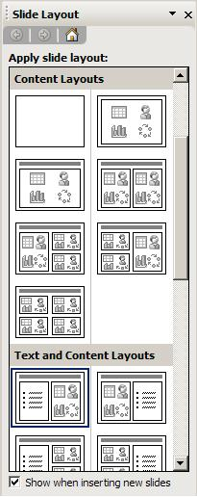
Use Slide Layout Instead of Text Boxes
Using the slide layout templates will make text appear in the outline, which is required for 508 compliance.
To access the slide layout templates, right-click on the slide and select “Slide layout…”
Slide layouts contain “placeholders” for content. Using these layouts will make your text appear in the outline and will be accessible to assistive technology.
The “placeholders” inside the slide layouts have the same functionality as text boxes.
You can modify the placeholders however you want. You can move the placeholders, color them, add a border, etc.

Slide 7
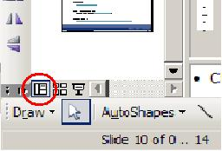
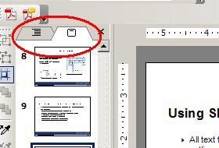
Text Needs To Appear in Outline View
To ensure 508 compliance, all text that appears on the slide needs to appear in the Outline view.
The Outline is viewable when you are in Normal view.
Normal view can be accessed by going to the View menu >> Normal View, or the button in the lower left corner.
To switch between slide view and outline view, click the tabs at the top left navigation window.
NOTE: Text added to the Notes Pane of a slide will not appear in the outline and will not be accessible by assistive technology.

Slide 8
Additional Notes About Text
Color should not be used as a primary means to emphasize a point.
Slides should avoid using flashing, flickering or animated text.
Should utilize the recommended fonts: Times New Roman, Veranda, Arial, Tahoma, and Helvetica.
Recommended to use 16 pt. or higher font size.

Slide 9
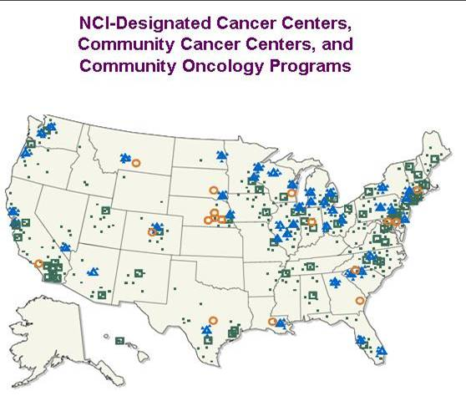
Add Alternate Text for
Non-Text Elements
Graphic elements must have Alt text for screen reader accessibility.
Right click on the image and choose “Format Picture.”
Choose the “Web” tab and enter a description of the image in the “Alternate Text” textbox. Then click the “OK” button.
Text needs to be brief but descriptive. For example: “Map of NCI-Designated Cancer Centers, Community Cancer Centers, and Community Oncology Programs.”
NOTE: You will not see the Alt text, only the screen reader will view it.

Slide 10
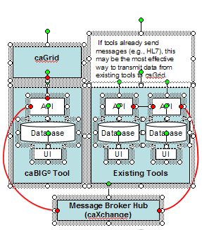
How to Group Small Graphics/Images
Select one of the images.
Hold down the “Shift” key and select the other images that are to be part of the group.
Right-click the image.
Scroll to “Grouping” and then mouse over to click “Group.”
Alternative Method
Open the “Drawing” toolbar by going to View>>Toolbar>>Drawing.
Click and drag to select all elements you would like to group.
Right-click the image, scroll to “Grouping” and select “Group.”

Slide 11
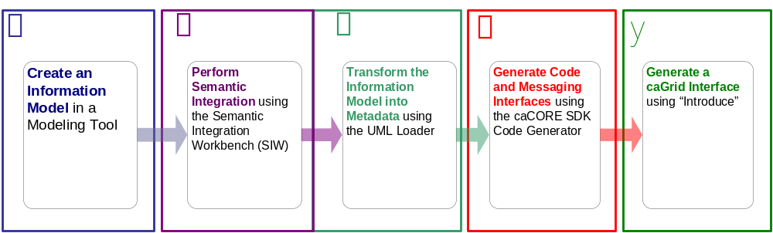
Complex Diagrams and Images Example:
Text Boxes
  Creating an Information Model in a modeling tool
  Performing Semantic Integration (Vocabularies) using the Semantic Integration Workbench(SIW)
  Transforming the Information Model into Metadata (Common Data Elements) using the UML Loader
  Generating Code and Messaging Interfaces (APIs) using caCORE SDK Code Generator
  Generating a caGrid Interface using “Introduce”
This graphic is built with inserted text boxes. To make this illustration 508 compliant, it should be treated like a picture and have Alt text attached to it. You can convert it to a picture by either grouping all of the objects together and adding Alt text as described in the above slides, or copying all of the objects in to MS Paint and saving as a .jpg or .gif and then adding Alt text.

Slide 12
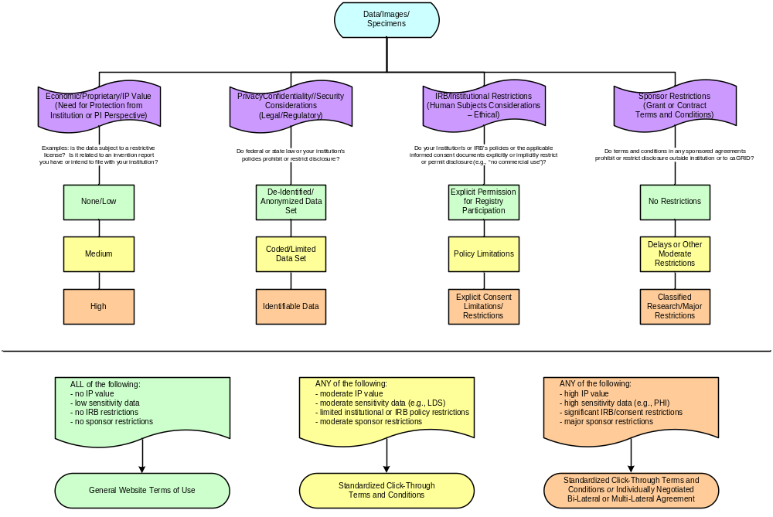
Complex Diagrams and Images Example (Cont’d): Org Chart
You can use the caBIG™ Data Sharing and Security Framework as a decision support tool to facilitate data sharing at your Center by determining which data can be shared and under which type of access and data security controls. To do so, you will need to assess the sensitivity of the data by using the Framework's four elements:
  Economic/Proprietary/IP Value
  Privacy/Confidentiality/Security Considerations
  IRB or Institutional Restrictions
  Sponsor Restrictions
The organization assesses the data to be shared along the four elements and assigns a low, medium or high sensitivity rating to the data, which drives the selection of the sharing mechanism.
The organization arrives at an overall level of sensitivity for the data by weighting the outcomes of the four elements according to its own judgment.
The outcome, that is, a low, medium or high sensitivity rating, determines how the organization wants to control access to that data.
The organization offering to share data determines the controls on access to that data by determining
The level of certainty needed regarding the authentication of the identity of data users, and
Whether particular authenticated groups or individuals are authorized to access the particular data.
The levels of security attached to data sensitivities of various levels are informed by guidance from the National Institute of Standards and Technology (NIST).
Alt text for this graphic would need to duplicate all of the text in the organizational chart, as well as explain the relationships conveyed by its structure.
Since that description would require a significant amount of text, it might be best to place the descriptive text in a placeholder hidden behind the graphic. The descriptive text would not be visible, but it would appear in the outline and be accessible for the screen reader. For further instructions, please see the following slide.
NOTE: It can be challenging to make some types of graphics reasonably accessible to screen readers.

Slide 13
Creating Hidden Placeholders
Choose the “Title & Text” or “Title, Text & Content” slide layout from the Slide Layout menu and apply it to the slide.
Add a title to the slide.
Use the placeholder to duplicate all of the text in the image/ organizational chart/ flow chart, as well as explain the relationships conveyed by its structure.
To hide the text, you can change the font color to the background color of the slide. For example, to hide text in this presentation, you would change the font color to white.
If you need to edit the text you can do so in the outline.
Next construct/ copy/ insert your image onto this slide.
Follow additional recommendations on the previous slides to make your image compliant.

Slide 14
Tables
 | Header | Header | Header
Header (If applicable) | Data | Data | Data
Header (If applicable) | Data | Data | Data
Header (If applicable) | Data | Data | Data
If tables must be included, they should be constructed with header rows, and may not contain merged cells. Also make sure reading order is left to right, top to bottom.
A header row is the first row or column in the table.
The table should also include a title and if applicable a short description if the table is too complex.

Slide 15
Hyperlinking
Write out the full URL, make sure it is an active link (clickable), and the link goes to the correct location.
  Correct: http://www.google.com
Do not link to words.
  Incorrect: Google
Write out full e-mail address and make sure they are hyperlinked.
  Correct: ncicb@pop.nci.nih.gov

Slide 16
Special Note on PowerPoint 2007
People creating PowerPoint presentations using the 2007 version of Microsoft Office need to follow all of these rules to achieve 508 compliance, although the user interface for doing so differs slightly from the techniques outlined above.
Please see the following two slides for tips that are specific to Microsoft Office PowerPoint 2007.

Slide 17
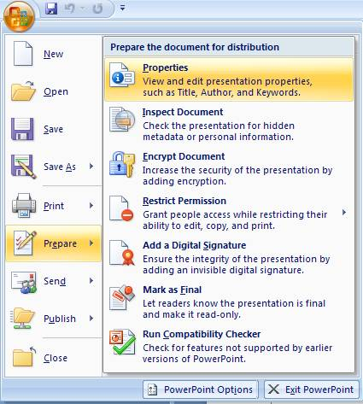
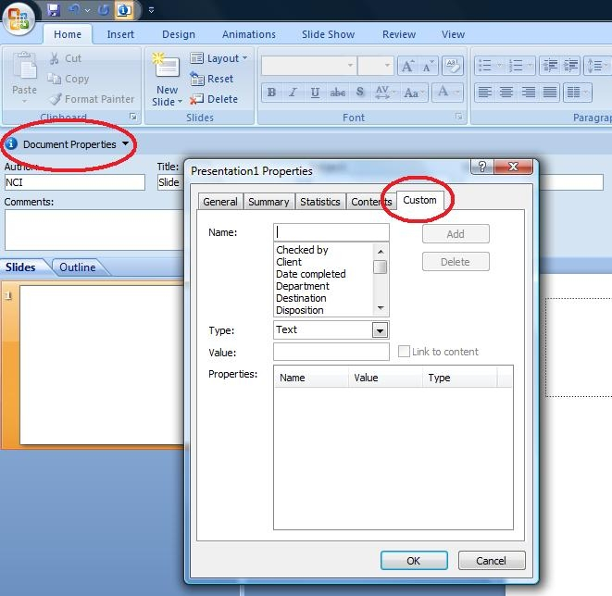
MS PowerPoint 2007:
Properties and Language
The properties menu can be found using the following steps:
  Press the MS Office Logo in the upper left corner.
  Choose “Prepare.”
  Choose “Properties.”
To set the language for the document, you first need to access the properties menu.
  Click the small button called document properties in the upper corner.
  Choose “Advance Properties.”
  Click the “Custom” tab.
  Fill in the fields as specified on
  slide 4 of this Quick Guide.

Slide 18
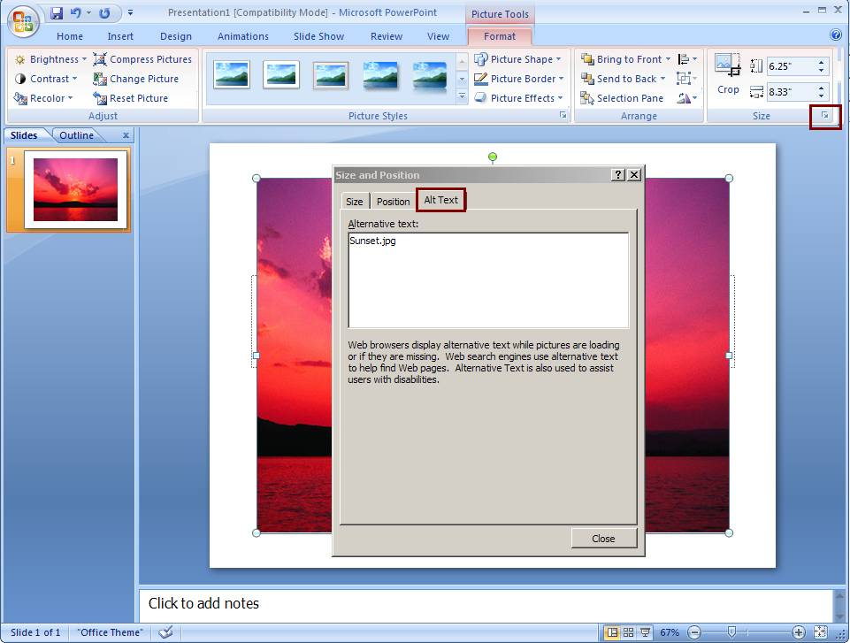
MS PowerPoint 2007:
Adding Alt Text to Images & Objects
To add alt text to an image:
  Double click the image.
  On the “Size” menu, select the drop down arrow in the upper right corner.
  Choose the “Alt text” tab.
Alternative method:
  Select the image.
  Right click and choose “Size and Position.”
  Choose the “Alt text” tab.

Slide 19
HHS 508 Checklists
  Follow HHS 508 Checklists to make files compliant:
    http://www.hhs.gov/web/508/index.html
  Word Document 508 Checklist
    http://www.hhs.gov/web/policies/checklistword.html
  PDF File 508 Checklist
    http://www.hhs.gov/web/policies/checklistpdf.html
  Multimedia File 508 Checklist
    http://www.hhs.gov/web/policies/checklistmulti.html
  HTML 508 Checklist
    http://www.hhs.gov/web/policies/checklisthtml.html
  PowerPoint Document 508 Checklist
    http://www.hhs.gov/web/policies/checklistppt.html

Slide 20
Useful Resources
  HHS 508 Web Site
  http://508.hhs.gov
  Microsoft Office Web-based Tutorial
  http://www.microsoft.com/enable/demos/windowsxp/default.aspx
  Web AIM
  http://www.webaim.org
  HHS Video Captioning Guidance
    http://www.hhs.gov/web/policies/videocaptionguidance.html
  Rehabilitation Act
    http://www.access-board.gov/sec508/guide/act.htm

