Slide 1
caIntegrator2
Translational Web Portals On-Demand
William FitzHugh
caBIG Annual Meeting, Washington, DC
July 21, 2009

Slide 2
What Is This Talk About?
What tasks need to be easier to enable Translational Research?
What existing caBIG® repositories can we leverage?
How can we create an easy-to-use but powerful tool to facilitate data exposure and analysis?
What can caIntegrator2 do to answer these questions?
  How does it work?
  What does it do?
  What will it do?
How can you contribute to this project?

Slide 3











Where Does caIntegrator2 Fit?

Slide 4

Where Does caIntegrator2 Fit?

Slide 5


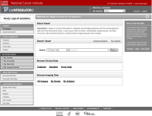

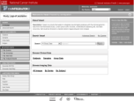

How Does caIntegrator2 Work?
Study Team
Public
first production release
Array Data
View Study
caIntegrator2
Clinical Data
Spread-sheet
Study Team
Deploy Study
Study Manager
Images
Image Annotations
Spread-sheet
Image Annotations
AIM
Tissue Data
later production releases

Slide 6
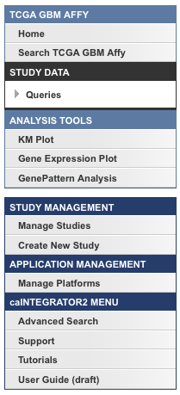
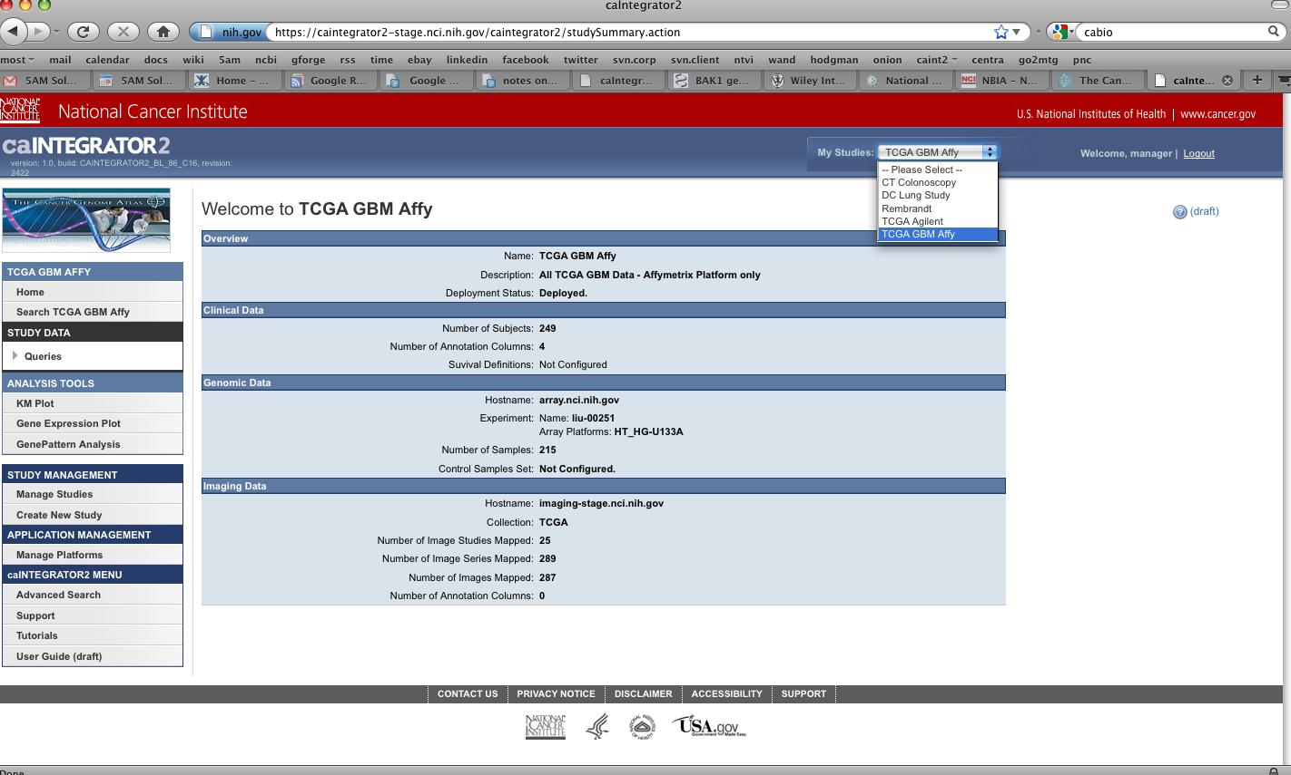
Top-level Navigation
Capabilities for Study Users/Researchers
Capabilities for Study Managers

Slide 7
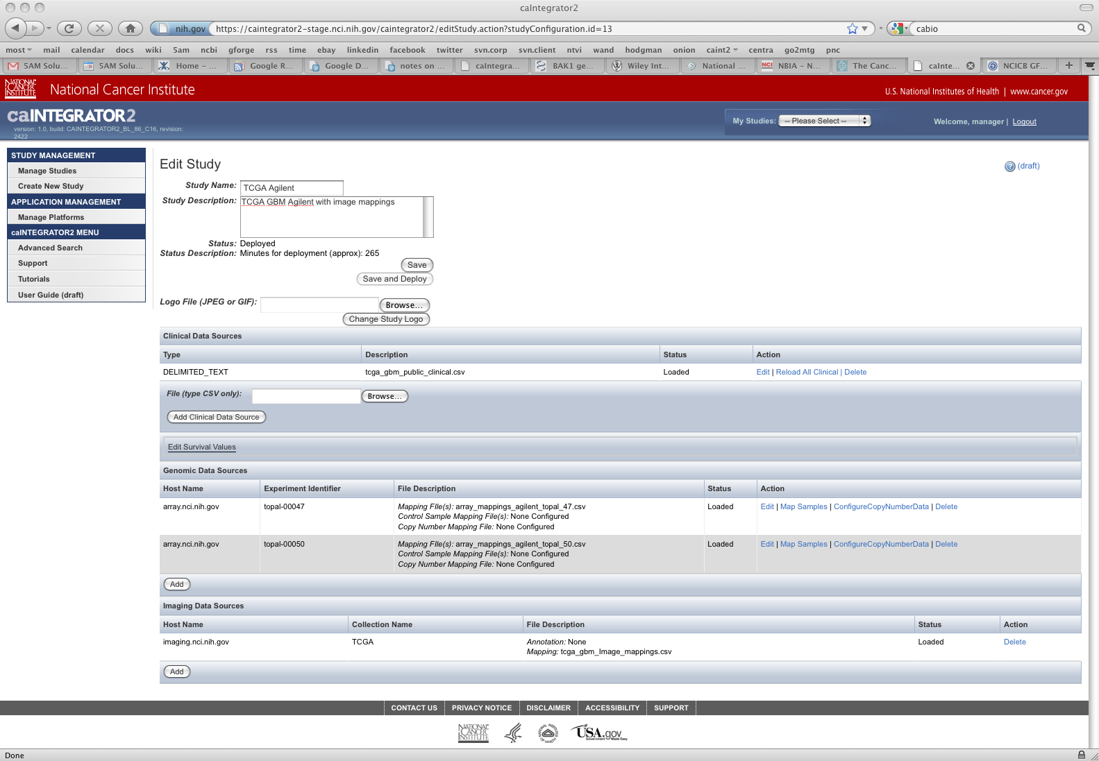
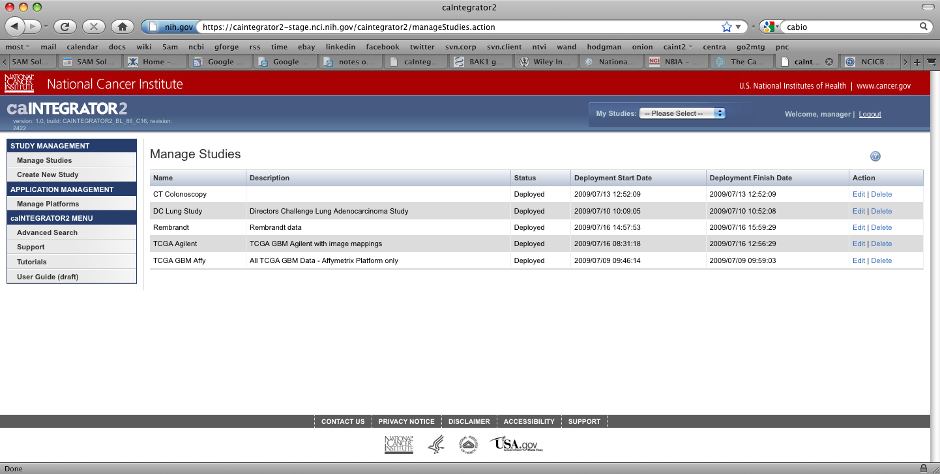
Creating and Managing Studies

Slide 8
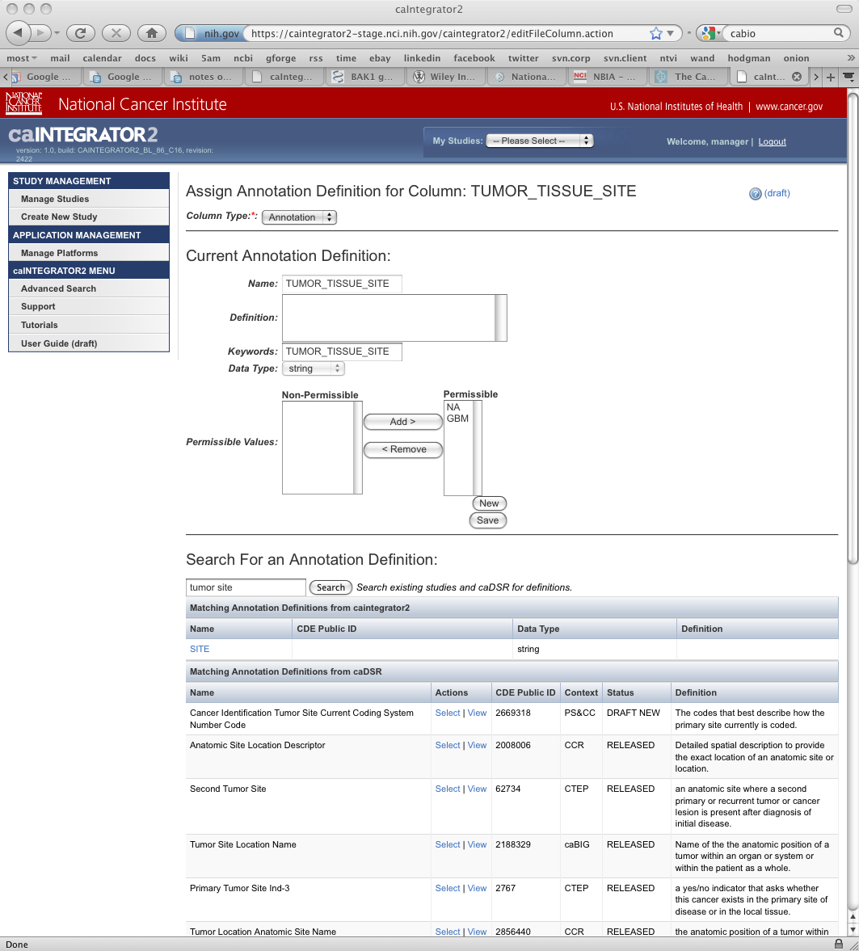
Creating and Managing Studies

Slide 9
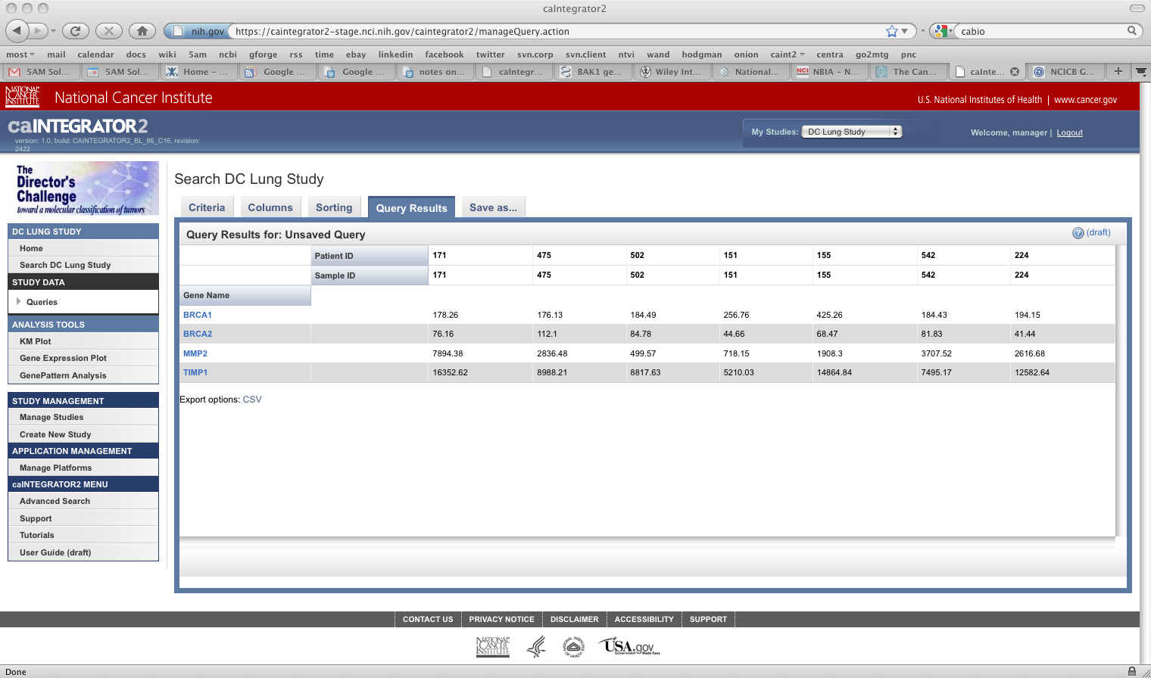
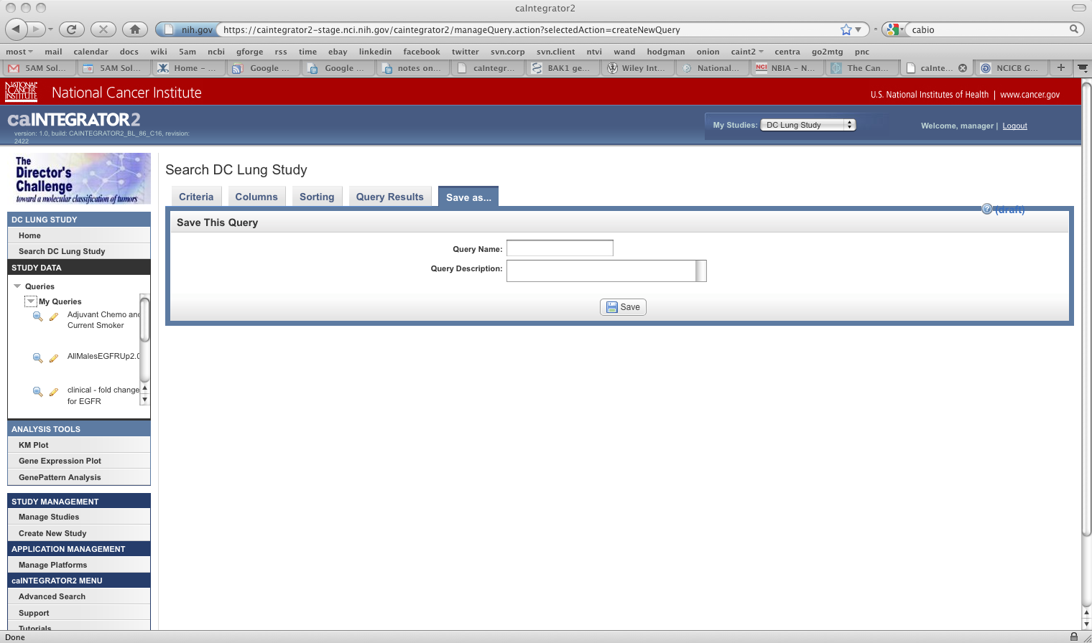
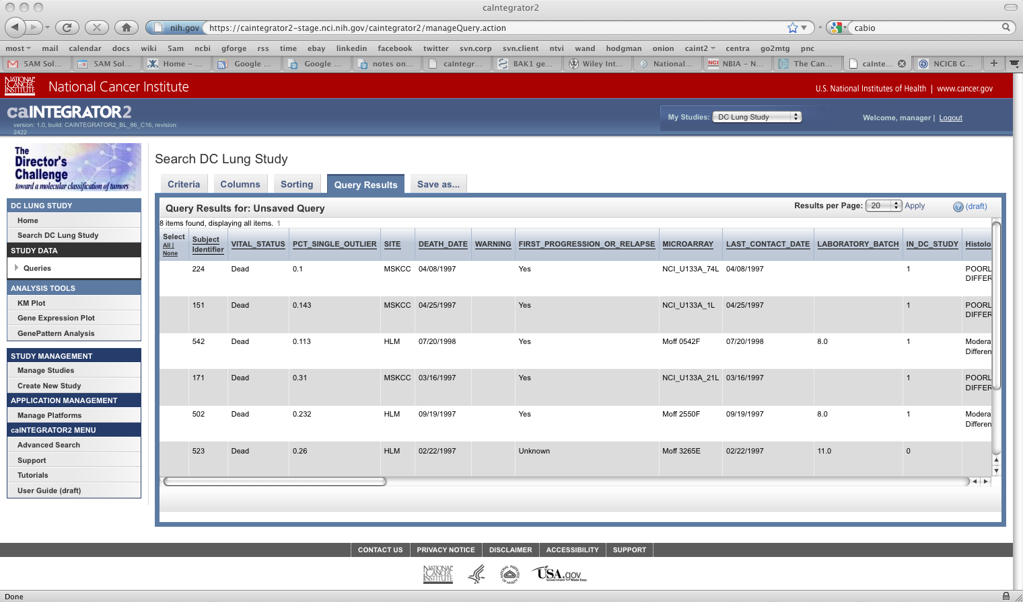
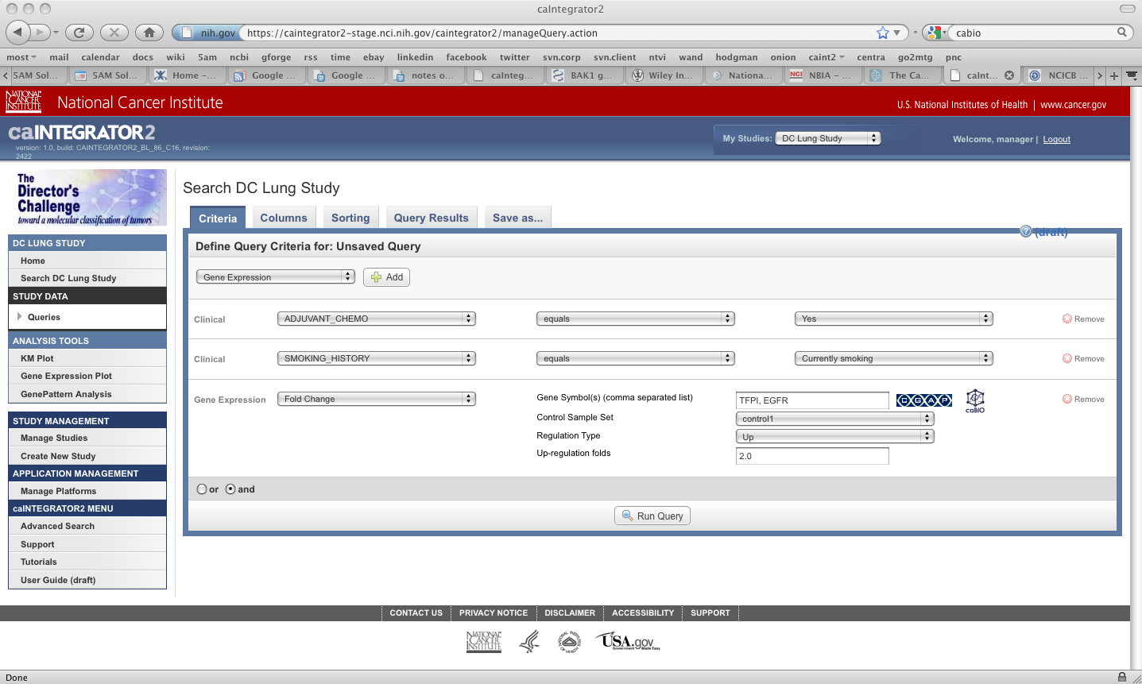
Querying Study Data

Slide 15
Acknowledgements
Shine Jacob
JP Marple
Eric Tavela
TJ Andrews
Ngoc Nguyen
Jill Hadfield
Anand Basu
Tom Boal
Cuong Nguyen
Quy Phung
Yuri Kotliarov
Huaitian Liu
http://gforge.nci.nih.gov/projects/caintegrator2/

