Slide 1
WebTree Navigator
Implementation & Customization
presented by
Marc Piparo
SAIC SmarTech Division – Celebration, FL

Slide 2
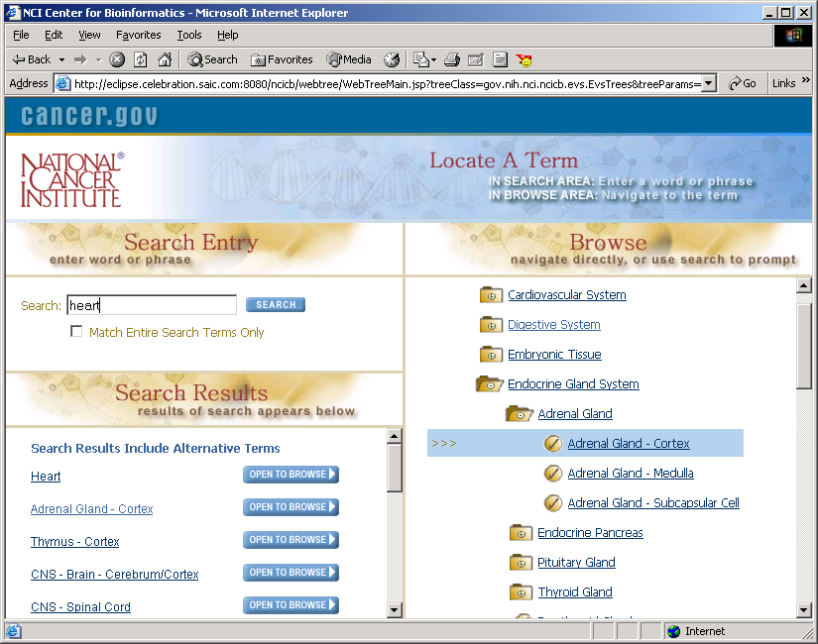
What is it?
The WebTree Navigator provides an HTML based enhanced tree hierarchy navigation tool with cross-browser compatibility.

Slide 3
Features
100% pure HTML (no JavaScript in tree functionality)
Java/JSP Implementation (portable)
Documented Java API (provides for scalable implementation)
Familiar folder style user-interface
Tree Search functionality with Node Highlighting
Support for expanded search logic (i.e. synonym searching)
File Parsing support utility for importing flat files
Customizable Look & Feel (Skins)

Slide 4
Browser Compatibility
WebTree is tested and maintained for the following Web Browsers:
  Microsoft Internet Explorer 5 & Up (Windows & Mac)
  Netscape 6.2 (Windows & Mac)
  Netscape Communicator 4.7 (Windows & Mac)
  Mozzila (Linux)

Slide 5
Implementation
Primary classes:
  WebTree (base class)
  WebNode (used for building nodes)
Tree data object structure is based on javax.swing.tree.DefautMutableTreeNode components

Slide 6
class: WebTree
Base class on which to extend your class from.
Methods to Implement:
  getTree(java.util.Hashtable params) – (required)
    Constructs and returns a DefaultMutableTreeNode representation of WebNodes. Params are passed from the URL invoking the tree.
  getSynonyms(String term) – (optional)
    If implemented, used for determining a Vector of similar terms based on the search term entered by the user. (synonym search logic using EVS has been implemented)
  getPostSearchMessage() – (optional)
    Returns a string message (HTML) that is returned the user following the search results.

Slide 7
class: WebNode
Used to build user objects for the DefaultMutableTreeNode representation of the tree.
At a minimum must contain a unique id, and a name.
Optionally may contain the following:
  action – href action of node (i.e.: url, JavaScript)
  info – string msg for mouse hover popup
  iconGraphic & iconAction – both are used for advanced features which allow you to over-ride the inherit behavior (expand/collapse) and graphic of the node’s icon.

Slide 8
Execution
WebTreeMain.jsp
  Primary JSP to call with the following parameters:
    treeClass – (required) the fully qualified java class name of the WebTree extended class implemented
    treeParams – (optional) list of parameters which are passed through the getTree method.
      Syntax: param1:value1;param2:value2;etc..
    skin – (optional) name of the skin to use for Look & Feel (skin name corresponds to directory name located in “…/webtree/skins/”, defaults to “../webtree/skins/default/” if not supplied.
    windowTitle – (optional) title for browser window
  Example URL:
  http://localhost:8080/ncicb/webtree/WebTreeMain.jsp?treeClass=gov.nih.nci.ncicb.evs.EvsTrees&treeParams=type:tissue;species:mouse;linkLevel:1;formName:exampleForm&skin=evs

Slide 9
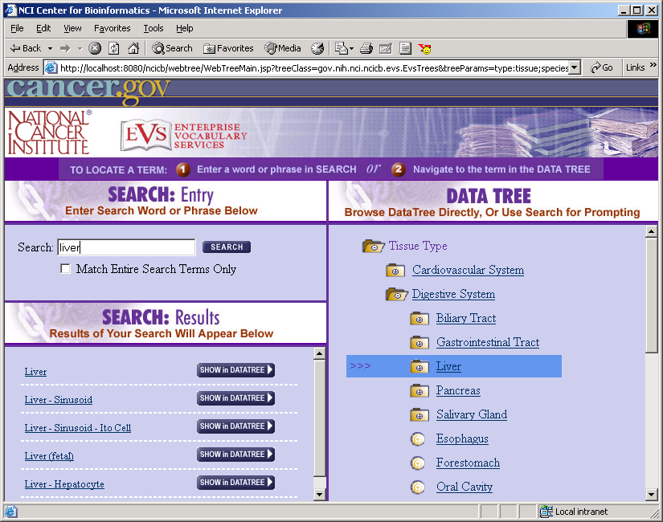
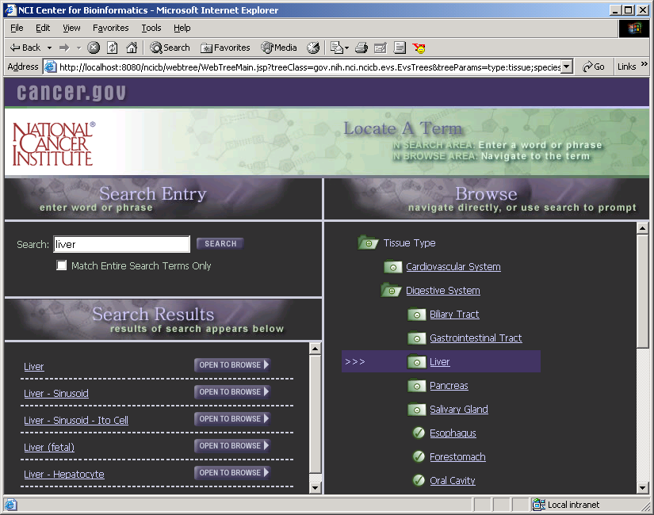
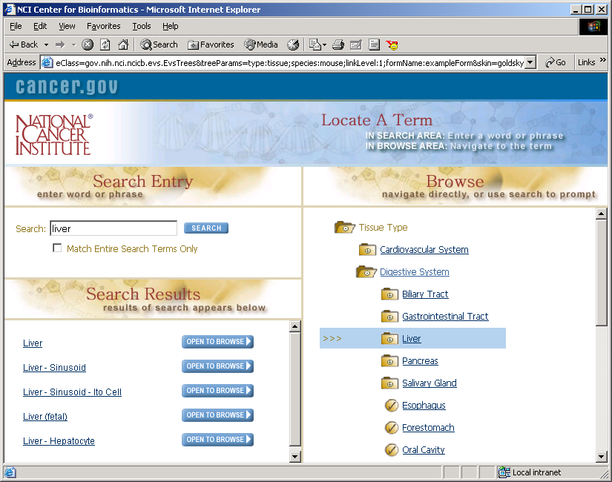
Skins

Slide 10
Skins
Provides the WebTree GUI with a color and graphic scheme.
Optionally provides JavaScript functionality for WebNode actions.
  “JavaScript.js” file in the skin directory is used for defining JavaScript functions accessible by WebNode actions, and advanced iconActions.
Skin file structure consists of HTML and graphics files, along with css files for customizing colors and graphics.

Slide 11
Tips
Cache large data trees, and dynamically build views (subsets) of the tree. (i.e. EVS Diagnoses Tree)
Make use of treeParams for communicating information to your JavaScript action functions. (i.e. HTML form name when action function must populate an HTML form)
Limit use of JavaScript as much as possible, use ECMA Script standard, making exceptions for Netscape 4.7

Slide 12
Questions?
contact info
marc.s.piparo@saic.com
slides:
http://www.celebration.saic.com/webtree
code:
cvs – lpgdev5.nci.nih.gov
repository: /export/home/cvs/master/ncicb

