Slide 1
Yeast Screening Data
Obtained from NCI’s Developmental Therapeutics Program

Slide 2
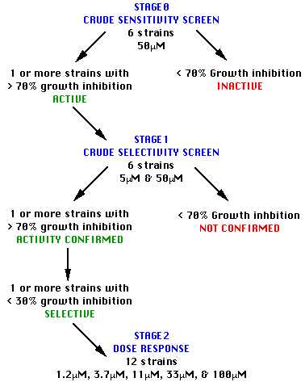
Testing Setup

Slide 3
Data set
Stage 0 = 521,047 records
Stage 1 = 178,044 records
Stage 2 = 142,285 records
Total = 841,376 records

Slide 4
Data set cont.
unique NSC numbers for Stage 0
87,284
unique NSC numbers for Stage 1
14,837
unique NSC numbers for Stage 2
2,189
unique NSC’s with data for each stage = 2,170

Slide 5
YeastModel
id
modelDescriptor
experimentalBackground
geneticBackground
1 or more
1
RAD 50 - 50562
rad50
1 or more
TargetedModification
ScreeningData
id
modificationType
engineeredGeneId
yeastModelId
id
stage
inhibitionRate
diffinh
aveinh
yeastModelId
treatmentScheduleId
agentId
1
0
.70
0.018
0.391
1
1
1
1
Deletion
1
1
2
0
.70
0.109
-0.0705
1
1
2
3
0
.70
0.041
0.1275
1
1
3
2
Deletion
2
1
4
1
.70
0.03
0.13
1
2
4
5
1
.70
0.05
0.93
1
1
4
3
Deletion
3
1
6
2
0.02
0.02
1
3
5
7
2
0.01
0.02
1
4
5
4
Insertion
4
1
8
2
0.38
-0.16
1
5
5
9
2
0.01
0.01
1
6
5
10
2
0.02
0.00
1
7
5
1
EngineeredGene
id
name
genotypeSummaryId
reference
Treatment
1 or more
1
Agent
id
dosage
regimen
id
NSCName
agentName
1
rad50
1
http://genome-www4.stanford.edu/cgi-bin/SGD/locus.pl?locus=rad50
1
50 microM
1
1
Toluquinone
2
5 microM
2
2
Benzothiazole,2,2’-dithiobis-
2
erg6
1
http://genome-www4.stanford.edu/cgi-bin/SGD/locus.pl?locus=erg6
3
100 microM
4
33 microM
3
3
Phenol,2-chloro-4,5-dinitro-
5
11 microM
4
6
<unknown>
3
pdr1
1
http://genome-www4.stanford.edu/cgi-bin/SGD/locus.pl?locus=pdr1
6
3.7 microM
5
670823
No name provided
7
1.2 microM
4
pdr3
1
http://genome-www4.stanford.edu/cgi-bin/SGD/locus.pl?locus=pdr3
Nomenclature
1
GenotypeSummary
id
name
id
summary
nomenclatureId
1
1
Stage 0/1 identified by relevant mutations
1
1
MAT A rad50 Δkan^{r} erg6 ΔLEU2 pdr1 ΔLEU2 pdr3 ΔhisG::URA3::hisG ade2 ade3 leu2 ura3
2
Stage 2 identified by relevant mutations
2
2
MAT A rad50 Δkan^{r} erg6 ΔLEU2 pdr1 ΔLEU2 pdr3 ΔhisG::URA3::hisG ade2 ade3 leu2 ura3

Slide 6
In-Vivo Screening Data
Obtained from NCI’s Developmental Therapeutics Program

Slide 7
Data set
1,168,995 records
160 different tumor models
115, 324 unique NSC numbers

Slide 8
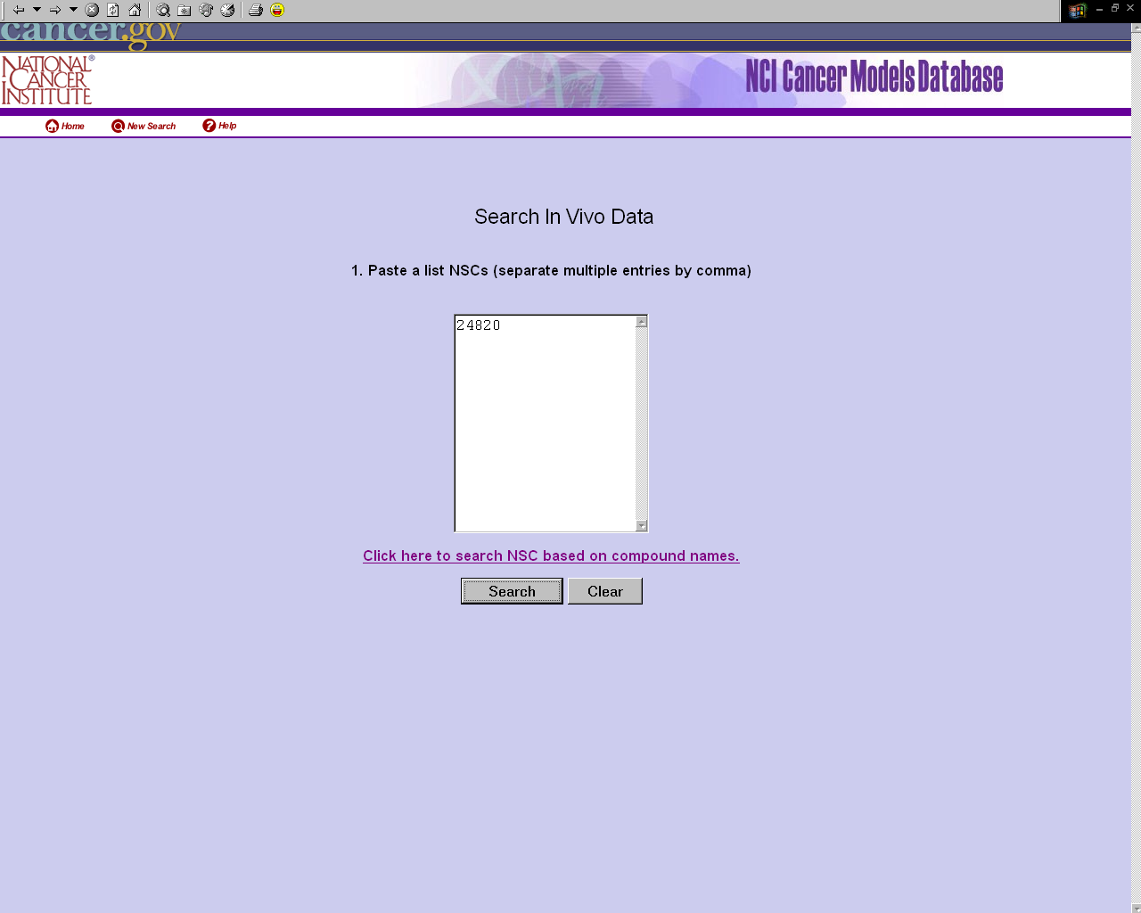

Slide 9
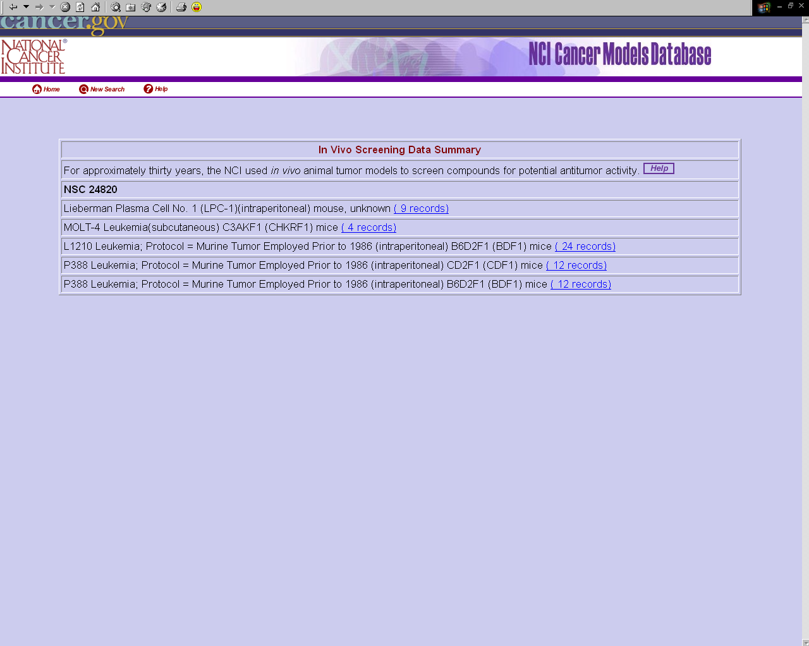

Slide 10
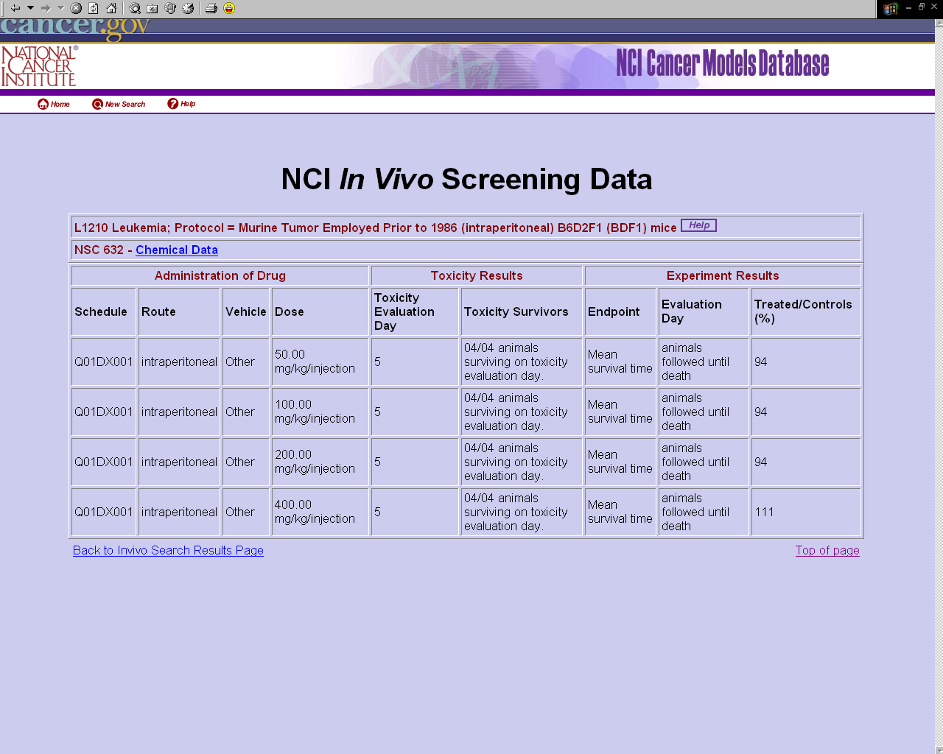

Slide 11
How are we going to display the data?

Slide 12
Suggestion 1
Some of the animal models have associated therapeutic experiments.
If we know the NSC number for the compound used we can add the yeast and in-vivo screening results to the therapeutic approaches page for this particular animal model.
(In the 2-tier app we use the NSC number to add data about human clinical trials. We can now show the responses from yeast to human on one page.)

Slide 13
Suggestion 2
Allow a search by NSC number and give the user a choice if the want to have the yeast, in-vivo, animal model and/or human trials displayed.
Would be nice to have a link to DTP to look up the NSC number if user knows only the name of the compound.

Slide 14
Suggestion 2 cont.
Utilize the currently existing results pages for yeast and in-vivo
(Where are the yeast pages at the moment?)

Slide 15
Suggestion 3
Display the different in-vivo tumor models and yeast models as models and associate the results of the screening with the models
Problem: Amount of data per model

Slide 16
Suggestion 4
???

Slide 17
Challenges
Performance
Amount of Data
make sure that there is no 1000 record limit

Slide 18
Data fields of each record
  Tumor_code_id
  Host_code_id
  Innoculation_site_code
  Schedule
  Route
  Vehicle
  Endpoint_code
  NSC_number
  Dose_unit
  Dose
  Percent_treated_to_control
  Evaluation_day
  Toxicity_Survivors
  Toxicity_Evaluation_Day

