Slide 1
caLAB Wireframes V4
Iteration 1
February 17, 2006

Slide 2
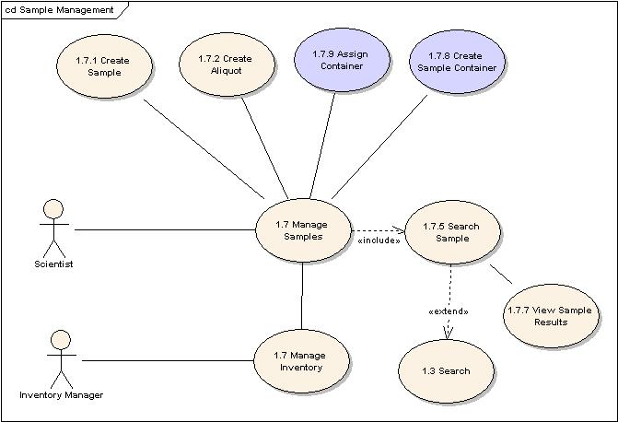
Use Cases
Iteration 1 supports the following use cases
  Login (Authentication Only)
  Manage Workflow (Basic)
    Execute Workflow
  Manage Sample
    Create Sample
    Create Aliquot
    Assign Aliquot
  Search (Workflow, Sample)
Iteration 1 Use Cases will not support Create Workflow and Container Management use cases
Security (Authorization) will not be included in Iteration 1

Slide 3

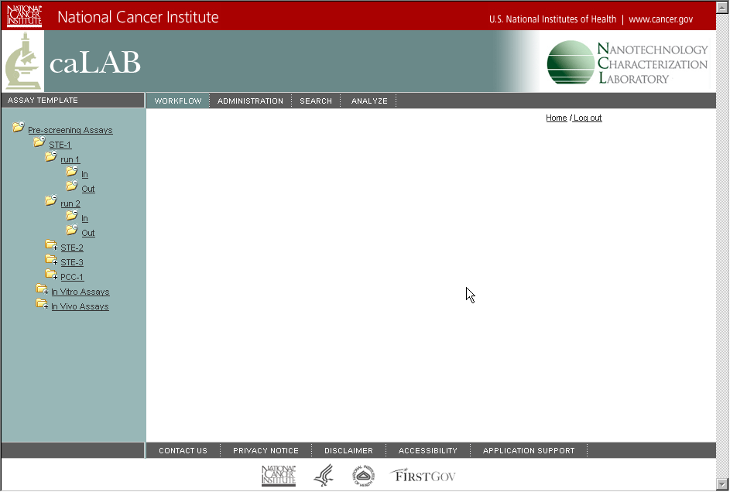

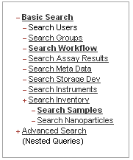
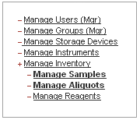
DRAFT caLAB Vision

Slide 4
Login
Wireframes
Iteration 1

Slide 5
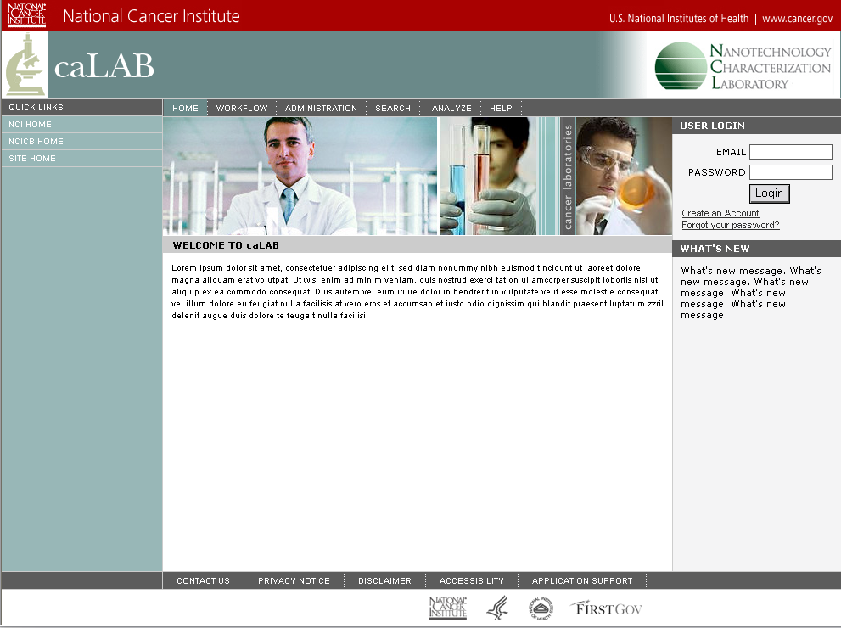
Login
Create an Account and Forgot Password will be manual in this iteration (i.e. e-mail admin who will create the user in the database)

Slide 6
Workflow Management
Wireframes
Iteration 1

Slide 7
Create Workflow
Create workflow will be implemented in subsequent releases of the adaptive management use cases
In iteration 1, an XML template will be loaded at startup which defines the laboratory assay structure.
  The XML template (draft) will support the following nodes in iteration 1:
  <activity name=“Pre-screening” type=“assay”>
  <activity name=“STE-1” type=“assay” action=“create_run”>
  <input name=“in” type=“aliquot” action=“use_aliquot”>/
  <input name=“in” type=“file” action=“upload_file,download_file”>/
  <output name=“out” type=“file” action=“upload_file,download_file>/
  </activity></activity>

Slide 8
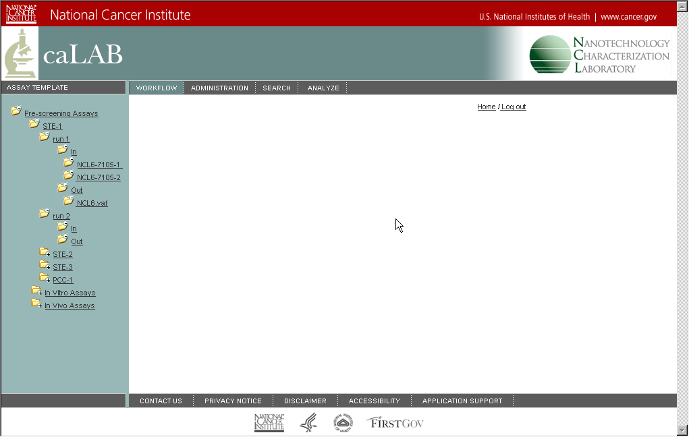






Execute Workflow
Create Assay Type
Mask Assay Type
(Next Iteration)
Create Assay
Mask Assay
(Next Iteration)
Create Run
+ Execute Workflow
2/20/2006 10:30:02.00 - Chris McLeland
Use Aliquot
Upload Files
Download Files
Download File Mask File
Mask Aliquot
Download File
Mask File

Slide 9
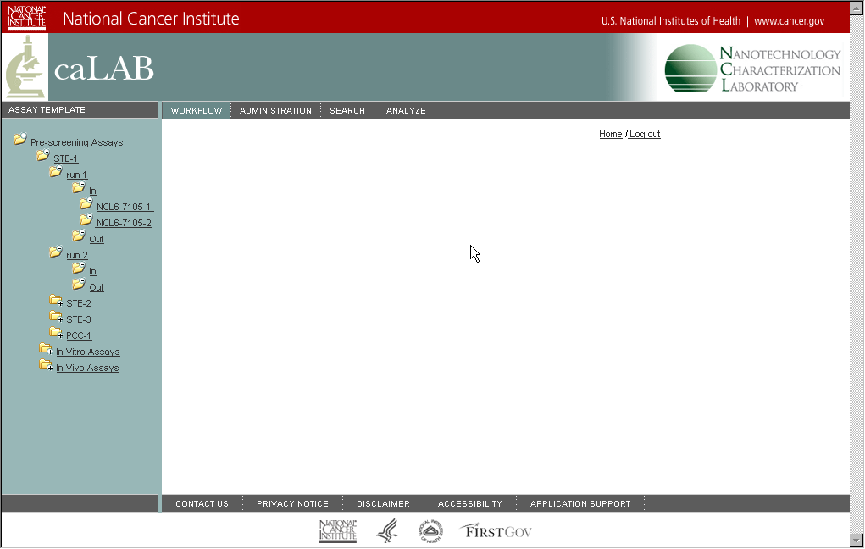

Execute Workflow (Create Run)
+ Execute Workflow
Create Run
Automatically creates new run and numbers sequentially; Captures date/time run created and user who created run

Slide 10
Execute Workflow (Inputs)
+ Execute Workflow
Use Aliquot
Upload Files
Download Files

Slide 11
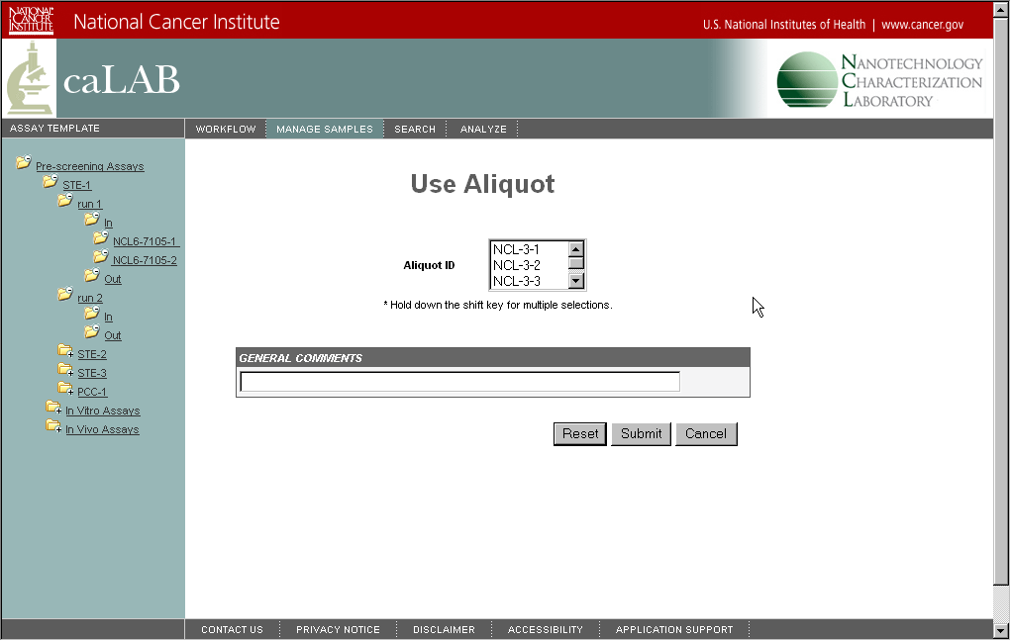

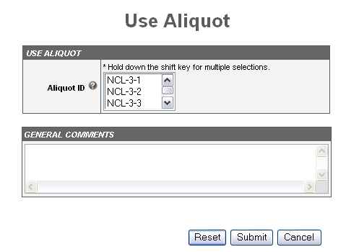
Execute Workflow (Use Aliquots)
Use Aliquot
Upload Files
Download Files

Slide 12
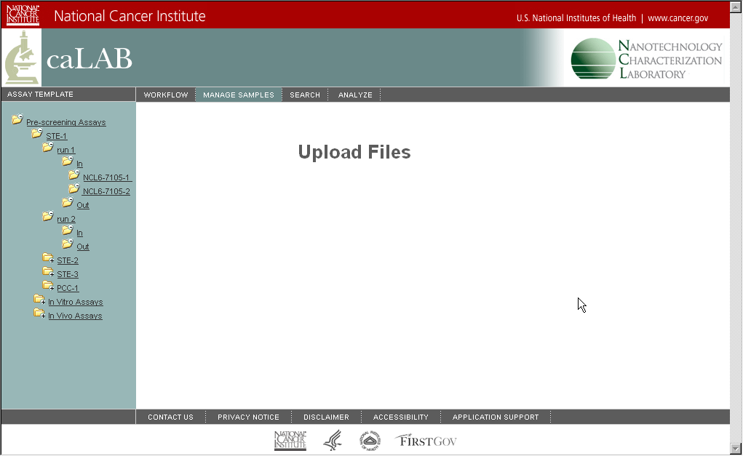

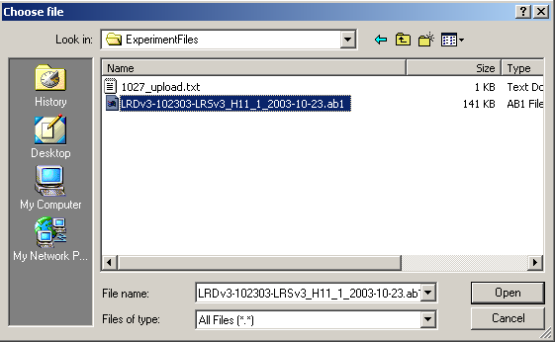
Execute Workflow (Upload Files)
This will be replaced by a multi-file upload applet
Use Aliquot
Upload Files
Download Files

Slide 13

Execute Workflow (Download Files)
+ Execute Workflow
Download all files in input directory (zipped or unzipped)
Use Aliquot
Upload Files
Download Files

Slide 14
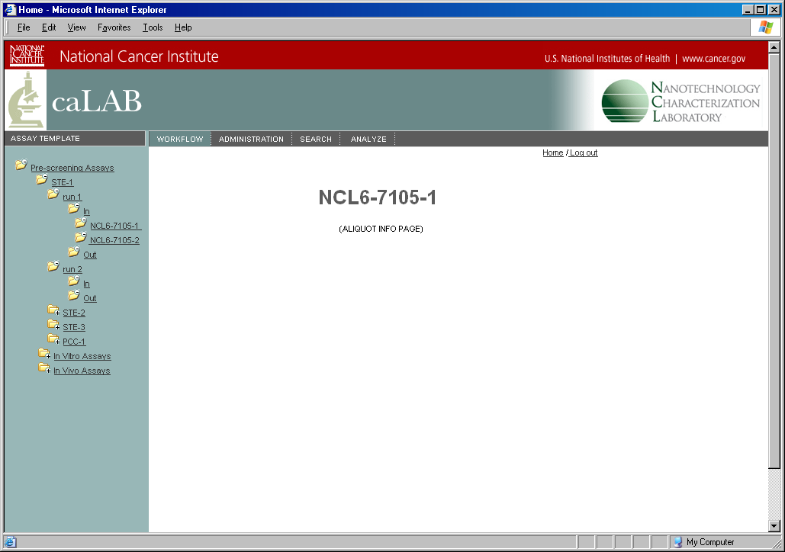

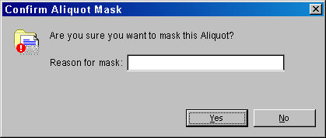
Execute Workflow (Input Management)
Download File
Mask File
Mask Aliquot
Displays properties of aliquot when aliquot selected “clicked”. When double click on filename, the OS would load the appropriate application

Slide 15
Execute Workflow (Run Outputs)
+ Execute Workflow
Upload Files
Download Files

Slide 16

Execute Workflow (Upload Files)
Upload Files
Download Files

Slide 17

Execute Workflow (Download Files)
Download all files in input directory (zipped or unzipped)
Upload Files
Download Files

Slide 18

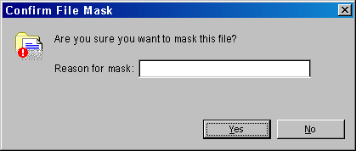
Execute Workflow (Output Management)
Download File
Mask File
When double click launches application
Asks for a reason prior to masking

Slide 19
Sample Management
Wireframes
Iteration 1

Slide 20
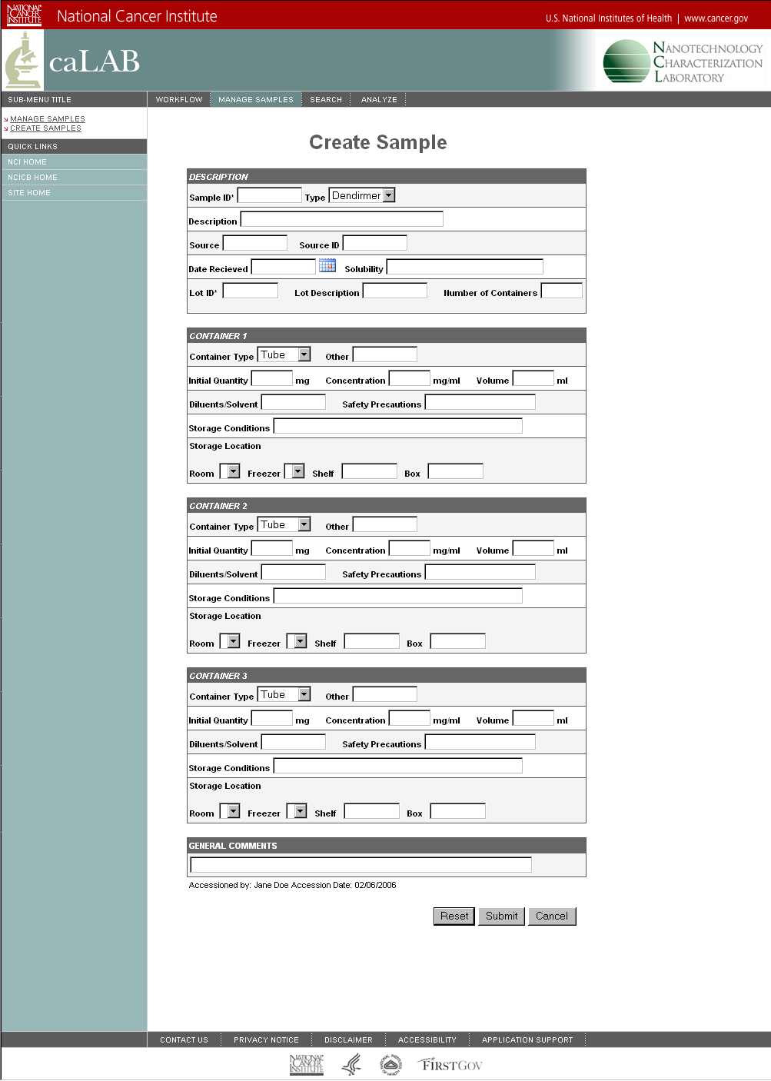
Create Sample
+ Manage Samples
SOP:
Sample Procedure 1
Automate Sample ID numbering but allow edit
mg
mg/ml
ml
Include Auditing – Record date/time sample accessioned

Slide 21
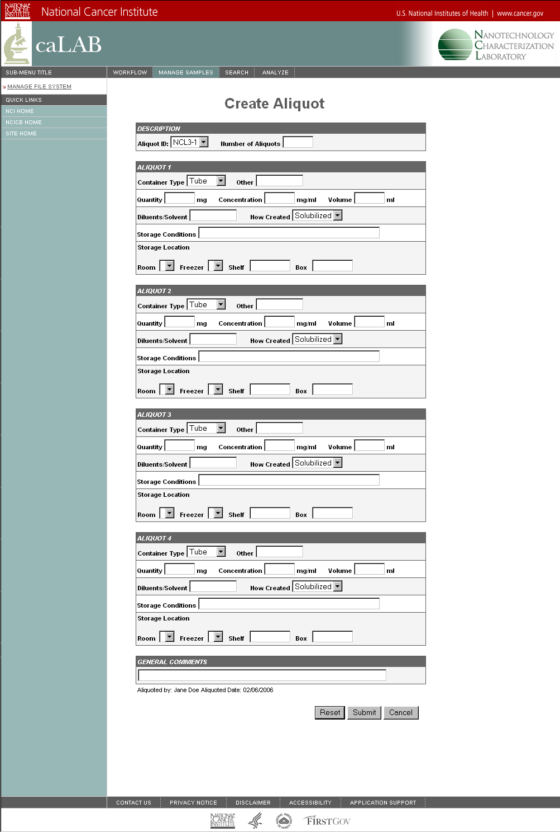
Create Aliquot
+ Manage Samples
mg
mg/ml
ml
These lines will be dynamic based on the # of aliquots selected
Default to parent (sample) storage information
Include Auditing – Record date/time aliquot created

Slide 22
Search
Wireframes
Iteration 1

Slide 23
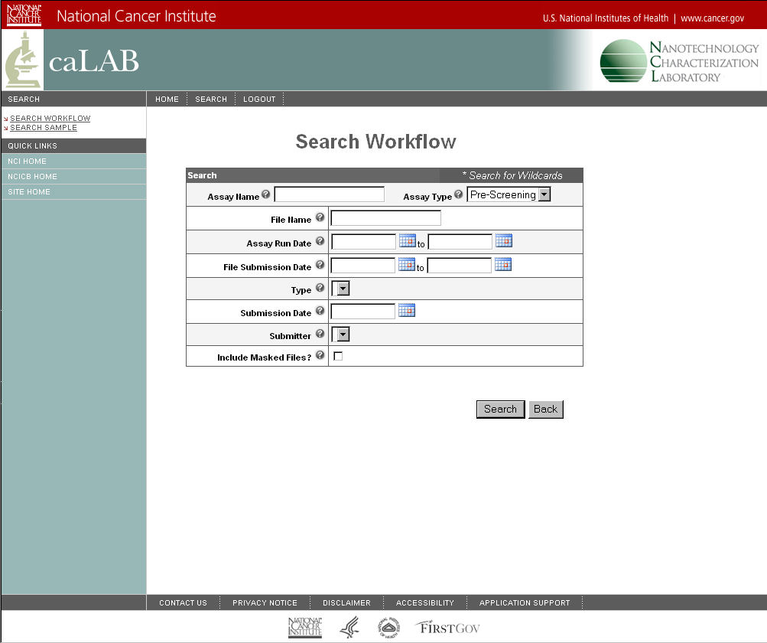
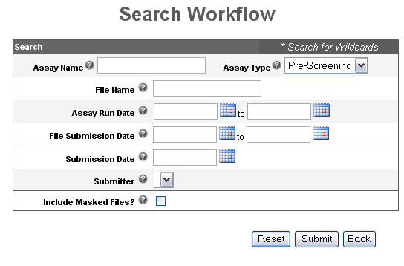
Search Workflow
+ Search Workflow
+ Search Samples
X
In
X
Out
Aliquot ID
NCL6*
Include Masked Aliquots?
File

Slide 24
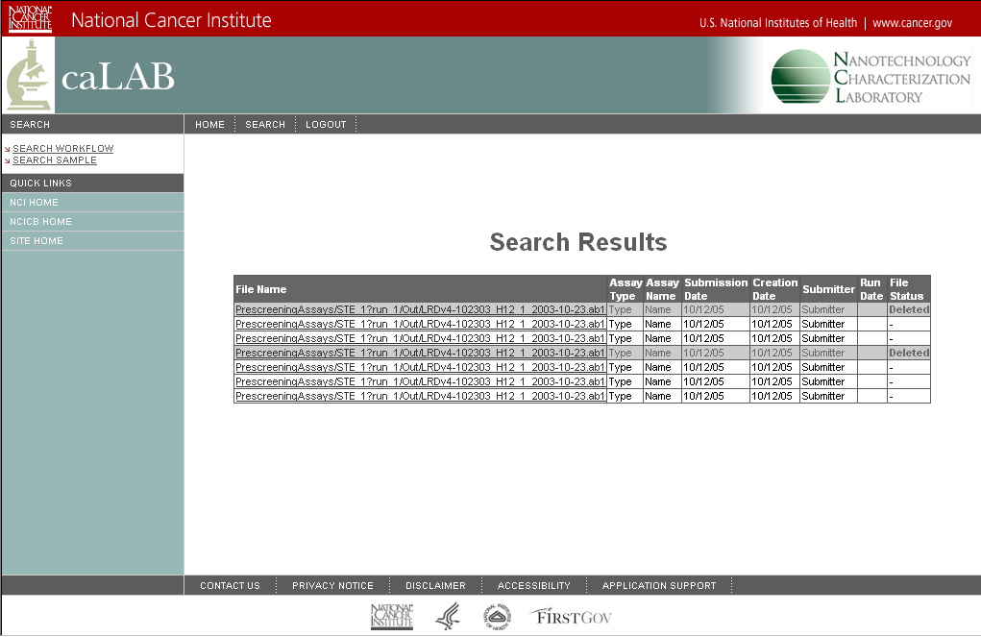
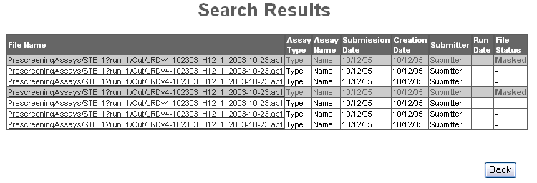
Search Results
+ Search Workflow
+ Search Samples

Slide 25
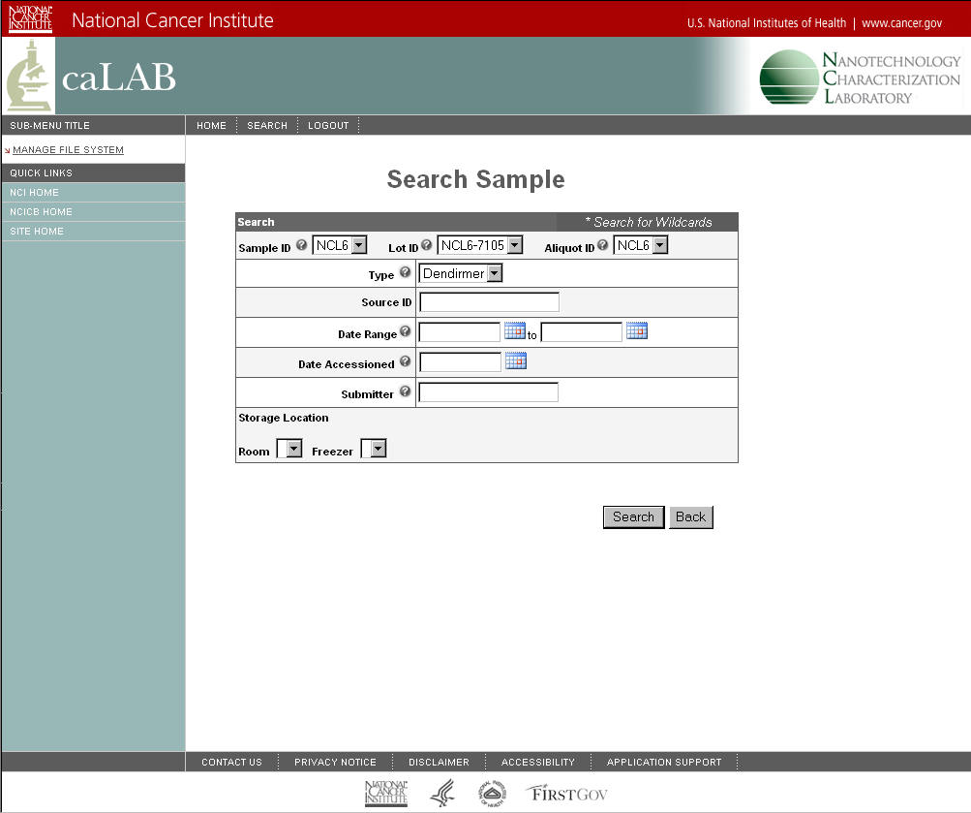
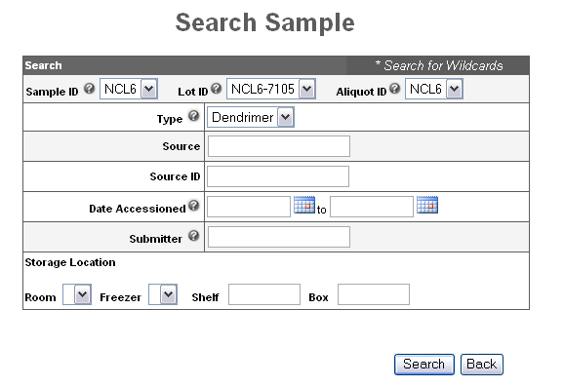
Search Sample
+ Search Workflow
+ Search Samples

Slide 26
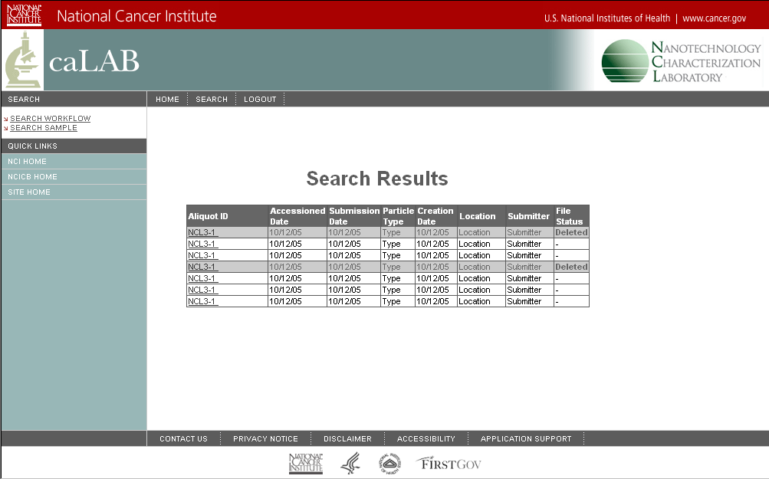
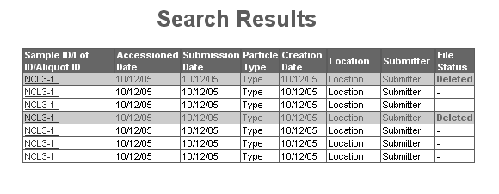
Search Results
+ Search Workflow
+ Search Samples
Edit next release
View
Edit
Mask
View
Edit
Mask
View
Edit
Mask
View
Edit
Mask
View
Edit
Mask
View
Edit
Mask
View
Edit
Mask
Back

Slide 27
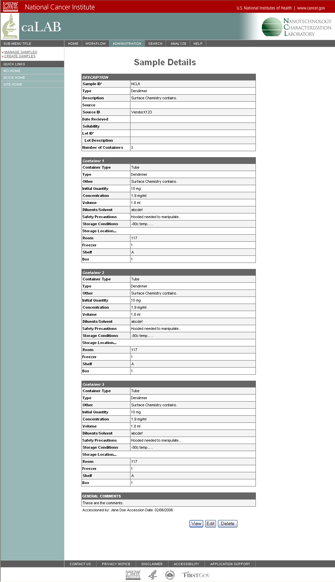
Sample Details

