Slide 1
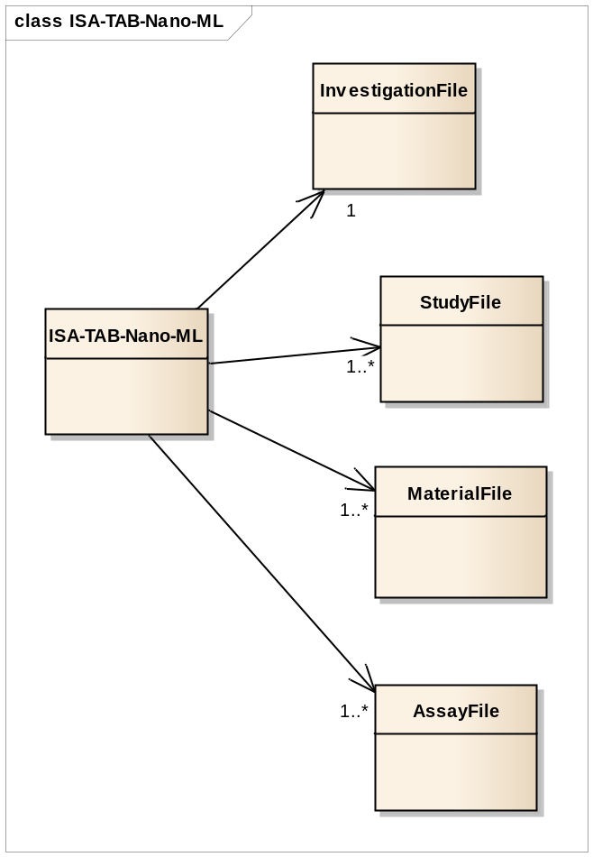
ISA-TAB-Nano-ML
4/25/2012

Slide 2
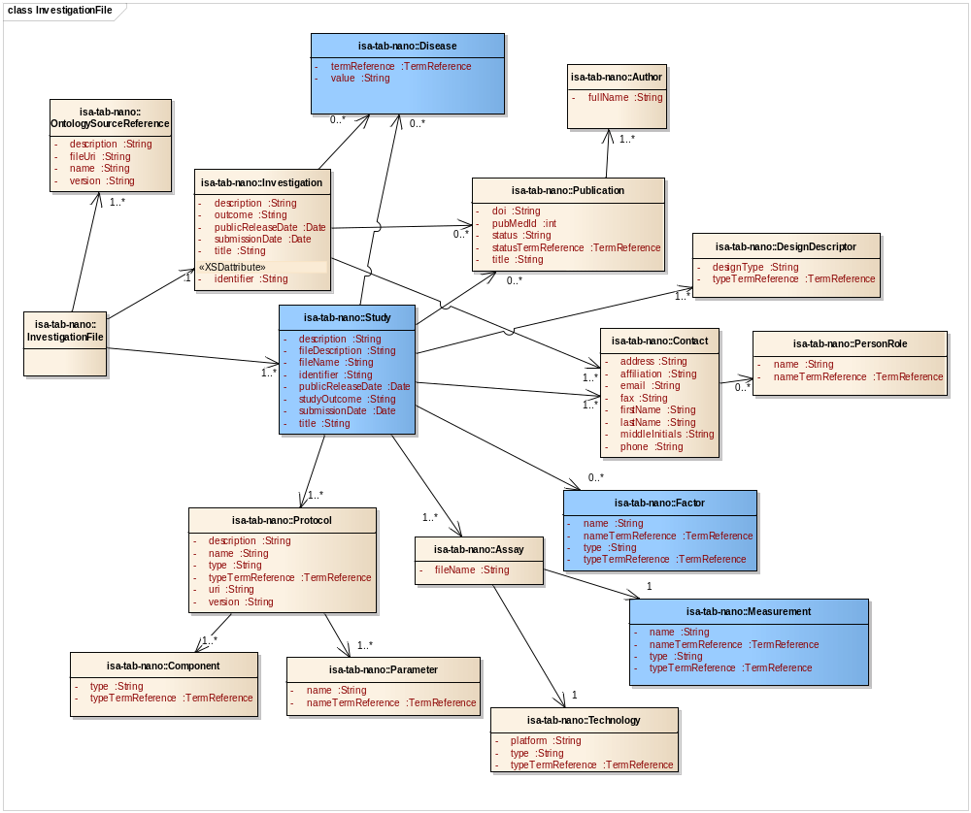
Investigation File
4/25/2012

Slide 3
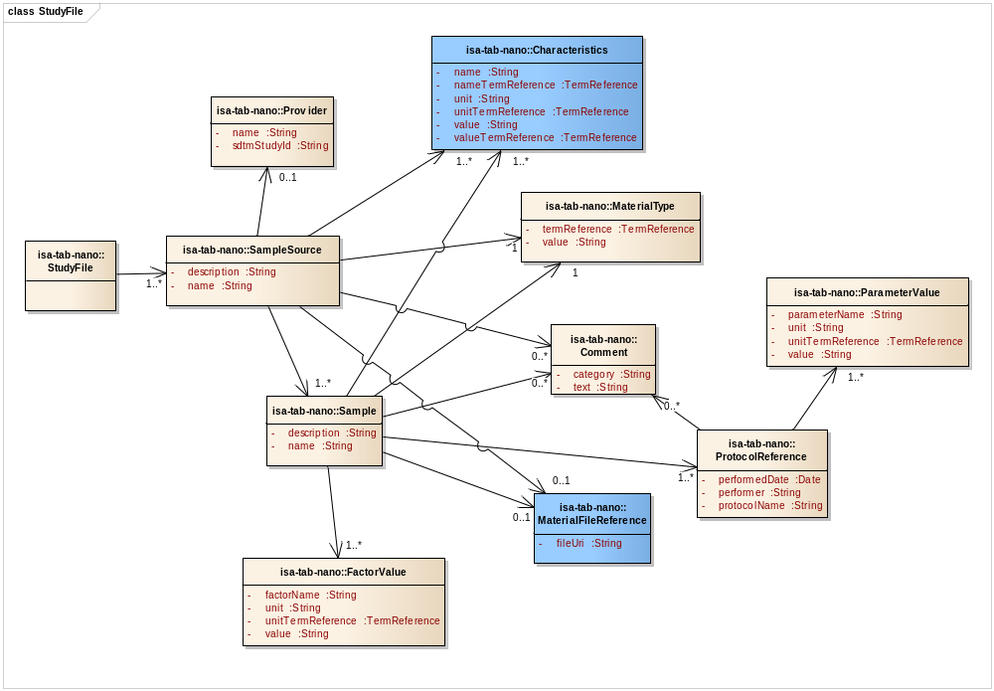
Study File
4/25/2012

Slide 4
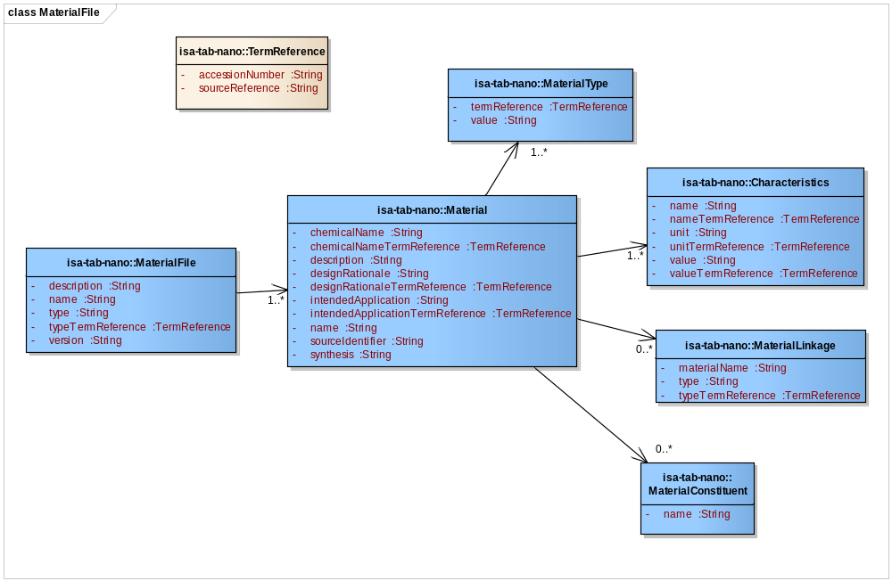
Material File
05/09/2012

Slide 5
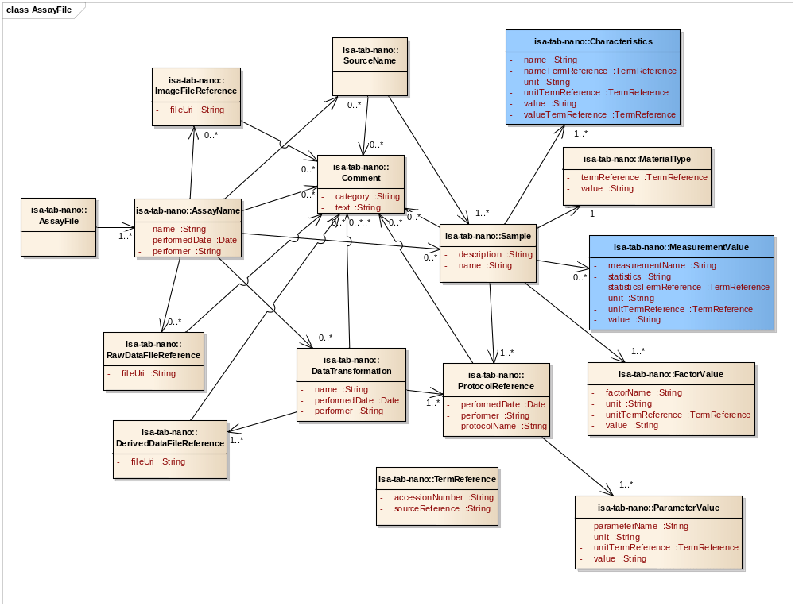
Assay File
4/25/2012

