Slide 1
caLAB Wireframe Review
Iteration 3
January 20, 2006

Slide 2
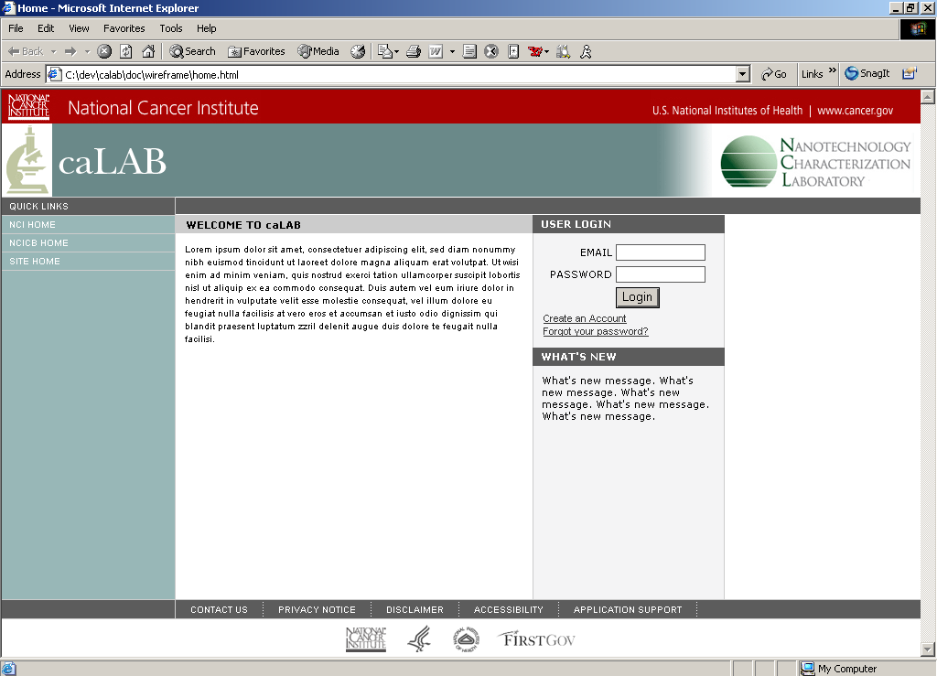

Slide 3
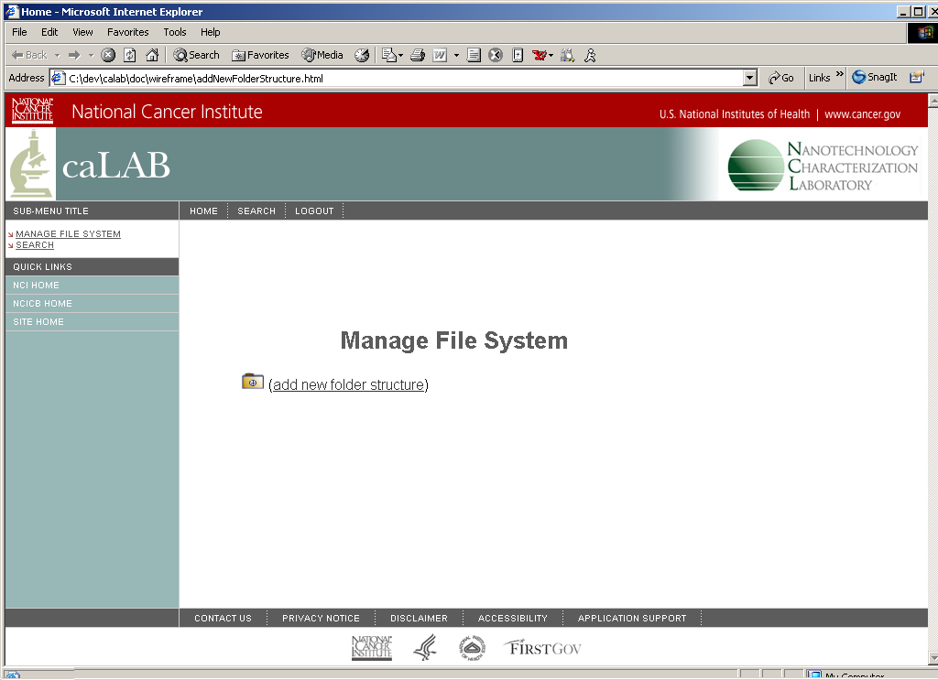

Slide 4
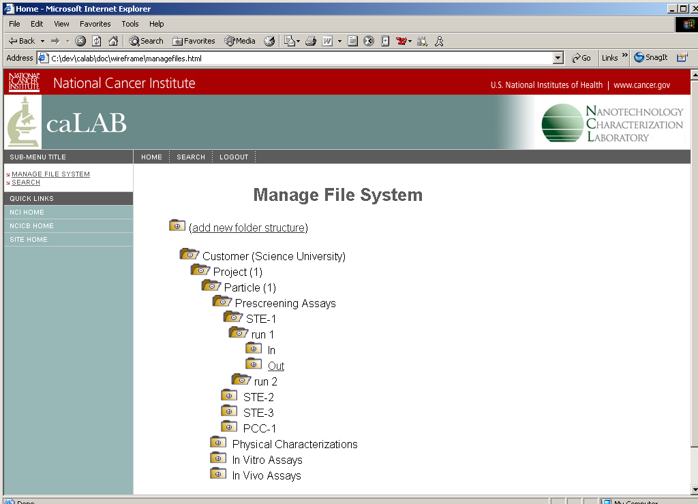

Slide 5
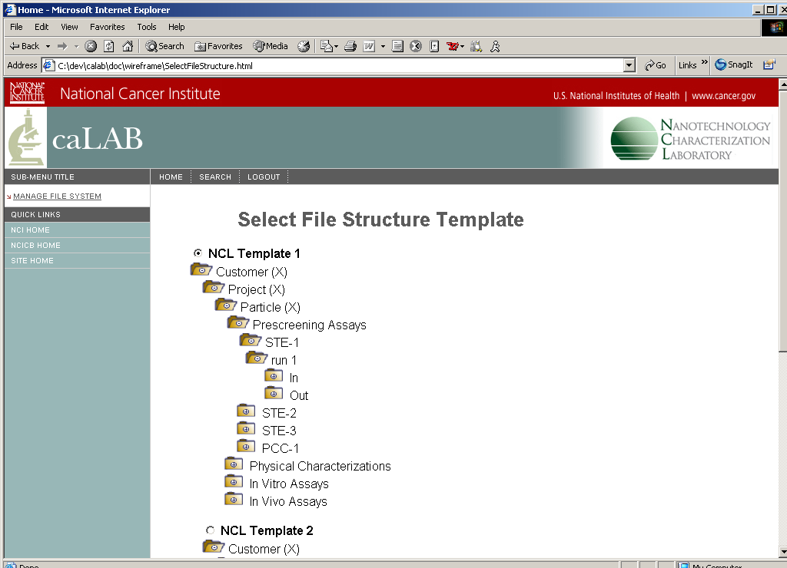

Slide 6
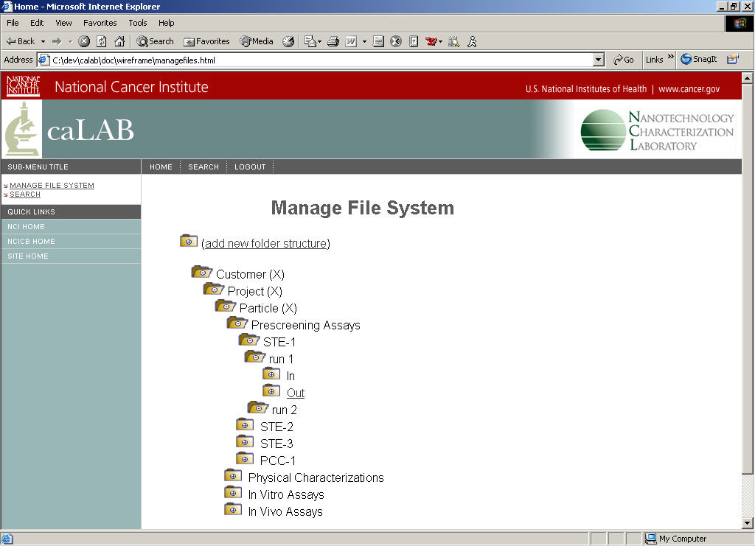
Selected template
Add Folder
Rename Folder
Mark As Deleted

Slide 7
renamed

Slide 8
renamed
Upload Files
Download Files
Rename Folder
Mark As Deleted

Slide 9
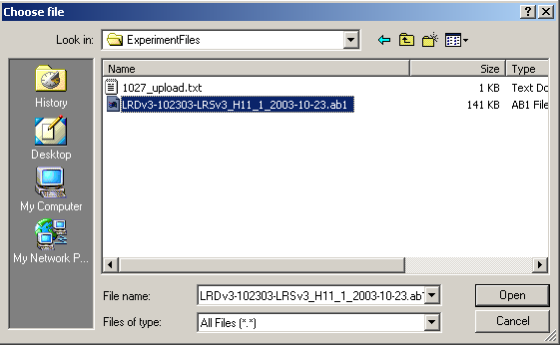
renamed
Upload Files
Download Files
Rename Folder
Mark As Deleted

Slide 10
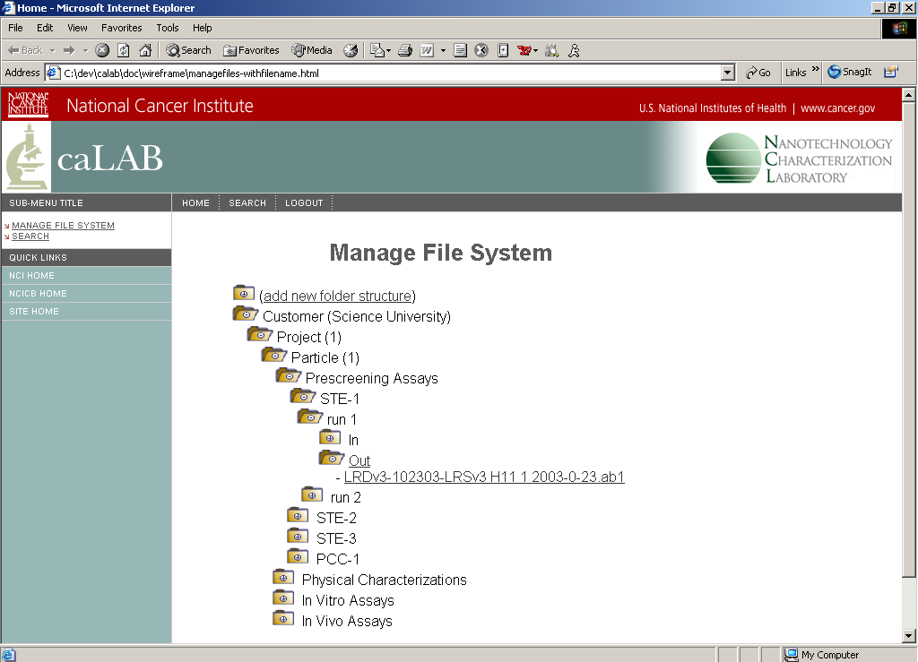
renamed
Download File
Mark As Deleted

Slide 11
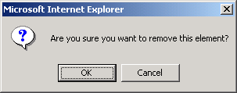
renamed
Download File
Mark As Deleted

Slide 12
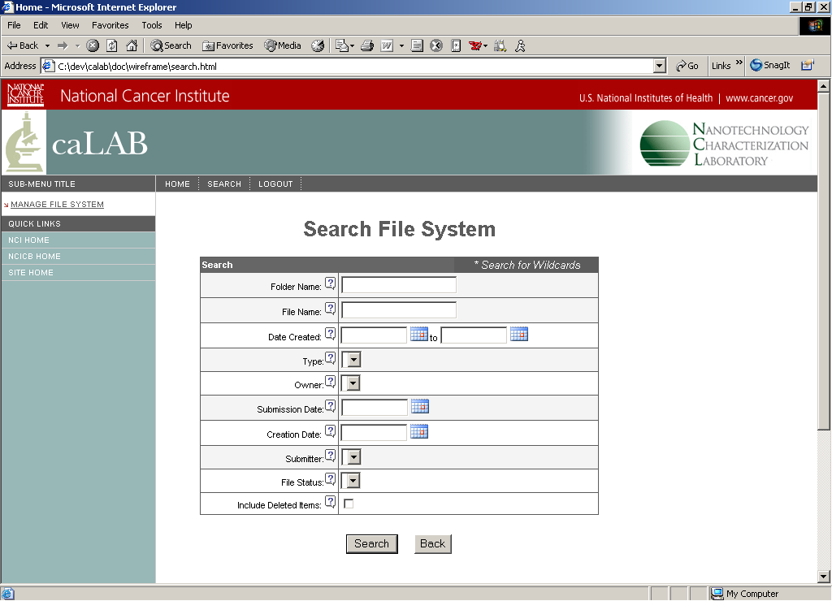

Slide 13
