Slide 1
Execute Workflow Wireframes
Draft 1.0
March 20, 2006

Slide 2
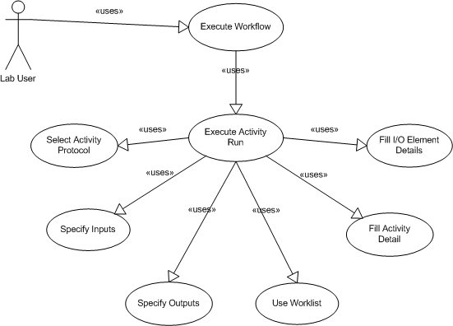
Use Cases

Slide 3
Execute Workflow
Used to describe executing standard activities within a workflow

Slide 4
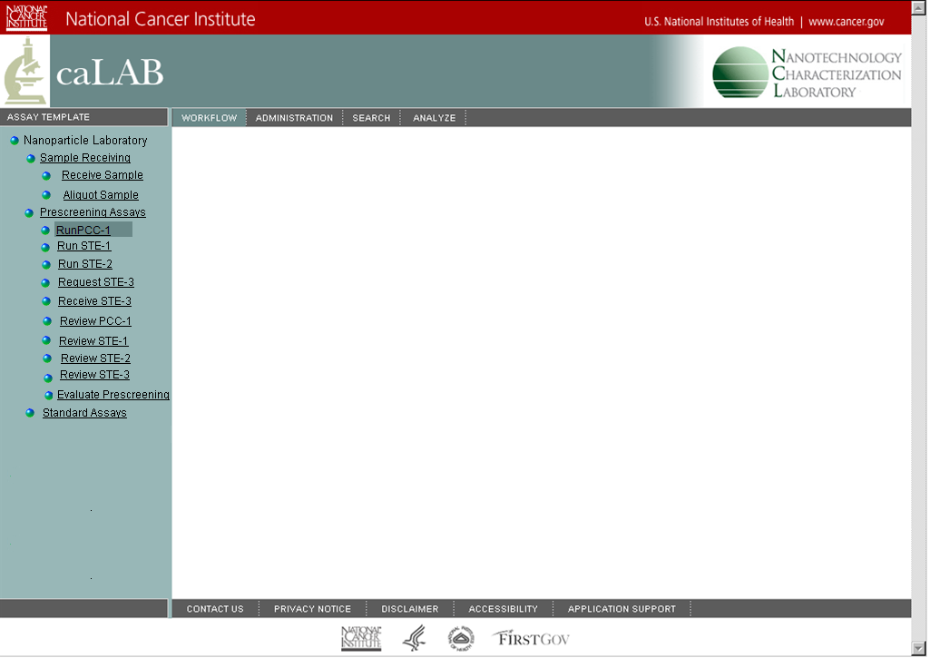
Execute Workflow
Navigation Area
Used to select an activity
Activity Area
This is the to-do list
Run PCC-1
Worklist Area
This is the to-do list
Activity Details Area
Here the activity protocol is specified and information is collected that applies to the activity as a whole.
Input / Output Area
Here inputs and outputs are defined.
Element Details Area
Information about the specific input or output is collected here
Save
Clear

Slide 5
Execute Activity Run
Run PCC-1
Hide Worklist
Worklist
Filter
Name
Starts With
GO
Comments
Name
Worklist Insertion Date
NCL6-1705
April 3, 2006, 12:00 p.m.
NCL7-1801
April 4, 2006, 1:00 p.m.
NCL8-1801
April 4, 2006, 1:00 p.m.
Activity Details
Protocol
Standard PCC-1
SOP
Generate Instrument Definition Files
Load Result Files
Volume used
3
ul
Nanoparticle Aliquot
Work Item Details
Notes
#
Barcode
Name
Nanoparticle: NCL8-1801
BC_NCL8-1801
NCL8-1801
1
Route To
Review PCC-1
1. Select Activty Protocol if needed
2. Specify Inputs and / or outputs
3. Specify Activity Details as needed
4. Specify Work Item Details as needed
5. Press Save to complete activity run.
Location
Save
Clear

Slide 6
Specify Activity Protocol
Run PCC-1
Hide Worklist
Worklist
Filter
Name
Starts With
GO
Comments
Name
Worklist Insertion Date
NCL6-1705
April 3, 2006, 12:00 p.m.
Specify activity protocol if other than the default
NCL7-1801
April 4, 2006, 1:00 p.m.
NCL8-1801
April 4, 2006, 1:00 p.m.
Activity Details
Protocol
Standard PCC-1
SOP
Nanoparticle Aliquot
#
Barcode
Name
Information collected for activity may change based on the activity protocol
1
Input and Output cardinality may change based on the activity protocol
Save
Clear

Slide 7
Specify Inputs
Run PCC-1
Hide Worklist
Worklist
Filter
Name
Starts With
GO
Comments
Name
Worklist Insertion Date
NCL6-1705
April 3, 2006, 12:00 p.m.
NCL7-1801
April 4, 2006, 1:00 p.m.
NCL8-1801
April 4, 2006, 1:00 p.m.
Nanoparticle Aliquot
#
Barcode
Name
1
If configured to also have outputs, outputs would be displayed here
Enter name or scan barcode of input. Corresponding item in worklist is checked. Configurable to display only names if barcodes are not used.
Save
Clear

Slide 8
Use Worklist to Identify Inputs
List of filter operators based on type of worklist column
Enter filter criteria
List of worklist columns which can be used to filter
Hide / Show Worklist
Run PCC-1
Hide Worklist
Worklist
Filter
Name
Starts With
GO
Comments
Name
Worklist Insertion Date
Execute filter (replace text with a filter icon)
NCL6-1705
April 3, 2006, 12:00 p.m.
NCL7-1801
April 4, 2006, 1:00 p.m.
Defined worklist columns. Click header to sort.
NCL8-1801
April 4, 2006, 1:00 p.m.
May click to select element as an input into the I/O area
May click to view comments attached to an element in the worklist
Nanoparticle Aliquot
#
Barcode
Name
1
Save
Clear

Slide 9
Specify Outputs
Receive Sample should be highlighted
Receive Sample
Hide Worklist
Worklist
Filter
Name
Starts With
GO
Comments
Name
Worklist Insertion Date
NCL6-1705
April 3, 2006, 12:00 p.m.
NCL7-1801
April 4, 2006, 1:00 p.m.
NCL8-1801
April 4, 2006, 1:00 p.m.
Nanoparticle Vial
#
Barcode
Name
1
Scan barcode of output. Enter name. Or define custom naming code to automatically name.
Save
Clear

Slide 10
Specify Inputs and Outputs
Enter Filter criteria
Aliquot Sample should be highlighted
List of Worklist Columns
Hide / Show Worklist
Aliquot Sample
Hide Worklist
Worklist
Filter
Name
Starts With
GO
Comments
Name
Worklist Insertion Date
NCL6-1705
April 3, 2006, 12:00 p.m.
NCL7-1801
April 4, 2006, 1:00 p.m.
NCL8-1801
April 4, 2006, 1:00 p.m.
I/O area could be replaced by a custom screen matching that currently used for NCL
May click to select into I/O input area
Nanoparticle Vial
Nanoparticle Aliquot
#
Barcode
Name
Barcode
Name
1
Enter name or scan barcode of input. Corresponding item in worklist is checked
Scan barcode or enter name
The cardinality of the inputs and outputs is configurable
Save
Clear

Slide 11
Fill Activity Details
Run PCC-1
Hide Worklist
Worklist
Filter
Name
Starts With
GO
Comments
Name
Worklist Insertion Date
NCL6-1705
April 3, 2006, 12:00 p.m.
NCL7-1801
Collapse or expand details area
Link to lab SOP page(s)
April 4, 2006, 1:00 p.m.
NCL8-1801
April 4, 2006, 1:00 p.m.
Activity Details
Protocol
Standard PCC-1
SOP
Generate Instrument Definition Files
Load Result Files
Volume used
ul
Nanoparticle Aliquot
Work Item Details
#
Barcode
Name
Other information collected for activity is added here
1
Save
Clear

Slide 12
Fill I/O Element Details
Run PCC-1
Hide Worklist
Worklist
Filter
Name
Starts With
GO
Comments
Name
Worklist Insertion Date
NCL6-1705
April 3, 2006, 12:00 p.m.
Review or add notes to the work item. Replace text with an icon
NCL7-1801
April 4, 2006, 1:00 p.m.
NCL8-1801
April 4, 2006, 1:00 p.m.
Protocol
Press to access a template that can apply work item details to all selected work items. Replace text with an icon
Activity Details
Standard PCC-1
SOP
Generate Instrument Definition Files
Load Result Files
Volume used
ul
Work Item details displayed for the currently selected input or output
Nanoparticle Aliquot
Apply to Sel
Work Item Details
Notes
#
Barcode
Name
Nanoparticle: NCL8-1801
BC_NCL8-1801
NCL8-1801
1
Routing options
Route To
Review PCC-1
Other information collected for the specific work item is added here
Current location of the work elemnt is displayed. Click location link to redefine location
Location
Save
Clear

Slide 13
Example of Customized I/O area
Aliquot Sample should be highlighted
Aliquot Sample
Hide Worklist
Worklist
Filter
Name
Starts With
GO
Comments
Name
Worklist Insertion Date
NCL6-1705
April 3, 2006, 12:00 p.m.
NCL7-1801
April 4, 2006, 1:00 p.m.
NCL8-1801
April 4, 2006, 1:00 p.m.
Protocol
Press to access a template that can apply details to all selected aliquots. Replace text with an icon
Activity Details
Standard PCC-1
SOP
# Aliquots
Specify number of aliquots. Aliquots in I/O area are autonamed
Nanoparticle Vial
Apply to Sel
Work Item Details
Notes
#
Name
NCL106-1
Nanoparticle: NCL106-1-1
Nanoparticle Aliquot
Route To
Review PCC-1
NCL106-1-1
NCL106-1-2
NCL106-1-3
NCL106-1-4
NCL106-1-5
Quantity
mg
NCL106-1-6
NCL106-1-7
NCL106-1-8
NCL106-1-9
NCL106-1-10
Volume
mg/ml
NCL106-1-11
NCL106-1-12
NCL106-1-33
NCL106-1-14
NCL106-1-15
Concentration
ml
NCL106-1-16
NCL106-1-17
NCL106-1-18
NCL106-1-19
NCL106-1-20
Location
NCL106-1-21
NCL106-1-22
NCL106-1-23
NCL106-1-24
NCL106-1-25

Slide 14
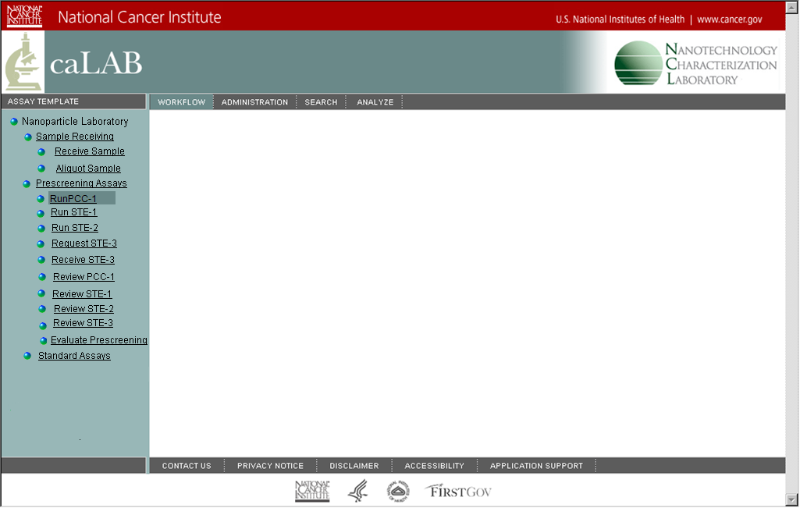
Possible Custom
Aliquot Sample should be highlighted
Run PCC-1
Show Worklist
Activity Details
Protocol
Standard PCC-1
SOP
Nanoparticle
Work Item Details
Notes
#
Name
Barcode
Nanoparticle:
1
Route To
Review PCC-1
Location
Ok
Cancel

