Slide 1
Define Workflow Wireframes
Draft 1.0
March 20, 2006

Slide 2
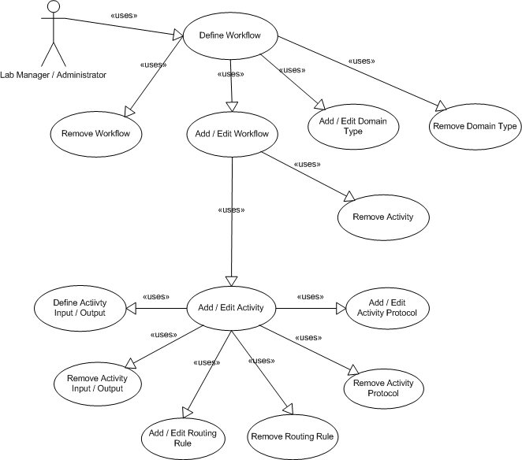
Use Cases

Slide 3
Define Workflow
Used to
  Define Workflows
    Activities
      Activity Protocols
      Inputs / Outputs
      Worklists
      Routing Rules
  Domain Types

Slide 4
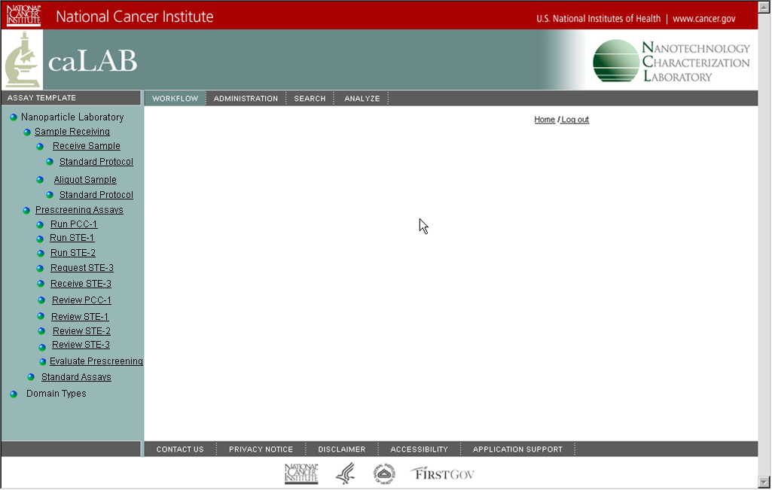
Define Workflow (Navigation Panel)
Navigation Panel.
Suggest using different icons for each node level.
Workflow Node.
Activity Node.
Activity Protocol Node.
Collapsed Activity Nodes
Collapsed Workflow Node
Collapsed Domain Type Node.

Slide 5
Define Workflow
Rename
Add Workflow
Add Workflow
Edit Workflow
Remove Workflow
Add Activity Type
Add Activity Type
Edit Activity Type
Remove Activity Type
Add Activity Protocol
Add Activity Protocol
Edit Activity Protocol
Remove Activity Protocol

Slide 6
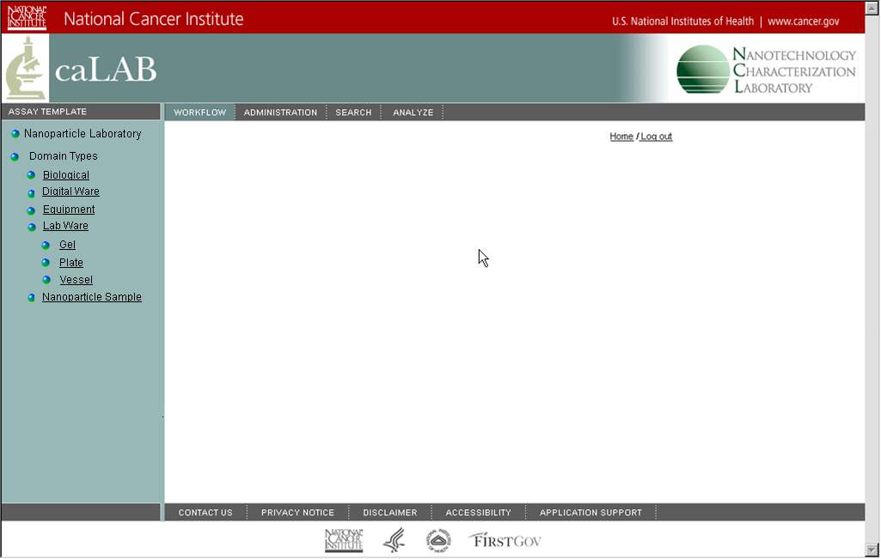
Define Domain Type
Would include some standard common types which can then be modified
Add Domain Type
Add Domain Type
Edit Domain Type
Remove Domain Type
Add Domain Type
Edit Domain Type
Remove Domain Type

Slide 7
Add /Edit Workflow
Internal Name
Display Name
Could be an integer field or an up/down arrow that could be used to visually reorder nodes
Display Order
Reset
Submit
Cancel

Slide 8
Add / Edit Activity Type
Internal Name
Advanced options
Advanced
Display Name
Popup window to add routing
Popup window to add inputs/outputs
Display Order
Inputs / Outputs
Add
Description
Has Worklist
Define
Popup window to define worklist
Routing
Add
Worklist starts open
Domain Type
Destination
Default
Worklist Columns
Reset
Submit
Cancel

Slide 9
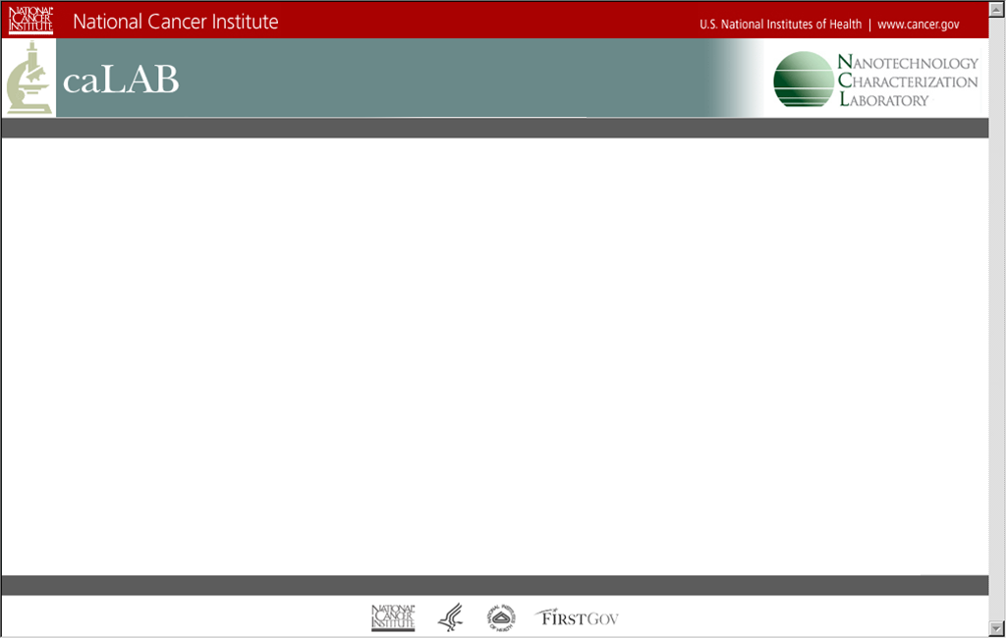
Add / Edit Inputs / Outputs
Input / Output Type
Input
Output
Domain Type
+ Domain Type
Currently specified Domain type
Browse Domain Type tree to select type
Ok
Cancel

Slide 10
Add / Edit Routing Rule
Currently specified Domain type
Browse Domain Type tree to select type
Domain Type
+ Domain Type
Destination
Drop down list of qualified activities
Default
Ok
Cancel

Slide 11
Define Worklist
Clears Column Detail for a new custom colum. Change Detail button becomes Add Custom
When column is selected Column Detail is displayed
Predefined Standard Columns
Column Detail
Available Columns
Used Columns
Display Name
Visible
Advanced
New
Internal Name
Closes window and updates worklist
Query Class
Comparator Class
Ok
Cancel
Applies any change to the column
Change Details

Slide 12
Advanced Activity Info
UI Identifier
Protocol Area Identifier
IO Area Identifier
Client IO Details Identifier
IO Detail Supplier
Input Validator
Output Validator
Activity Save Plug-In
Ok
Cancel

Slide 13
Add / Edit Activity Protocol
Internal Name
Advanced
Display Name
Version
Active
Author
Display Order
SOP Link
Description
Popup window to add input / output cardinality
Cardinality for the inputs and outputs of this protocol
Input / Output Cardinality
Add
Activity Details
Add
Domain Type
Default
Min
Max
Work Item Details for
List of Activity Detail fields. Entries can be edited or removed
List of input and output types for protocol
Add
Popup window to add activity detail fields
Popup window to add work item detail fields
Reset
Submit
Cancel
List of Work Item Details fields for selected I/O type. Entries can be edited or removed.

Slide 14
Add / Edit Input / Output Cardinality
List of I/O types from the activity
Domain Type
Default
Minimum
Maximum
Ok
Cancel

Slide 15
Add / Edit Activity Detail Field
Click to edit master list
List of measurement types (default is blank)
List of possible field types
Internal Name
Is Active
Measurement Type
Display Name
Is Visible
Is Required
List of units defined for measurement type
Description
Possible Units
Is Editable
Field Length
Click to edit master list
Field Type
Use Current Date / Time
Default Value
Time Format
Allowable Units
Minimum
Used for date / time fields
Maximum
Ok
Cancel
Allowable units for this item
Used for numeric fields

Slide 16
Add / Edit Work Item Detail Field
Click to edit master list
List of measurement types (default is blank)
List of possible field types
Internal Name
Is Active
Measurement Type
Display Name
Is Visible
Field Type
Is Required
List of units defined for measurement type
Possible Units
Default Value
Is Editable
Minimum
Field Length
Click to edit master list
Maximum
Use Current Date / Time
Time Format
Allowable Units
Used for numeric fields
Used for date / time fields
Ok
Cancel
Allowable units for this item

