Slide 1
caTRIP GUI Overview
Session Length: approx 15 minutes
Target Audience: Medical Doctors and Clinicians
Trainer: Self-paced
Creation Date: May 23, 2007

Slide 2
Session Details
Target Audience:
  Medical Doctors and Clinicians that need to access data records pertaining to info on patients on clinical trials and their survival, surgery & treatment, to help them make decisions on treatment for other patients.
Prerequisites:
  General working knowledge of:
    Querying relational databases
    Html, Excel and CSV file formats
Acronyms Defined:
  GUI – Graphic User Interface
  SNP – Single Nucleotide Polymorphism
  CSV – Comma Separated Values
  caTRIP – Cancer Translational Research Informatics Platform
  DCQL – An extension to CQL, to express concepts as joins, aggregations and
  target services (CQL is a uniform query language)
  CDE – Common Data Elements

Slide 3
Session Details:
Session Objectives
By the end of this session, you should be able to
  Describe what caTRIP GUI is
  In what ways it is useful
  How to use it to access data

Slide 4
Session Details:
Lesson Plan
Topic 1: Introduction to caTRIP GUI
Topic 2: Overview of the “Basic Query Builder”
Topic 3: A Comprehensive Look at the “Basic Query Builder”
Topic 4: Overview of the “Query Search Interface”
Topic 5: A Comprehensive Look at the “Query Search Interface”
Topic 6: Overview of the “Advance Query Builder”
Topic 7: A Comprehensive Look at the “Advance Query Builder”

Slide 5
Topic 1: Introduction to caTRIP GUI
In this Topic, an overview of the application will be discussed:
  What is the caTRIP GUI
  The goal of the tool
  Databases involved
  caBIG systems being used
  Launching the application
  Layout of the GUI

Slide 6
Topic 1: Introduction to caTRIP GUI
What is caTRIP GUI?
  A web based tool for querying multiple database
  Designed to bring together 2 very important steps in patient care:
    Basic research that occurs in the lab
    Patient care that occurs in the clinic
  “Translational Medicine”
    A branch of medical research that attempts to more directly connect basic research to patient care
  How does it work:
    It bridges the gap using open standards/APIs
    And by harmonized semantics

Slide 7
Topic 1: Introduction to caTRIP GUI
What is its Goals?
  Assist in ‘Outcomes’ Analysis, by:
    Using data from existing patients to the treatment of other patients
    Leveraging clinical, pathology, tissue, and basic science data
    Providing an interface to allow clinicians to query across disparate data types, in a user-friendly manner

Slide 8
Topic 1: Introduction to caTRIP GUI
What Legacy Databases are involved:
  Medical Assistant on the World Wide Web (MAW3)
    Tissue banking, pathology, and some clinical annotations
  Tumor Registry (TR)
    Endpoint data since 1980
  Decision Support Repository (DSR)
    Patient clinical data, crossing all medical specialties, lab data
  Genetic Modifiers of BRCA1 and BRCA2 (GEMS)
    Basic science SNP data on germ line BRCA1/2 mutation carriers
  However, other institutions could be included in the GUI

Slide 9
Topic 1: Introduction to caTRIP GUI
What caBIG™ Systems are being used?
  Clinical data: Tumor Registry
    Diagnosis, treatment, recurrence
  Clinical results: CAE
    Pathology biomarkers
  Tissue bank: caTissue CORE
    Tissue specimens, location
  Pathology reports: caTIES
    Free-text fields
  Basic Science: caIntegrator
    SNP data
Tied together
with semantically
equivalent
Common Data
Elements
(CDEs)

Slide 10
Topic 1: Introduction to caTRIP GUI
To Launch the caTRIP GUI:
  The URL for the test GUI, is Duke’s
    http://cagrid2.duhs.duke.edu/catrip-webstart/
    Note: each institution will have it’s own, unique URL
  Notes:
    The first time you launch the application it will take a little longer because it has to download & setup libraries, resources and directories, on your local drive
    Subsequent sessions of the GUI should load much faster.

Slide 11
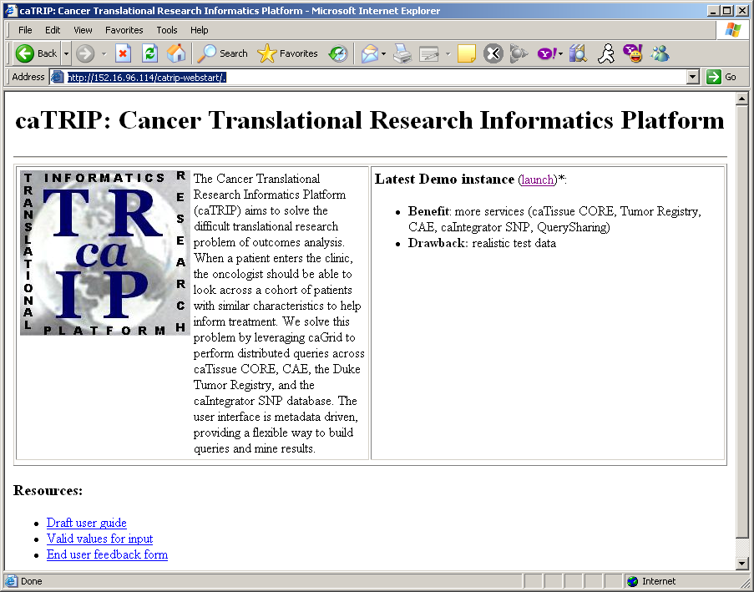
Topic 1: Introduction to caTRIP GUI
caTRIP GUI: Startup Page
1 Click Launch

Slide 12
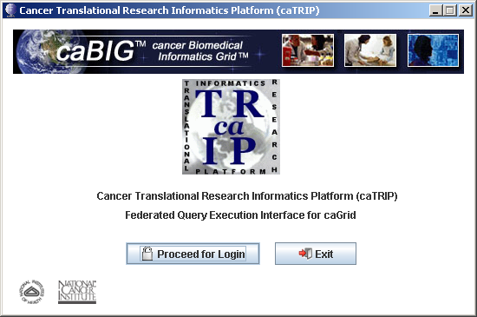
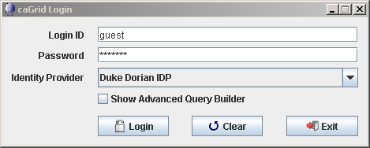
Topic 1: Introduction to caTRIP GUI
caTRIP GUI: Login Page
Note:
For Training, use the ‘guest’ account, otherwise, contact your institutional administrator for a local login
Notes:
BYTEit2MSP: i do need to get info from someone about the 'protocol' for users to get a login/pass - per the reviewer of the training mod...
pmccon012: ok - i think the way they will do it is use their instituational login (e.g. their workstation login) or get a user name/password from an administrator
pmccon012: either way, they should ask their administrator i think
BYTEit2MSP: k, thx

Slide 13
Topic 1: Introduction to caTRIP GUI
caTRIP GUI: Login Page
  How to go about getting login and password?
    For training, you should use the ‘guest’ account
    Otherwise, you should use your institutional login (e.g. their workstation login) or get a user name/password from an administrator
  Who is allowed access the system?
    Clinicians and doctors should have access to the system to help them make decisions on treatment for other patients
  How to get qualified to use it?
    Your administrator at your institution should help determine who qualifies to use the GUI

Slide 14
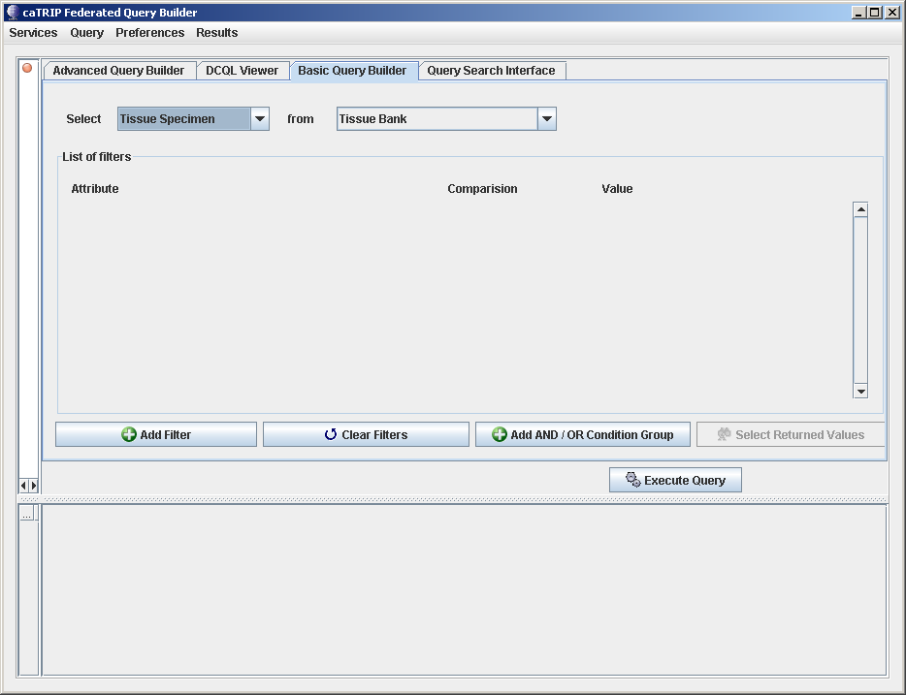
Topic 1: Introduction to caTRIP GUI
caTRIP GUI: Layout
Menu Bar
Query Tabs
Query Building
& Filtering Canvas
Query Results
Notes:
‘Menu Bar’
Services (allows adding or deleting services)
Query (allows to retrieve, create, save , delete or execute a query)
Preferences (allow for adding or selecting a search engine, or add a search engine by url)
Results (allows for exporting results to either HTML, Excel or CSV formatted data files)
‘Query Tabs’
Advance Query Builder – Not yet implimented
DCQL Viewer – Allows to view and query, using DCQL
Basic Query Builder – Most commonly used query tool
Query Search Interface – Used to load previously built and saved queries
‘Query Builder & Filtering’ – Where the columns, tables and filters are defined for querying
‘Query Results’ – Where returned record results are displayed

Slide 15
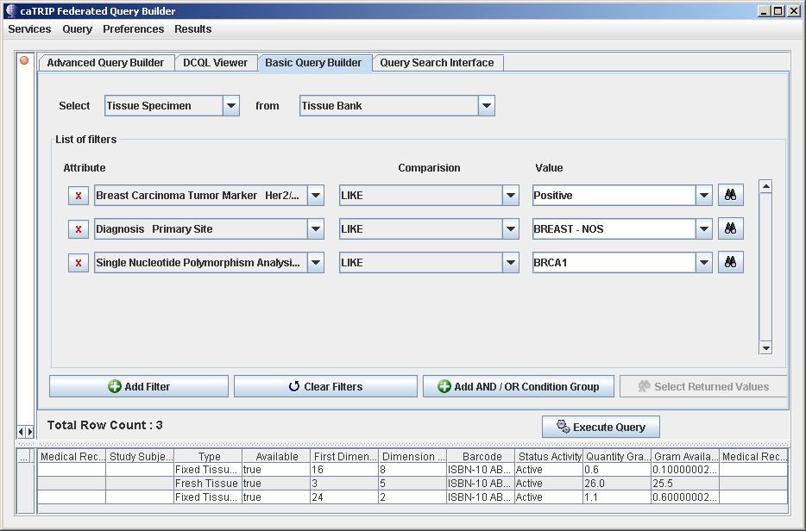
Topic 2: Overview of the “Basic Query Builder”
Example query:
Notes:
To build a query, do the following:
Select the ‘return’ data
Select the table
Add filters to the query by:
Clicking on the ‘Add Filter’, ‘Clear Filters’ and ‘Add ADD/OR Condition Group’ buttons, as needed
Then select the ‘Attributes’, ‘Comparison’ and the ‘Value’ for each filter
Note: to populate the codelist for the ‘Value’ pulldown, click on the binoculars
Once the filters have been defined, click on the ‘Execute Query’ button and results will appear on the bottom half of the GUI window

Slide 16
Topic 3: A Comprehensive Look at the “Basic Query Builder”
Building a query:
1 Select the ‘return’ target data element
2 Select the data source
4
Then select the ‘Attributes’, ‘Comparison’ and the ‘Value’ for each filter
Note: To populate the codelist for the ‘Value’ pulldown, click on the binoculars
3 Clicking on the ‘Add Filter’, ‘Clear Filters’ and ‘Add ADD/OR Condition Group’ buttons, as needed
5 Click ‘Execute Query’
6
Results will be populated here
Notes:
To build a query, do the following:
Select the ‘return’ data
Select the table
Add filters to the query by:
Clicking on the ‘Add Filter’, ‘Clear Filters’ and ‘Add ADD/OR Condition Group’ buttons, as needed
Then select the ‘Attributes’, ‘Comparison’ and the ‘Value’ for each filter
Note: to populate the codelist for the ‘Value’ pulldown, click on the binoculars
Once the filters have been defined, click on the ‘Execute Query’ button and results will appear on the bottom half of the GUI window

Slide 17
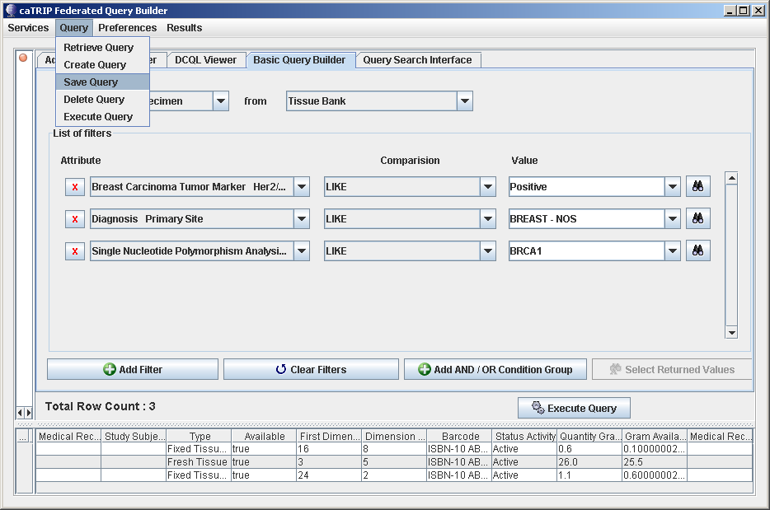
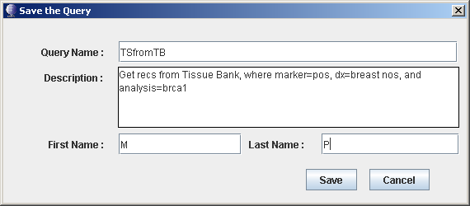
Topic 3: A Comprehensive Look at the “Basic Query Builder”
Saving a query:
1 Select the ‘Save Query’ for the ‘Query’ pulldown
Enter info about query and click ‘Save’ 2
Notes:
To save a query for using again later:
On the toolbar, click: Query -> Save Query
A popup appears, allowing the user to ‘Name’ and the ‘Description’ of the query
Then, by entering the user’s name and clicking ‘Save’
The query and be retrieved for later use

Slide 18
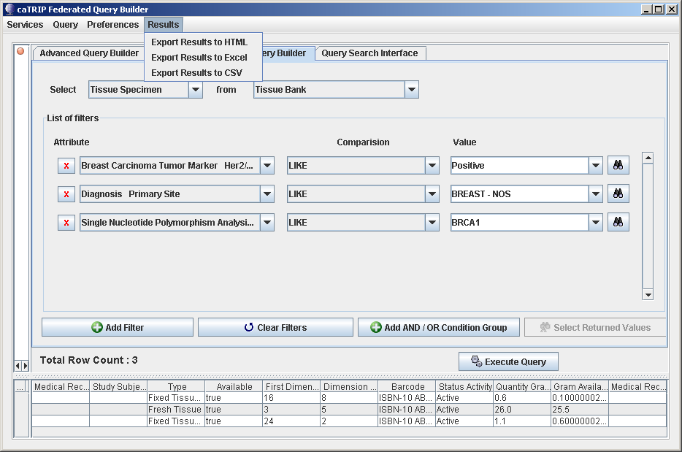
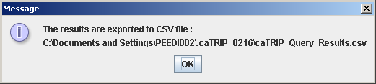
Topic 3: A Comprehensive Look at the “Basic Query Builder”
1 Click, either: ‘Export Results to HTML’, ‘Export Results to Excel’
or ‘Export Results to CSV’
Saving the results:
Notes:
To save the results of a query, to the file system:
On the toolbar, click:
Results -> Export Results to HTML (to save to a HTML doc)
Results -> Export Results to Excel (to save to a Excel doc)
Results -> Export Results to CSV (to save to a comma delimited doc)

Slide 19
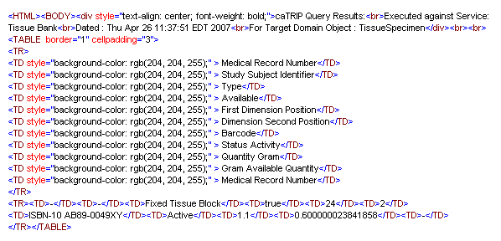
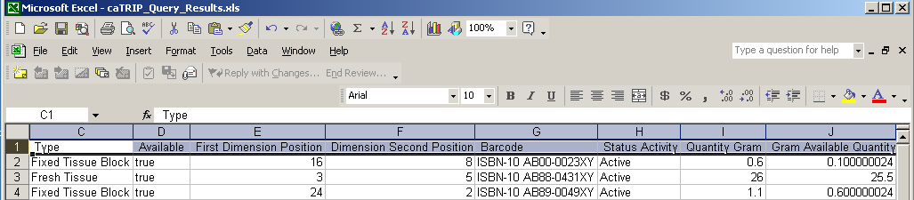
Topic 3: A Comprehensive Look at the “Basic Query Builder”
Snippet of the output files of results:
  HTML Format:
  Excel Format:

Slide 20
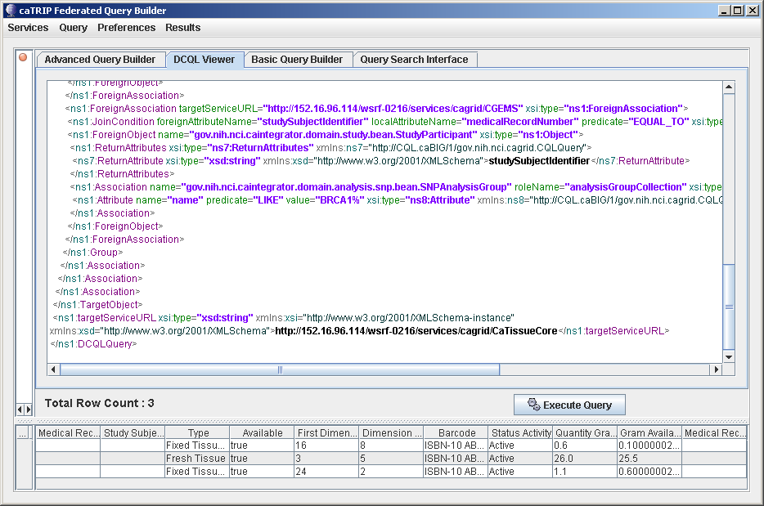
Topic 3: A Comprehensive Look at the “Basic Query Builder”
Viewing the DCQL:
Note:
This area is ‘Read Only’ text area of what the ‘Basic Query’ looks like in DCQL
Notes:
To view the DCQL for the ‘Basic Query’ created:
Click on the ‘DCQL Viewer’ tab

Slide 21
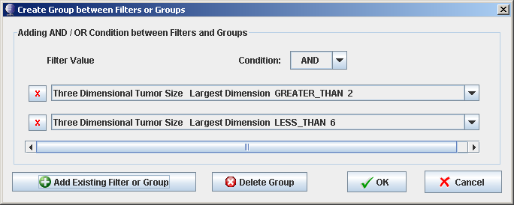
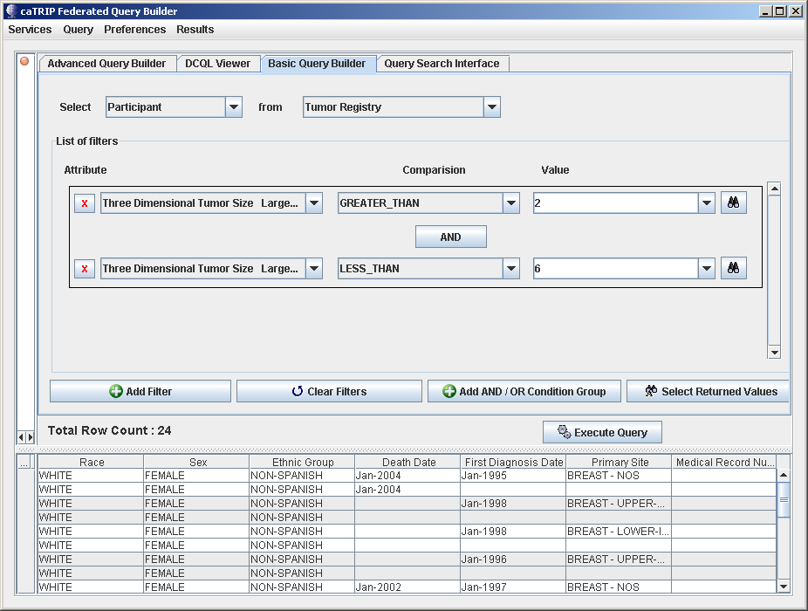
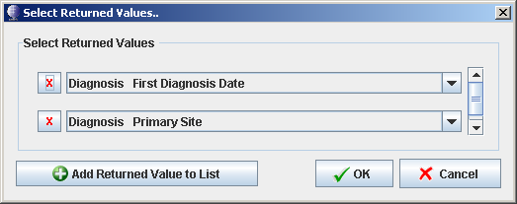
Topic 3: A Comprehensive Look at the “Basic Query Builder”
Another example of an Basic Query
Click on ‘Add AND / OR…’ button to add to filter group.
2 1
Click on ‘Select Returned Values’ button to add columns to the return result listing.. 1
2
Notes:
To build a query, do the following:
Select the ‘return’ data
Select the table
Add filters to the query by:
Clicking on the ‘Add Filter’, ‘Clear Filters’ and ‘Add ADD/OR Condition Group’ buttons, as needed
Then select the ‘Attributes’, ‘Comparison’ and the ‘Value’ for each filter
Note: to populate the codelist for the ‘Value’ pulldown, click on the binoculars
Once the filters have been defined, click on the ‘Execute Query’ button and results will appear on the bottom half of the GUI window

Slide 22
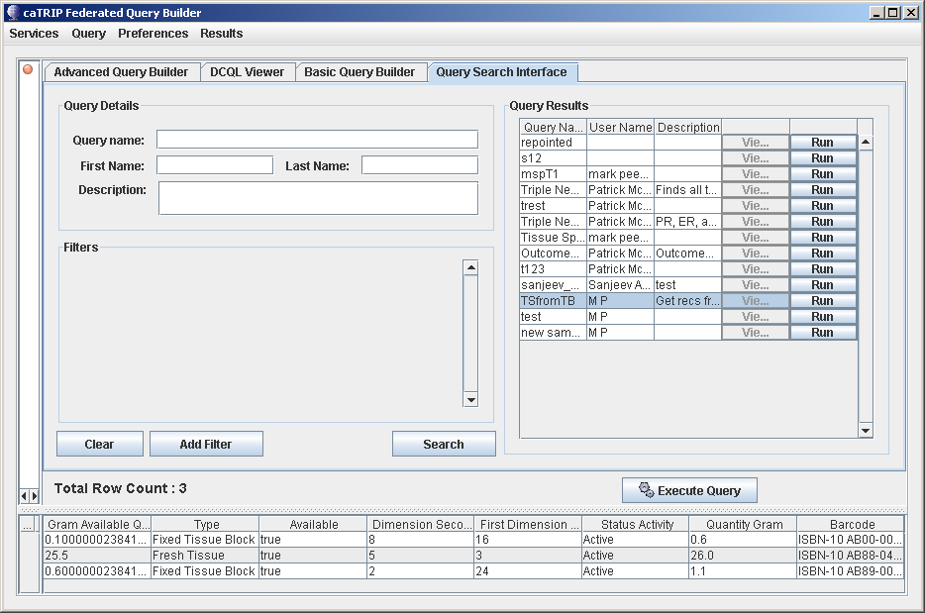
Topic 4: Overview of the “Query Search Interface”
Example of Retrieved query:
Notes:
To save the results of a query, to the file system:
Click on the ‘Query Search Interface’ tab
Click on the ‘Search’ button
And all the queries that are saved will appear in the ‘Query Results’
To retrieve the query and run it:
Select the query
Then, either click ‘Run’ next to the query or ‘Execute Query’ button
Results from executing the query will appear in the bottom half of the GUI

Slide 23
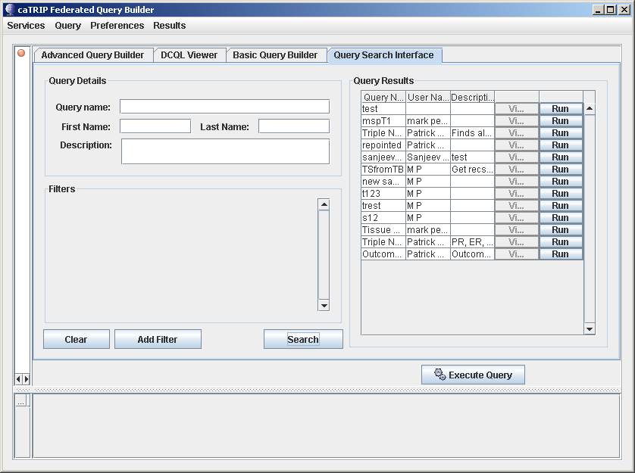
Topic 5: A Comprehensive Look at the “Query Search Interface”
Retrieving all saved queries:
Retrieved queries will be listed here.
2
Leave all the ‘Query Details’ blank and click ‘Search’ to list all the queries saved.
1

Slide 24
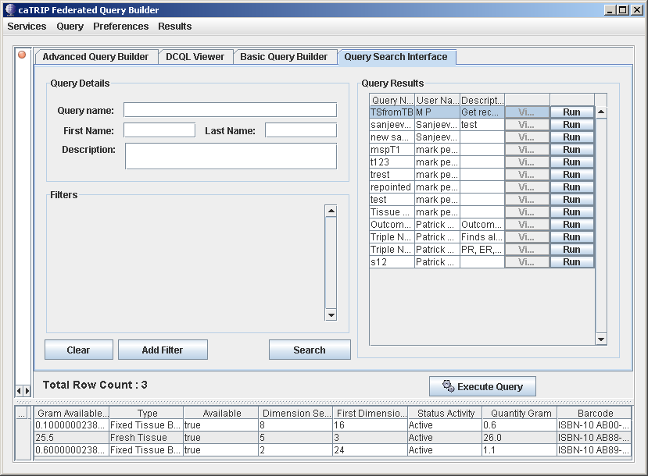
Topic 5: A Comprehensive Look at the “Query Search Interface”
Running the selected saved query:
After selecting the query to run, click the [Run] button
1
The results from running the query will be listed here.
2

Slide 25
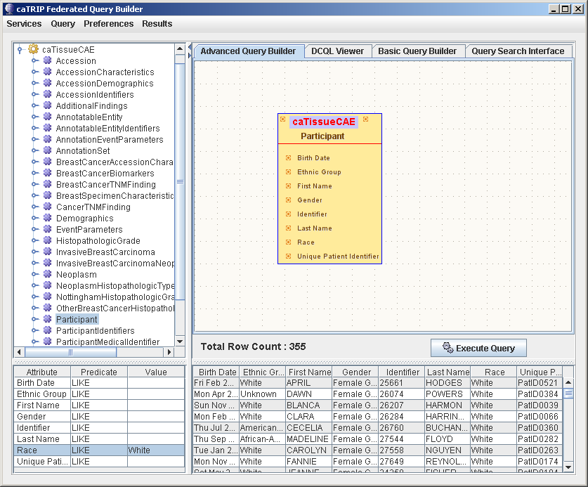
Topic 6: Overview of the “Advanced Query Builder”
Example of Advanced Query:

Slide 26
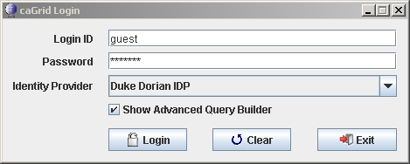
Topic 7: A Comprehensive Look at “Advanced Query Builder”
1st, Need to select the ‘Show Advance Query Builder’:
Need to make sure that you check this box, upon logging in
1
And click [Login]
2

Slide 27
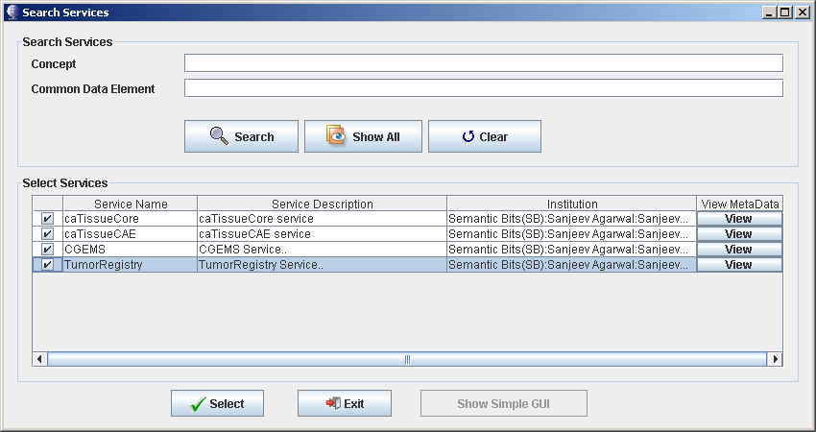
Topic 7: A Comprehensive Look at “Advanced Query Builder”
2nd, Need to select the Search Services:
Click [Show All] button, to get all services available
1
Select the services wanted
2
Then, click [Select]
3

Slide 28
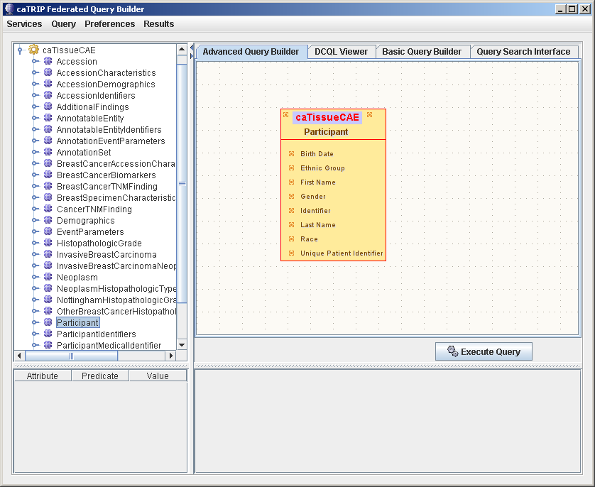
Topic 7: A Comprehensive Look at “Advanced Query Builder”
3rd, Select the table objects from the services:
Select table object(s) 1
Drag them to the 2 builder pane

Slide 29
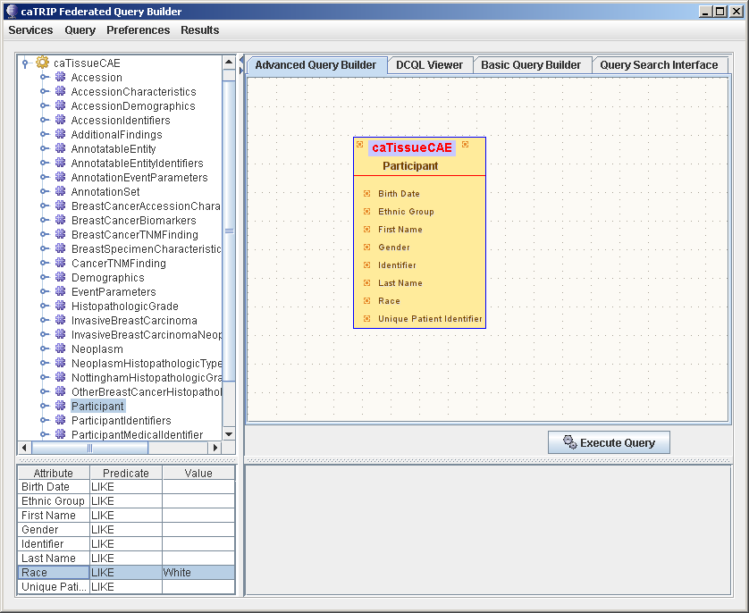
Topic 7: A Comprehensive Look at “Advanced Query Builder”
3rd, Click on the table object(s), to populate the attribute pain and enter any filtering values
Once the table is in the builder pane, click on the table
3
Select table object(s) 1
And the attributes will appear here, for filtering and enter necessary filter values
4
Drag them to the 2 builder pane

Slide 30
Topic 7: A Comprehensive Look at “Advanced Query Builder”
4th, Click on the [Execute Query] button and the results will be populated in the results pane
Select class(es)
1
Once the table is in the builder pane, click on the table
3
Once the table is in the builder pane, the attributes will appear here, for filtering
4
Drag them to the 2 builder pane
Then, click
[Execute Query]
5
6
Results appear here

Slide 31
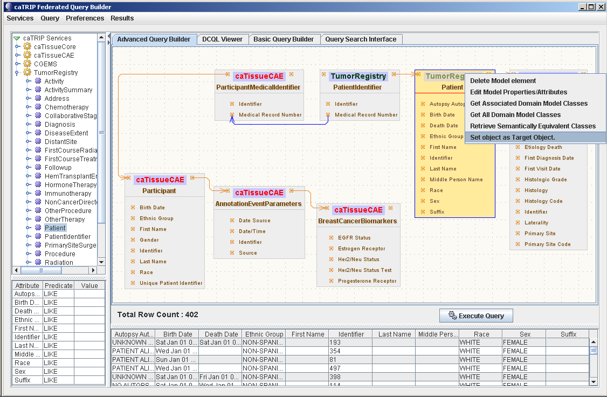

Topic 7: A Comprehensive Look at “Advanced Query Builder”
Another example of an Advanced Query
Note:
Right click on the top part of the class object and a ‘pulldown’ appears, of what can be done to the object
Note:
Hovering the mouse over the top part of the class object and service & package names appear

Slide 32
Session Review
Now that you have successfully completed this training, you should be able to
  Describe what is the caTRIP GUI
  Who will benefit from the caTRIP GUI
  How to launch and use the caTRIP GUI
  How to use the “Basic Query Builder”
  How to use the “Query Search Interface”
  How to use the “Advance Query Builder”

Slide 33
Session Review:
Questions?
Please send us your questions and/or suggestions to:
  catrip-training@gforge.nci.nih.gov
You can also refer to the user’s guide for more information:
caTRIP_End_User_Manual.doc (http://gforge.nci.nih.gov/projects/catrip)

