Slide 1
caTRIP Overview
Raj Dash
Duke Comprehensive Cancer Center

Slide 2
Agenda
Background
Problem scenario
Datasets and Tools
Architecture
Goals

Slide 3
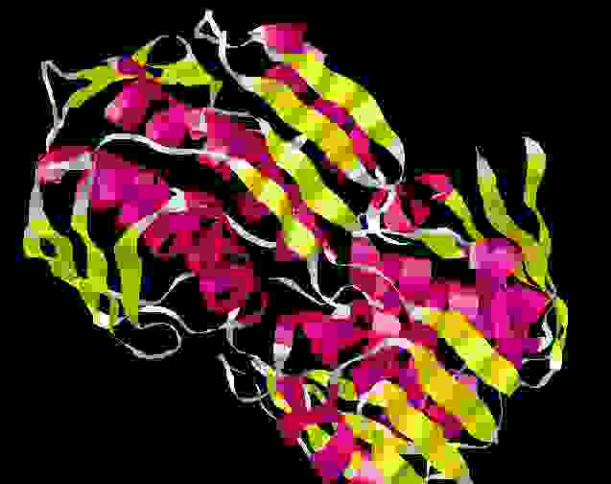

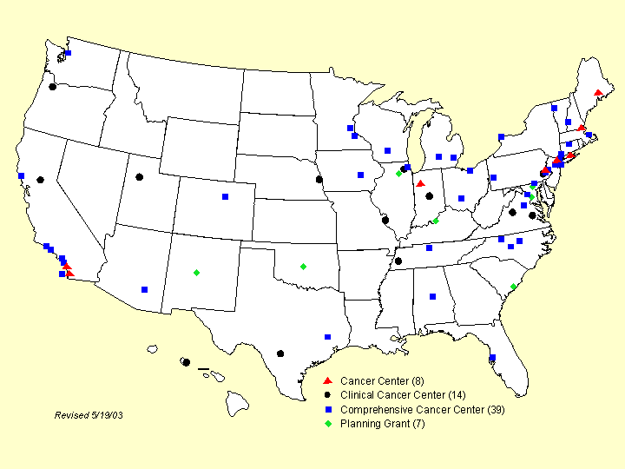

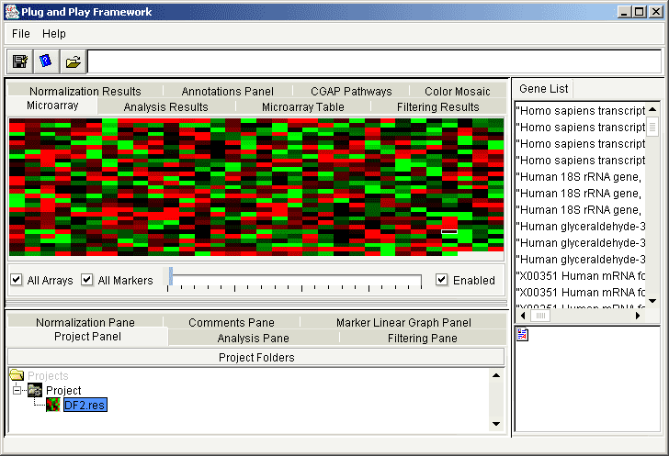
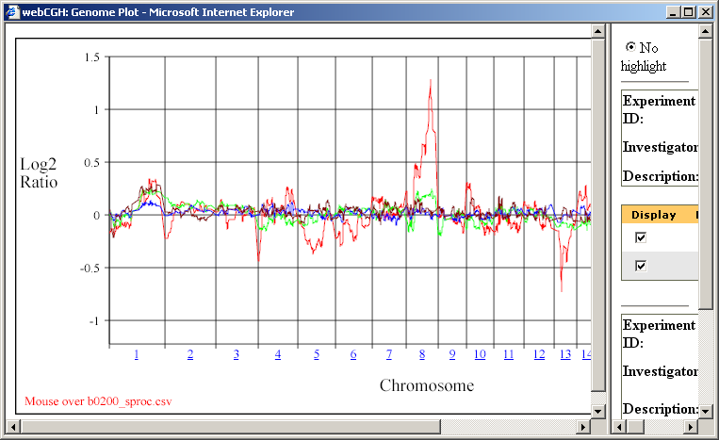
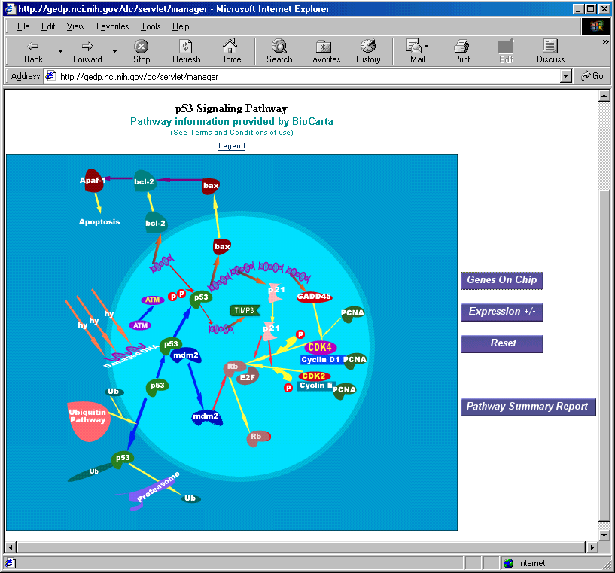

caBIG goals
Common, widely
distributed infrastructure
permits research
community to focus on
innovation
Shared vocabulary, data elements, data models facilitate information exchange
Collection of interoperable applications developed to common standards
Raw published cancer research data is available for mining and integration

Slide 4
caBIG workspaces
DOMAIN WORKSPACE 1
Clinical Trial Management Systems
Addresses the need for consistent, open and comprehensive tools for clinical trials management.
DOMAIN WORKSPACE 2
Integrative Cancer Research
Provides tools and systems to enable integration and sharing of information.
DOMAIN WORKSPACE 3
Tissue Banks & Pathology Tools
Provides for the integration, development, and implementation of tissue and pathology tools.
DOMAIN WORKSPACE 4
Imaging
Provides for the sharing and analysis of in vivo imaging data.
Responsible for evaluating, developing, and integrating systems for vocabulary and ontology content, standards, and software systems for content delivery.
CROSS CUTTING WORKSPACE 1
Vocabularies & Common
Data Elements
Developing architectural standards and architecture necessary for other workspaces.
CROSS CUTTING WORKSPACE 2
Architecture

Slide 5
caBIG principles
Open source
Open access
Open development
Federated

Slide 6
caTRIP background
Translational RFP in Feb-March
  30+ proposals
  Duke/Semantic Bits/5AM collaboration
caTRIP: Cancer Translational Research Informatics Platform
Two 6 months phases
  Function prototype, production system

Slide 7
Who is involved
Duke Bioinformatics
  Jamie Cuticchia (PI)
  Patrick McConnell
  (lead architect)
Duke Information Systems
  Bob Annechiarico (PM)
  Wilma Stanley (developer)
  Mark Peedin (developer)
  Mohamad Farid (DBA)
  Jeff Allred (IT manager)
Duke Pathology
  Raj Dash (domain expert)
  Chris Hubbard (developer)
Duke CALGB
  Kimberly Johnson
  (DataMart liaison)
Semantic Bits
  Ram Chilukuri (lead developer)
  Vinay Kumar (developer)
  Sanjeev Agarwal (developer)
  Srini Akkala (developer)
5 AM Solutions
  Bill Mason (developer)
3rd Millennium
  Julie Klemm (ICR WS lead)
NCI
  Carl Shaefer (NCI rep)
  Subha Madhavan
  (caIntegrator PM)

Slide 8
What is translational research?
Bench-to-Bedside
Wikipedia (the source of all knowledge):
Translational medicine is a branch of medical research that attempts to more directly connect basic research to patient care.
Basic research occurs in the lab
Patient care occurs in the clinic

Slide 9
Translational research extension
Also from Wikipedia:
Translational medicine can also have a much broader definition, referring to the development and application of new technologies in a patient driven environment - where the emphasis is on early patient testing and evaluation.
…facilitate the interaction between basic research clinical medicine, particularly in clinical trials.
Our focus will be on connecting existing data systems, including basic science data, to enhance patient care

Slide 10
Problem scenario
Outcomes analysis: using data from existing patients to inform the treatment of another patient
Leverage clinical, pathology, tissue, and basic science data
Scenario:
Patient A enters the clinic. What treatments were applied with success on other patients with similar characteristics (race, sex, symptoms, pathology results, adverse events, biomarkers).

Slide 11
Problem scenario cont.
Drawing associations between events and predefined end-points, usually over a large cohort of patients
Events and end-points will have to be defined as CDEs and captured
  Clinical: adverse events, treatment, dosage, weight, height, sex, age
  Pathology: biopsy results, tumor size, glucose level, white blood cell count
  Wet lab: gene expression, proteomics, SNP

Slide 12
Problem scenario cont.
New patient with “invasive lobular breast cancer”
Risks for recurrence?
  With surgery alone
  With chemotherapy
  With radiation
  With combined treatments in various sequences

Slide 13
Problem scenario: follow-up questions
What about other breast neoplasms that are less well studied?
What about men who develop breast cancer?
What about very young women that develop breast cancer?
  If a woman carries a defective BRCA1 or BRCA2 gene, she may have a 35 to 85 percent chance of developing breast cancer in her lifetime. Why such a wide range?
  What about men?

Slide 14
caBIG Tools
Clinical trials: C3D, CTOM
Clinical data: CAE
Tissue bank: caTissue CORE
Pathology: caTIES
Basic Science
  Microarray: caArray, caIntegrator
  Proteomics: RProteomics, caIntegrator
  SNP: TrAPSS, caIntegrator

Slide 15
Duke databases
Medical Assistant on the World Wide Web (MAW3)
  Entity-centric database
  Tissue banking, pathology, and some clinical annotations
Decision Support Repository (DSR)
  Data warehouse
  Patient clinical data, crossing all medical specialties
Tumor Registry
  Relational database
  Endpoint data since 1980
Genetic Modifiers of BRCA1 and BRCA2 (GEMS)
  SNP Illumina flat-files
  Investigation to identify factors that influence the incidence of breast cancer in germline BRCA1/2 mutation carriers

Slide 16
Proposed Solution
Federated versus warehouse
  Leverage semantics to perform distributed queries
  Enabled by heavy use of Common Data Elements (CDEs)
Three major components
  Domain services
  Distributed query engine
  Graphical user interface
Enabled by the grid (alphabet soup)
  Advertisement/discover: Index Service
  Metadata: caDSR/EVS
  APIs: WSDL
  Transport: XML over SOAP
  Data model: XML Schema stored in the GME
  Security: Dorian layered over Duke IDP (Identity Provider)

Slide 17

Proposed solution diagram
GUI
query
Distributed
Query
Engine
discover
Index Service
Domain Grid Services
caTissue
CORE
caTIES
CAE
CAE
CTOM
CTOM
CGEMS
SNP
Duke Databases
MAW3
DSR
Tumor
Registry
caIntegrator

Slide 18
Graphical User Interface
Discover services
Build queries via metadata
Graphical representation of data models
Drag-and-drop interface
Customizable reporting
Stored queries

Slide 19
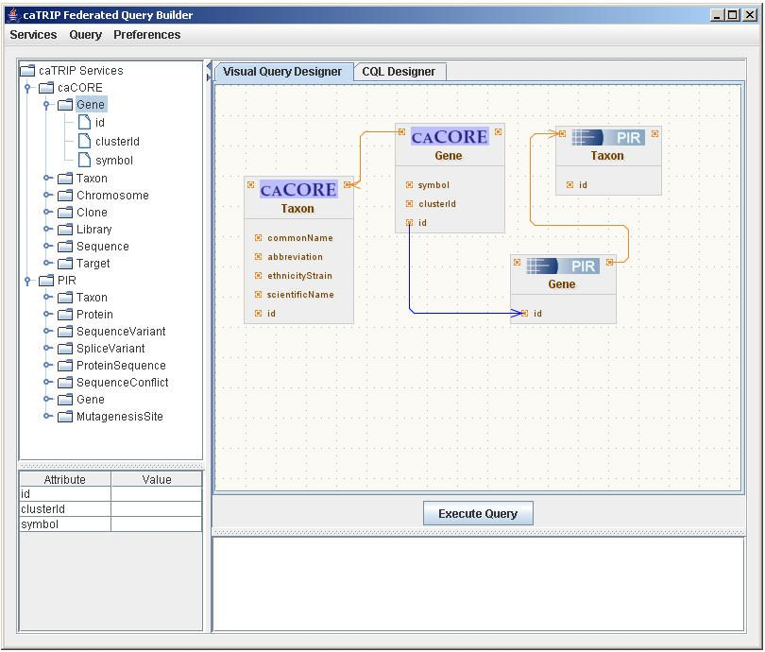
Graphical User Interface

Slide 20
Goals for Phase 1
Provide demonstratable, functional prototype
Bench-to-bedside
  All domains: clinical, pathology, tissue, basic science
Limit use cases
Limit datasets
Limit user functionality

Slide 21
Goals for Phase II
Provide production system that could be used by researchers
Full set of use cases, functionality
Include Breast DataMart

Slide 22
Breast Cancer DataMart (Phase II)
NCI-supported Cooperative Groups
Will provide a data-mining capability that would allow contemporaneous and frequent analyses of pooled breast cancer research data from the contributing Cooperative Groups
The data includes general patient and protocol information, surgical procedures, disease description, and endpoints in treatment
The Breast Cancer Data Mart is currently housed at the NCICB in a C3D database
The ultimate programmatic access mechanism for this data will be the Clinical Trials Object Model (CTOM)
Formal approval processes in place for access to the data in DataMart

Slide 23
For more information
GForge (http://gforge.nci.nih.gov/projects/catrip/)
  Wiki
  Document manager
  File manager
  Mailing lists
    catrip-general, catrip-user, catrip-developer
CVS
(cvs -d :ext:NAME@cbiocvs2.nci.nih.gov checkout catrip)

Slide 24
Backup Slides

Slide 25
Domain Services
Goal: make data accessible via a data grid service
  Strategy 1: wrap database with caBIG tool
  Strategy 2: wrap database with caBIG data model
  Strategy 3: migrate data into caBIG tool
  Strategy 4: migrate data into caBIG data model
We will leverage caCORE SDK to wrap non-compliant systems
Connection between caCORE-like system and the grid is straightforward
Should try to wrap existing databases to reuse security model

Slide 26
Service implementation
Index Service
advertise
advertise
Distributed
Query
Engine
caGrid Data Service
CQL Query
caCORE SDK
CQL Engine
domain
model
Object-relational
mapping
database

Slide 27
Distributed query engine overview
CQL
caGrid data
service
database
data
objects
DCQL
Distributed
Query
Engine
CQL
caGrid data
service
database
data
objects
data
objects
CQL
database
caGrid data
service
data
objects

Slide 28
Security overview
authorization
User Grid
Certificate
Grid
Data Service
authentication
User
Credentials
SAML
Assertion
existing
application security
Dorian
new
security model
Grid User | App User
CSM
caGrid
Authentication Service
Duke
Authentication Plugin
database
Duke Domain Controller
NT Security

Slide 29
C3D Overview
Purpose
  NCI’s clinical trails information management system
  Provides standardized templates and eCRF’s for data collection
  Provides user-friendly electronic data capture
  Several adopters including Duke
Implementation
  Uses Oracle Clinical
  Bronze Compliant, uses CDE’s for building CRF’s
  Closed system, no public API

Slide 30
CTOM Overview
Purpose
  Domain model for clinical trials
  Reference implementation for BRIDG
  CDE Driven
Implementation
  Has not been implemented yet
  No caCORE-like API
  CTOM database has been created
  Data loading based on CTMS reports
  CTOM Implementation RFP

Slide 31
CAE Overview
Purpose
  Single point of access to clinical data about cancer patients and the biospecimens collected from them.
  Will allow cancer centers to integrate data from a variety of clinical systems and supplement that data with manual annotations as necessary
Implementation
  “silver level” compliant
  Uses CSM
  Has a caCore like API

Slide 32
caTissue Core Overview
Purpose
  Solution for biospecimen inventory, tracking, and basic annotation that may be used by biospecimen resource facilities, regardless of the nature of biospecimen transactions that occur or the type of biospecimens involved in the transaction.
  Will closely be integrated with CAE and caTIES
Implementation
  Currently “silver level” compliant
  Uses CSM
  Has caCore-like API

Slide 33
caTIES Overview
Purpose
  Extract coded info from free text surgical pathalogy reports (SPR’s) using controlled vocabularies
Implementation
  Data services reference implementation for caGrid 0.5
  caCORE-like API
  Robust custom security

Slide 34
caArray Overview
Purpose
  NCICB’s cancer array informatics project
  Facilitates storing, searching, sharing and annotating microarray data
  Supports importing microarray experimental data in variety of formats including MAGE-ML
Implementation
  Microarray database, analysis and visualization tools
  Based on MAGE-OM
  Has secure caCORE-like API
  Uses CSM for security
  Reference data service implementation for caGrid 0.5

Slide 35
TrAPSS Overview
Transcript Annotation Prioritization and Screening System
Aid scientists who are searching for the genetic mutation or mutations that are linked to expression of a disease phentotype
The true importance of TrAPSS is that it is based upon a novel way to examine a large candidate list of genes. Rather than sequentially examining full genes, the scheme often followed in current target identification projects, TrAPSS provides tools that offer the user the opportunity to screen certain small parts of several genes from the candidate list at once
Silver level

Slide 36
RProteomics Overview
Tool/service for analyzing mass spectrometry data
Has a database and data service component
ScanFeatures
  Name/Value features
  Value can be complex (array) or simple (string)
Gold level analytical service
Gold level data service

Slide 37
caIntegrator Overview
Translational research informatics framework that integrates various types of biomedical data
  Clinical Trials
  Micro-array gene expression
  Immunohistochemistry
  SNP
Implementation
  Based on Clinical Genomics Object Model (CGOM)
  Multi-tier architecture
  Intuitive user interface
  Well defined service layer API
  Data warehouse
  Security implemented using CSM

