Slide 1
caTRIP Status Update
Patrick McConnell¹, Ram Chilukuri²
¹Duke Comprehensive Cancer Center
²Semantic Bits

Slide 2
Agenda
Mapping EAV to relational data models
Reengineering CAE
Bringing the Tumor Registry to caBIG

Slide 3
EAV background
Metadata-driven system
Tables are virtualized
  Sometimes known as a “data dictionary”
  Simulates a conventional relational design
Benefits
  System can be entirely driven from metadata
    GUI, data collection, forms, etc.
  Flexible to allow for different tables based upon individual projects
Drawbacks
  Performance
  Referential integrity must be enforced by the application
  New virtual databases must be created via metadata

Slide 4
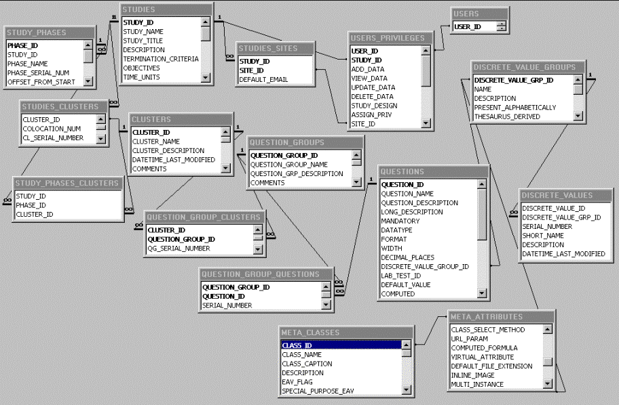
Example (CSDMS, Yale)
Entity
Attribute
Value

Slide 5
Relational background
In EAV design, one row stores a single fact.
In a conventional table that has one column per attribute, by contrast, one row stores a set of facts
  Each “entity” or class would have it’s own table
  Each column would refer to an attribute

Slide 6
Issues mapping EAV to relational models
Each study may have its own set of entities and attributes
  Makes mapping labor intensive and tricky
Entities and attributes encoded in table values
  Not easy to digest and map
Physical mapping requires many attribute-based queries
  Can’t simply draw lines between tables

Slide 7
Reengineering CAE
Original implementation is EAV
  Good for performing some types of queries
  Not conducive to caCORE-SDK
  Not conducive to CQL-style queries
Reimplemented with relational backend database

Slide 8
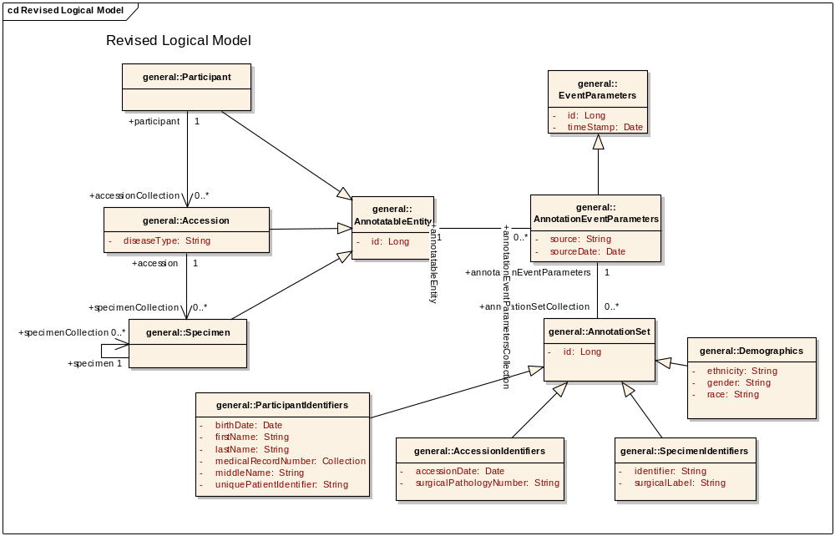
CAE backbone objects

Slide 9
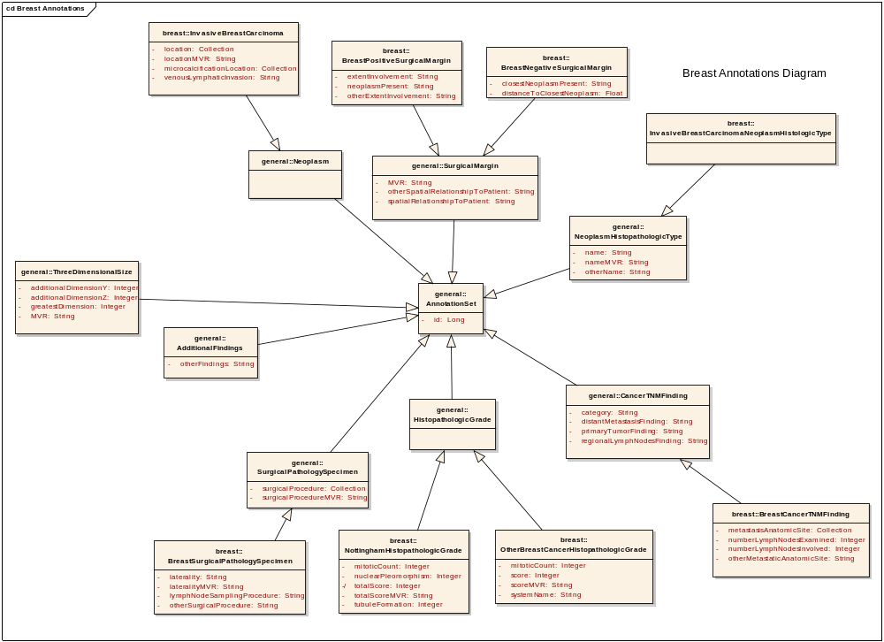
CAE Breast Model

Slide 10
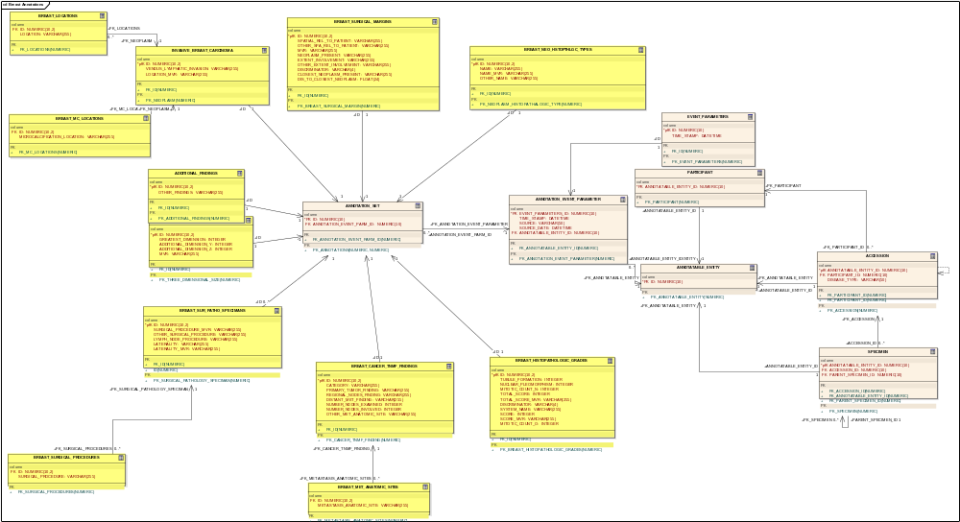
CAE Relational DB Model

Slide 11
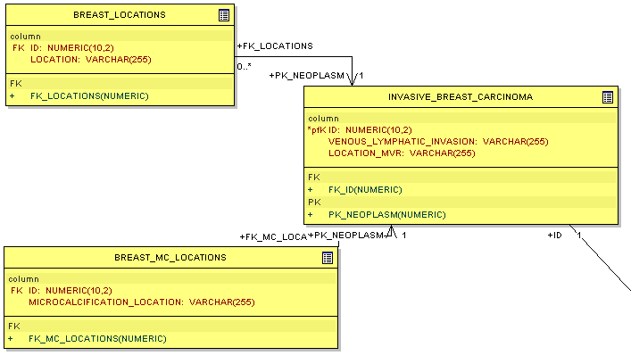
Relational mapping for Collections

Slide 12
Tumor Registry
Rich source of information
  Endpoint data: cause of death, date of death
  Tumor information: anatomical site, grade
  Treatment: date, radiation, surgery
Does not fit perfectly into any of the existing TBPT or CTMS data models
  Re-use CTOM and BRIDG objects whereever appropriate
  Should ultimately be harmonized with BRIDG

Slide 13
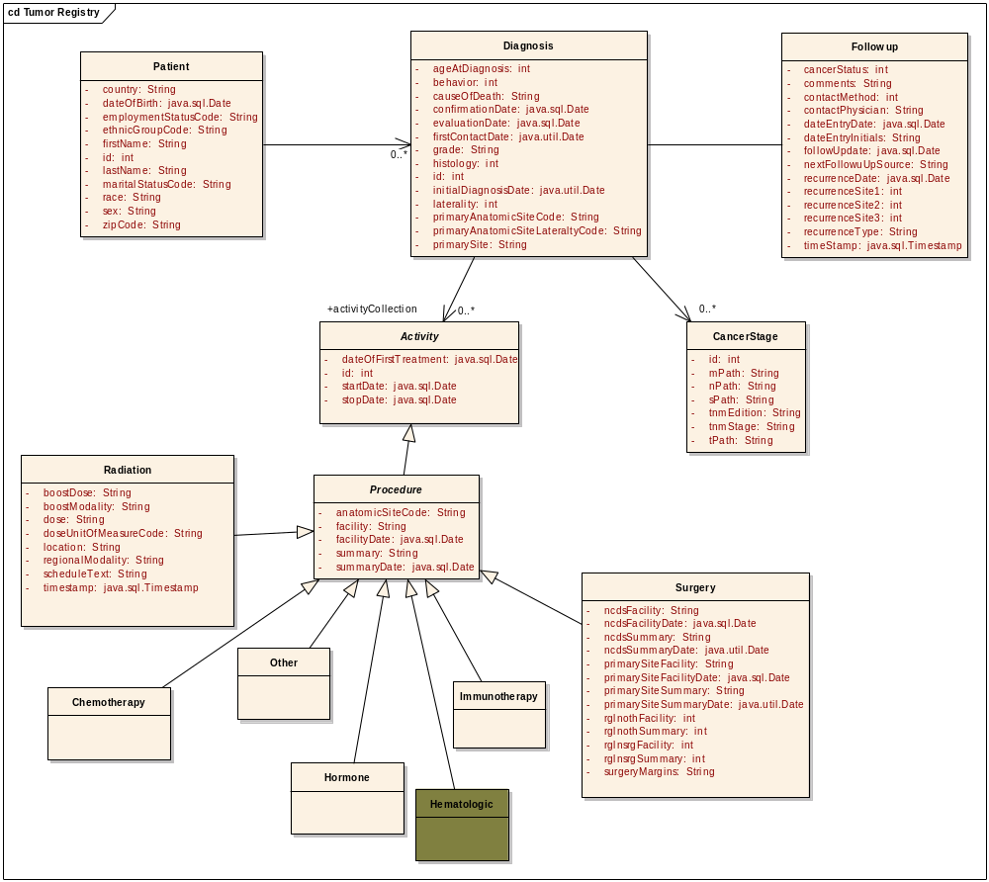
Tumor registry

Slide 14
Discussion
Any other points of discussion
Questions about other aspects of the project

