Slide 1
caTRIP Overview
Patrick McConnell
Duke Comprehensive Cancer Center

Slide 2
Agenda
Background
Problem scenario
Goals
Datasets and Tools
Architecture

Slide 3
Who is involved
Duke Bioinformatics
  Jamie Cuticchia (PI)
  Patrick McConnell
  (lead architect)
Duke Information Systems
  Bob Annechiarico (PM)
  Wilma Stanley (developer)
  Mark Peedin (developer)
  Mohamad Farid (DBA)
  Jeff Allred (IT manager)
Duke Pathology
  Raj Dash (domain expert)
  Chris Hubbard (developer)
Duke CALGB
  Kimberly Johnson
  (DataMart liaison)
Semantic Bits
  Ram Chilukuri (lead developer)
  Vinay Kumar (developer)
  Sanjeev Agarwal (developer)
  Srini Akkala (developer)
5 AM Solutions
  Bill Mason (developer)
3rd Millennium
  Julie Klemm (ICR WS lead)
NCI
  Carl Shaefer (NCI rep)
  Subha Madhavan
  (caIntegrator PM)

Slide 4
What is translational research?
Bench-to-Bedside
Wikipedia (the source of all knowledge):
Translational medicine is a branch of medical research that attempts to more directly connect basic research to patient care.
Basic research occurs in the lab
Patient care occurs in the clinic

Slide 5
Translational research extension
Also from Wikipedia:
Translational medicine can also have a much broader definition, referring to the development and application of new technologies in a patient driven environment - where the emphasis is on early patient testing and evaluation.
…facilitate the interaction between basic research clinical medicine, particularly in clinical trials.
Our focus will be on connecting existing data systems, including basic science data, to enhance patient care

Slide 6
Problem scenario
Outcomes analysis: using data from existing patients to inform the treatment of another patient
Leverage clinical, pathology, tissue, and basic science data
Scenario:
Patient A enters the clinic. What treatments were applied with success on other patients with similar characteristics (race, sex, symptoms, pathology results, adverse events, biomarkers).

Slide 7
Goals for Phase 1
Provide demonstratable, functional prototype
Bench-to-bedside
  All domains: clinical, pathology, tissue, basic science
Limit use cases
Limit datasets (only test data)
Limit user functionality
  No stored queries, security
Limit architecture
  DQE bound to specific services

Slide 8
Goals for Phase II
Provide production system that could be deployed at any institution
Full set of scientific use cases
Full set of functionality
Generalized architecture
Include Breast DataMart

Slide 9
caBIG Tools
Clinical data: CAE
Tissue bank: caTissue CORE
Pathology: caTIES
Endpoint: Tumor Registry
Basic Science
  Microarray: caArray, caIntegrator
  Proteomics: RProteomics, caIntegrator
  SNP: TrAPSS, caIntegrator

Slide 10
Duke databases
Medical Assistant on the World Wide Web (MAW3)
  Entity-centric database
  Tissue banking, pathology, and some clinical annotations
Decision Support Repository (DSR)
  Data warehouse
  Patient clinical data, crossing all medical specialties
Tumor Registry
  Relational database
  Endpoint data since 1980
Genetic Modifiers of BRCA1 and BRCA2 (GEMS)
  SNP Illumina flat-files
  Investigation to identify factors that influence the incidence of breast cancer in germline BRCA1/2 mutation carriers

Slide 11
Proposed Solution
Federated versus warehouse
  Leverage semantics to perform distributed queries
Three major components
  Domain services
  Distributed query engine
  Graphical user interface
Enabled by the grid (alphabet soup)
  Advertisement/discover: Index Service
  Metadata: caDSR/EVS
  APIs: WSDL
  Transport: XML over SOAP
  Data model: XML Schema stored in the GME
  Security: Dorian layered over Duke IDP (Identity Provider)

Slide 12

Proposed solution diagram
GUI
query
Distributed
Query
Engine
discover
Index Service
Domain Grid Services
caTissue
CORE
caTIES
CAE
CAE
CTOM?
TR
CGEMS
SNP
Duke Databases
MAW3
DSR
Tumor
Registry
caIntegrator

Slide 13
Service implementation
Index Service
advertise
advertise
Distributed
Query
Engine
caGrid Data Service
CQL Query
caCORE SDK
CQL Engine
domain
model
Object-relational
mapping
database

Slide 14
Distributed query engine overview
CQL
caGrid data
service
database
data
objects
DCQL
Distributed
Query
Engine
CQL
caGrid data
service
database
data
objects
data
objects
CQL
database
caGrid data
service
data
objects

Slide 15
Security overview
authorization
User Grid
Certificate
Grid
Data Service
authentication
User
Credentials
SAML
Assertion
existing
application security
Dorian
new
security model
Grid User | App User
CSM
caGrid
Authentication Service
Duke
Authentication Plugin
database
Duke Domain Controller
NT Security

Slide 16
Graphical User Interface
Discover services
Build queries via metadata
Graphical representation of data models
Drag-and-drop interface
Simplified menu-based interface
Customizable reporting
Stored queries

Slide 17
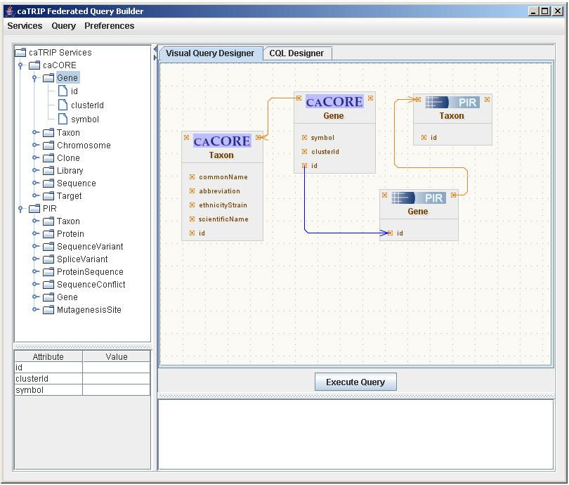
Graphical Query Builder

Slide 18
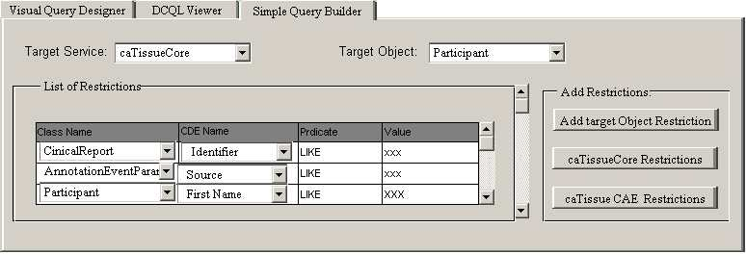
Simplified Query Builder

Slide 19
Breast Cancer DataMart (Phase II)
NCI-supported Cooperative Groups
Will provide a data-mining capability that would allow contemporaneous and frequent analyses of pooled breast cancer research data from the contributing Cooperative Groups
The data includes general patient and protocol information, surgical procedures, disease description, and endpoints in treatment
The Breast Cancer Data Mart is currently housed at the NCICB in a C3D database
The ultimate programmatic access mechanism for this data will be the Clinical Trials Object Model (CTOM)
Formal approval processes in place for access to the data in DataMart

Slide 20
For more information
GForge (http://gforge.nci.nih.gov/projects/catrip/)
  Wiki
  Document manager
  File manager
  Mailing lists
    catrip-general, catrip-user, catrip-developer
CVS
(cvs -d :ext:NAME@cbiocvs2.nci.nih.gov checkout catrip)

Slide 21
Demo Architecture
Aggregate Results
GUI
DCQL
Distributed
Query
Engine
Discover
Clinician
Index Service
CQL
CQL
CQL
CQL
Results
CQL
Results
CQL
Results
Domain Grid Services
caTissue
CORE
caTIES
CAE
CAE
CTOM
TR
CGEMS
SNP
Duke Databases
MAW3
DSR?
Tumor
Registry
caIntegrator

Slide 22
Demo queries
red=attribute, blue=class, black=filter criteria
caTissue Core: What are all the tissue specimens where tissue site is breast?
caTissue CAE: What are all the participants having total score of Nottingham Histopathalogic Grade greater than 1?
caTissue Core & caTissue CAE: What are all the tissue specimens that are available from patients having total score of Nottingham Histopathalogic Grade greater than 1?
Review in the models

Slide 23
Live demo

Slide 24
Discussion?

