Slide 1
caTRIP Beta Release
Patrick McConnell¹ and Ram Chilukuri²
¹Duke Comprehensive Cancer Center
²Semantic Bits, LLC

Slide 2
Agenda
Scientific overview
  Background, features, use cases, demo, next steps
Technical design
  Architecture overview
  Data services (overview, data loading, test data)
  Distributed query engine
  GUI (simple and advanced)
  caGrid collaboration
Phase 1 review

Slide 3
Who is involved
Duke Bioinformatics
  Jamie Cuticchia (PI)
  Patrick McConnell (lead architect)
Duke Information Systems
  Bob Annechiarico (PM)
  Wilma Stanley (developer)
  Mark Peedin (developer)
  Mohamad Farid (DBA)
  Jeff Allred (IT manager)
Duke Pathology
  Raj Dash (domain expert)
  Chris Hubbard (developer)
Duke Oncology
  Kelley Marcom (domain expert)
  Gretchen Kimmick (domain expert)
  Kimberly Blackwell (domain expert)
  Lee Wilke (domain expert)
Duke CALGB
  Kimberly Johnson (DataMart liaison)
Semantic Bits
  Ram Chilukuri (lead developer)
  Srini Akkala (developer)
  Sanjeev Agarwal (developer)
5 AM Solutions
  Bill Mason (developer)
3rd Millennium
  Julie Klemm (ICR WS lead)
NCI
  Carl Shaefer (NCI rep)
  Subha Madhavan
  (caIntegrator PM)
BAH
  Mehul Shah (tech support)

Slide 4
caTRIP Overview
Patrick McConnell
Duke Comprehensive Cancer Center

Slide 5
Initial problem scenario
Outcomes analysis: using data from existing patients to inform the treatment of another patient
Leverage clinical, pathology, tissue, and basic science data
Scenario:
Patient A enters the clinic. What treatments were applied with success on other patients with similar characteristics (race, sex, symptoms, pathology results, adverse events, biomarkers).

Slide 6

caTRIP Alpha Overview
Aggregate Results
GUI
DCQL
Distributed
Query
Engine
Discover
Clinician
Index Service
CQL
CQL
CQL
CQL
Results
CQL
Results
CQL
Results
Domain Grid Services
caTissue
CORE
caTIES
CAE
CAE
CTOM
TR
CGEMS
SNP
Duke Databases
MAW3
DSR?
Tumor
Registry
caIntegrator

Slide 7
caTRIP Beta Overview
GUI
query
Distributed
Query
Engine
authenticate
discover
Core Grid Services
Domain Grid Services
IdP
Service
Index
Service
Grid
Grouper
authorize
caTissue
CORE
caTIES
CAE
TR
CGEMS
SNP
Duke
Domain
Controller
caTissue
CORE
caTIES
CAE
TR
caIntegrator
MAW3
Tumor Registry
Illumina

Slide 8
Tumor Registry
Created from Duke TR database
Submitted model for loading into the DSR
Duke
  Validated model
  Provided real de-identified test data
Data Loading
  Delimited data files
  Hibernate API
Available at GForge under caTRIP project

Slide 9
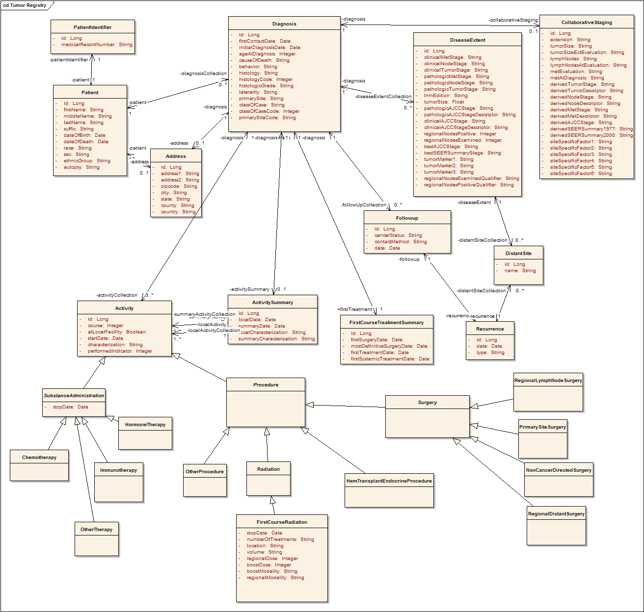
Tumor Registry Model
Participant
Diagnosis
Collaborative
Staging
Follow up and
Recurrence
Treatment

Slide 10
Loading test data
Identified sample data
  Queried various Duke databases
  Googled cancer websites
Built input files
  Text files with values that correspond to CDEs
Loaded data
  Randomly selected values from text files
  Used Hibernate APIs to load objects

Slide 11
Data loading example
Curated
Data Files
Data
Generator
Participant
randomly
select
generate
objects
Maria
Kennedy
Liles | MARY
Harris | PATRICIA
Kennedy | LINDA
Wynne | BARBARA
Lytle | ELIZABETH
Lytle | JENNIFER
Tamborella | MARIA
Chopra | SUSAN
Denny | MARGARET
. . . | . . .
Participant
DB
Linda
Liles
Participant
load via
hibernate
Susan
Wynne
Participant
Barbara
Chopra
. . .

Slide 12
Data sharing challenges
Sharing identifiable data
  Step 1: caTRIP gets IRB approval to build a system
  Step 2a: researcher gets IRB approval for protocol to view data
  Step 2b: clinician uses data for patient care (trickier than it sounds) or quality of service
Sharing deidentified data
  Traditional method: data manager deidentifies an entire dataset then throws away the key
    Centralized: not scalable
  Proposed method: trusted service provider (TSP) deidentifies discreet values
    Distributed: everyone is responsible for their own deid
    Very scalable

Slide 13

Distributed deidentification
Secure connection
MRN3
MRN3
GHI789
Trusted Service
Provider
GHI789
Has IRB approval to see identifiable data
Has IRB approval to see identifiable data
Has IRB approval to store identifiable data
PHI | DEID
MRN1 | ABC123
MRN2 | DEF456
. . . | . . .
PHI | DEID
MRN1 | ABC123
MRN2 | DEF456
MRN3 | GHI789
. . . | . . .
Randomly generated

Slide 14
caTRIP data sharing
Current deidentified datasets (via modified centralized way)
  caTissue CORE, Tumor Registry
Future deidentified datasets
  CAE, SNP
Goals
  Get IRB approval at Duke for sharing identifiable data
  Modify Duke deidentification policy to allow distributed model
  Use caTRIP as one model for data sharing in caBIG

Slide 15
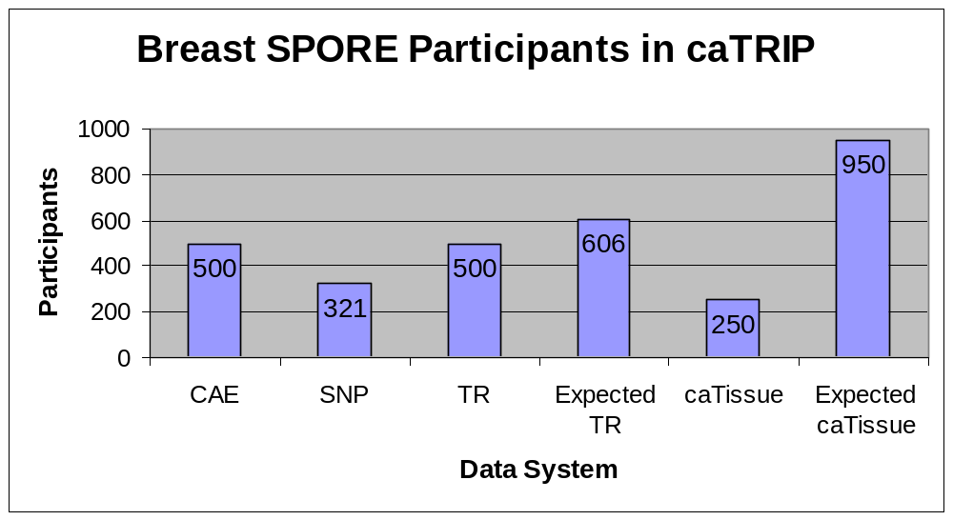
caTRIP data system statistics

Slide 16
Scientific use cases
Find available tumor tissue
Find factors of survival
Find patients for trials
Determine the distribution of disease factors over time
Determine correlation of factors pre and post surgery
Find pathology reports of interest
Notes:
Find available tumor tissue
caTissue CORE: protocol #, pathological status, clinical diagnosis
CAE: ER, PR, Her-2/neu, EGFR status
Find factors of survival
Cohorts of patients who have survived a certain number of years following their diagnosis
Tumor registry: dates of diagnosis/treatment/death, nodal/distant metastasis status, grade of tumor
CAE: ER, PR, Her-2/neu, EGFR status
SNP: BRCA1/BRCA2 status
Determine the distribution of disease factors over time
Factors that may contribute to or reflect progression of a disease state
Tumor registry: dates of diagnosis/treatment/death, nodal/distant metastasis status, grade of tumor
CAE: ER, PR, Her-2/neu, EGFR status
Find patients for trials
Example is that of the triple negative hormone
Tumor registry: dates of diagnosis/treatment/death, nodal/distant metastasis status, grade of tumor
CAE: ER, PR, Her-2/neu, EGFR status
Determine correlation of factors pre and post surgery
Patients that have particular factors change before and after surgery
Tumor registry: dates of surgery
CAE: ER, PR, Her-2/neu, EGFR status
Find pathology reports of interest
Tumor registry: dates of diagnosis/treatment/death, nodal/distant metastasis status, grade of tumor
CAE: ER, PR, Her-2/neu, EGFR status
caTIES: pathology report
Find SNP results correlated with factors
Tumor registry: nodal/distant metastasis status, grade of tumor
CAE: ER, PR, Her-2/neu, EGFR status
SNP: BRCA1/2 status, genotype finding, gene biomarker

Slide 17
Phase 1 scientific queries
Find available tumor tissue
What are all the available tissue specimens from the breast?
What are all the tissue specimens from patients that have a her2/new status of positive?
What are all the tissue specimens from her2/neu positive patients that have a primary tumor in the breast?
What are all the tissue specimens from her2/neu positive patients that have a primary tumor in the breast and are BRCA1 positive?

Slide 18
Phase 1 scientific queries
Find factors of survival
What are all the ER positive patients that have survived breast cancer after radiation treatment?
What are all the BRCA1 positive patients over the age of 50 that have survived breast cancer after surgery?

Slide 19
Phase 1 scientific queries
Find patients for trials
What are all the patients that are triple negative (ER, PR, and HER2/NEU negative)?

Slide 20
caTRIP Demo
Patrick McConnell
Duke Comprehensive Cancer Center

Slide 21
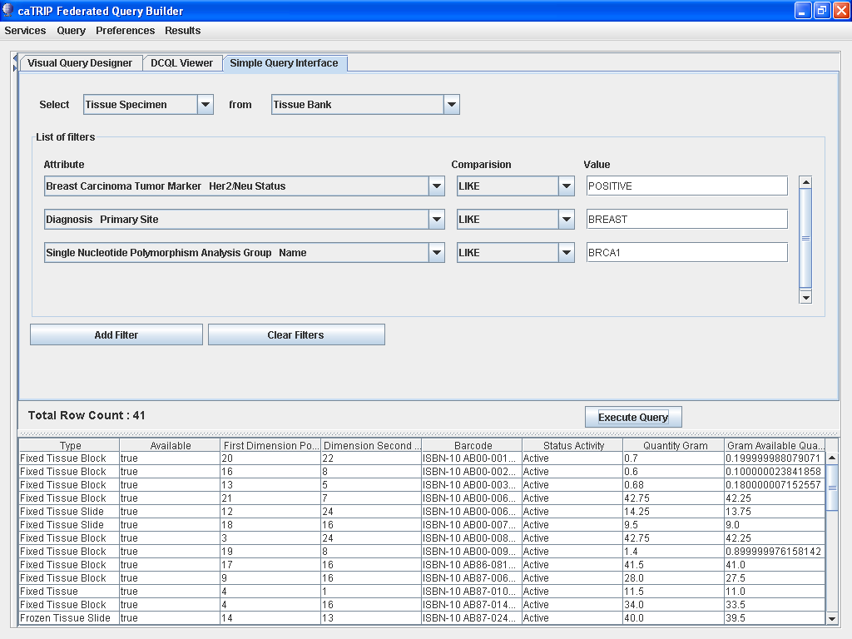
Phase 1 scientific queries
Find available tumor tissue
What are all the tissue specimens from her2/neu positive patients that have a primary tumor in the breast and are BRCA1 positive?

Slide 22
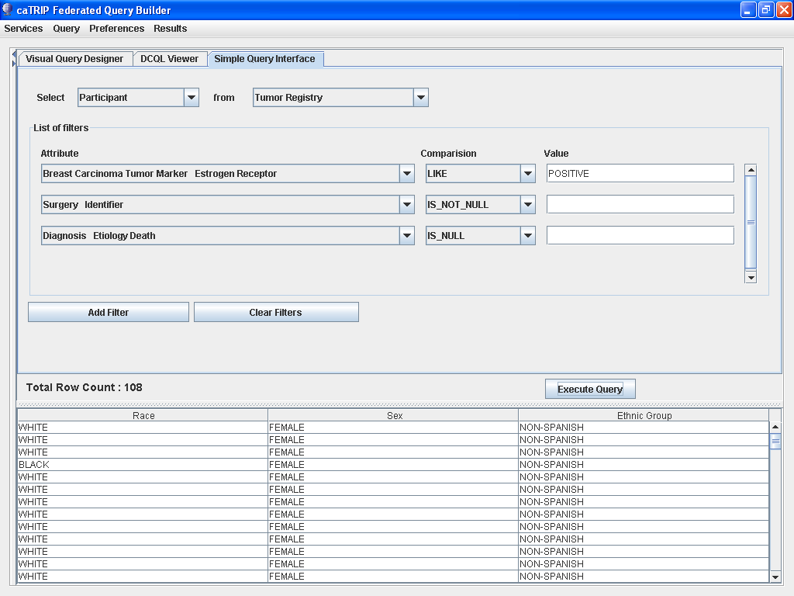
Phase 1 scientific queries
Find factors of survival
What are all the ER positive patients that have survived breast cancer after radiation treatment?

Slide 23
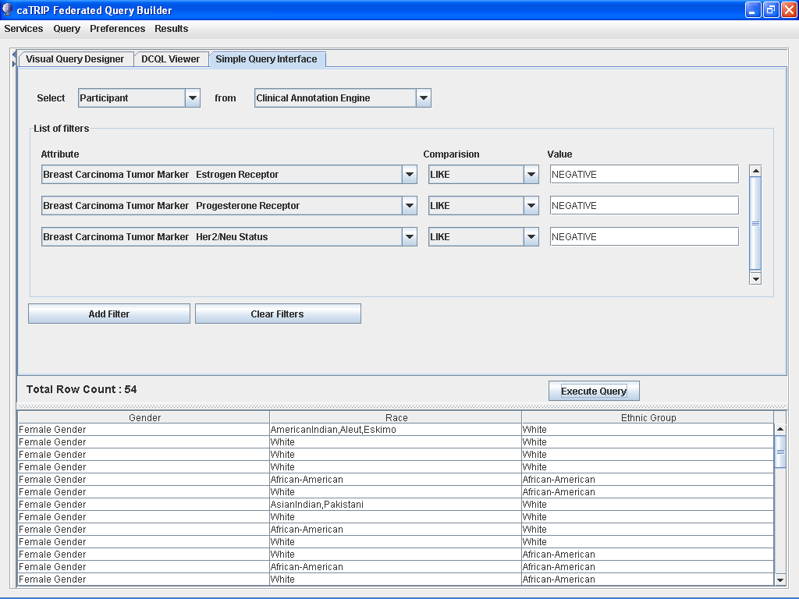
Phase 1 scientific queries
Find patients for trials
What are all the patients that are triple negative (ER, PR, and HER2/NEU negative)?

Slide 24
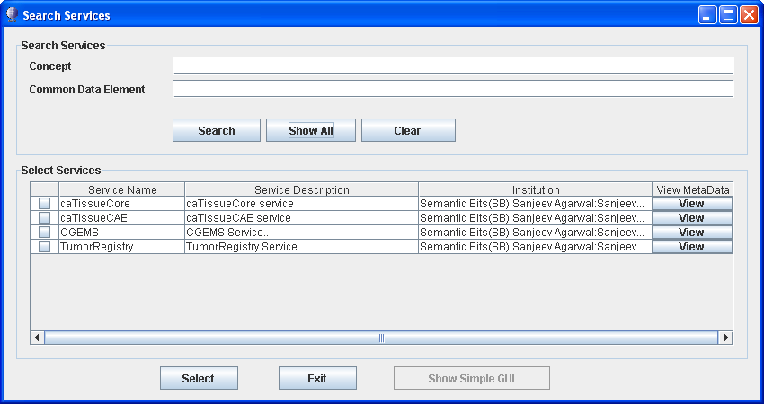
Dynamic Service Discovery

Slide 25
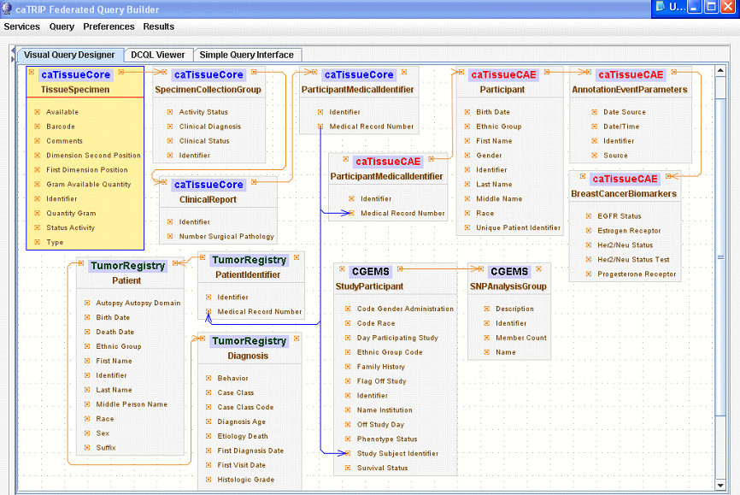
Phase 1 scientific queries
Find available tumor tissue
What are all the tissue specimens from her2/neu positive patients that have a primary tumor in the breast and are BRCA1 positive?
caTissue CORE
CAE
Participant
Medical Record Number
Tumor Registry
CGEMS

Slide 26
Phase 1 scientific queries
Find available tumor tissue
What are all the tissue specimens from her2/neu positive patients that have a primary tumor in the breast and are BRCA1 positive?
Select tissue
<DCQLQuery xmlns="http://caGrid.caBIG/1.0/gov.nih.nci.cagrid.dcql">
<TargetObject name="edu.wustl.catissuecore.domainobject.impl.TissueSpecimenImpl" serviceURL="http://152.16.96.114/wsrf/services/cagrid/CaTissueCore">
<Association name="edu.wustl.catissuecore.domainobject.impl.SpecimenCollectionGroupImpl" roleName="specimenCollectionGroup">
<Association name="edu.wustl.catissuecore.domainobject.impl.ClinicalReportImpl" roleName="clinicalReport">
<Association name="edu.wustl.catissuecore.domainobject.impl.ParticipantMedicalIdentifierImpl" roleName="participantMedicalIdentifier">
<Group logicRelation="AND">
<ForeignAssociation>
<JoinCondition>
<LeftJoin>
<Object>edu.wustl.catissuecore.domainobject.impl.ParticipantMedicalIdentifierImpl</Object>
<Property>medicalRecordNumber</Property>
</LeftJoin>
<RightJoin>
<Object>edu.duke.catrip.cae.domain.general.ParticipantMedicalIdentifier</Object>
<Property>medicalRecordNumber</Property>
</RightJoin>
</JoinCondition>
<ForeignObject name="edu.duke.catrip.cae.domain.general.ParticipantMedicalIdentifier" serviceURL="http://152.16.96.114/wsrf/services/cagrid/CAE">
<Association name="edu.duke.catrip.cae.domain.general.Participant" roleName="participant">
<Association name="edu.pitt.cabig.cae.domain.general.AnnotationEventParameters" roleName="annotationEventParametersCollection">
<Association name="edu.pitt.cabig.cae.domain.breast.BreastCancerBiomarkers" roleName="annotationSetCollection">
<Attribute name="HER2Status" predicate="LIKE" value="POSITIVE%"/>
</Association>
</Association>
</Association>
</ForeignObject>
</ForeignAssociation>
<ForeignAssociation>
<JoinCondition>
<LeftJoin>
<Object>edu.wustl.catissuecore.domainobject.impl.ParticipantMedicalIdentifierImpl</Object>
<Property>medicalRecordNumber</Property>
</LeftJoin>
<RightJoin>
<Object>edu.duke.cabig.tumorregistry.domain.PatientIdentifier</Object>
<Property>medicalRecordNumber</Property>
</RightJoin>
</JoinCondition>
<ForeignObject name="edu.duke.cabig.tumorregistry.domain.PatientIdentifier" serviceURL="http://152.16.96.114/wsrf/services/cagrid/CaTRIPTumorRegistry">
<Association name="edu.duke.cabig.tumorregistry.domain.Patient" roleName="patient">
<Association name="edu.duke.cabig.tumorregistry.domain.Diagnosis" roleName="diagnosisCollection">
<Attribute name="primarySite" predicate="LIKE" value="BREAST%"/>
</Association>
</Association>
</ForeignObject>
</ForeignAssociation>
<ForeignAssociation>
<JoinCondition>
<LeftJoin>
<Object>edu.wustl.catissuecore.domainobject.impl.ParticipantMedicalIdentifierImpl</Object>
<Property>medicalRecordNumber</Property>
</LeftJoin>
<RightJoin>
<Object>gov.nih.nci.caintegrator.domain.study.bean.StudyParticipant</Object>
<Property>studySubjectIdentifier</Property>
</RightJoin>
</JoinCondition>
<ForeignObject name="gov.nih.nci.caintegrator.domain.study.bean.StudyParticipant" serviceURL="http://152.16.96.114/wsrf/services/cagrid/CGEMS">
<Association name="gov.nih.nci.caintegrator.domain.analysis.snp.bean.SNPAnalysisGroup" roleName="analysisGroupCollection">
<Attribute name="name" predicate="LIKE" value="BRCA1%"/>
</Association>
</ForeignObject>
</ForeignAssociation>
</Group>
</Association>
</Association>
</Association>
</TargetObject>
</DCQLQuery>
Foreign Join w/ CAE
HER2/NEU Positive
Foreign Join w/ Tumor Registry
Primary Site Breast
Foreign Join w/ CGEMS
BRCA1 Positive

Slide 27
caTRIP Next Steps
Patrick McConnell
Duke Comprehensive Cancer Center

Slide 28
caTRIP next steps
Add functionality
  GUI, DQE
Implement security
  Authorization, authentication
Add audit capabilities
  Common logging component
Implement compliance
  Section 508 and 21 CFR part 11
Add datasets
  CAE, SNP

Slide 29
GUI enhancements
Reporting
  Data-mining style reporting
Filters
  Drop-down values for enumerated value domains and distinct values
  Filter type based on data type
  Groups of ORs and ANDs
Query sharing and synchronization
  Synchronize DQCL, simple, and advanced GUI
  Share new queries, invoke existing queries

Slide 30
DQE enhancements
Service
  Grid service for DQE
  Delegation
XML-based processing
  Generalize to any grid service
DCQL enhancements
  Define return type (associated objects)
  Return distinct values or single attributes
Implementation
  Distributed joins other than equality

Slide 31
Security
authorization
User Grid
Certificate
authentication
Grid
Data Service
User
Credentials
SAML
Assertion
Dorian
CSM
Trust Fabric
caGrid
Authentication Service
Grid
Grouper
backend
data
Duke
Authentication Plugin
Duke Domain Controller
NT Security

Slide 32
Auditing module
caGrid
Authentication Service
GUI
caLog?
caLog?
Security
Call-out
Grid Service
user
D/CQL
caLog
HQL
CSM
CQLProcessor
results
. . .
Hibernate
CLM?
Domain DB
Log DB
or
Log File

Slide 33
Compliance
Section 508
  Mostly pertain to usability for people with vision impairments.
  Examples
    Alternative keyboard navigation
    Animated displays, color and contrast settings, flash rate, and electronic forms
  Implemented by simplified GUI input form
21 CFR part 11
  Ensures the authenticity, integrity, non-repudiation and confidentiality of electronic records and signatures
  Implemented by the logging module

Slide 34
Beyond phase 2
Invocation of analytical services
Building workflows
Adding data visualization
Asynchronous querying

Slide 35
caTRIP Architecture and Design
Ram Chilukuri
SemanticBits, LLC

Slide 36




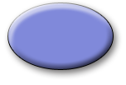


caTRIP Architecture
GUI
Federated Query Engine
DCQL Generator
Query
Builder
DCQL
Federated
Query Processor
caTissueCore Grid Service
Discoverer
Result
Aggregator
Data Grid Service
CQL
Service
CQL
Processor
CQL
CQL
Processor
Globus
Discovery APIs
Tomcat
Service
Register
HTTP
caDSR
Index Service
Globus Hibernate
CAE Grid Service
caCore SDK generated
Java Service
Tomcat
Oracle
Jboss
Register
CQL
Processor
Service
Application Service
Domain Objects
Hibernate
Globus Hibernate
Tomcat
Oracle
MySQL

Slide 37

caGrid Data Service Overview
Builds XML CQL query
query(CQL Query)
caGrid
Data Service
Data
Service
Client
Deserialized Data Objects
CQLQueryResults
processQuery(CQLQuery)
CQLQueryResults
Serialized to XML
Query Processor
ResultSet
createQuery(HQL Query)
Data Source

Slide 38
caGrid Data Service Invocation
Client builds CQL Query
CQL query is submitted as part of request to the query() method of the caGrid data service via standard grid protocol
Data service deserializes XML representation of CQL query into a CQLQuery object and then passes it to configured CQL Query Processor implementation class
CQL query processor converts CQL into HQL and queries the underlying data source to generate the result set.
Results are serialized as XML and returned to the client as a single CQLQueryResults object.
Introduce generated data service client iterates thru the result set and deserializes the XML into java object

Slide 39
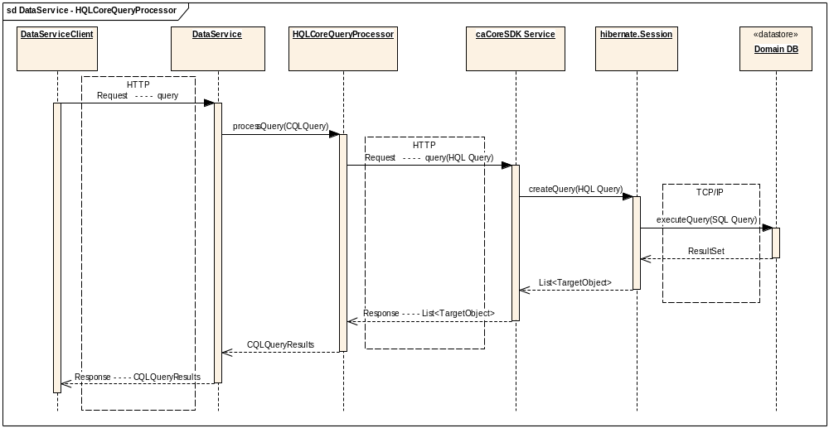
Data Service - HQLCoreQueryProcessor

Slide 40
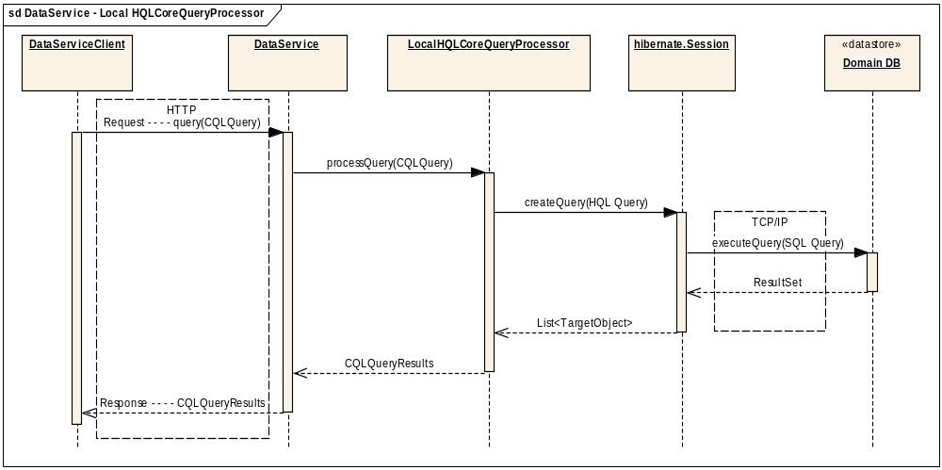
Data Service - LocalHQLCoreQueryProcessor

Slide 41
caTRIP Architecture
GUI
Federated Query Engine
DCQL Generator
Query
Builder
DCQL
Federated
Query Processor
caTissueCore Grid Service
Discoverer
Result
Aggregator
Federated Query Engine
CQL
Service
CQL
Processor
CQL
Federated
Query Processor
Globus
Discovery APIs
Tomcat
Register
HTTP
caDSR
Index Service
Result
Aggregator
CAE Grid Service
caCore SDK generated
Java Service
CQL
Processor
Jboss
Register
Service
Application Service
Domain Objects
Hibernate
Globus Hibernate
Tomcat
Oracle
MySQL

Slide 42
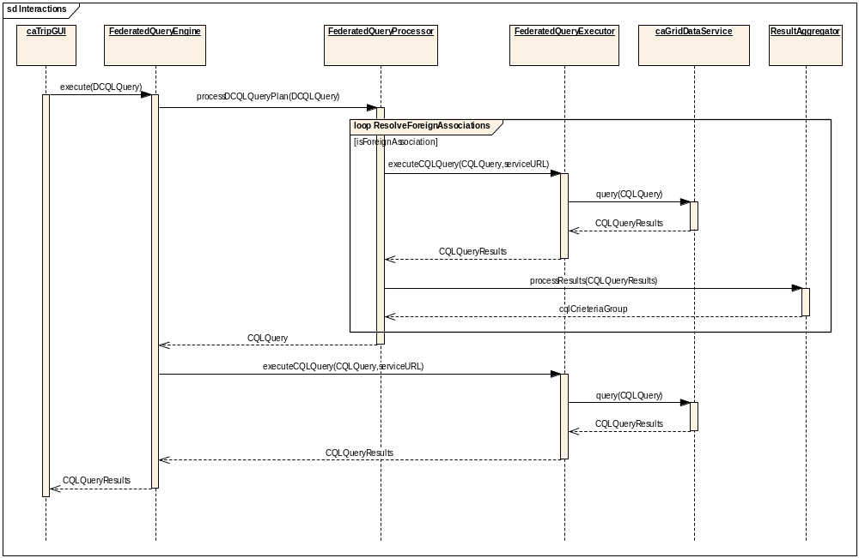
Federated Query Engine
Sequence Diagram

Slide 43
Federated Query Engine
Class Overview
FederatedQueryEngine
Entry point to the system. caTRIP GUI provides DCQLQuery Object to this class.
FederatedQueryProcessor
Decomposes DCQL into individual data service CQLs
FederatedQueryExecutor
Issues CQL Query to corresponding data service
ServiceClientFactory
Instantiates appropriate Data Service and returns the instance to Federated Query Executor
ResultAggregator
Performs right and left joins on CDEs and builds criteria and returns the criteria as Group

Slide 44
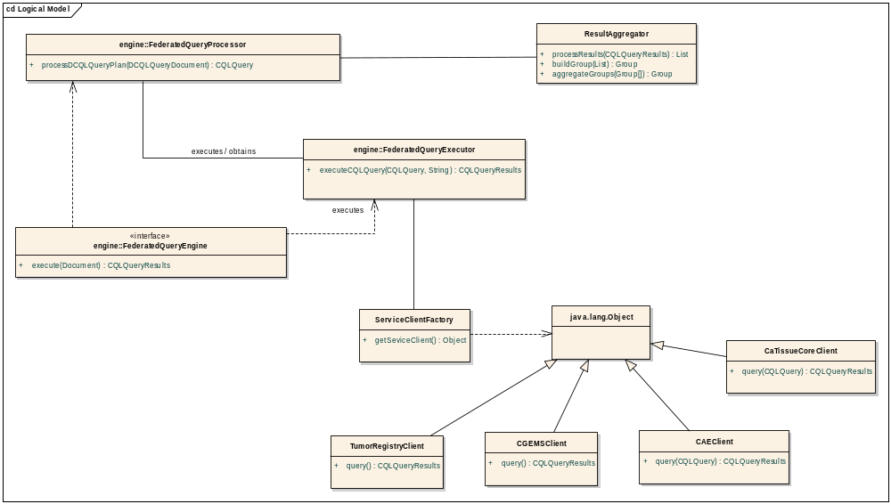
Federated Query Engine
Runtime Class Diagram

Slide 45
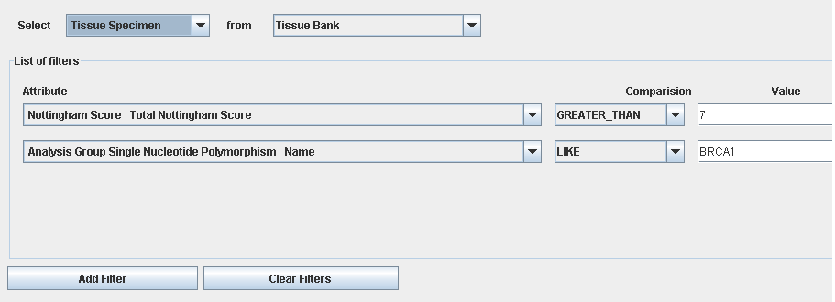
Federated Query Processer
Example Query

Slide 46
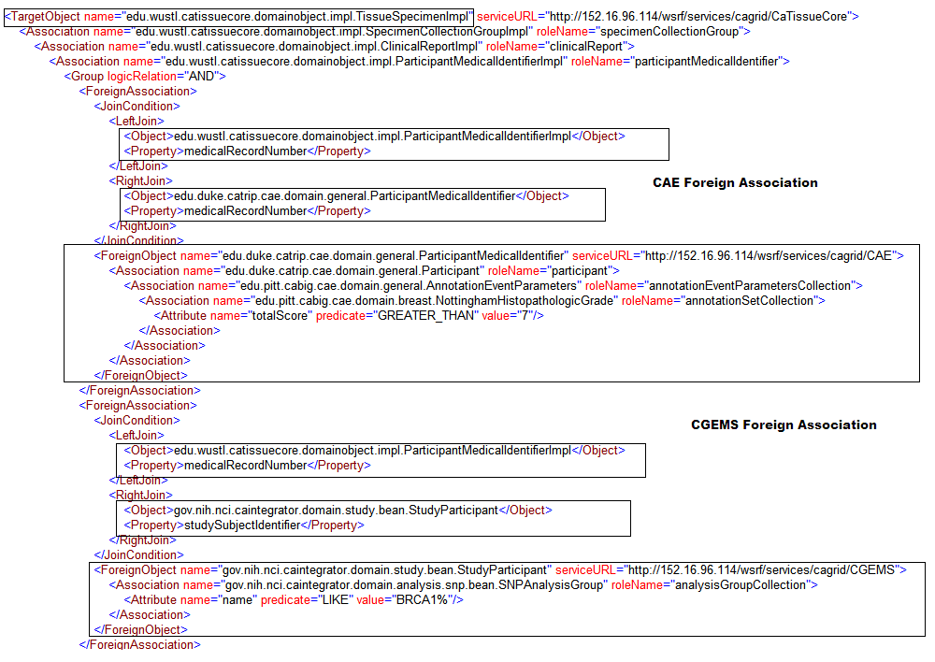
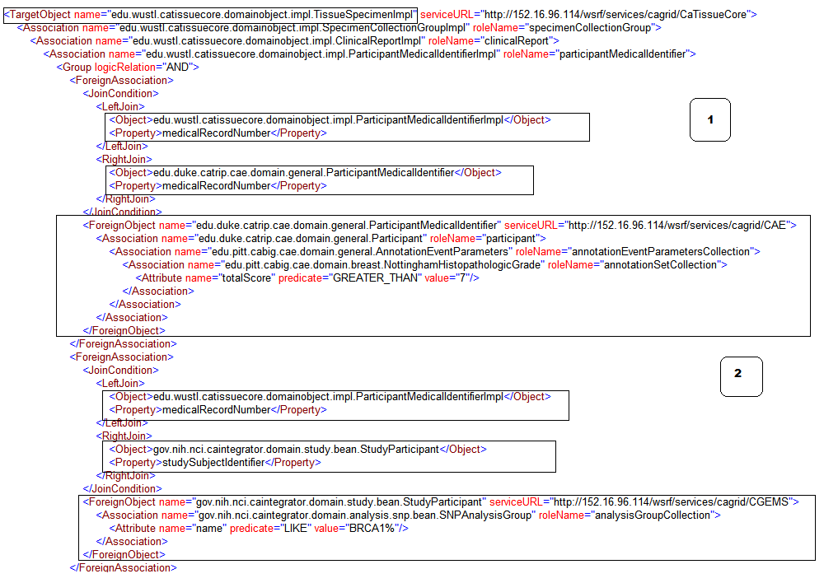
Federated Query Processer
Example DCQL

Slide 47
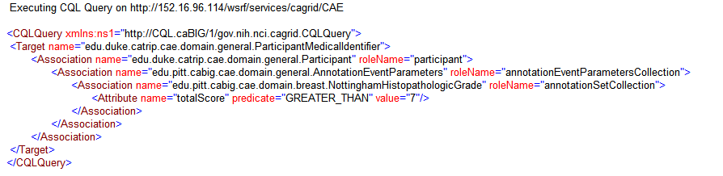
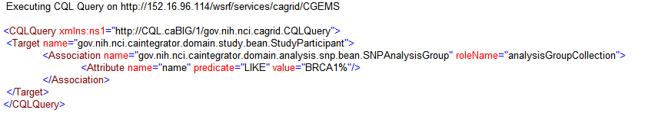
Federated Query Processer
Decomposing DCQL into CQL
CAE CQL
CGEMS CQL

Slide 48
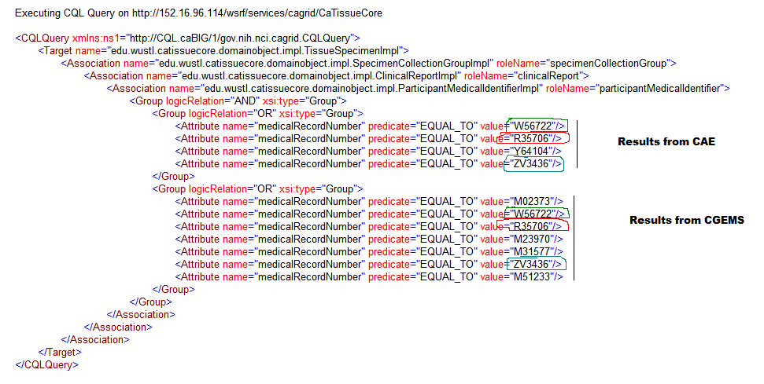
Federated Query Processer
Final CQL

Slide 49
caTRIP Architecture
GUI
Federated Query Engine
DCQL Generator
Query
Builder
DCQL
Federated
Query Processor
caTissueCore Grid Service
Discoverer
Result
Aggregator
GUI
CQL
Service
CQL
Processor
CQL
DCQL Generator
Globus
Discovery APIs
Query
Builder
Tomcat
Register
HTTP
caDSR
Index Service
Discoverer
CAE Grid Service
caCore SDK generated
Java Service
CQL
Processor
Jboss
Register
Service
Application Service
Domain Objects
Hibernate
Globus Hibernate
Tomcat
Oracle
MySQL

Slide 50
Motivation for Simple GUI
Challenges of advanced GUI usage
  Intimate knowledge of UML Model
    Associations, class names, attributes/CDEs
  Familiarity with technology
    Drag-n-drop, graph, tree, etc.
  Visual query building: flexibility breeds complexity
Simple GUI
  Benefits
    Eliminates most complexities
    Services and CDEs selected by caTRIP admin
  Drawbacks
    Lose freedom to select association path, CDEs, target objects
    Dynamic discovery & loading of services is not supported

Slide 51
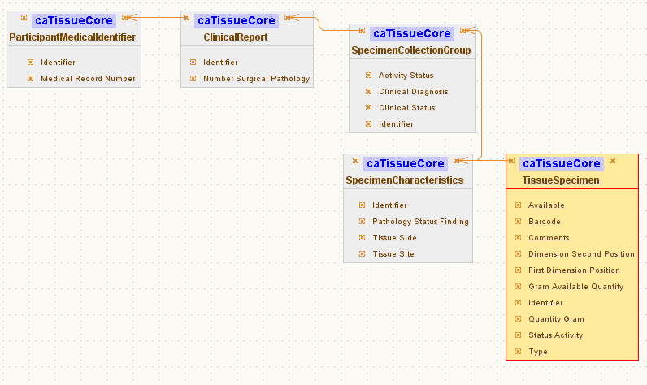
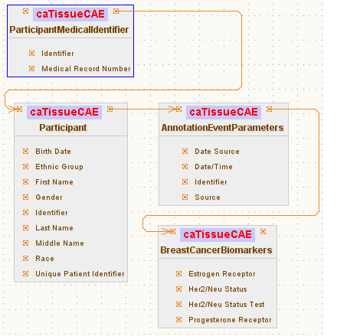
Simple GUI: Configuration file Schema
Inbound Path
ParticipantMedicalIdentifier
AnnotationEventParameters
BreastCancerBiomarkers
Outbound Path
Association path
Participant
TissueSpecimen
Foreign Association inbound Path
SpecimenCollectionGroup
ClinicalReport
caTissueCore Filter
ParticipantMedicalIdentifier
Association path
SpecimenCollectionGroup
ParticipantMedicalIdentifier
TissueSpecimen
ClinicalReport
SpecimenCharacteristics
CAE Filter
Foreign Association Outbound Path

Slide 52
Simple GUI: Configuration file Schema
Service A
Service B
TissueSpecimen
SpecimenCollectionGroup
BreastCancerBiomarkers
Target
ClinicalReport
Linking Object
Join Condition
Associated
Classes
ParticipantMedicalIdentifier
Association Direction
Filter
Object
SpecimenCharacteristics
Associated Object Tree
Foreign Association inbound Paths
Linking Object
Join Condition
Join Condition: CDE ex. MRN
Target
Association Direction
Service A
Service B
Foreign Association Outbound Path
Foreign Association

Slide 53
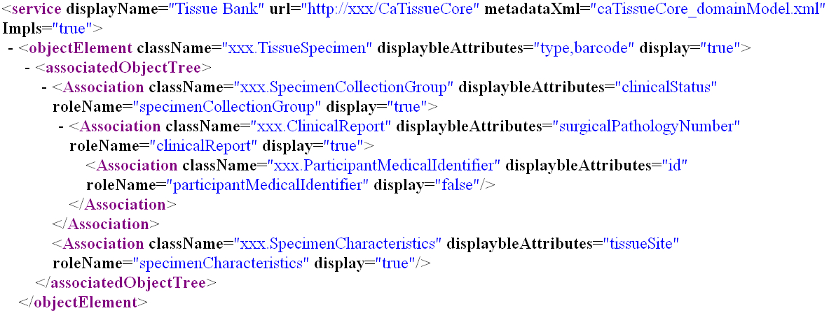
Simple GUI: Configuration file Schema
Associated Object Tree

Slide 54
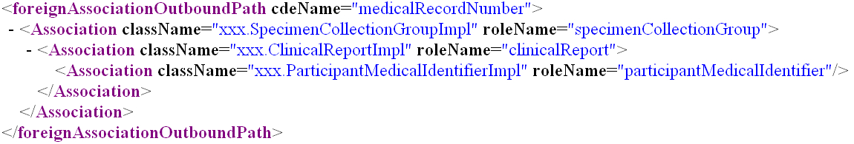
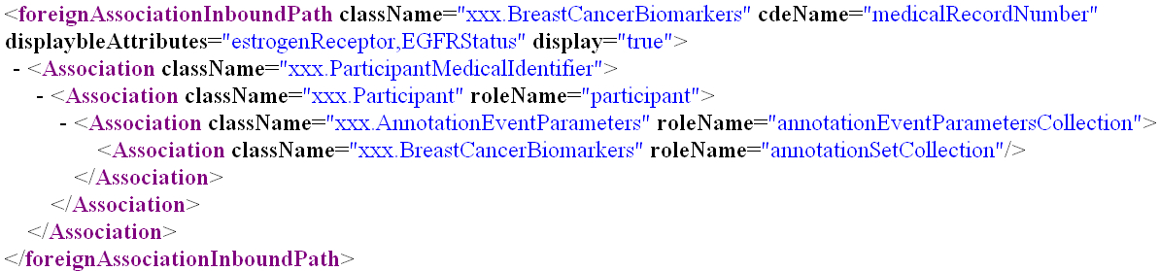
Simple GUI: Configuration file Schema
Foreign Association Outbound Path
Foreign Association inbound Path

Slide 55
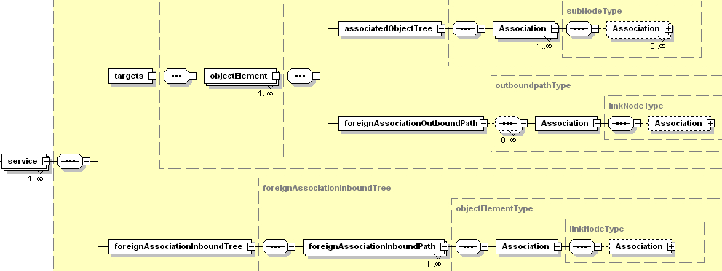
Simple GUI: Configuration file Schema
simpleQueryInterface-config.xsd

Slide 56
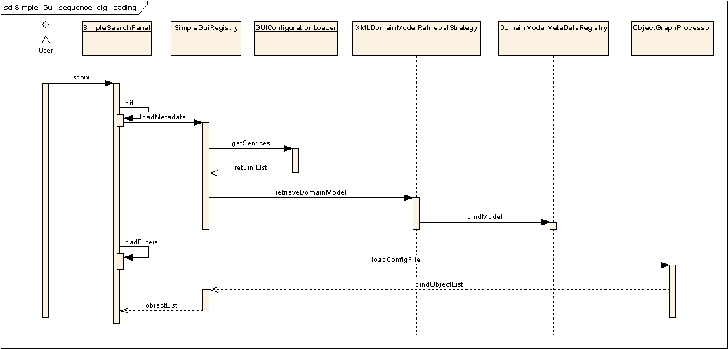
Sequence Diagram: Simple GUI
Loading of the Configuration and Domain Model Metadata Extract

Slide 57
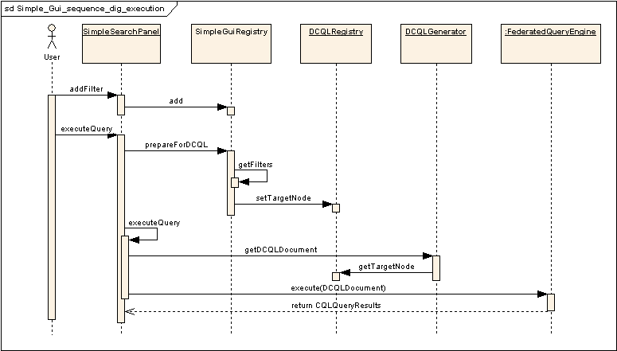
Sequence Diagram : Simple GUI
Execution of the Query

Slide 58
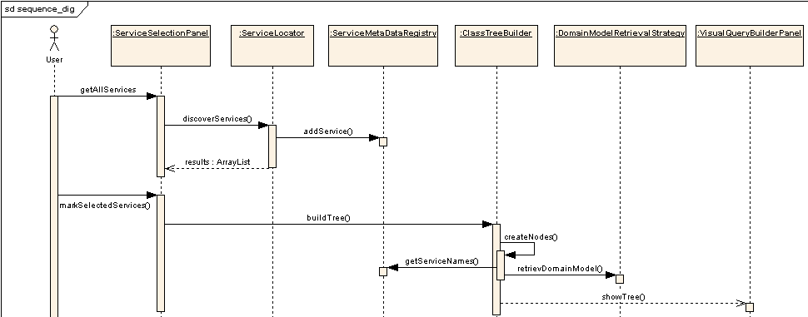
Sequence Diagram : Advance GUI
Loading and Discovery of Domain Model Metadata Extract

Slide 59
Performance Tuning
Domain Services
  Hibernate layer tuning (Lazy Loading)
    Before tuning: ~75 seconds
    After tuning: ~2 seconds
GUI
  Reuse Axis Engine for CQLObjectResultsIterator
    Before tuning: ~45 seconds
    After tuning: ~1.2 seconds
The above figures are for a CQL Result Set of 500 records

Slide 60
Collaboration with caGrid 1.0
caTRIP use cases were a major factor in the implementation of CQL Query Processor
  Led to development of HQL-based implementation and deprecation of Criteria-based implementation
Helped finalize the DCQL schema
caTRIP FQE is the basis for caGrid FQE
Helped finalize the domain model extract schema and implementation
Identified a major issue in de-serialization that led to significant performance improvement
  37 fold increase in performance
Reported several defects and tested the fixes

Slide 61
Discussion
Patrick McConnell¹ and Ram Chilukuri²
¹Duke Comprehensive Cancer Center
²Semantic Bits, LLC

Slide 62
caTRIP Phase 1 Review
Patrick McConnell
Duke Comprehensive Cancer Center

Slide 63
Technical evaluation
Number of scientific use cases identified and the percentage of high priority use cases implemented in the beta release
  50% of all use cases met
  100% high priority use cases met
Usability criteria
  End-users review
    Oncologists will start review on Nov 5th
  Installation
    Web-start is easy
  Maintainability
    Design document, modular code

Slide 64
Technical evaluation cont.
Software quality
  Followed industry standard best practices
Potential for software reuse by others as measured by modular design, remote access
  caGrid is already reusing some of our code
  All domain services are remotely accessible
Reuse
  caGrid, caCORE SDK, caDSR
  caTissue CORE, CAE, caIntegrator

Slide 65
Project management
Schedule adherence
  On time with all deliverables
  Managed dependencies (caDSR, domain services)
Cost adherence
  We can ask for more money?
  Just kidding…

Slide 66
caBIG collaboration
Silver-level compatibility of caTRIP services, with Grid-compatible APIs
  We leverage fairly recent caGrid codebase (Oct 4)
  Silver-level compatibility review will begin in phase 2
Reuse of domain workspace systems, including domain object models
  caIntegrator CGEMS: complete reuse
  caTissue CORE: complete reuse
  CAE: extended handful of classes
Interaction with the broader caBIG community
  Monthly presentations at translational SIG
  Presentation at latest ICR, Architecture/VCDE F2F meetings
  Presentations to other groups (e.g. population sciences)

Slide 67
Discussion
Patrick McConnell
Duke Comprehensive Cancer Center

Slide 68
Backup slides
Patrick McConnell
Duke Comprehensive Cancer Center

