Slide 1
Cancer Translational Research Informatics Platform (caTRIP)
A translational tool in action
Patrick McConnell
Duke Comprehensive Cancer Center
patrick.mcconnell@duke.edu
r.dash@duke.edu

Slide 2
Who is involved in caTRIP?
Duke Bioinformatics
  Jamie Cuticchia (PI)
  Patrick McConnell (lead architect)
Duke Information Systems
  Bob Annechiarico (PM)
  Wilma Stanley (developer)
  Mark Peedin (developer)
  Mohamad Farid (DBA)
  Jeff Allred (IT manager)
Duke Pathology
  Raj Dash (domain expert)
  Chris Hubbard (developer)
Duke Oncology
  Kelley Marcom (domain expert)
  Gretchen Kimmick (domain expert)
  Kimberly Blackwell (domain expert)
  Lee Wilke (domain expert)
Duke CALGB
  Kimberly Johnson (DataMart liaison)
^{Software Developers}
^{Managers and Architects}
SemanticBits
  Ram Chilukuri (lead developer)
  Srini Akkala (developer)
  Sanjeev Agarwal (developer)
5 AM Solutions
  Bill Mason (developer)
NCI
  Juli Klemm (NCI rep)
  Carl Shaefer (NCI)
  Subha Madhavan (NCI)
BAH
  Curtis Lockshin (WS lead)
  Mehul Shah (tech support)
^{Database Developers and IT}
^{NCI/BAH}
^{Domain Experts}

Slide 3
Agenda
caTRIP overview (5 min)
  Translational informatics, goals, data systems, application
Demonstration (15 min)
  Demonstration of clinical and research scenarios
  Demonstration of features
caTRIP in-depth (15 min)
  UI, architecture, modeling, extensibility data sharing
Next steps (1 min)
Discussion/questions (10 min)

Slide 4
Overview
What is translational research?
Bench-to-Bedside
Wikipedia (the source of all knowledge):
Translational medicine is a branch of medical research that attempts to more directly connect basic research to patient care.
Basic research occurs in the lab
Patient care occurs in the clinic
Translational research broadened…
Translational medicine can also have a much broader definition, referring to the development and application of new technologies in a patient driven environment - where the emphasis is on early patient testing and evaluation.
…facilitate the interaction between basic research clinical medicine, particularly in clinical trials.

Slide 5
Overview
Initial focus
Our initial focus will be on connecting existing data systems, including basic science data, to enhance patient care
Initial problem scenario: outcomes analysis
  Use data from existing patients to inform the treatment of another patient
  Leverage clinical, pathology, tissue, and basic science data
Scenario:
Patient A enters the clinic. What treatments were applied with success on other patients with similar characteristics (race, sex, symptoms, pathology results, adverse events, biomarkers).

Slide 6
Overview
Broadened focus: scientific use cases
Find available tumor tissue
  What are all the tissue specimens from her2/neu positive patients that have a primary tumor in the breast and are BRCA1 positive?
Find factors of survival
  What are all the ER positive patients that have survived breast cancer after radiation treatment?
Find patients for trials
  What are all the patients that are triple negative (ER, PR, and HER2/NEU negative)?
Determine the distribution of disease factors over time
  Does a change in pathology biomarkers over time contribute to recurrence or death?
Determine correlation of factors pre and post surgery
  Does a change in ER or PR status before and after surgery correlate with other factors?
Find pathology reports of interest
  Show me all of the pathology reports for Her2/Neu positive patients with a lobular carcinoma.

Slide 7
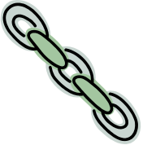
Overview
Connecting disparate data systems
^{CAE}
^{Pathology Biomarkers}
^{Tumor Registry}
^{Diagnosis, Treatment,}
^{Recurrence, Follow-up}
^{caTissue CORE}
^{Tissue Bank}
^{MRN}
caTRIP
caTRIP
caTRIP
caTRIP
^{caIntegrator}
^{SNP Data}
^{caTIES}
^{Pathology Reports}

Slide 8




Overview
Architecture
Graphical User Interface
Distributed Query Engine
Core caGrid Services
Grid Services
…
…
Institutional Services
Relational Databases
…
…

Slide 9
Demonstration
Clinical and research scenarios
Clinical scenario for demonstration
  A patient enters the clinic and is diagnosed with a lobular carcinoma
  The Her2/Neu biomarker test comes back positive
  What are the treatments and outcomes of other patients with similar characteristics?
  Query for diagnosis date, treatment, treatment date, survival, recurrence, and BRCA1 and BRCA2 status
  Look for treatments given with success and correlation between BRCA status in case test should be ordered
Research scenario for demonstration
  Is there a correlation between recurrence, mortality, histologic grade, and Her2/Neu status for breast cancer patients diagnosed with lobular carcinoma?
  Query caTRIP for recurrence type, date of death, histologic grade, and Her2/Neu status for patients diagnosed with lobular carcinoma
  Correlation is determined in Microsoft Excel
  Investigate gene biomarkers that correlate with a Her2/Neu status of negative and survival
  Query caTRIP for all available tissue to order for microarray experiments
Query sharing
  What are all the triple negative patients?

Slide 10
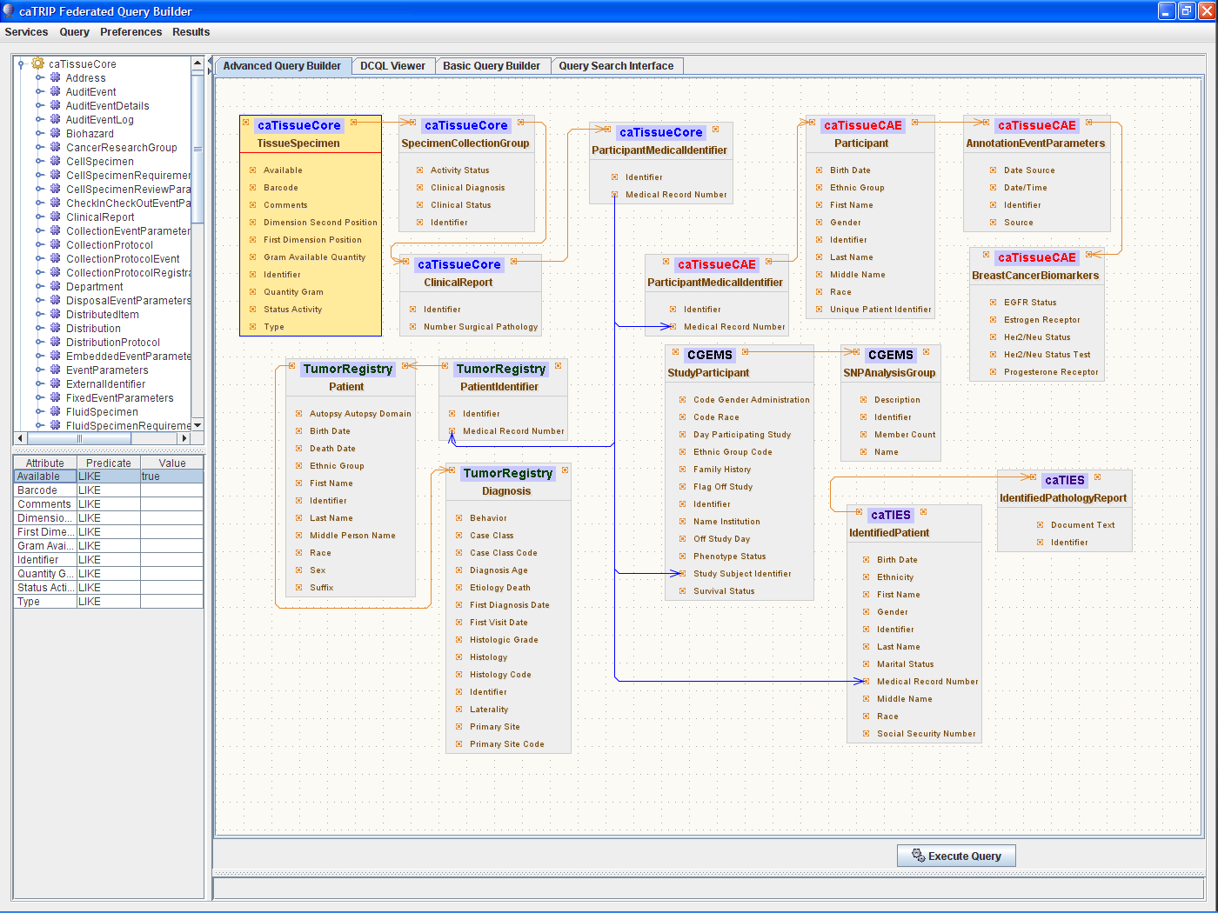
caTRIP in-depth
Why the simple GUI?
What are all the tissue specimens from her2/neu positive patients that have a primary tumor in the breast, are BRCA1 positive, and have a pathology report?
caTissue CORE
CAE
Participant
Medical Record Number
Tumor Registry
caTIES
CGEMS

Slide 11
caTRIP in-depth
Why not write DCQL?
What are all the tissue specimens from her2/neu positive patients that have a primary tumor in the breast and are BRCA1 positive?
<DCQLQuery xmlns="http://caGrid.caBIG/1.0/gov.nih.nci.cagrid.dcql">
<TargetObject name="edu.wustl.catissuecore.domainobject.impl.TissueSpecimenImpl" serviceURL="http://152.16.96.114/wsrf/services/cagrid/CaTissueCore">
<Association name="edu.wustl.catissuecore.domainobject.impl.SpecimenCollectionGroupImpl" roleName="specimenCollectionGroup">
<Association name="edu.wustl.catissuecore.domainobject.impl.ClinicalReportImpl" roleName="clinicalReport">
<Association name="edu.wustl.catissuecore.domainobject.impl.ParticipantMedicalIdentifierImpl" roleName="participantMedicalIdentifier">
<Group logicRelation="AND">
<ForeignAssociation>
<JoinCondition>
<LeftJoin>
<Object>edu.wustl.catissuecore.domainobject.impl.ParticipantMedicalIdentifierImpl</Object>
<Property>medicalRecordNumber</Property>
</LeftJoin>
<RightJoin>
<Object>edu.duke.catrip.cae.domain.general.ParticipantMedicalIdentifier</Object>
<Property>medicalRecordNumber</Property>
</RightJoin>
</JoinCondition>
<ForeignObject name="edu.duke.catrip.cae.domain.general.ParticipantMedicalIdentifier" serviceURL="http://152.16.96.114/wsrf/services/cagrid/CAE">
<Association name="edu.duke.catrip.cae.domain.general.Participant" roleName="participant">
<Association name="edu.pitt.cabig.cae.domain.general.AnnotationEventParameters" roleName="annotationEventParametersCollection">
<Association name="edu.pitt.cabig.cae.domain.breast.BreastCancerBiomarkers" roleName="annotationSetCollection">
<Attribute name="HER2Status" predicate="LIKE" value="POSITIVE%"/>
</Association>
</Association>
</Association>
</ForeignObject>
</ForeignAssociation>
<ForeignAssociation>
<JoinCondition>
<LeftJoin>
<Object>edu.wustl.catissuecore.domainobject.impl.ParticipantMedicalIdentifierImpl</Object>
<Property>medicalRecordNumber</Property>
</LeftJoin>
<RightJoin>
<Object>edu.duke.cabig.tumorregistry.domain.PatientIdentifier</Object>
<Property>medicalRecordNumber</Property>
</RightJoin>
</JoinCondition>
<ForeignObject name="edu.duke.cabig.tumorregistry.domain.PatientIdentifier" serviceURL="http://152.16.96.114/wsrf/services/cagrid/CaTRIPTumorRegistry">
<Association name="edu.duke.cabig.tumorregistry.domain.Patient" roleName="patient">
<Association name="edu.duke.cabig.tumorregistry.domain.Diagnosis" roleName="diagnosisCollection">
<Attribute name="primarySite" predicate="LIKE" value="BREAST%"/>
</Association>
</Association>
</ForeignObject>
</ForeignAssociation>
<ForeignAssociation>
<JoinCondition>
<LeftJoin>
<Object>edu.wustl.catissuecore.domainobject.impl.ParticipantMedicalIdentifierImpl</Object>
<Property>medicalRecordNumber</Property>
</LeftJoin>
<RightJoin>
<Object>gov.nih.nci.caintegrator.domain.study.bean.StudyParticipant</Object>
<Property>studySubjectIdentifier</Property>
</RightJoin>
</JoinCondition>
<ForeignObject name="gov.nih.nci.caintegrator.domain.study.bean.StudyParticipant" serviceURL="http://152.16.96.114/wsrf/services/cagrid/CGEMS">
<Association name="gov.nih.nci.caintegrator.domain.analysis.snp.bean.SNPAnalysisGroup" roleName="analysisGroupCollection">
<Attribute name="name" predicate="LIKE" value="BRCA1%"/>
</Association>
</ForeignObject>
</ForeignAssociation>
</Group>
</Association>
</Association>
</Association>
</TargetObject>
</DCQLQuery>
Select tissue
Foreign Join w/ CAE
HER2/NEU Positive
Foreign Join w/ Tumor Registry
Primary Site Breast
Foreign Join w/ CGEMS
BRCA1 Positive

Slide 12

caTRIP in-depth
Architecture
GUI
query
Distributed
Query
Engine
authenticate
discover
Core Grid Services
Domain Grid Services
IdP
Service
Index
Service
Grid
Grouper
authorize
caTissue
CORE
caTIES
CAE
TR
CGEMS
SNP
Duke
Domain
Controller
caTissue
CORE
caTIES
CAE
TR
caIntegrator
MAW3
Tumor Registry
Illumina

Slide 13
caTRIP in-depth
Service implementation
Index Service
advertise
advertise
Distributed
Query
Engine
caGrid Data Service
CQL Query
caCORE SDK/
Hibernate
CQL Engine
domain
model
Object-relational
mapping
database

Slide 14
caTRIP in-depth
Security
authorization
User Grid
Certificate
authentication
Grid
Data Service
User
Credentials
SAML
Assertion
Dorian
CSM
Trust Fabric
caGrid
Authentication Service
Grid
Grouper
backend
data
Duke
Authentication Plugin
Duke Domain Controller
NT Security

Slide 15
caTRIP in-depth
Distributed query engine
CQL
caGrid data
service
database
data
objects
DCQL
Distributed
Query
Engine
CQL
caGrid data
service
database
data
objects
data
objects
CQL
database
caGrid data
service
data
objects

Slide 16
caTRIP in-depth
Simple GUI configuration
Service A
Service B
TissueSpecimen
SpecimenCollectionGroup
BreastCancerBiomarkers
Target
ClinicalReport
Linking Object
Join Condition
Associated
Classes
ParticipantMedicalIdentifier
Association Direction
Filter
Object
SpecimenCharacteristics
Associated Object Tree
Foreign Association inbound Paths
Linking Object
Join Condition
Join Condition: CDE ex. MRN
Target
Association Direction
Service A
Service B
Foreign Association Outbound Path
Foreign Association

Slide 17
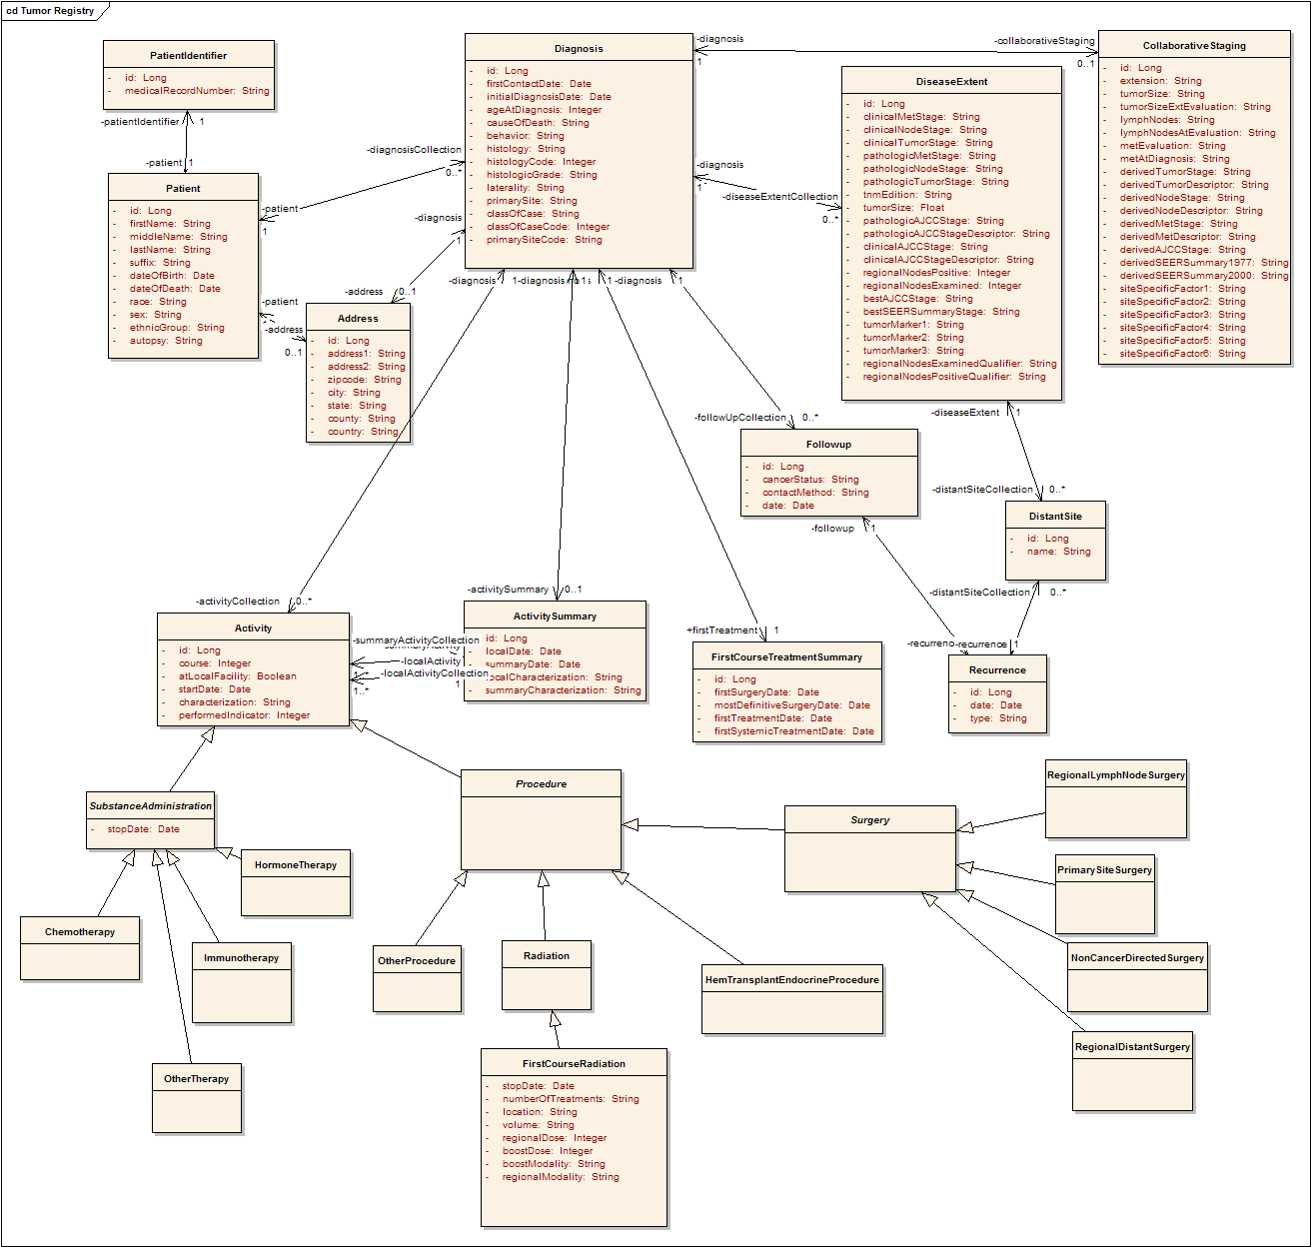
caTRIP in-depth
Tumor Registry model
Participant
Diagnosis
Collaborative
Staging
Follow up and
Recurrence
Treatment

Slide 18
caTRIP
Extensibility: plugging into existing services
Advanced Query Builder
  Point to an Index Service and perform discovery
Basic Query Builder
  Add service information to configuration file and redeploy
  Add service endpoint
  Select CDEs for foreign joins
  Add CDEs for filters
    Inbound and outbound paths to MRNs
  Add CDEs for return values
Limitations
  caGrid does not support selecting any arbitrary attribute for return values
  Use the caTRIP CQL Processor to provide this

Slide 19
caTRIP
Extensibility: creating a new service
Prerequisite: there is some data available in a traditional relational database
Domain model
  Create a new domain model (it is easier to reuse one)
  Register it in the caDSR
Create object/relational mapping (use caCORE SDK or do manually)
  Create Java beans
  Generate Hibernate mappings
Create grid service
  Use Introduce to generate a data service
  Select the domain model
  Select the caTRIP CQL Processor
Deploy grid service
  Use Introduce to deploy to your container (Tomcat)
Add to caTRIP
  See previous slide

Slide 20
caTRIP in-depth
Challenges in data sharing
Building data-oriented systems
  Duke requires IRB approval to gain access to identifiable data
  We worked around by leveraging people already on IRB protocols
Deidentifying data
  Data is owned by different groups across the cancer center
  Traditional deidentification: data manager deidentifies an entire dataset then throws away the key
  Distributed deidentification: trusted service provider (TSP) deidentifies discreet values
  Traditional approach is not scalable – requires a middle-man
  IRB approval required for distributed approach because it deviates from traditional deidentification (at Duke)

Slide 21


caTRIP in-depth
Distributed deidentification
Can join on GHI789, which is a deidentified ID
Distributed
Query
Engine
^{CAE}
^{caTissue}
^{CORE}
CAE
caTissue
CORE
GHI789
Trusted Service
Provider
GHI789
MRN3
MRN3
Data owners submit PHI to be deidentified by the TSP
^{Data Owner}
^{Data Owner}

Slide 22
Next Steps
Wider spread adoption of caTRIP and underlying tools
Cross-institutional queries
  What are all of the breast tissue specimens on the grid from patients that are positive for the estrogen receptor biomarker?
Enhanced support for high throughput datasets
  Now give me all the microarray experiments for those patients.
Enhanced reporting
  I want to export the data to Excel with an automated pivot on key data columns.
Integration at a user interface level
  I’ve identified some patients of interest, now let me order the tissue samples.
Enhanced querying
  I know my query is going to take a long time, so just email me the results when they are done

Slide 23
Discussion
Documentation (Docs tab at: http://gforge.nci.nih.gov/projects/catrip/)
  End user guide
  Training module
  Technical guide/installation manual, administration guide
  Release notes
Training instance
  http://152.16.96.114/catrip-webstart/
Release (Files tab at http://gforge.nci.nih.gov/projects/catrip/)

Slide 24
Cancer Translational Research Informatics Platform (caTRIP)
Backup demonstration

Slide 25
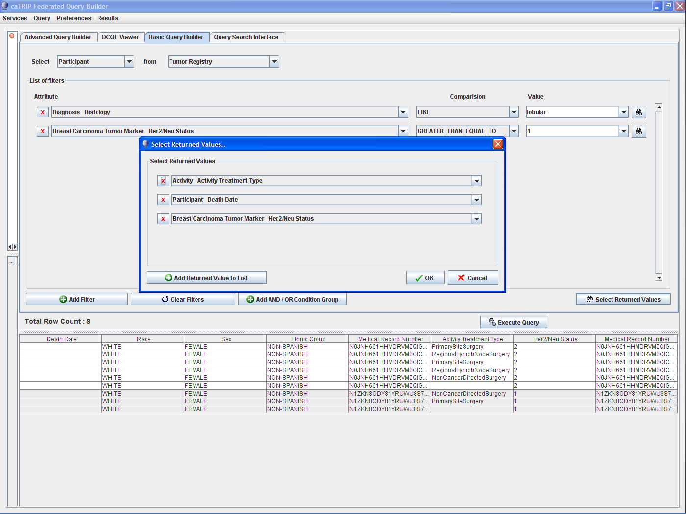

Slide 26
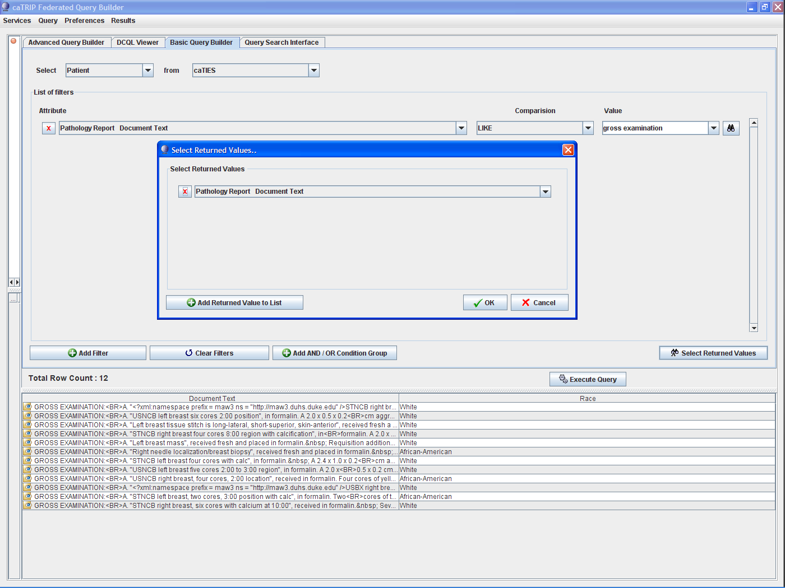

Slide 27
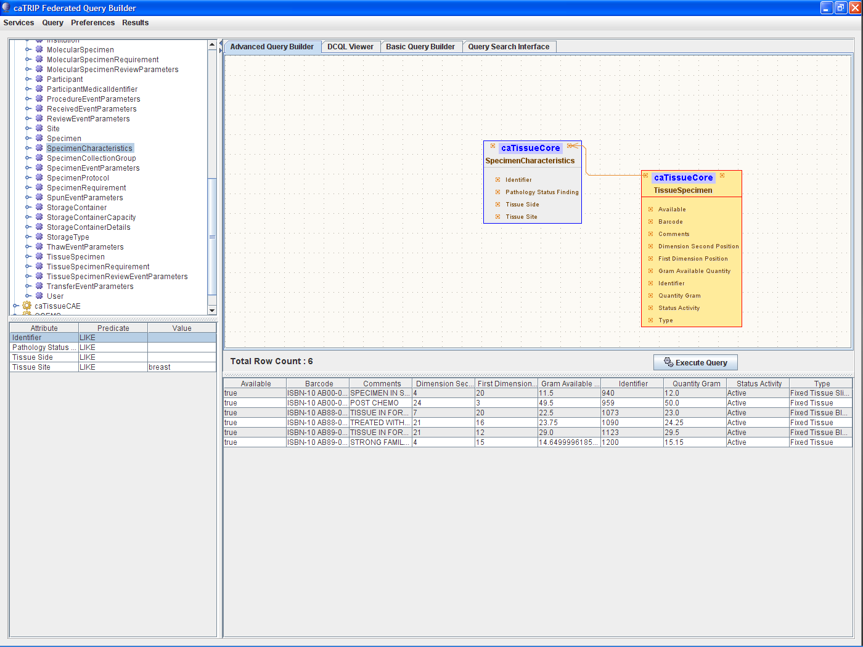

Slide 28
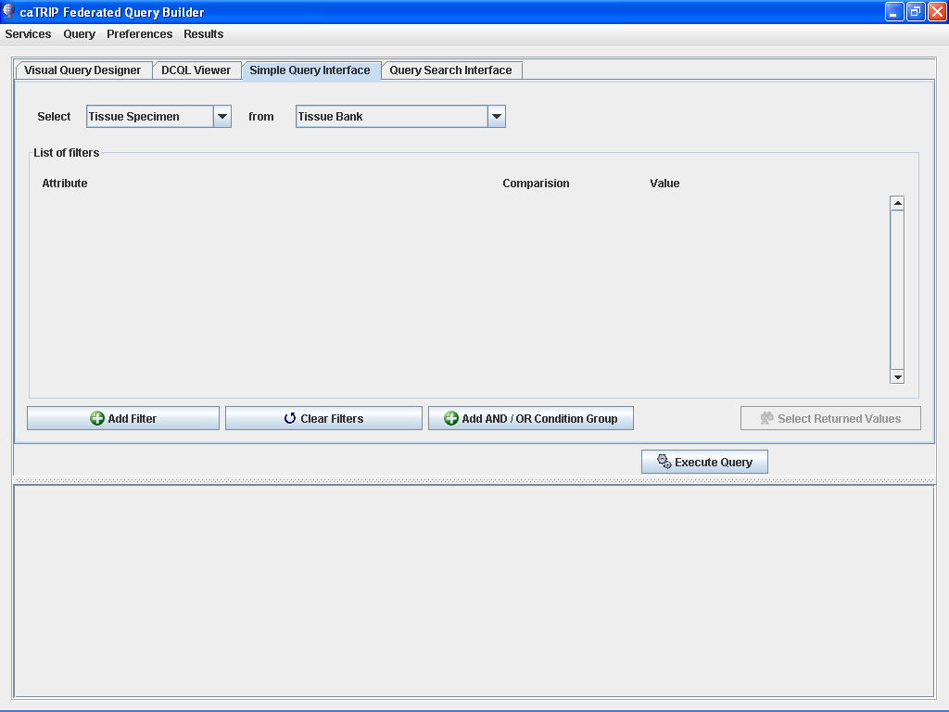

Slide 29
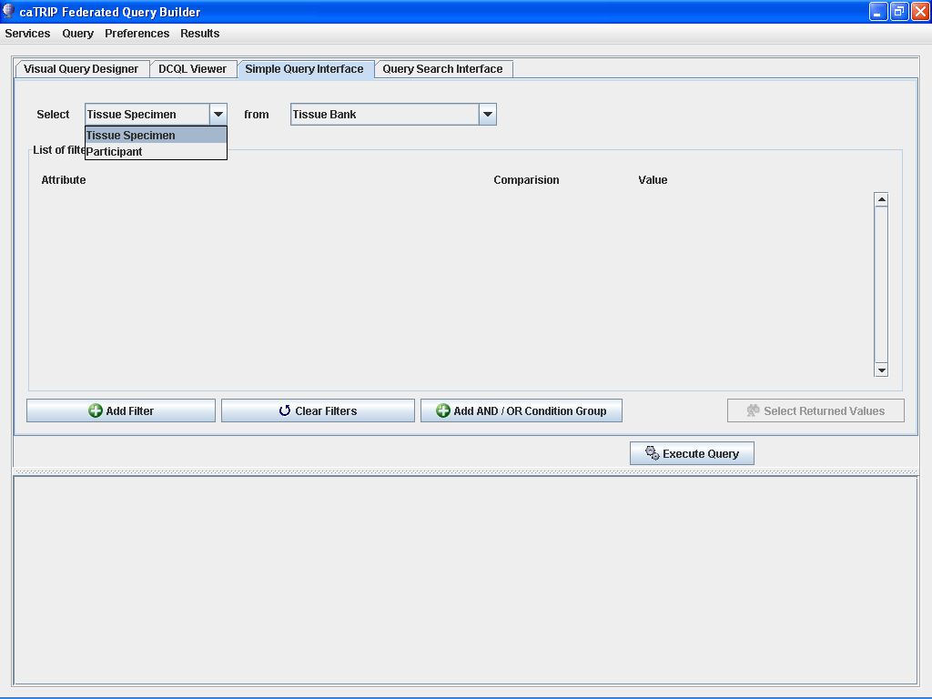

Slide 31
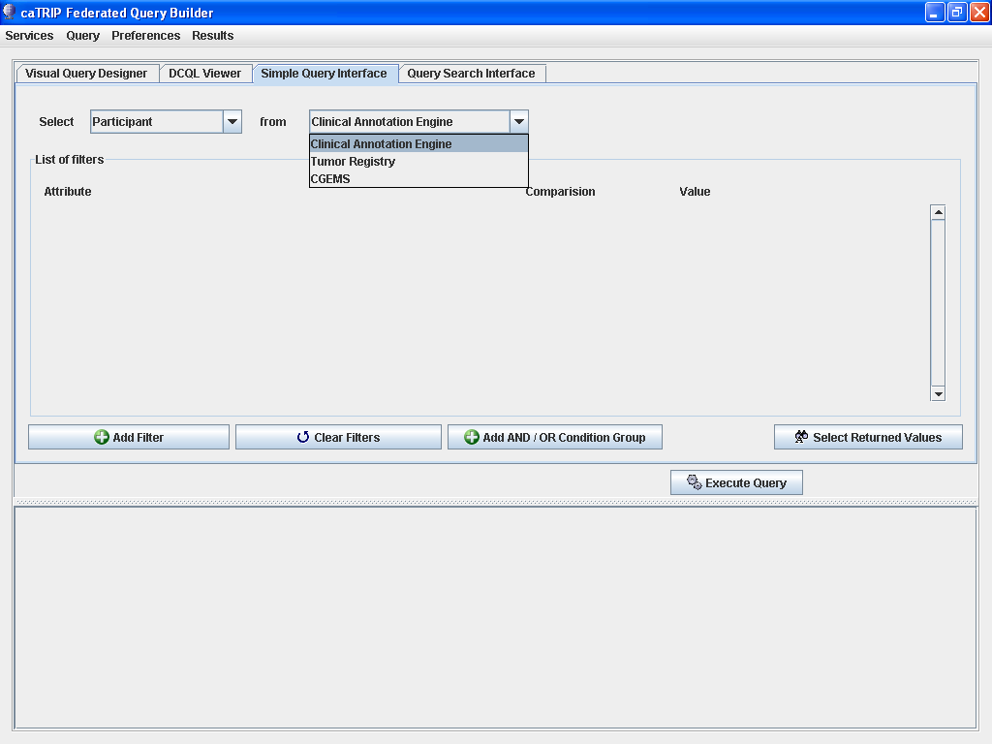

Slide 32
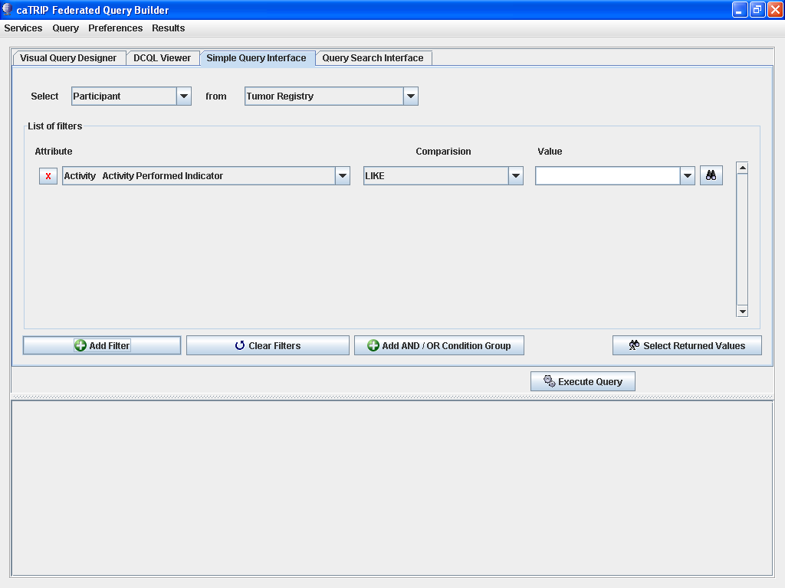

Slide 33
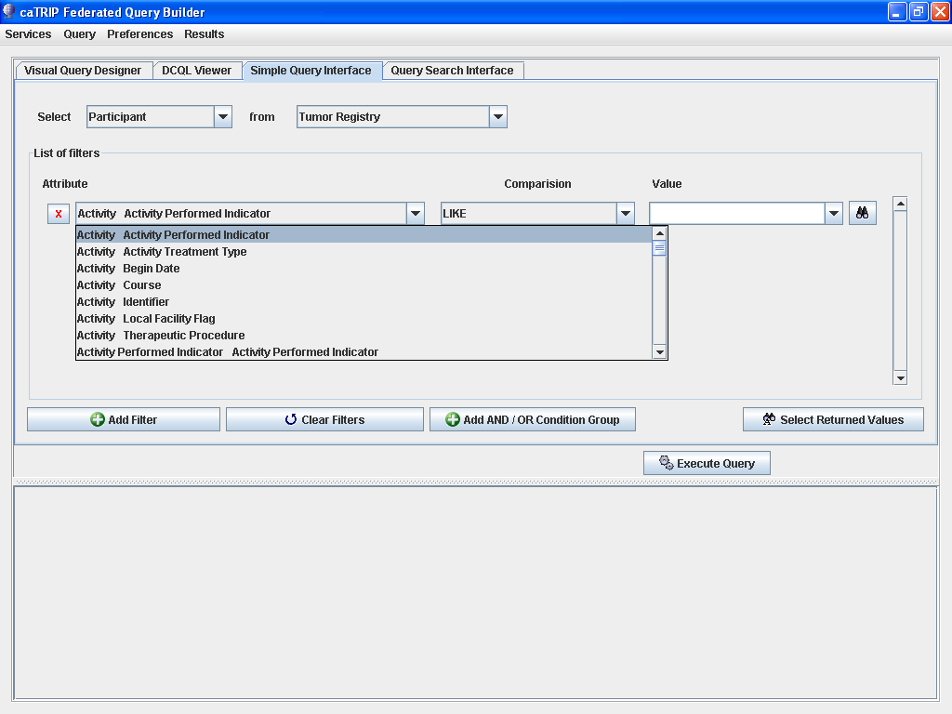

Slide 34
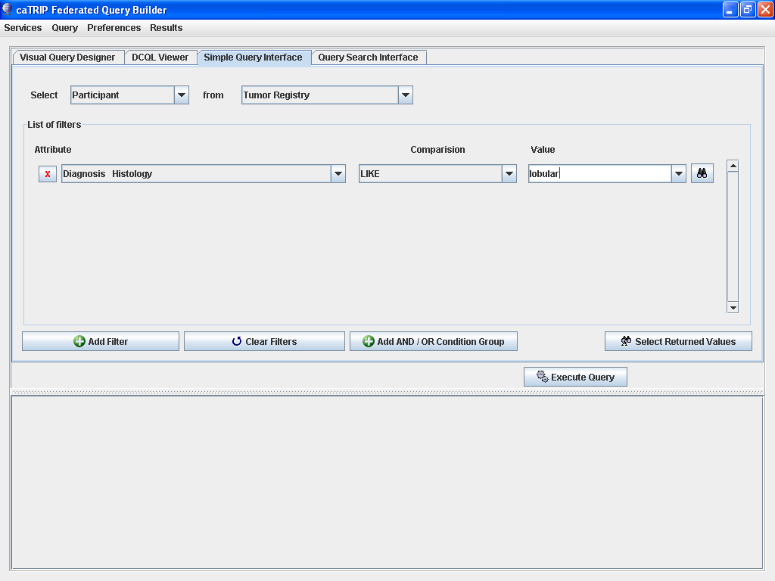

Slide 35
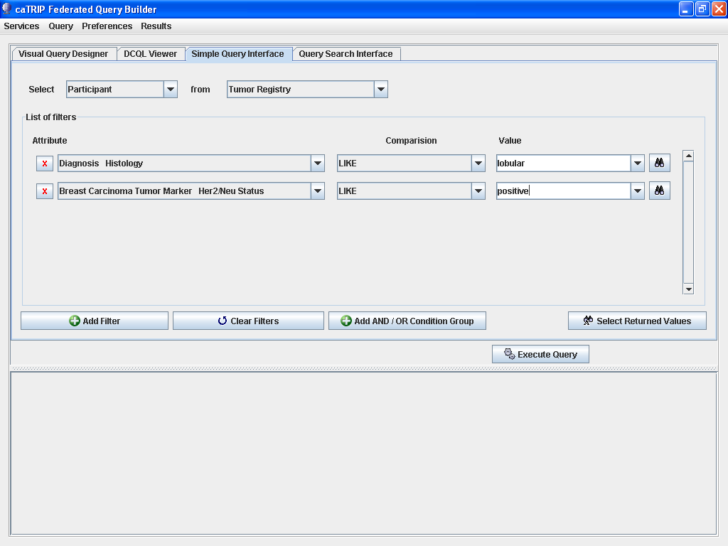

Slide 36
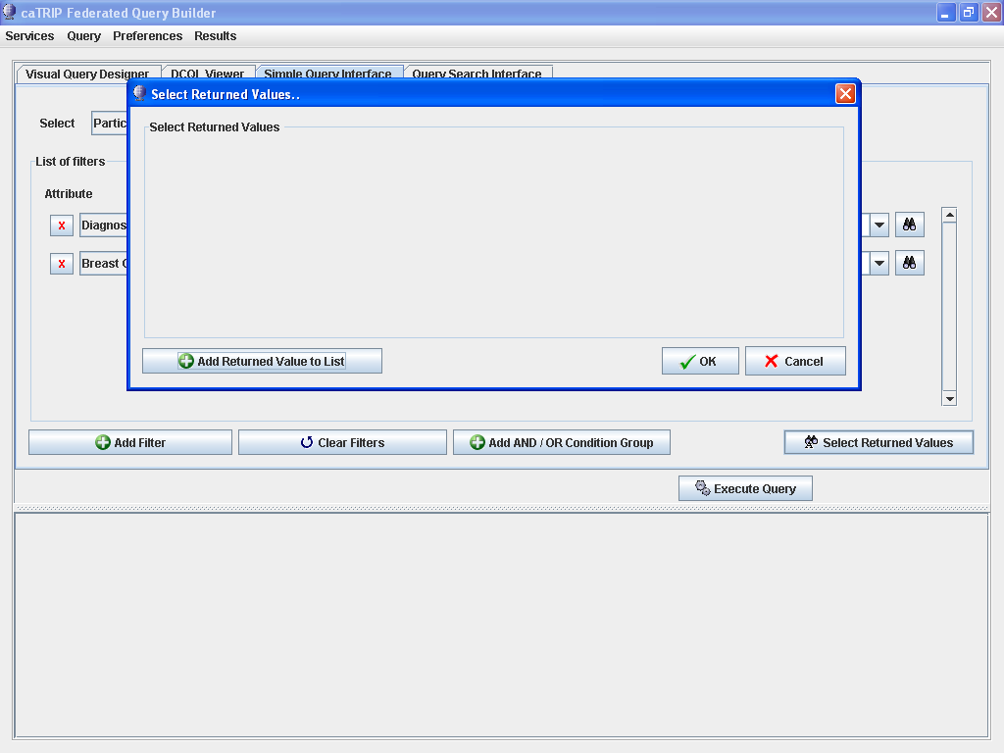

Slide 37
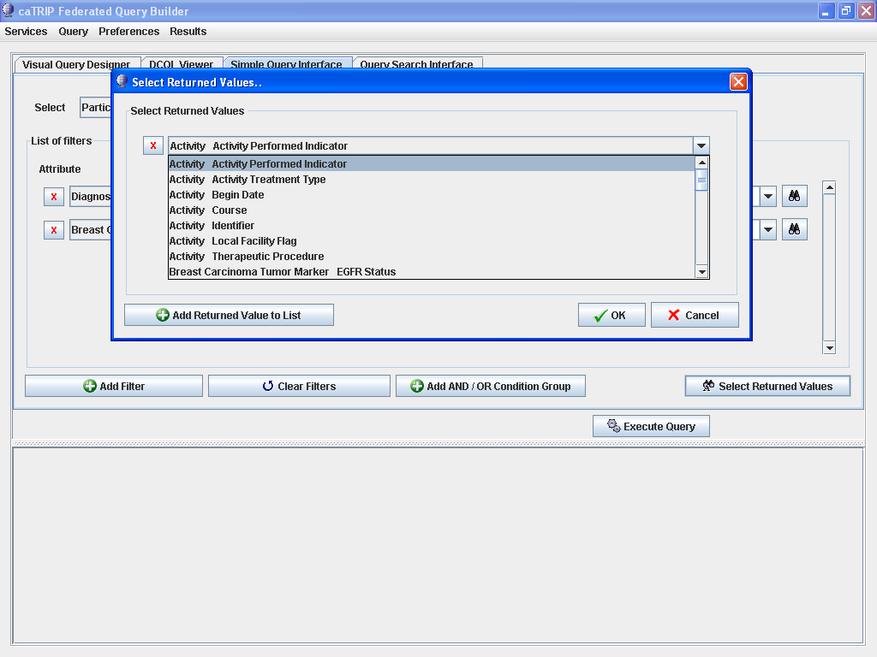

Slide 38
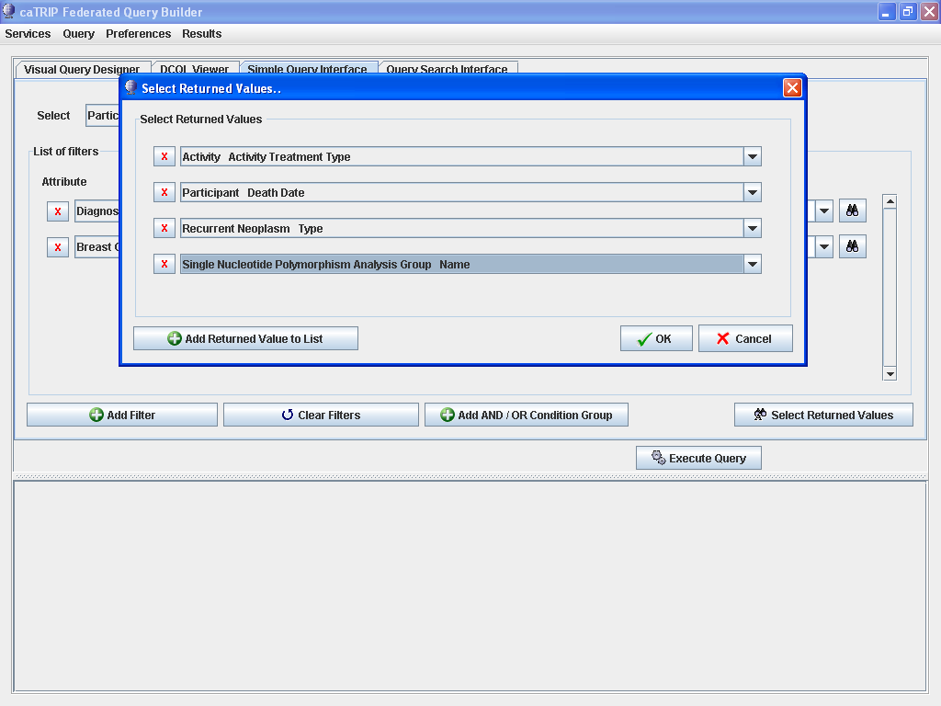

Slide 39
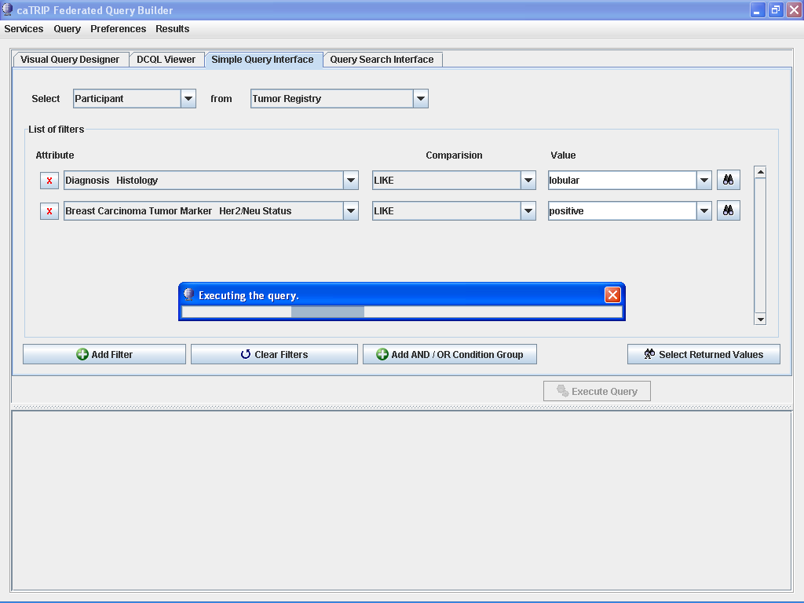

Slide 40
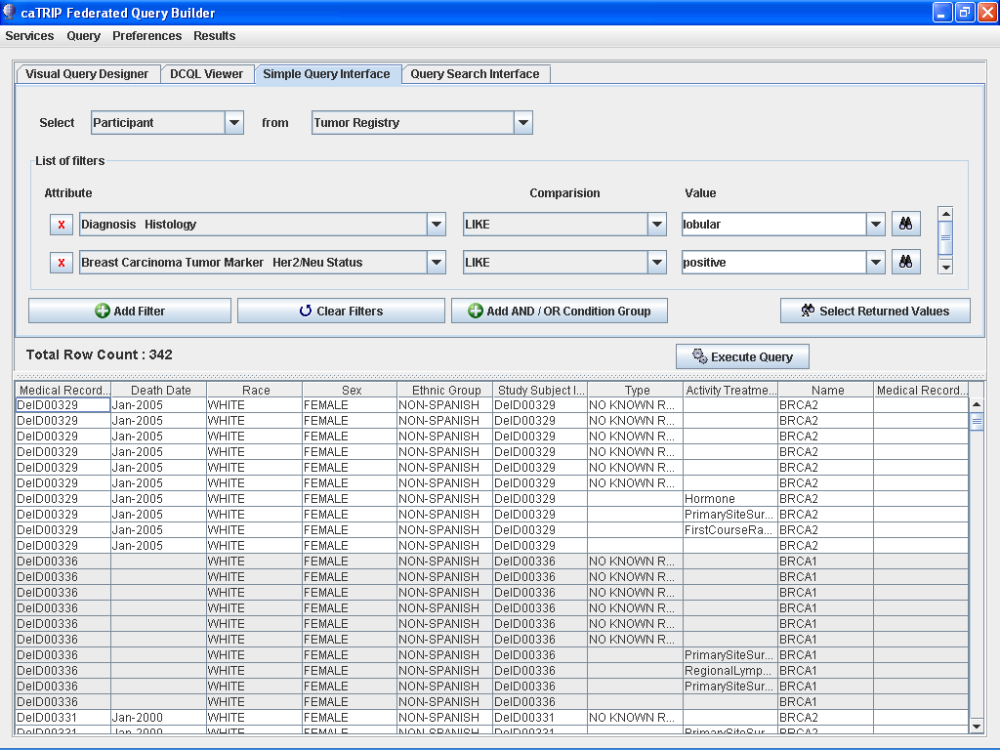

Slide 41
Cancer Translational Research Informatics Platform (caTRIP)
Backup slides

Slide 42

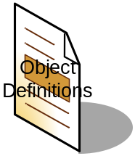



Technical details
Interfaces and metadata
^{Discover Metadata}
^{Query}
^{Discover Services}
^{Invoke}
^{Distributed Query Engine}
^{Register}
^{Query}
^{Query}
^{Query}
^{Grid}
^{Service}
^{Grid}
^{Service}
^{Grid}
^{Service}
…
^{Model}
Database
^{Database}
^{Database}
…

Slide 43
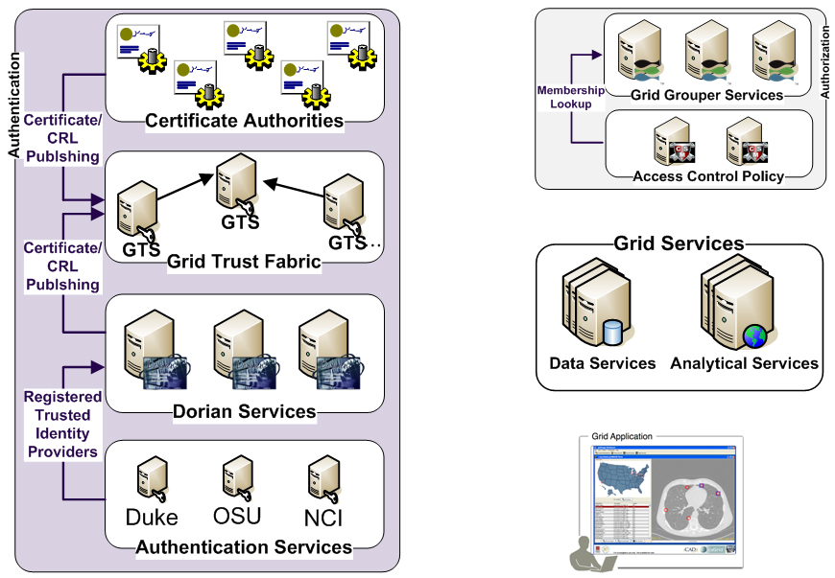
caTRIP caGrid Security
Is member of?
Should I trust the
credential signer?
Is
Authorized?
SAML Assertion
Grid
Credentials
Grid
Credentials
Authenticate with
Local Credential Provider
SAML Assertion

Slide 44
Development process
Generating documentation
Developer
Technical Guide
Installation Guide
Administration Guide
Release Notes
Adopters
End user manual
Training modules
Overview/hands-on
Technical Manual (Architecture):
Describes architecture, systems requirements, APIs, and other tools that integrate with the software and their implementation.
^{Release Notes:}
Written before product release: lists new features and functionalities, addresses known issues, and lists appropriate documentation and websites.
^{Installation Guide:}
Outlines the supported configurations and technical installation instructions for software application. Can include basic test procedures.
^{End User Manual:}
Includes software authorizations, interface design, protocols, workflow, tools, data sources, database(s), data search, data management, and integration with component software.
^{Administration Guide:}
Describes process for updating and maintaining application, importing and deleting data, creating authorization for user groups.
^{Training Modules:}
Give users general information about the application (Overview), and practical examples and handson exercises (HandsOn).

