Slide 1
caTRIP Demo
Patrick McConnell
Duke Comprehensive Cancer Center
Semantic Bits, LLC

Slide 2
Agenda
Overview
  Problem scenario, overview, use cases
Demo
  Core GUI, Query Builder
Next steps
  Phase 2, beyond
Discussion

Slide 3
Who is involved
Duke Bioinformatics
  Jamie Cuticchia (PI)
  Patrick McConnell (lead architect)
Duke Information Systems
  Bob Annechiarico (PM)
  Wilma Stanley (developer)
  Mark Peedin (developer)
  Mohamad Farid (DBA)
  Jeff Allred (IT manager)
Duke Pathology
  Raj Dash (domain expert)
  Chris Hubbard (developer)
Duke Oncology
  Kelley Marcom (domain expert)
  Gretchen Kimmick (domain expert)
  Kimberly Blackwell (domain expert)
  Lee Wilke (domain expert)
Duke CALGB
  Kimberly Johnson (DataMart liaison)
Semantic Bits
  Ram Chilukuri (lead developer)
  Srini Akkala (developer)
  Sanjeev Agarwal (developer)
5 AM Solutions
  Bill Mason (developer)
3rd Millennium
  Julie Klemm (ICR WS lead)
NCI
  Carl Shaefer (NCI rep)
  Subha Madhavan
  (caIntegrator PM)
BAH
  Mehul Shah (tech support)

Slide 4
Initial problem scenario
Outcomes analysis: using data from existing patients to inform the treatment of another patient
Leverage clinical, pathology, tissue, and basic science data
Scenario:
Patient A enters the clinic. What treatments were applied with success on other patients with similar characteristics (race, sex, symptoms, pathology results, adverse events, biomarkers).

Slide 5

caTRIP Beta Overview
GUI
query
Distributed
Query
Engine
authenticate
discover
Core Grid Services
Domain Grid Services
IdP
Service
Index
Service
Grid
Grouper
authorize
caTissue
CORE
caTIES
CAE
TR
CGEMS
SNP
Duke
Domain
Controller
caTissue
CORE
caTIES
CAE
TR
caIntegrator
MAW3
Tumor Registry
Illumina

Slide 6
Scientific use cases
Find available tumor tissue
  What are all the tissue specimens from her2/neu positive patients that have a primary tumor in the breast and are BRCA1 positive?
Find factors of survival
  What are all the ER positive patients that have survived breast cancer after radiation treatment?
Find patients for trials
  What are all the patients that are triple negative (ER, PR, and HER2/NEU negative)?
Determine the distribution of disease factors over time
Determine correlation of factors pre and post surgery
Find pathology reports of interest
Notes:
Find available tumor tissue
caTissue CORE: protocol #, pathological status, clinical diagnosis
CAE: ER, PR, Her-2/neu, EGFR status
Find factors of survival
Cohorts of patients who have survived a certain number of years following their diagnosis
Tumor registry: dates of diagnosis/treatment/death, nodal/distant metastasis status, grade of tumor
CAE: ER, PR, Her-2/neu, EGFR status
SNP: BRCA1/BRCA2 status
Determine the distribution of disease factors over time
Factors that may contribute to or reflect progression of a disease state
Tumor registry: dates of diagnosis/treatment/death, nodal/distant metastasis status, grade of tumor
CAE: ER, PR, Her-2/neu, EGFR status
Find patients for trials
Example is that of the triple negative hormone
Tumor registry: dates of diagnosis/treatment/death, nodal/distant metastasis status, grade of tumor
CAE: ER, PR, Her-2/neu, EGFR status
Determine correlation of factors pre and post surgery
Patients that have particular factors change before and after surgery
Tumor registry: dates of surgery
CAE: ER, PR, Her-2/neu, EGFR status
Find pathology reports of interest
Tumor registry: dates of diagnosis/treatment/death, nodal/distant metastasis status, grade of tumor
CAE: ER, PR, Her-2/neu, EGFR status
caTIES: pathology report
Find SNP results correlated with factors
Tumor registry: nodal/distant metastasis status, grade of tumor
CAE: ER, PR, Her-2/neu, EGFR status
SNP: BRCA1/2 status, genotype finding, gene biomarker

Slide 7
caTRIP Demo
Patrick McConnell
Duke Comprehensive Cancer Center

Slide 8
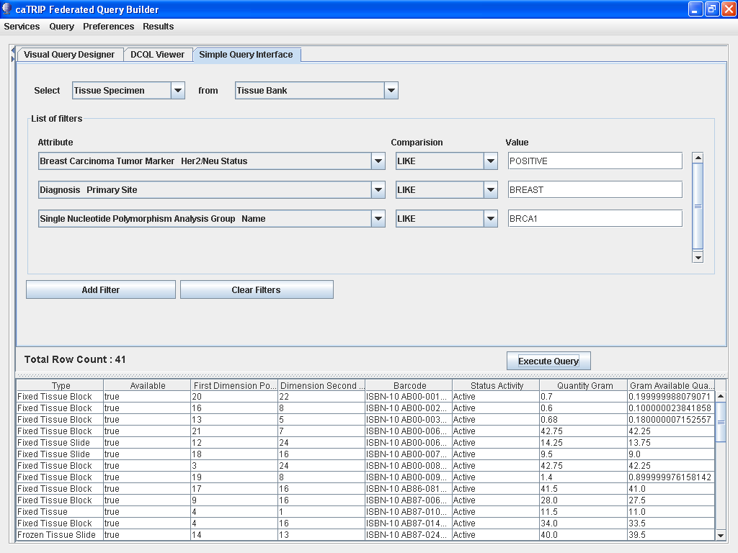
Phase 1 scientific queries
Find available tumor tissue
What are all the tissue specimens from her2/neu positive patients that have a primary tumor in the breast and are BRCA1 positive?

Slide 9
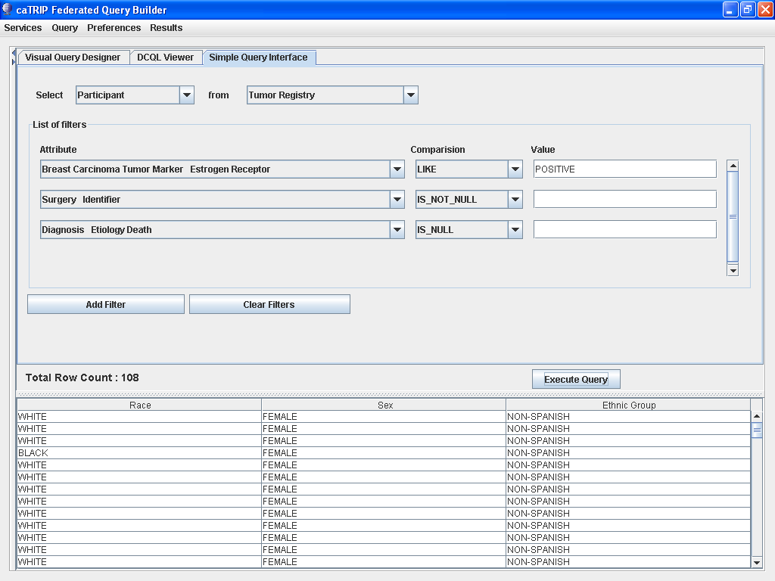
Phase 1 scientific queries
Find factors of survival
What are all the ER positive patients that have survived breast cancer after radiation treatment?

Slide 10
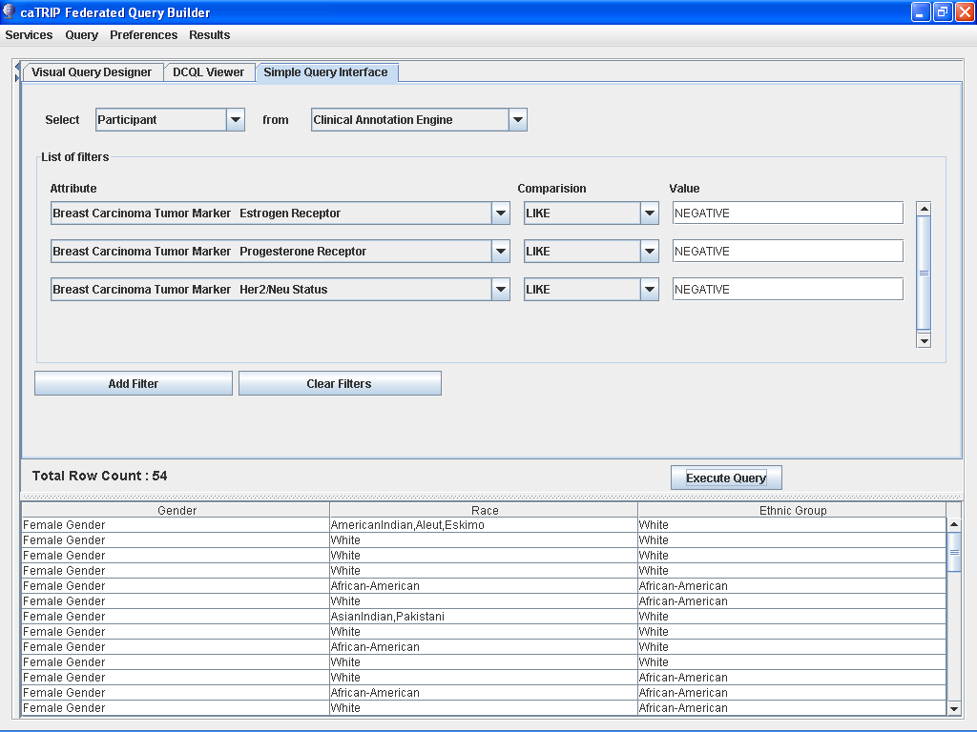
Phase 1 scientific queries
Find patients for trials
What are all the patients that are triple negative (ER, PR, and HER2/NEU negative)?

Slide 11
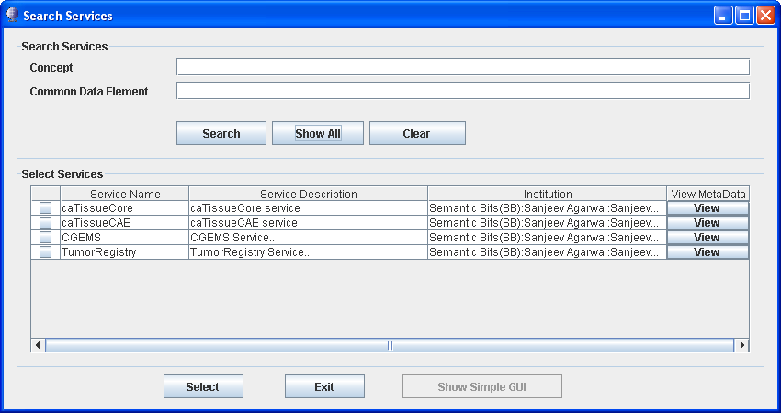
Dynamic Service Discovery

Slide 12
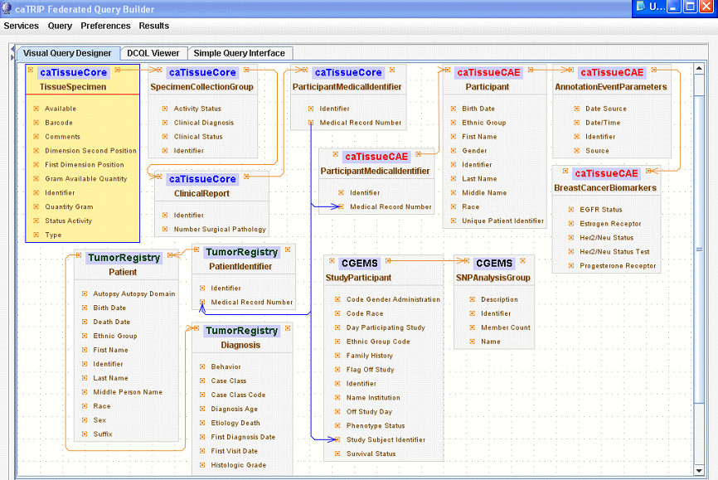
Phase 1 scientific queries
Find available tumor tissue
What are all the tissue specimens from her2/neu positive patients that have a primary tumor in the breast and are BRCA1 positive?
caTissue CORE
CAE
Participant
Medical Record Number
Tumor Registry
CGEMS

Slide 13
Phase 1 scientific queries
Find available tumor tissue
What are all the tissue specimens from her2/neu positive patients that have a primary tumor in the breast and are BRCA1 positive?
Select tissue
<DCQLQuery xmlns="http://caGrid.caBIG/1.0/gov.nih.nci.cagrid.dcql">
<TargetObject name="edu.wustl.catissuecore.domainobject.impl.TissueSpecimenImpl" serviceURL="http://152.16.96.114/wsrf/services/cagrid/CaTissueCore">
<Association name="edu.wustl.catissuecore.domainobject.impl.SpecimenCollectionGroupImpl" roleName="specimenCollectionGroup">
<Association name="edu.wustl.catissuecore.domainobject.impl.ClinicalReportImpl" roleName="clinicalReport">
<Association name="edu.wustl.catissuecore.domainobject.impl.ParticipantMedicalIdentifierImpl" roleName="participantMedicalIdentifier">
<Group logicRelation="AND">
<ForeignAssociation>
<JoinCondition>
<LeftJoin>
<Object>edu.wustl.catissuecore.domainobject.impl.ParticipantMedicalIdentifierImpl</Object>
<Property>medicalRecordNumber</Property>
</LeftJoin>
<RightJoin>
<Object>edu.duke.catrip.cae.domain.general.ParticipantMedicalIdentifier</Object>
<Property>medicalRecordNumber</Property>
</RightJoin>
</JoinCondition>
<ForeignObject name="edu.duke.catrip.cae.domain.general.ParticipantMedicalIdentifier" serviceURL="http://152.16.96.114/wsrf/services/cagrid/CAE">
<Association name="edu.duke.catrip.cae.domain.general.Participant" roleName="participant">
<Association name="edu.pitt.cabig.cae.domain.general.AnnotationEventParameters" roleName="annotationEventParametersCollection">
<Association name="edu.pitt.cabig.cae.domain.breast.BreastCancerBiomarkers" roleName="annotationSetCollection">
<Attribute name="HER2Status" predicate="LIKE" value="POSITIVE%"/>
</Association>
</Association>
</Association>
</ForeignObject>
</ForeignAssociation>
<ForeignAssociation>
<JoinCondition>
<LeftJoin>
<Object>edu.wustl.catissuecore.domainobject.impl.ParticipantMedicalIdentifierImpl</Object>
<Property>medicalRecordNumber</Property>
</LeftJoin>
<RightJoin>
<Object>edu.duke.cabig.tumorregistry.domain.PatientIdentifier</Object>
<Property>medicalRecordNumber</Property>
</RightJoin>
</JoinCondition>
<ForeignObject name="edu.duke.cabig.tumorregistry.domain.PatientIdentifier" serviceURL="http://152.16.96.114/wsrf/services/cagrid/CaTRIPTumorRegistry">
<Association name="edu.duke.cabig.tumorregistry.domain.Patient" roleName="patient">
<Association name="edu.duke.cabig.tumorregistry.domain.Diagnosis" roleName="diagnosisCollection">
<Attribute name="primarySite" predicate="LIKE" value="BREAST%"/>
</Association>
</Association>
</ForeignObject>
</ForeignAssociation>
<ForeignAssociation>
<JoinCondition>
<LeftJoin>
<Object>edu.wustl.catissuecore.domainobject.impl.ParticipantMedicalIdentifierImpl</Object>
<Property>medicalRecordNumber</Property>
</LeftJoin>
<RightJoin>
<Object>gov.nih.nci.caintegrator.domain.study.bean.StudyParticipant</Object>
<Property>studySubjectIdentifier</Property>
</RightJoin>
</JoinCondition>
<ForeignObject name="gov.nih.nci.caintegrator.domain.study.bean.StudyParticipant" serviceURL="http://152.16.96.114/wsrf/services/cagrid/CGEMS">
<Association name="gov.nih.nci.caintegrator.domain.analysis.snp.bean.SNPAnalysisGroup" roleName="analysisGroupCollection">
<Attribute name="name" predicate="LIKE" value="BRCA1%"/>
</Association>
</ForeignObject>
</ForeignAssociation>
</Group>
</Association>
</Association>
</Association>
</TargetObject>
</DCQLQuery>
Foreign Join w/ CAE
HER2/NEU Positive
Foreign Join w/ Tumor Registry
Primary Site Breast
Foreign Join w/ CGEMS
BRCA1 Positive

Slide 14
caTRIP Next Steps

Slide 15
caTRIP next steps
Add functionality
  GUI, DQE
Implement security
  Authorization, authentication
Add audit capabilities
  Common logging component
Implement compliance
  Section 508 and 21 CFR part 11
Add datasets
  CAE, SNP

Slide 16
Beyond phase 2
Invocation of analytical services
Building workflows
Adding data visualization
Asynchronous querying

Slide 17
Discussion

Slide 18
Backup slides

Slide 19
Tumor Registry
Created from Duke TR database
Submitted model for loading into the DSR
Duke
  Validated model
  Provided real de-identified test data
Data Loading
  Delimited data files
  Hibernate API
Available at GForge under caTRIP project

Slide 20
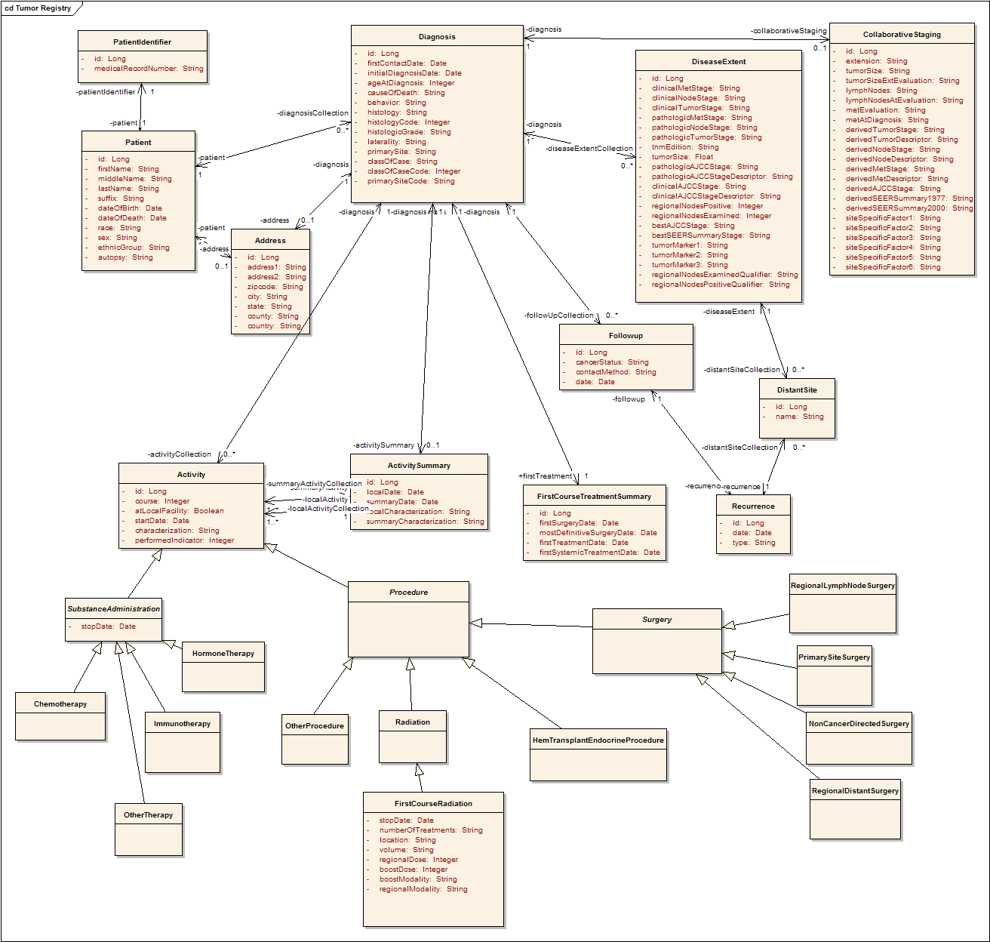
Tumor Registry Model
Participant
Diagnosis
Collaborative
Staging
Follow up and
Recurrence
Treatment

Slide 21
Loading test data
Identified sample data
  Queried various Duke databases
  Googled cancer websites
Built input files
  Text files with values that correspond to CDEs
Loaded data
  Randomly selected values from text files
  Used Hibernate APIs to load objects

Slide 22
Data loading example
Curated
Data Files
Data
Generator
Participant
randomly
select
generate
objects
Maria
Kennedy
Liles | MARY
Harris | PATRICIA
Kennedy | LINDA
Wynne | BARBARA
Lytle | ELIZABETH
Lytle | JENNIFER
Tamborella | MARIA
Chopra | SUSAN
Denny | MARGARET
. . . | . . .
Participant
DB
Linda
Liles
Participant
load via
hibernate
Susan
Wynne
Participant
Barbara
Chopra
. . .

Slide 23
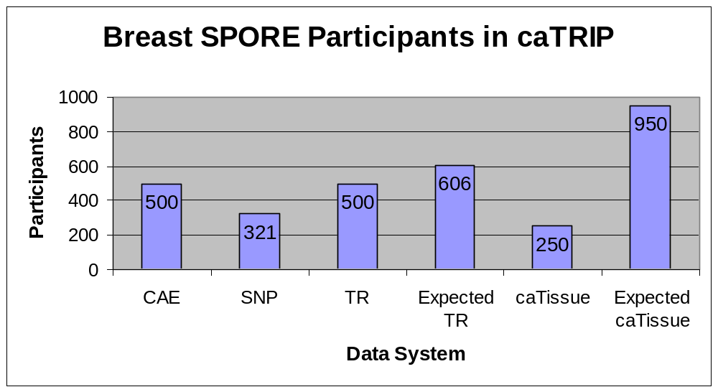
caTRIP data system statistics

Slide 24
Data sharing challenges
Sharing identifiable data
  Step 1: caTRIP gets IRB approval to build a system
  Step 2a: researcher gets IRB approval for protocol to view data
  Step 2b: clinician uses data for patient care (trickier than it sounds) or quality of service
Sharing deidentified data
  Traditional method: data manager deidentifies an entire dataset then throws away the key
    Centralized: not scalable
  Proposed method: trusted service provider (TSP) deidentifies discreet values
    Distributed: everyone is responsible for their own deid
    Very scalable

Slide 25

Distributed deidentification
Secure connection
MRN3
MRN3
GHI789
Trusted Service
Provider
GHI789
Has IRB approval to see identifiable data
Has IRB approval to see identifiable data
Has IRB approval to store identifiable data
PHI | DEID
MRN1 | ABC123
MRN2 | DEF456
. . . | . . .
PHI | DEID
MRN1 | ABC123
MRN2 | DEF456
MRN3 | GHI789
. . . | . . .
Randomly generated

Slide 26
caTRIP data sharing
Current deidentified datasets (via modified centralized way)
  caTissue CORE, Tumor Registry
Future deidentified datasets
  CAE, SNP
Goals
  Get IRB approval at Duke for sharing identifiable data
  Modify Duke deidentification policy to allow distributed model
  Use caTRIP as one model for data sharing in caBIG

Slide 27
Phase 1 scientific queries
Find available tumor tissue
What are all the available tissue specimens from the breast?
What are all the tissue specimens from patients that have a her2/new status of positive?
What are all the tissue specimens from her2/neu positive patients that have a primary tumor in the breast?
What are all the tissue specimens from her2/neu positive patients that have a primary tumor in the breast and are BRCA1 positive?

Slide 28
Phase 1 scientific queries
Find factors of survival
What are all the ER positive patients that have survived breast cancer after radiation treatment?
What are all the BRCA1 positive patients over the age of 50 that have survived breast cancer after surgery?

Slide 29
Phase 1 scientific queries
Find patients for trials
What are all the patients that are triple negative (ER, PR, and HER2/NEU negative)?

Slide 30
caTRIP Next Steps
Patrick McConnell
Duke Comprehensive Cancer Center

Slide 31
caTRIP next steps
Add functionality
  GUI, DQE
Implement security
  Authorization, authentication
Add audit capabilities
  Common logging component
Implement compliance
  Section 508 and 21 CFR part 11
Add datasets
  CAE, SNP

Slide 32
GUI enhancements
Reporting
  Data-mining style reporting
Filters
  Drop-down values for enumerated value domains and distinct values
  Filter type based on data type
  Groups of ORs and ANDs
Query sharing and synchronization
  Synchronize DQCL, simple, and advanced GUI
  Share new queries, invoke existing queries

Slide 33
DQE enhancements
Service
  Grid service for DQE
  Delegation
XML-based processing
  Generalize to any grid service
DCQL enhancements
  Define return type (associated objects)
  Return distinct values or single attributes
Implementation
  Distributed joins other than equality

Slide 34
Security
authorization
User Grid
Certificate
authentication
Grid
Data Service
User
Credentials
SAML
Assertion
Dorian
CSM
Trust Fabric
caGrid
Authentication Service
Grid
Grouper
backend
data
Duke
Authentication Plugin
Duke Domain Controller
NT Security

Slide 35
Auditing module
caGrid
Authentication Service
GUI
caLog?
caLog?
Security
Call-out
Grid Service
user
D/CQL
caLog
HQL
CSM
CQLProcessor
results
. . .
Hibernate
CLM?
Domain DB
Log DB
or
Log File

Slide 36
Compliance
Section 508
  Mostly pertain to usability for people with vision impairments.
  Examples
    Alternative keyboard navigation
    Animated displays, color and contrast settings, flash rate, and electronic forms
  Implemented by simplified GUI input form
21 CFR part 11
  Ensures the authenticity, integrity, non-repudiation and confidentiality of electronic records and signatures
  Implemented by the logging module

Slide 37
Beyond phase 2
Invocation of analytical services
Building workflows
Adding data visualization
Asynchronous querying

